Slide 1
PsychoPy
COGS 508 – Tutorial 1

Slide 2
Motivations

Slide 3
Experiments

Slide 4

Resources
https://www.psychopy.org/download.html
https://www.psychopy.org/documentation.html
https://www.youtube.com/channel/UCQo2aB6cXJasHyXJp0afaWg
https://pavlovia.org/
https://github.com/alazaydin
https://gitlab.pavlovia.org/alaz/stroop
https://code.visualstudio.com/
https://jupyter.org/
https://docs.conda.io/projects/conda/en/latest/user-guide/install/index.html

Slide 5
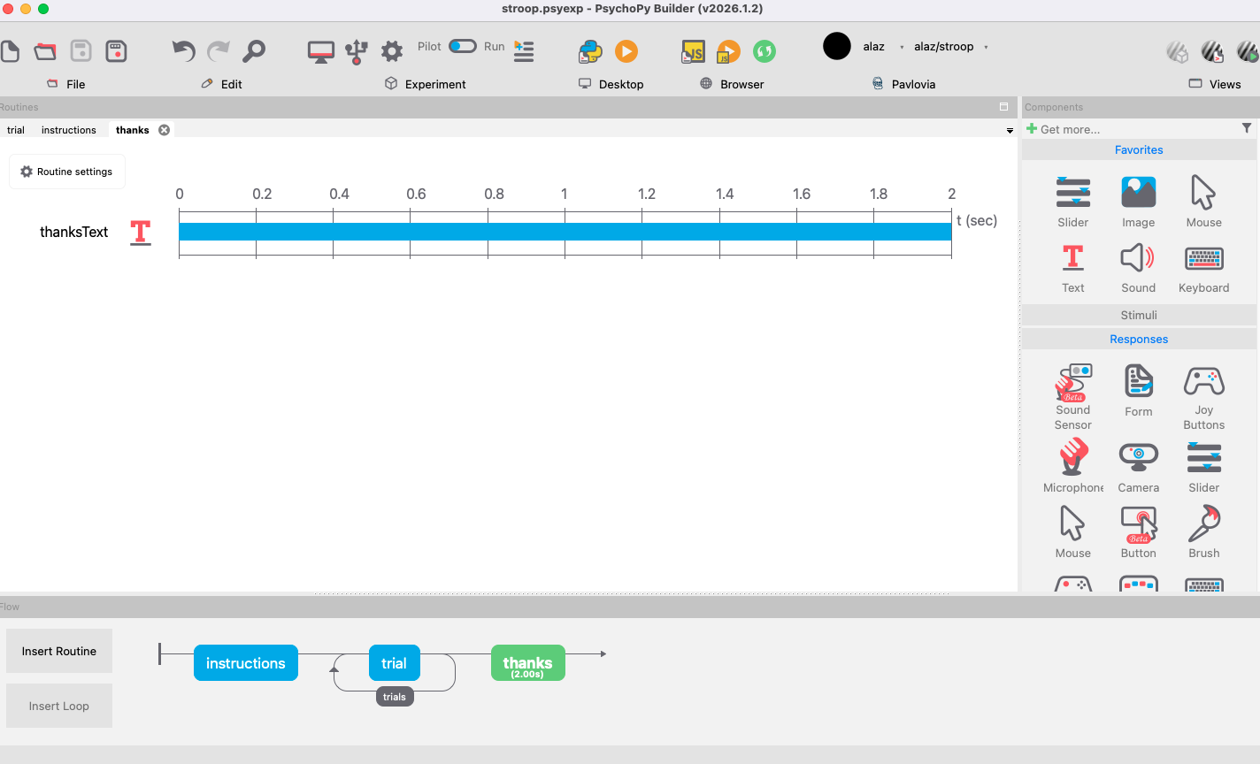
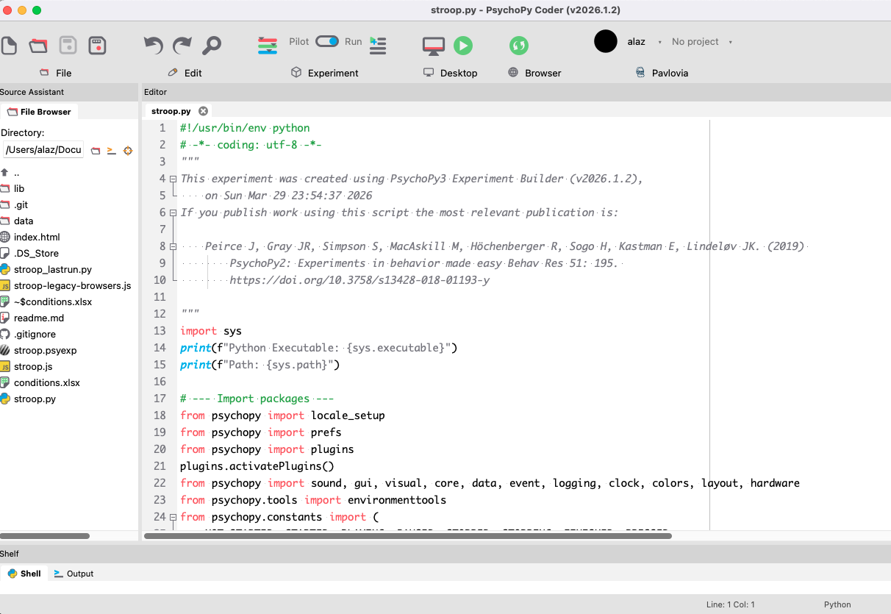
PsychoPy
psychopy has two interfaces:
1. builder interface
2. a code editor
"many users (including ourselves) use a combined approach, whereby they construct the bulk of the experiment in the Builder view (because the nature of one trial and the saving of data are usually fairly straightforward) and then simply add Code Components to handle aspects that aren’t easy to construct graphically (like the randomization method).”
Use Pavlovia to take experiments online
And gitlab/github to share projects

Slide 6
Designing Experiments
physical limits:
refresh rate: e.g. 60Hz. what range of stimuli durations can you present?
monitor type: organic light emitting diodes, cathode ray tubes
keyboard timing: recording responses take time (around 30ms, and variable within 15ms)
presentation requires time: e.g. a 5MP image (RGB) = 3 x 5 = 15 million numbers should be presented
solutions:
present stimuli in multiples of frame intervals
buy button boxes that allow for more precise timing of responses
image files can be preloaded and can be much smaller than you might think, with no loss of quality
probably not required

Slide 7
PsychoPy
A library for the Python programming language.
A distribution of the Python programming language (the Standalone installers install Python and many dependent libraries so that you don’t need to and your own installation of Python won’t be affected).
A code editor (cunningly called ‘Coder’) that, as it happens, was also written in the Python programming language.
A graphical interface (called ‘Builder’) for converting visual representations of experiments into computer code.

Slide 8
Python
general-purpose: it can be used for many things
high-level: achieve a lot with a few simple commands
interpreted: you don’t have to ‘compile’ the code into ‘machine code’ after you’ve written it
community driven: open source libraries

Slide 9
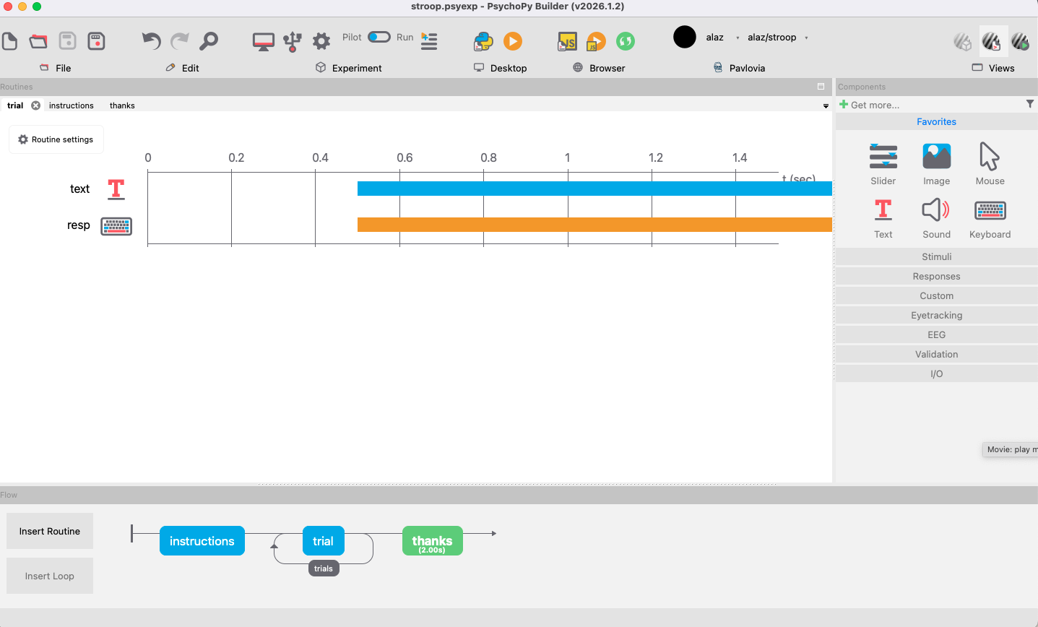
The Builder
Flow > Routines > Components
components: basic items that can be combined to create an experiment
routines: define how Components interact in time (e.g. a trial: presenting stimuli and getting a response)
routine is like a track editor for movie/audio editing software
flow: When you first create an experiment it simply has a blue box on the timeline indicating the (default) trial Routine
Flow is just a flow chart and controls the order of things and whether or not they repeat in Loops
you can zoom in and out in the flow view
loops: Loops are used to control repetition and also to allow things to vary from one repeat to the next. They can be nested.
Loops can be used to select random or sequential presentation of conditions or to create ‘staircase’ procedures whereby the next condition is determined by responses to the previous one.
there's a toolbar on the top

Slide 10
Today: STROOP TASK
Color names are presented on the screen either in colored letters that match the word being spelled (a congruent condition) or with letters that differ in color from the word
What stroop studies in cogsci: executive function and attention
Study individual differences, asking whether certain groups of people show more or less Stroop-type interference
Create a separate folder for each project!
Think:
what changes from trial to trial (controlled by a conditions file)
what stays the same (defined within a Routine)
In a Stroop trial we will show a color word and get response, and this "routine" will stay the same
But we will change color names and also the congruency condition
so, can you list the variables?
the word the text stimulus present
color of its letters
value of the correct answer
we should define these in the conditions file (csv, xlsx)

Slide 11
Defining Conditions
How to prepare a conditions file: rows: each type of trial that you intend to run; cols: variables; cells: values
colors: red, green, blue; corrAns: should report the color of the text: left (R), down (G), right (B)
Some rules for the conditions file:
Variables in your conditions file must have unique names
Variables cannot contain spaces, punctuation or accents
All columns with values in them need a variable name at the top
Naming of variables/conditions is case-sensitive
!!!Watch out for spaces in your conditions file!!! (e.g. variable names)

Slide 12
Defining a Trial
Components
Textbox
Keyboard
Demo time…

Slide 13
Assignment
Find a task
Explore pavlovia repositories (https://pavlovia.org/explore)
Explore OSF (https://osf.io/)
Consider relevant research questions
Search for variations of the task
Find an additional categorical contrast (e.g. Turkish-English in Stroop)
Can also be a between-participants group contrast
You can’t find a particular group
Sample is limited to class participants
But you can ask participants about information relevant to your task (e.g. smoker status for risk taking tasks)
Implement your variation of the task
Make your reasoning about this variation explicit
Make sure the task does not last more than 5 minutes
You can use public repositories from pavlovia, and build on it. But if you do so, make sure to give reference to original repository.
Upload your code to Pavlovia
Make your GitLab repo public
Share it with your classmates (via odtuclass forum)
Follow the forum, and make sure that you fork each repository, run it in pilot mode, and upload your data

