Slide 1
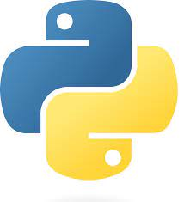
PYTHON

Slide 2
PYTHON

Slide 3
INTRODUCE
Al Azhar Rizqi Rifa’i Firdaus (1)
Fahruddin Zaim Ibrahim (9)
Mochamad Wildani Azizi (17)

Slide 4
PYTHON
Python is a versatile programming language that can be used for a variety of applications in many fields, from web development to machine learning.
Python is a programming language that is easy enough for beginners to learn, making it one of the most popular programming languages.

Slide 5
PYTHON
Advantages of Python for Programming
Python is free and open-source
Python is an easy language to learn
High-paying job opportunities
Python is popular in the programming community
Python is a versatile language

Slide 6





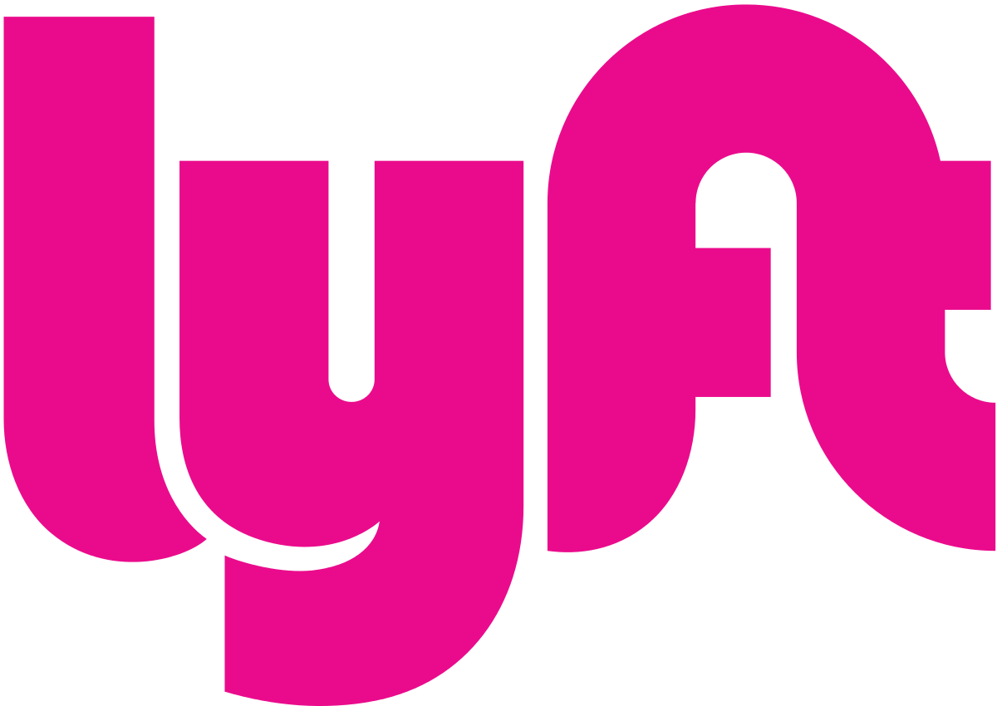



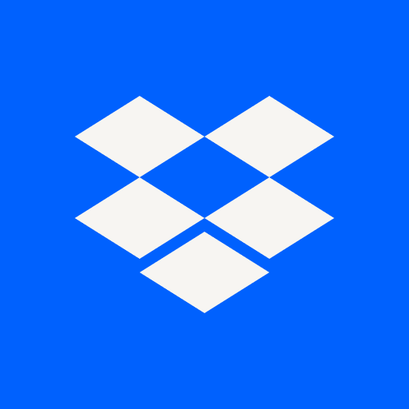
PYTHON
What are the Uses and Functions of Python?
Web Development
System Automation and Scripting
Software Testing
Data Analytics and Machine Learning
Game Development

Slide 7
PYTHON
Companies that Use Python
Google
Facebook
Instagram
Dropbox
Spotify
Reddit
Uber
Lyft
Netflix
Twilio

Slide 8
PYTHON
EXAMPLE CODE

Slide 9
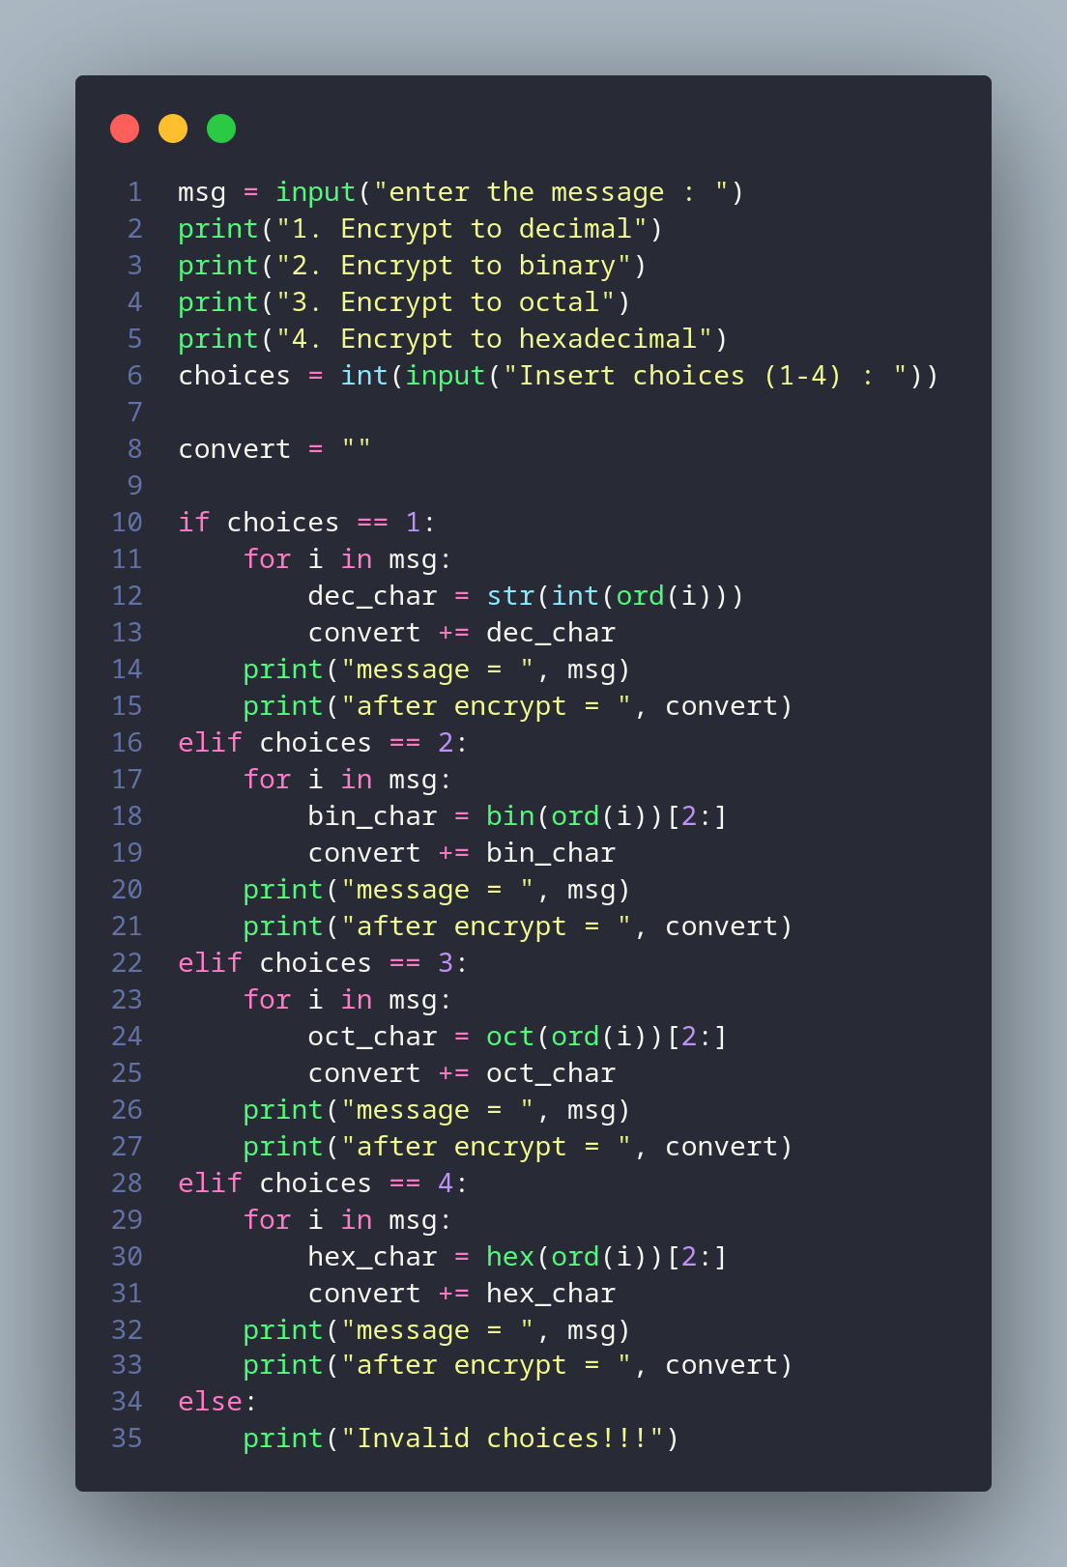
PYTHON
ENCRYPT MESSAGE
Get the source code : https://github.com/alazharizqi/encrypt-message.git

Slide 10
PYTHON
ANY QUESTION?

Slide 11
PYTHON
THANK YOU

