Slide 1
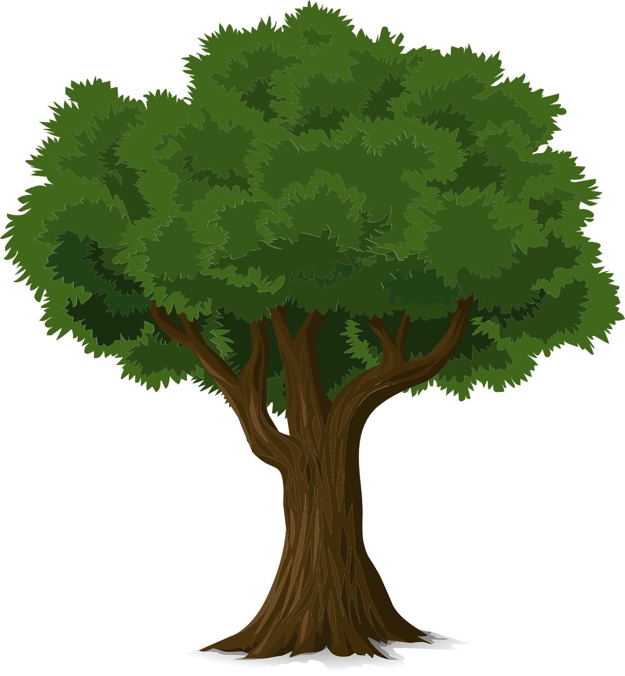
Tree
Endah Septa Sintiya,S.Pd.,M.Kom
Sumber: Rinaldi Munir/ Matematika diskrit

Slide 2
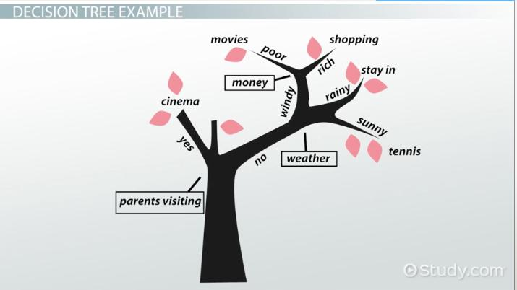

Slide 3
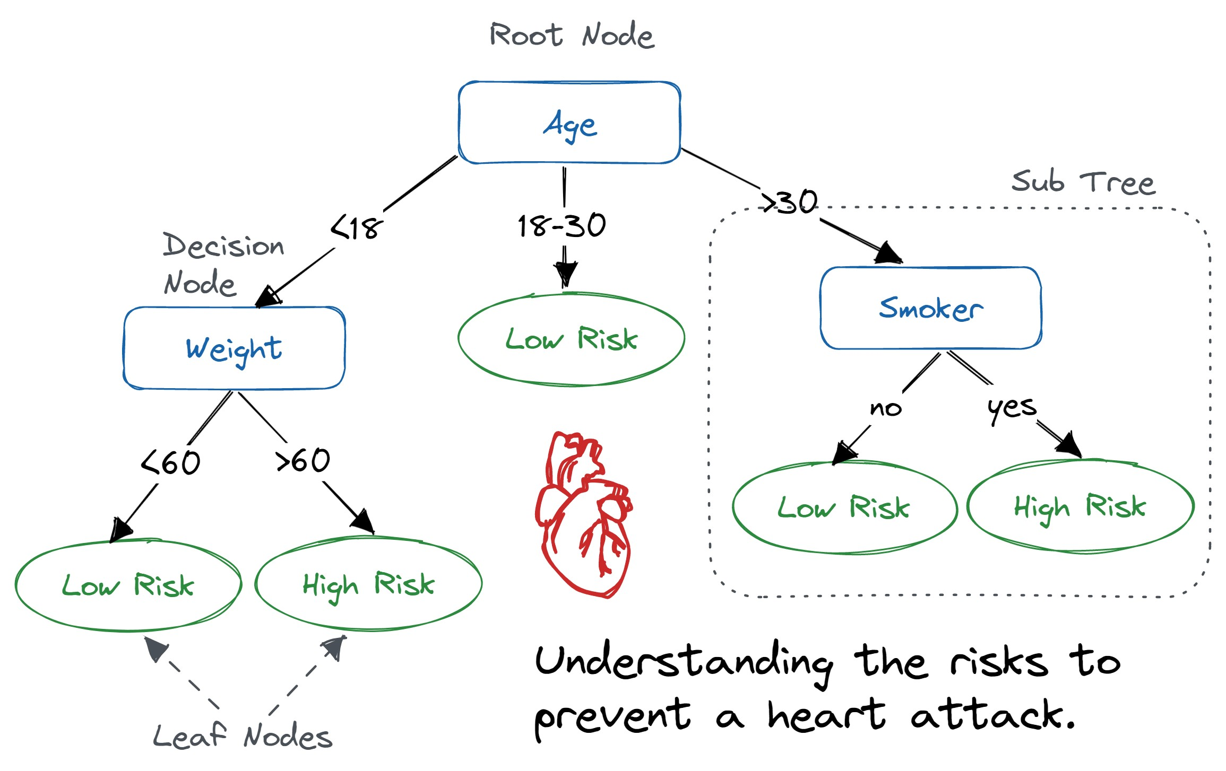

Slide 4
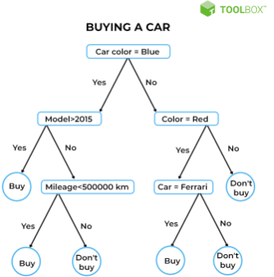
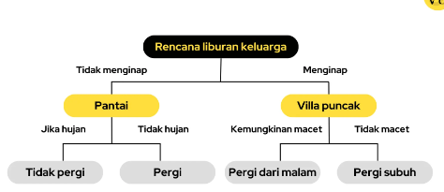

Slide 5
Tree
Trees have been used since 1857 by the English mathematician Arthur Cayley to calculate the number of chemical compounds and family trees.
Tree diagrams can be used as a tool to solve problems by depicting all alternative solutions.
One application of trees in data mining for classification: decision tree algorithms

Slide 6
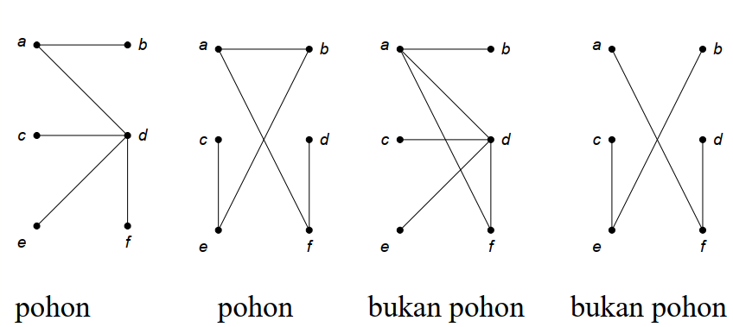
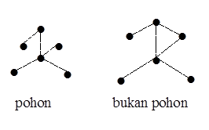
Introduction
A tree is a connected undirected graph that does not contain circuits.
A tree is a graph whose number of vertices/sides is equal to n (n>1), if:
~ The graph has no circumference (cycle free)
~ number of edges/sides =n-1, n is a vertex or point.
~ The graph is undirected but connected .
Tree | Tree | Not Tree | Not Tree | Tree | Not Tree

Slide 7

forest
Sumber: Google/ hutan

Slide 8
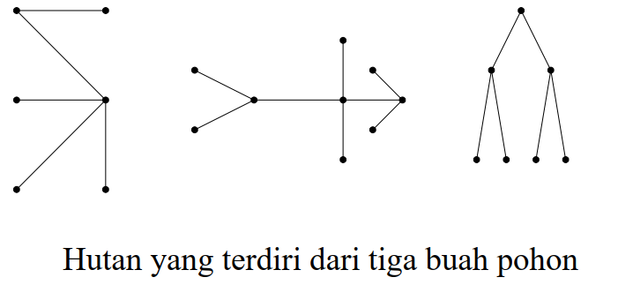
forest
A collection of mutually exclusive trees consists of unconnected graphs that do not contain circuits.
Each component in the connected graph is a tree.
Forest characteristics:
number of points/nodes = n
number of trees = k
number of edges/sides = n-k
a forest consisting of three trees

Slide 9
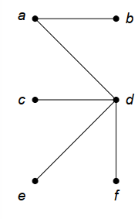
Properties of tree
Theorem. Let G = (V, E) be a simple undirected graph and the number of vertices is n, the number of edges is m. So, all the statements below are equivalent:
G is a tree.
Each pair of vertices in G is connected by a single path.
G is connected and has m(edges) = n(nodes) – 1.
G does not contain a circuit and has m = n – 1 edges.
G contains no circuits and adding one edge to the graph will create only one circuit.
G is connected and all sides are bridges.
The theorem above can be said to be another definition of a tree.

Slide 10
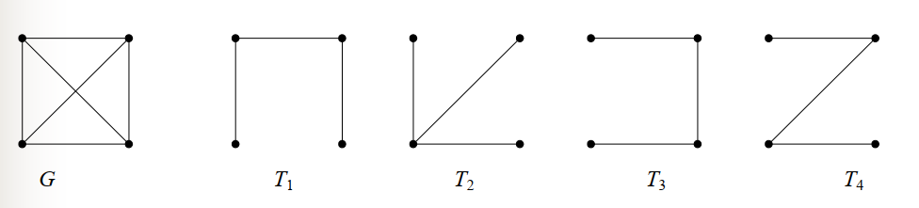
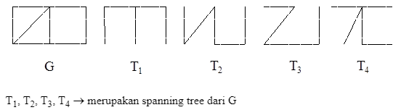
spanning tree
A spanning tree of a connected graph is a spanning graph in the form of a tree.
Spanning trees are obtained by breaking circuits in a graph
Every connected graph has at least one spanning tree.
An unconnected graph with k components has k spanning forests.

Slide 11

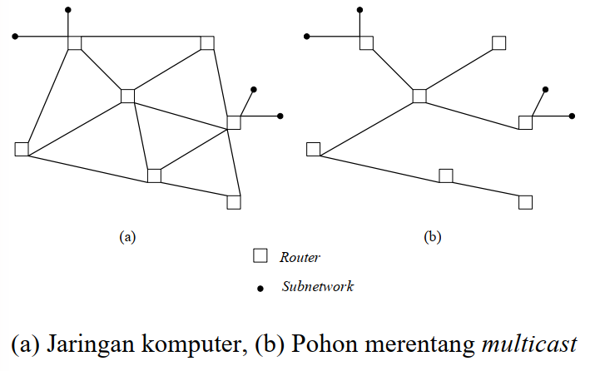
Spanning Tree Applications
The minimum possible number of roads connecting all cities so that each city remains connected to each other.
Routing (routing) messages on a computer network.

Slide 12
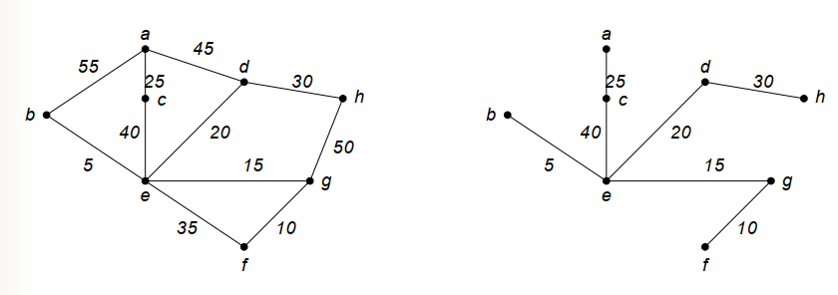
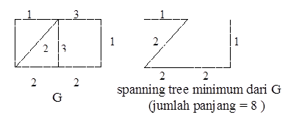
Spanning Tree Applications
A connected-weighted graph may have more than 1 spanning tree.
A spanning tree with minimum weight is called a minimum spanning tree.
spanning tree of a graph that has a minimum number of edge lengths.

Slide 13
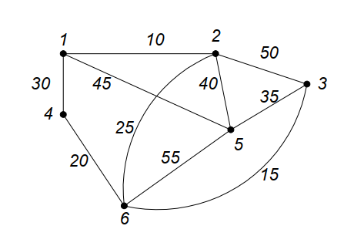
Example
From the following graph:
Form a spanning tree and
Minimum spanning tree

Slide 14
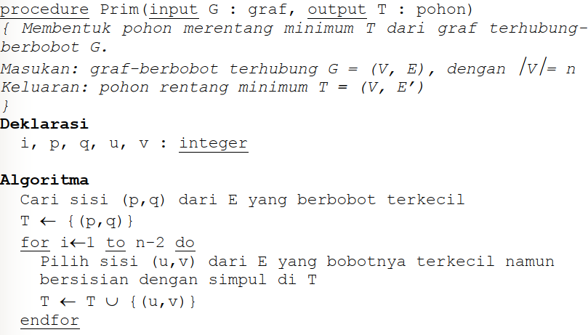
Prim's Algorithm
Step 1: take the edge of the graph G(Graph) with the minimum weight, insert it into T(Tree).
Step 2: select the edge (u, v) which has the minimum weight and is adjacent to the vertex in T, but (u, v) does not form a circuit in T. Insert (u, v) into T.
Step 3: repeat step 2 as many times as n – 2 times

Slide 15
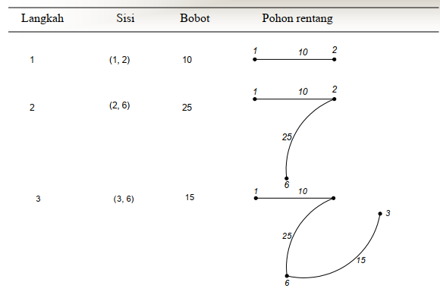
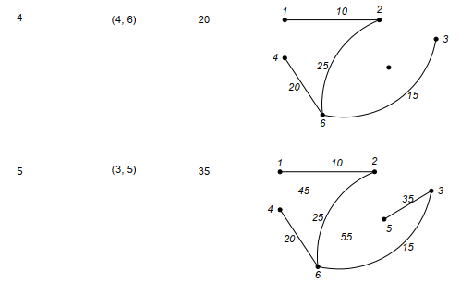
Solution

Slide 16
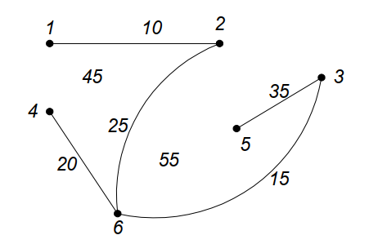
Result
Minimum spanning tree generated:
Weight = 10 + 25 + 15 + 20 + 35 = 105

Slide 17
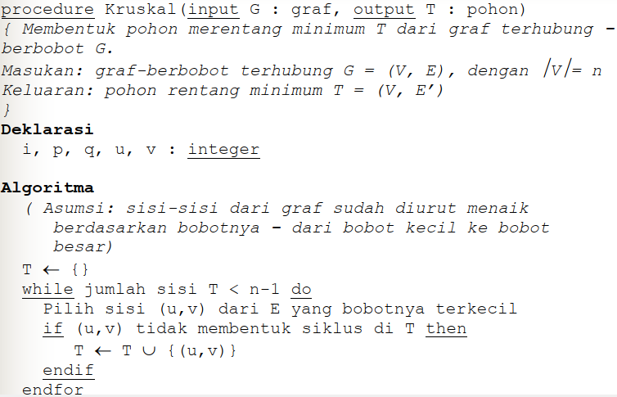
Kruskal's Algorithm
(Step 0: the edges of the graph have been sorted in ascending order by weight – from small weight to large weight)
Step 1: T is still empty
Step 2: select the edge (u, v) with minimum weight that does not form a circuit in T. Add (u, v) into T.
Step 3: repeat step 2 n – 1 times

Slide 18
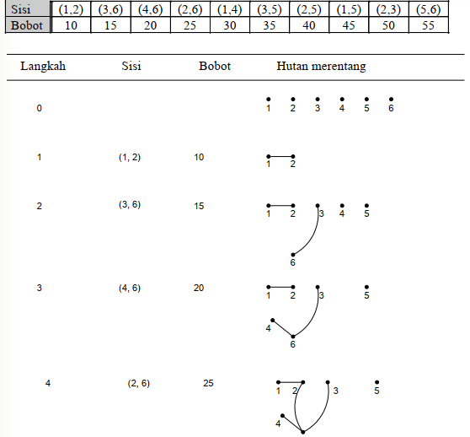

Slide 19
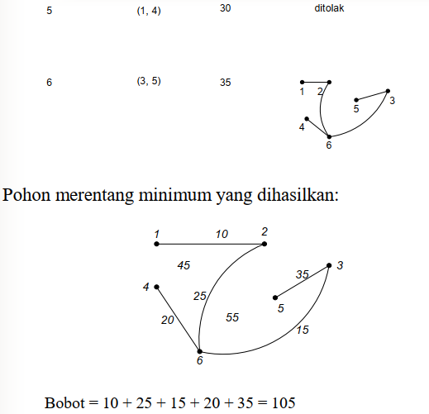

Slide 20
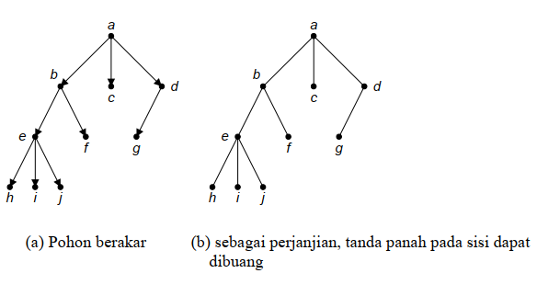
rooted tree
A tree in which one node is treated as a root and the edges are given directions so that it becomes a directed graph is called a rooted tree.

Slide 21
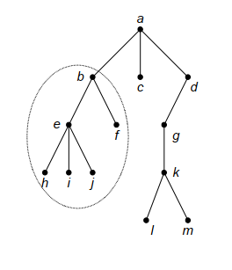
Terminology on Rooted Trees
child atau children) and (parent) b, c, and d are the children of node a, a is the parent of those children.
path The path from a to j is a, b, e, j. The path length from a to j is 3.
sibling f is e's sibling, but g is not e's sibling, because their parents are different.
Upapohon (subtree) part of the tree in a circle..

Slide 22
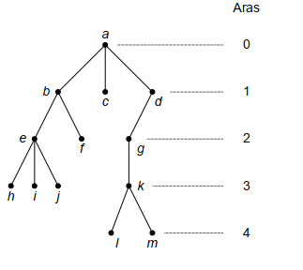
5. Degree The degree of a node is the number of subtrees (or number of children) at that node. Degree a is 3, degree b is 2, Degree d is one and degree c is 0. Maximum degree = 3
6. leaf Nodes with degree zero (or have no children) = leaves.
Vertices h, i, j, f, c, l, and m are leaves.
7. internal nodes
A node that has children is called an inner node.
Vertices b, d, e, g, and k are inner nodes.
8. Aras (level) 9. height or depth The maximum height of a tree is called the height or depth of the tree. The tree above has a height of 4

Slide 23
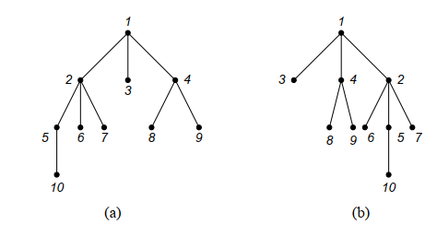
ordered tree
A rooted tree in which the order of its children is important is called an ordered tree. The order of the saplings starts from left to right.

Slide 24
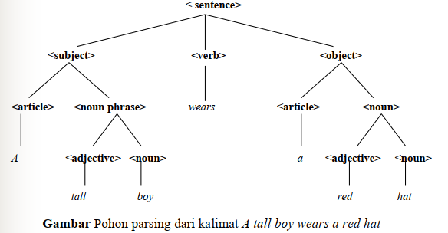
n-ary tree
A rooted tree in which each branch node has at most n children is called an n-ary tree. Usually to present a structure.
An n-ary tree is said to be regular or full if each branch node has exactly n children.

Slide 25
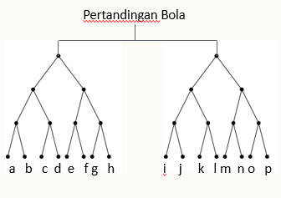
binary tree
This tree has roots that have at most 2 children or n=2.
This type of tree is usually for decision making.
football match

Slide 26
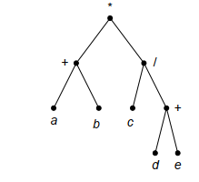

Example of applying a binary tree
Expression tree of (a + b)*(c/(d + e))

Slide 27
Group Task

Slide 28
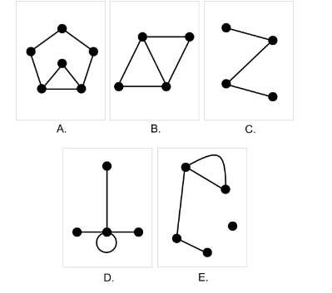
Task 1 Which of the following images is a tree graph?

Slide 29
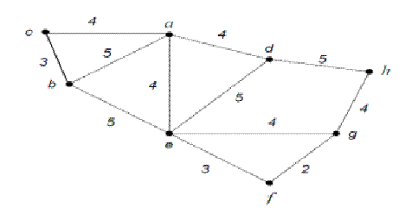
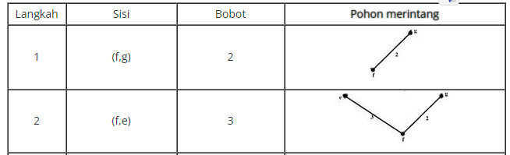
Task 2
Find the minimum spanning tree from the following image with the prim algorithm, continue the table below

Slide 30
Task 3
Look for 1 example of a journal application of a Tree / Decision tree and draw a picture of the tree arrangement

