Slide 1
Singe Page Application

Slide 2
Agenda
Software design patterns
Model View Controller

Slide 3
Design pattern
from Wikipedia:
A general reusable solution to a commonly occurring problem within a given context in software design

Slide 4
MVC Design Pattern
M Model
V View
C Controller

Slide 5
MVC architecture

Slide 6
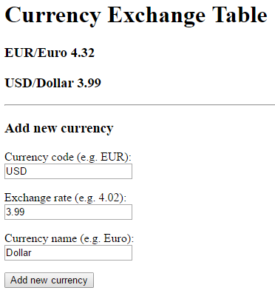
MVC App
Currency Exchange Table
currency.html
model.js
view.js
controller.js
Data object
{code: …, rate: …, name: …}

Slide 7
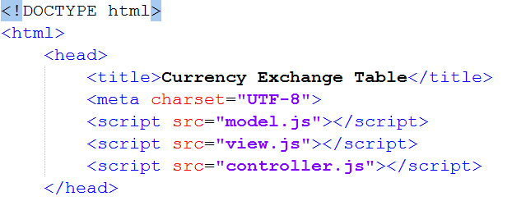
HTML head

Slide 8
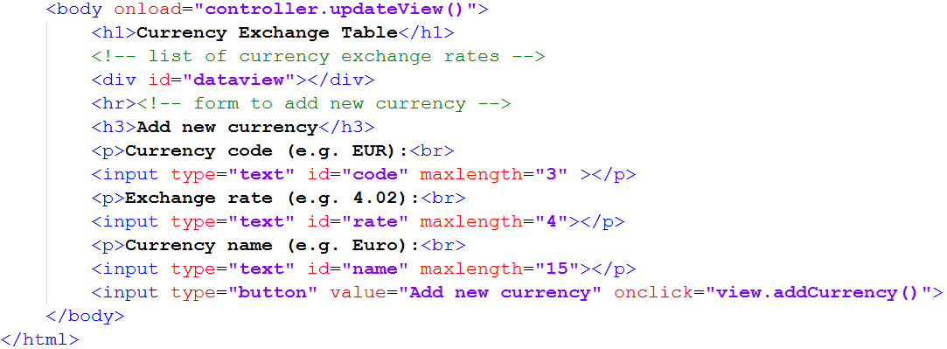
HTML body

Slide 9
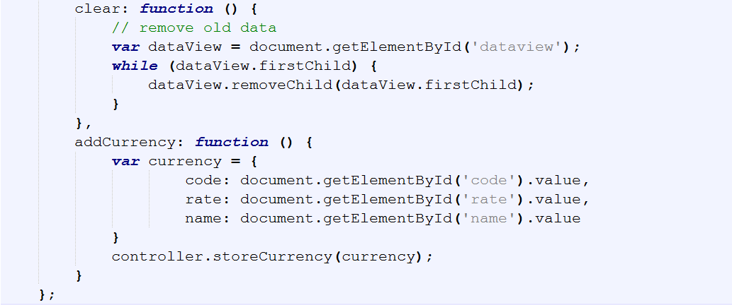
View

Slide 10
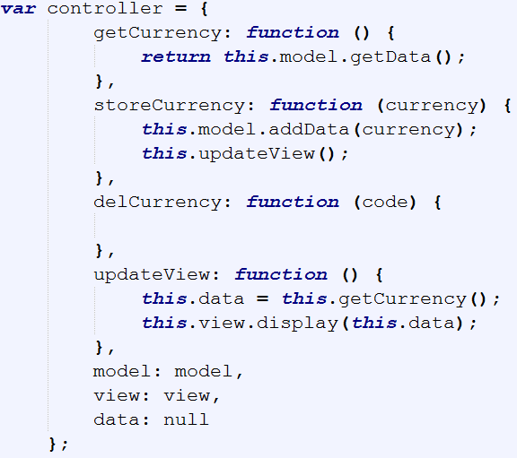
Controller

Slide 11
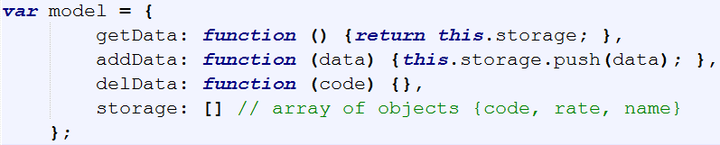
Model

Slide 12
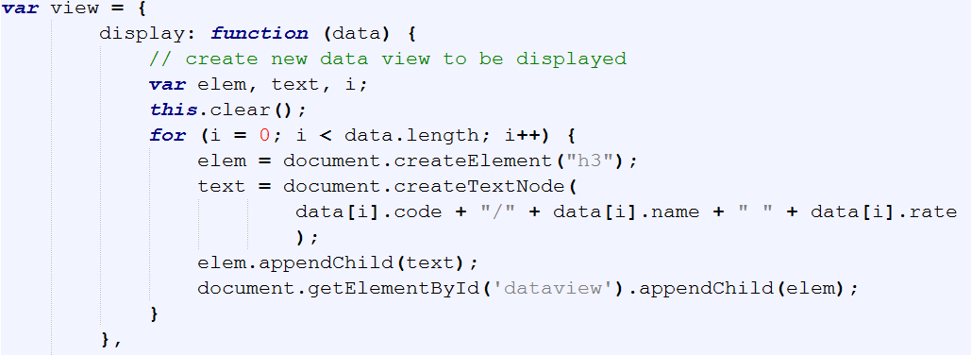
View

Slide 13
To do

Slide 14
Create drop-down list
Modify the Currency app.
Instead of typing currency code and name, create a drop-down list with currency codes and names.
Add to the drop-down list the following items: EUR, USD, GBP, CHF, CZK, HRK, HUF
Modify the addCurrency method in the view.js to create an object to store in the database.

Slide 15
Create HTML table
Modify the app view to display the data in an HTML table as in the example.
Change the source code of the display method to create table elements:
Table
Table header
Table rows
Table data cells
Code | Name | Rate
USD | Dollar | 3.98
EUR | Euro | 4.32
HUF | Forint | 0.14
… | … | …

Slide 16
Handle events
Add a new app feature to remove selected currency item from the table.
After double click on a table row, the row is to be deleted.
During creating the table, add the event handler (double click) to all table rows executing the controller method:
controller.delCurrency(XXX)
where XXX is the currency code in quotation marks.
Complete the following methods:
Controller.delCurrency()
Model.delData()

Slide 17
Improve app look and feel
Use the bootstrap framework to improve look and feel of the app.

Slide 18
Store data in local storage
Modify the app model.
Store the app data in the local storage.

Slide 19
Store data in local SQL database
Modify the app model.
Store the app data in the a Web SQL database.

Slide 20
Retrieve data from Web Service
Modify the app to read the current currency exchange rates from a web service.
Instead of typing the currency exchange rate, use the National Polish Bank Web API (http://api.nbp.pl/)
Optimise the app to cache external data sources locally (local storage, local database).

