Slide 1
Ballet moves
Ana NyStedt
Allyson Bieryla

Slide 2
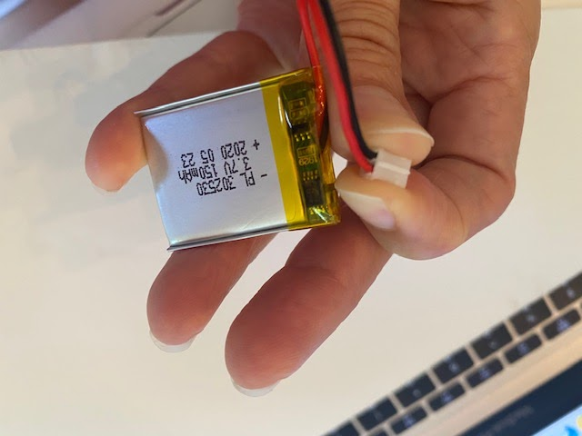
So far…
Hardware
SensorTile kit
PowerBoost 500 Charger (just received this week)
Lithium Ion Battery (just received this week) – WRONG +/- wiring
Reordered battery
Using a battery operated charger
Soldered the USB connector and glued the sensor tile
Software
Setup directories for Github, google drive and zoom meetings

Slide 3
Next week…
Figure out the orientation for sensor on ankle to collect data
Start collecting data
Work on code for collecting and cleaning data

