Slide 1
Classifying
Small Ballet jumps with
Machine Learning
ANA NYSTEDT
ALLYSON BIERYLA

Slide 2
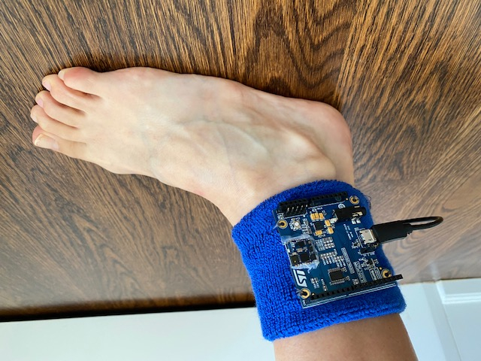
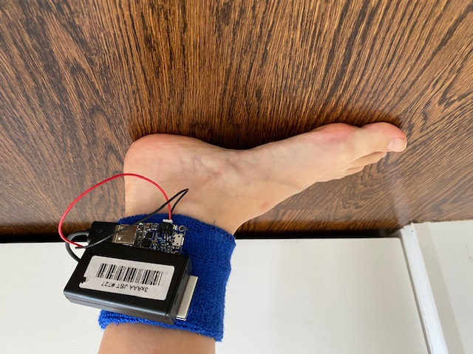
HARDWARE SETUP
Secured and tested sensor on ankle
Took test images using 3 AAA battery pack, but found it to be too big
Final design uses the Lithium Ion battery (3.7V 500 mAh with power boost) - see next slide

Slide 3
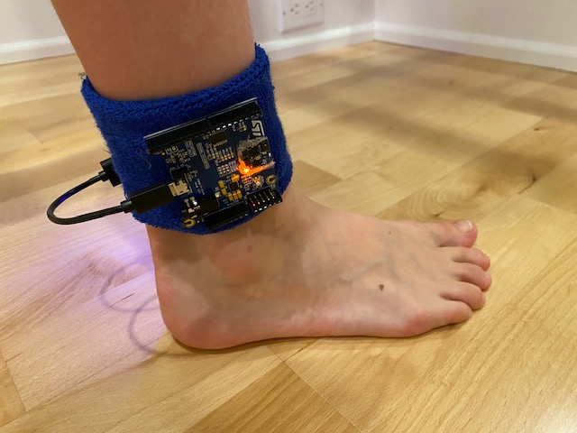
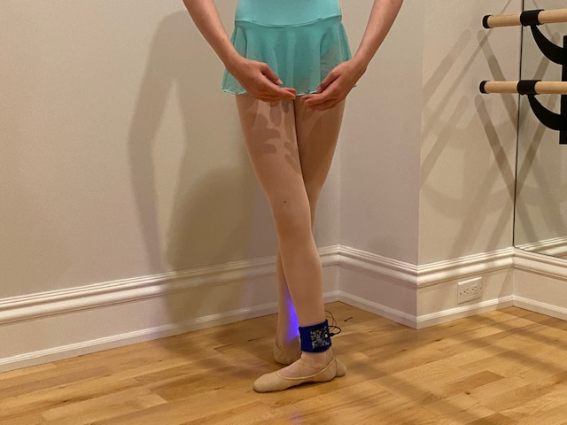
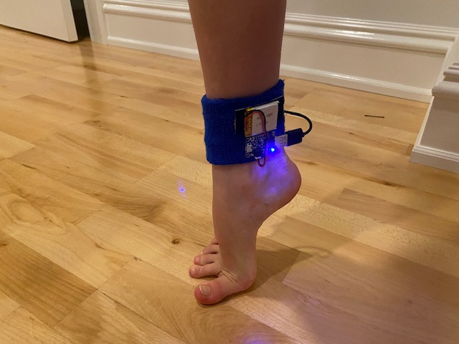

Slide 4

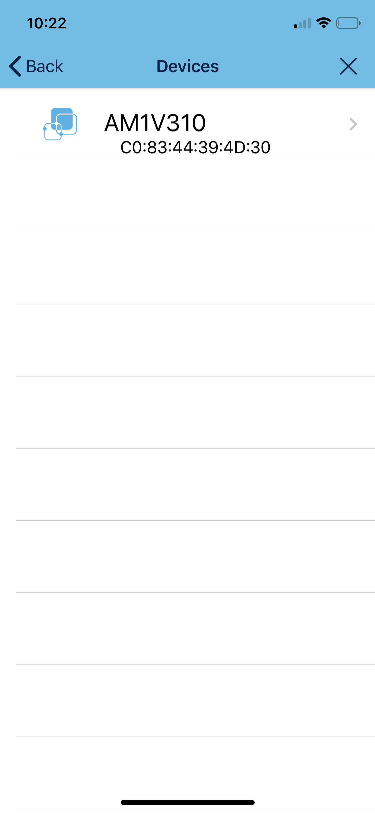
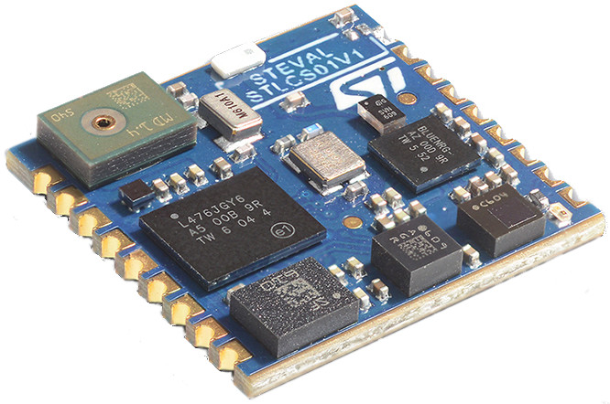

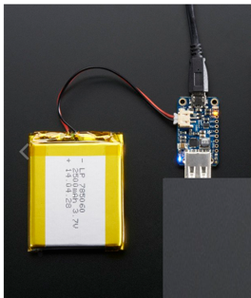
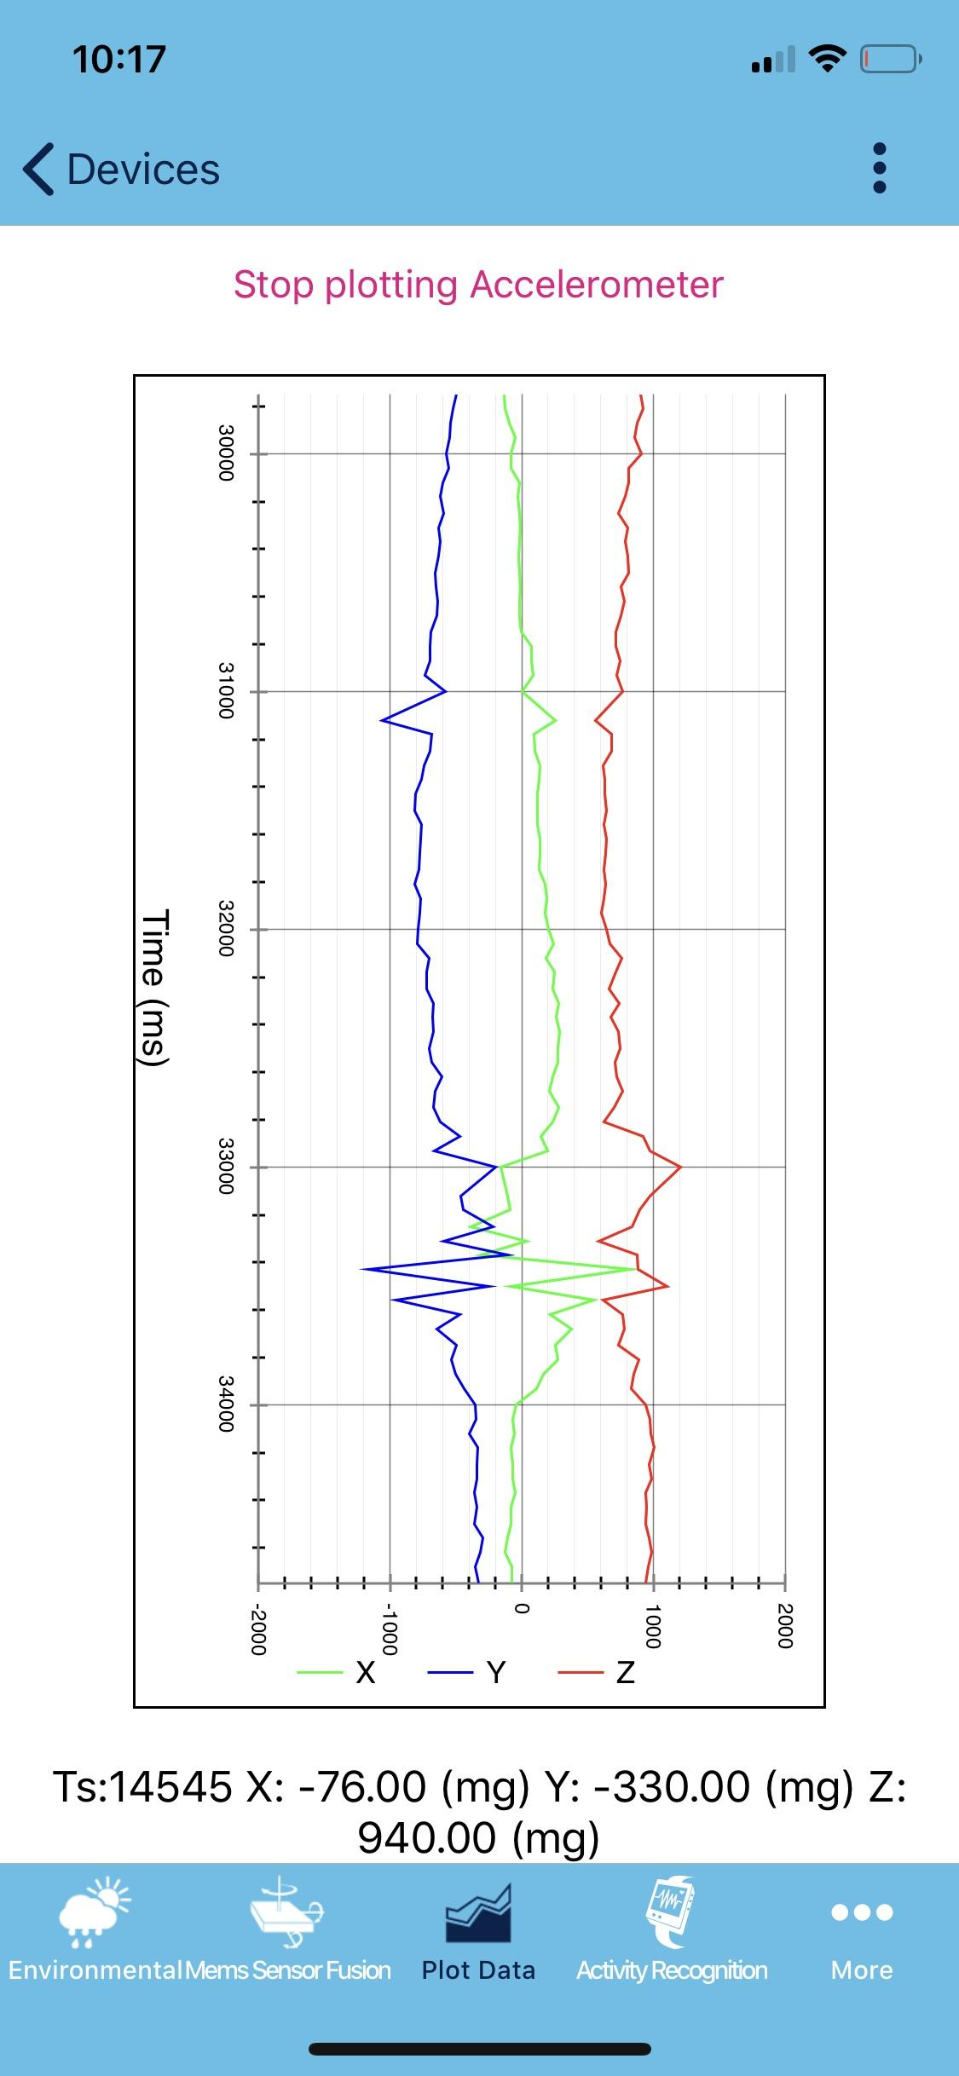

ST Sensor
System Setup
+
ST Sensor BLE iPhone app

Slide 5
DATA COLLECTION
Took test data using both Unicleo and ST Sensor BLE and decided to use the iPhone app ST Sensor BLE, because it was more stable.
Collected data using ST Sensor BLE and the SensorTile(Accelerometer, Gyro and Magnetometer) of three types of ballet jumps (jete, pas-de-chat and glissade)
3 datasets of 50 jumps for each type of jump
Divided the datasets in two 40 jumps for training, and 10 jumps for testing of each type of jump

Slide 6
SOFTWARE
Used “Pair Programming” through Zoom to developed Python code to load, clean, visualize data, and use machine learning to classify the jumps
Jupyter Notebook, Pandas, numpy, matplotlib, seaborn
Github

Slide 7
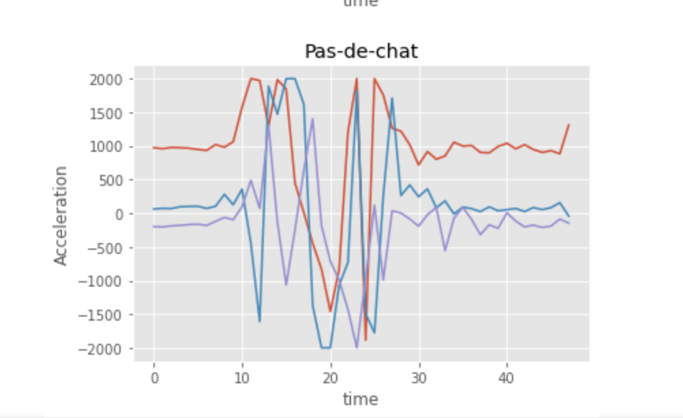
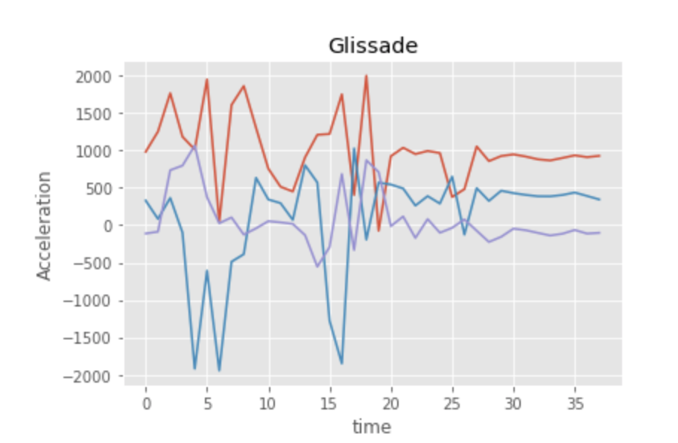
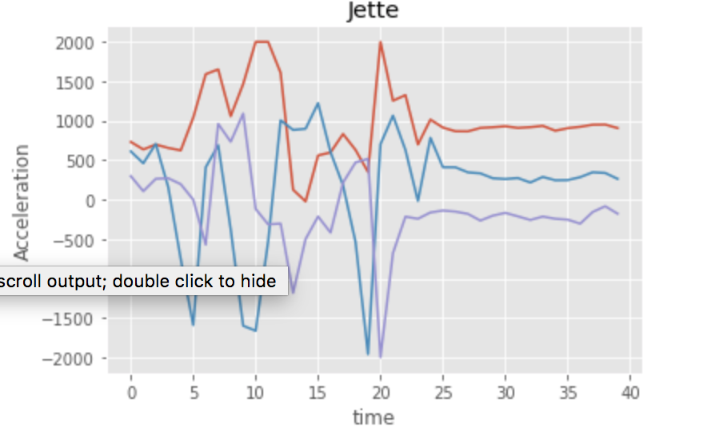
Visualizing Acceleration Data
100 Hz- Sampling rate (10 ms)
Acc - Full scale +/- 2G (it may have been better to increase it to 4G)

Slide 8
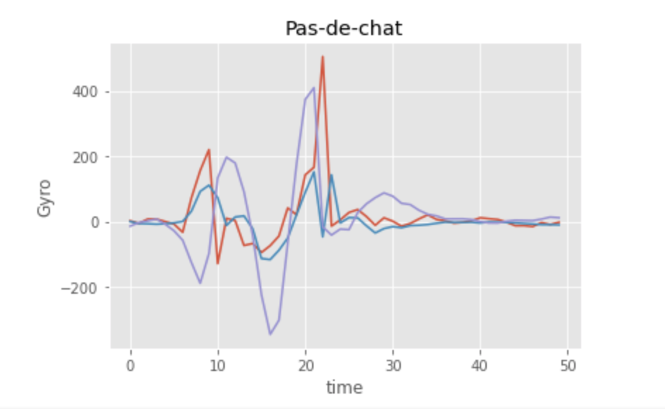
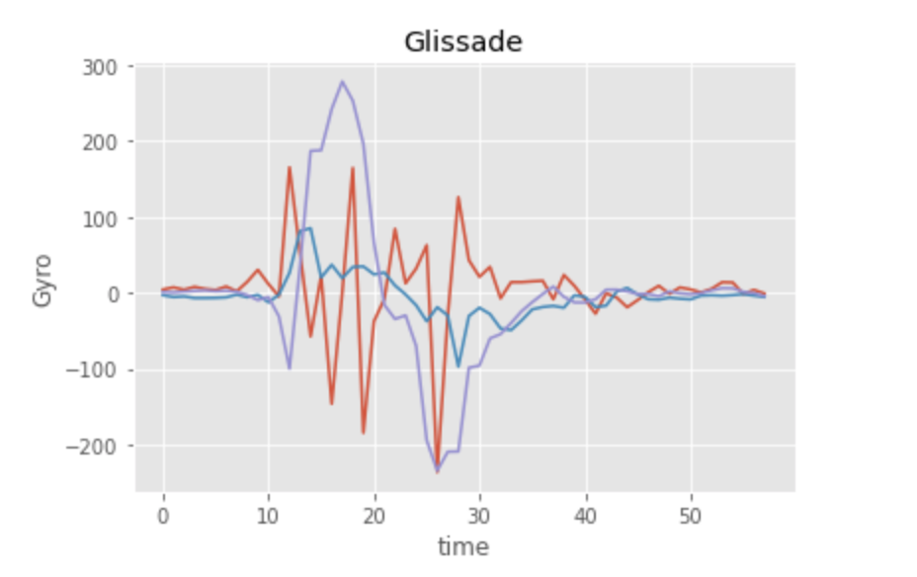
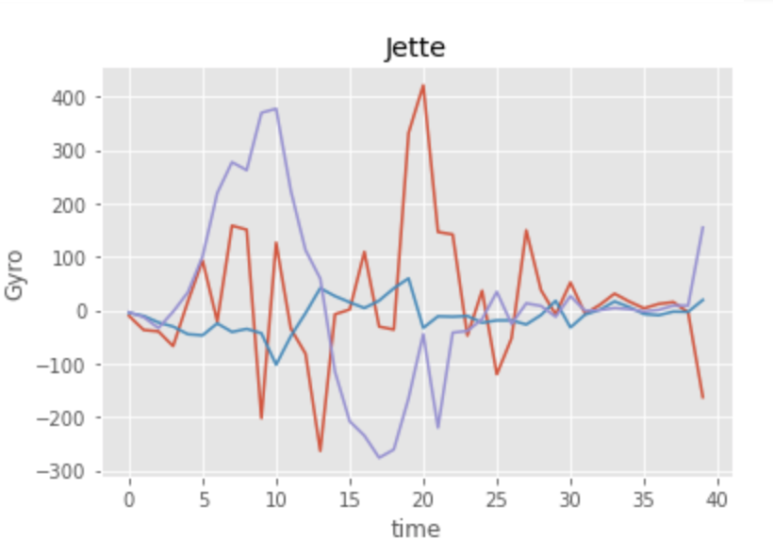
Visualizing Gyroscope Data
Gyro- Full scale 500? (+/-.5 dps? )

Slide 9
Machine Learning - model
After analysing the data, we extracted 2 features for each jump:
1) Feature 1 - Mean (Acc_Z)
2) Feature 2 - Std (Acc_Z)
We decided to predict only 2 out of the 3 jumps with this model
Trained an SVM.SVC model to classify the jumps and did preliminary testing
Preliminary results - Our model classifies between two jumps
Show notebook

Slide 10
Notes: Improvements
Increase FS of the accelerometer to 4G
Truncate data? to eliminate unintended motions occurring before and after the jump? not sure if necessary since the jumps were recorded in isolation from no motion

