Slide 1
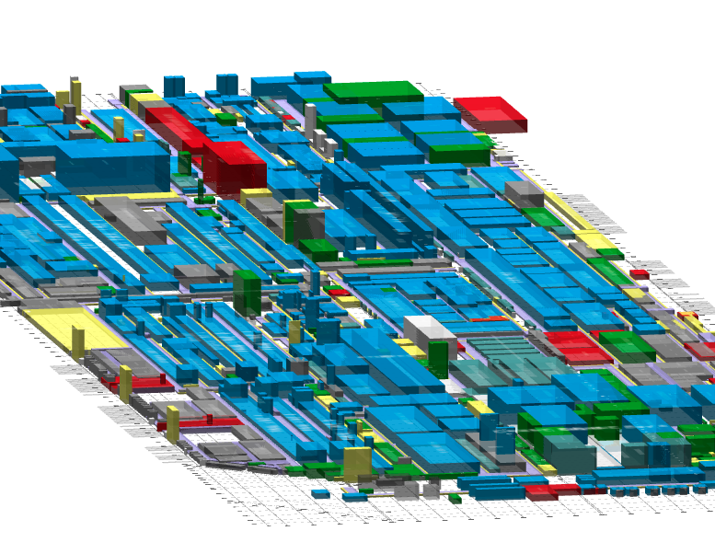
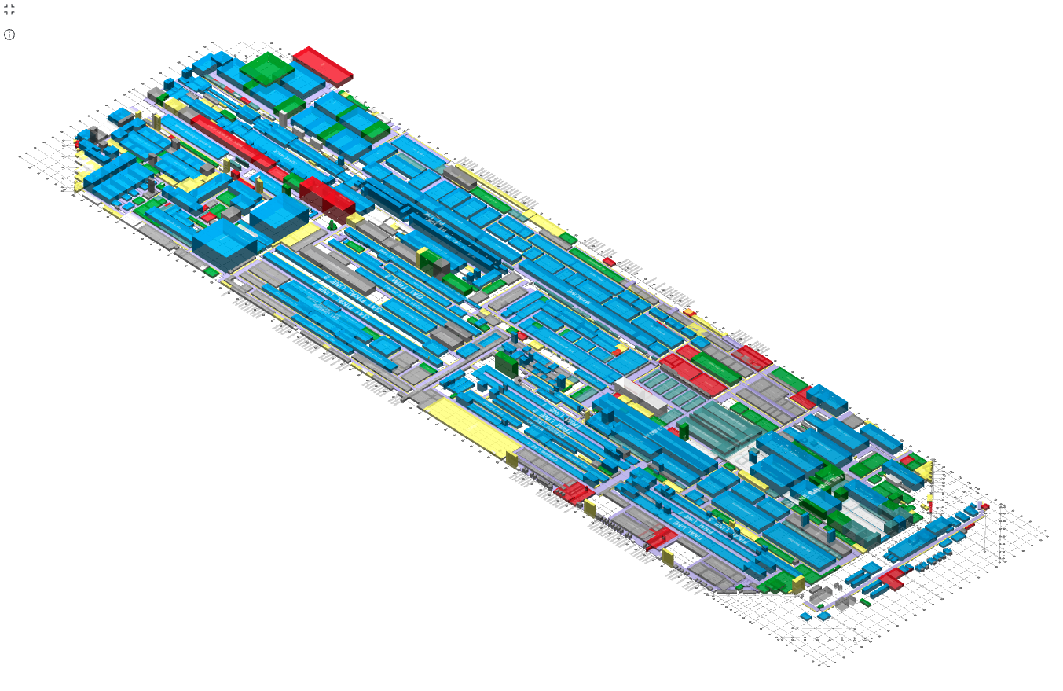
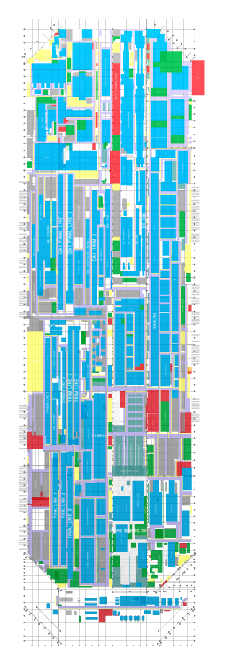
Factory Design Tools
Rohan Singh

Slide 2
Factory Design Tools
Rohan Singh
July 28th 2023

Slide 3
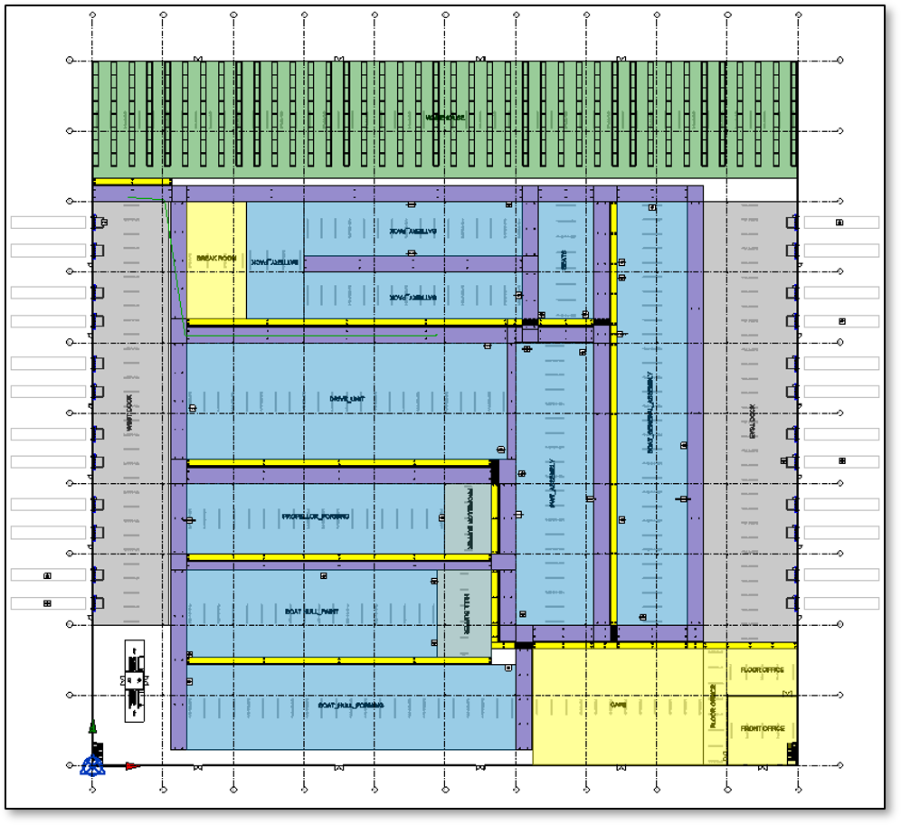
What/Why?
Tesla's "build the box" strategy involves constructing the Gigafactory first, followed by incremental development of its contents.
This approach creates a profoundly iterative environment for the Factory Design teams responsible for the box's design and its components.
Evaluating these designs also becomes an equally iterative process.

Slide 4
Current Situations
Conventional Business Intelligence (BI) tools and visTable are used to assess layouts.
Relying solely on data management visualizations for evaluation proves ineffective.
Transitioning to Revit allowed the Factory Design team to generate custom, structured, spatial data from layouts.
This transition presented a valuable opportunity for the team to find a less time consuming and more accurate and efficient way to iterate.
SolidWorks
1
1
1
1
1
1
1
1
1
1
1
1
1
1
1
1
1
1
1
1
1
1
1
1
1
1
1
1
Vistable
Layout + Logistics KPI’s
Layout + Logistics KPI’s
Layout + Logistics KPI’s
Layout + Logistics KPI’s
Layout + Logistics KPI’s
Layout + Logistics KPI’s
Layout + Logistics KPI’s
Layout + Logistics KPI’s
Layout + Logistics KPI’s
Revit
1
2
3
4
5
6
7
8
9
10
11
12
Factory Design Tools
Layout + Logistics KPI’s
Layout + Logistics KPI’s
Layout + Logistics KPI’s
Layout + Logistics KPI’s
Layout + Logistics KPI’s
Layout + Logistics KPI’s
Layout + Logistics KPI’s

Slide 5
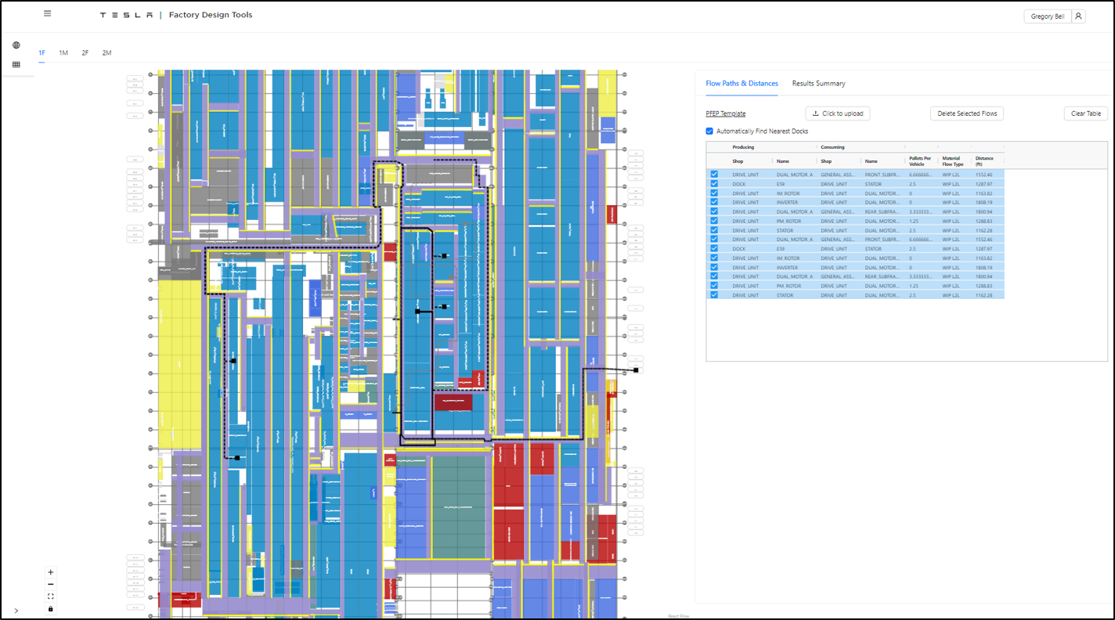
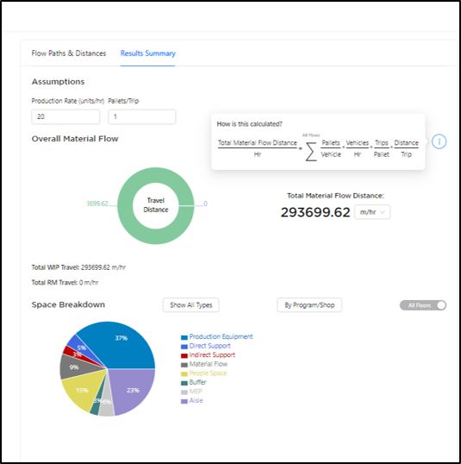
Objective
Develop a software that effectively utilizes the Revit element metadata to convey material flow concepts across a vast array of layout design options.
Enhance the Gigafactory's design process by increasing the number of layout iterations under consideration.
Accelerated evaluation of individual options and the provision of diverse customized tools catering to specific trade needs.
Expedite the design process of Gigafactories.

Slide 6
Contributions to the Mission
Originally a task that usually took 12 hours of manually opening models and running a script that extracted information
Has now been optimized to currently run 20-25 full Revit models in 50 min extracting millions of lines Revit element data
Conversely, Autodesk Forge Flex tokens can be utilized to perform these functions however they comes with a price of $30/day per token not to mention the hassle of requesting for permission to use these tokens which has 6+ months with no luck.
Would need a token for every model plus additional tokens for accessing the BIM cloud where the models are hosted
This could cost anywhere from $436,800 (40 tokens) - $1,092,000 (100 tokens) annually which is just the lower end assuming minimum usage.
Contributed to frontend development utilizing DeckGL to render extracted data on the web and perform complex calculations to assist the Material Flow Team as well as create a simple UI for users to run adhoc revit extractions jobs.

