Slide 1
Feelings of movies
A sentimental analyser of Movies
www.justinbloomb.org
and
best-domain-name.com

Slide 2
Inspiration
Positive feelings can make positive impact to people
Movies are a major stream for people getting emoted
IMDB has a HUGE database of movie reviews
Ratings are subjective, but a summary of review is objective
We need to know which movies are really helping people feel positive or negative
Especially to help people out when they are depressed
www.justinbloomb.org

Slide 3
What does it do?
Analyse movie reviews
Summary of the emotions in a film’s reviews
Auto clustering similar feeling films
Alexa can tell you which movie is the best for your feeling

Slide 4
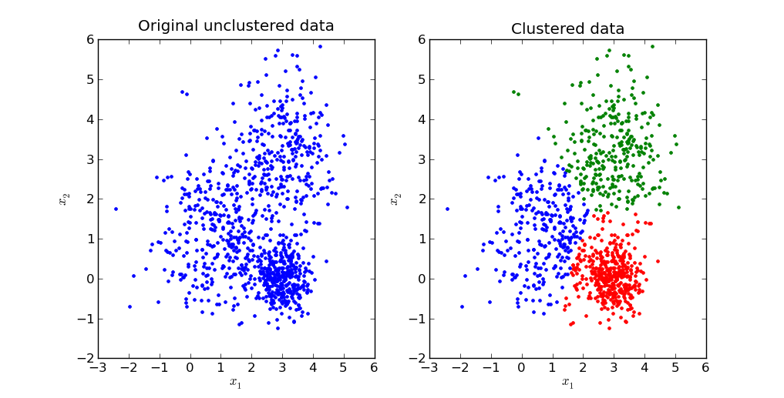





Movies
Movie1
Movie2
…
Movie N
TF-IDF vectors
K Mean Clustering
WORD!
WORD2
WORD3
WORD4
…
WORD11000
TFIDF1
TFIDF2
TFIDF3
TFIDF4
…
TFIDF110000
TEXT
Positive Word1
Negative Word2
…
Positive Word N
Movie cluster 1
Movie cluster 2
…
Movie cluster N

Slide 5

How Do we make it?
Web Crawler to read movie reviews on IMDB
Artificial Intelligence powered sentimental analyse of reviews
Running on AWS c4.8xlarge HPC 36 cores with 60GB RAM
Self-made TF-IDF based vector generation
Amazon Alexa skills enable the new level of interactions
A comprehensive integration of Machine Learning (Supervised and Unsupervised)
AWS Lambda and IBM Watson
LAMP Server with MediaWiki

Slide 6
Demo time
Website at Justinbloomb.org and best-domain-name.com to demonstrate our result of the BIG DATA analyze
Alexa skills that can discuss which film is the best for you
Comparison of user sentiments and ratings on films were controversial
People’s review changing over the time

Slide 7


Any Questions?
Special Thanks to
MLH
Bloomberg
J.P. MORGAN
AMAZON (AWS RDS\EC2\Lambda ,Alexa)
IMDB
MashapeAPI
IBM Bluemix and Watson
GitHub

