Slide 1
Introduction to NLP
What is Natural Language Processing?

Slide 2
Question Answering: IBM’s Watson
Won Jeopardy on February 16, 2011!
WILLIAM WILKINSON’S
“AN ACCOUNT OF THE PRINCIPALITIES OF WALLACHIA AND MOLDOVIA”
INSPIRED THIS AUTHOR’S
MOST FAMOUS NOVEL
Bram Stoker

Slide 3
Information Extraction
Event: Meeting
Date: Jan-16-2016
Start: 10:00am
End: 11:30am
Where: Office 101
Subject: meeting
Date: January 15, 2016
To: Me
Hi Sr, we’ve now scheduled the meeting.
It will be in Office 101 tomorrow from 10:00-11:30.
-Chris
Create new Calendar entry

Slide 4

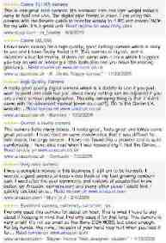
Information Extraction & Sentiment Analysis
Attributes:
zoom
affordability
size and weight
flash
ease of use
Size and weight
✓
nice and compact to carry!
since the camera is small and light, I won't need to carry around those heavy, bulky professional cameras either!
the camera feels flimsy, is plastic and very light in weight you have to be very delicate in the handling of this camera
✓
✗

Slide 5
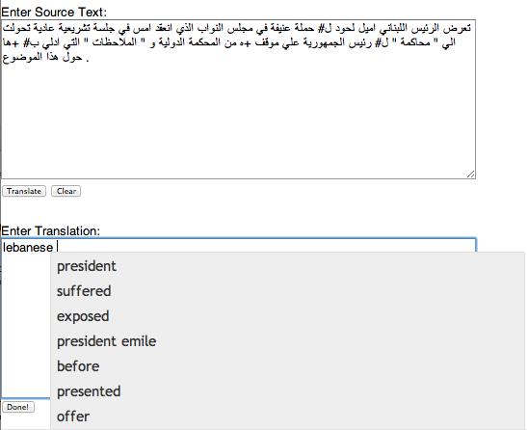
Machine Translation
Helping human translators
Fully automatic
Enter Source Text:
这 不过 是 一 个 时间 的 问题 .
Translation from Stanford’s Phrasal:
This is only a matter of time.

Slide 6


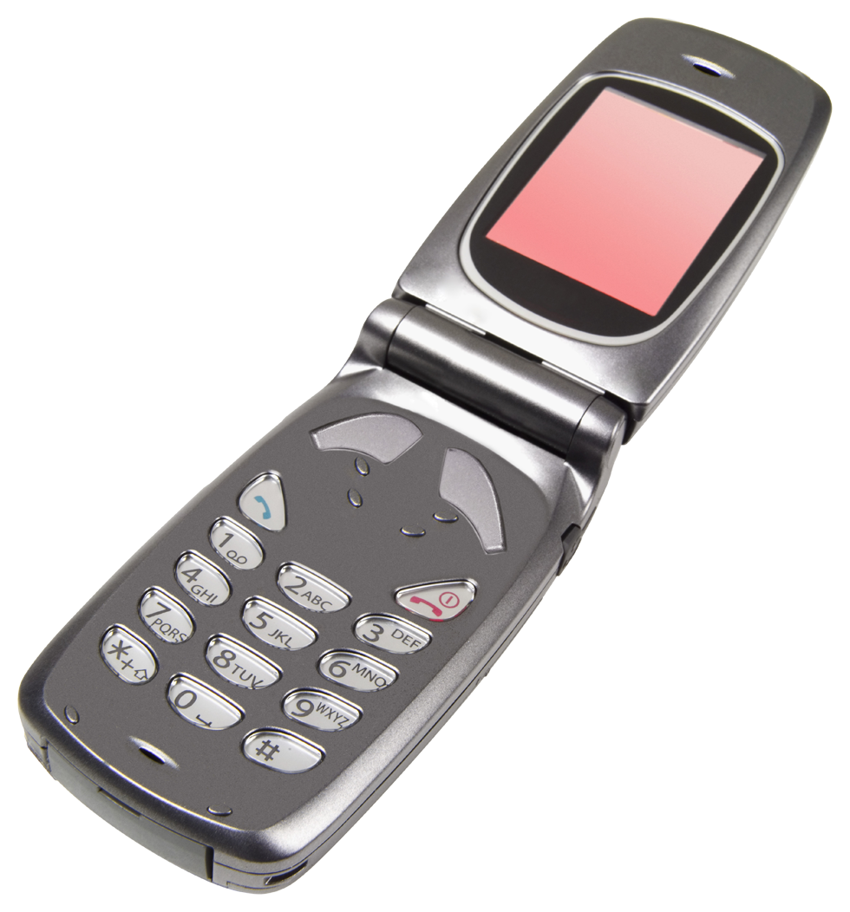

Language Technology
making good progress
Sentiment analysis
still really hard
mostly solved
Best roast chicken in San Francisco!
Question answering (QA)
The waiter ignored us for 20 minutes.
Spam detection
Coreference resolution
Q. How effective is ibuprofen in reducing fever in patients with acute febrile illness?
✓
Let’s go to Agra!
Paraphrase
✗
Carter told Mubarak he shouldn’t run again.
Buy V1AGRA …
Word sense disambiguation (WSD)
XYZ acquired ABC yesterday
Part-of-speech (POS) tagging
I need new batteries for my mouse.
ABC has been taken over by XYZ
ADJ ADJ NOUN VERB ADV
Summarization
Colorless green ideas sleep furiously.
Parsing
The Dow Jones is up
Economy is good
I can see Alcatraz from the window!
The S&P500 jumped
Named entity recognition (NER)
Machine translation (MT)
Housing prices rose
PERSON ORG LOC
第13届上海国际电影节开幕…
Dialog
Where is Citizen Kane playing in SF?
Einstein met with UN officials in Princeton
The 13th Shanghai International Film Festival…
Information extraction (IE)
Castro Theatre at 7:30. Do you want a ticket?
You’re invited to our dinner party, Friday May 27 at 8:30
Party May 27 add

Slide 7
Ambiguity makes NLP hard: “Crash blossoms”
100% REAL
Violinist Linked to JAL Crash Blossoms
Teacher Strikes Idle Kids
Red Tape Holds Up New Bridges
Hospitals Are Sued by 7 Foot Doctors
Juvenile Court to Try Shooting Defendant
Local High School Dropouts Cut in Half

Slide 8
Ambiguity is pervasive
New York Times headline (17 May 2000)
Fed raises interest rates
Fed raises interest rates
Fed raises interest rates 0.5%

Slide 9
Why else is natural language understanding difficult?
non-standard English
segmentation issues
idioms
Great job @justinbieber! Were SOO PROUD of what youve accomplished! U taught us 2 #neversaynever & you yourself should never give up either♥
dark horse
get cold feet
lose face
throw in the towel
the New York-New Haven Railroad
the New York-New Haven Railroad
neologisms
world knowledge
tricky entity names
unfriend
Retweet
bromance
Mary and Sue are sisters.
Mary and Sue are mothers.
Where is A Bug’s Life playing …
Let It Be was recorded …
… a mutation on the for gene …
But that’s what makes it fun!

Slide 10
Making progress on this problem…
The task is difficult! What tools do we need?
Knowledge about language
Knowledge about the world
A way to combine knowledge sources
How we generally do this:
probabilistic models built from language data
P(“maison” → “house”) high
P(“L’avocat général” → “the general avocado”) low
Luckily, rough text features can often do half the job.

Slide 11
Introduction to NLP
What is Natural Language Processing?

Slide 12
Basic Text Processing
Word tokenization

Slide 13
Text Normalization
Every NLP task needs to do text normalization:
Segmenting/tokenizing words in running text
Normalizing word formats
Segmenting sentences in running text

Slide 14
How many words?
I do uh main- mainly business data processing
Fragments, filled pauses
Seuss’s cat in the hat is different from other cats!
Lemma: same stem, part of speech, rough word sense
cat and cats = same lemma
Wordform: the full inflected surface form
cat and cats = different wordforms

Slide 15
How many words?
they lay back on the San Francisco grass and looked at the stars and their
Type: an element of the vocabulary.
Token: an instance of that type in running text.
How many?
15 tokens (or 14)
13 types (or 12) (or 11?)

Slide 16
How many words?
N = number of tokens
V = vocabulary = set of types
|V| is the size of the vocabulary
Church and Gale (1990): |V| > O(N^{½})
 | Tokens = N | Types = |V|
Switchboard phone conversations | 2.4 million | 20 thousand
Shakespeare | 884,000 | 31 thousand
Google N-grams | 1 trillion | 13 million

Slide 17
Simple Tokenization in UNIX
(Inspired by Ken Church’s UNIX for Poets.)
Given a text file, output the word tokens and their frequencies
tr -sc ’A-Za-z’ ’\n’ < shakes.txt
| sort
| uniq –c
1945 A
72 AARON
19 ABBESS
5 ABBOT
... ...
Change all non-alpha to newlines
Sort in alphabetical order
Merge and count each type
25 Aaron
6 Abate
1 Abates
5 Abbess
6 Abbey
3 Abbot
.... …

Slide 18
The first step: tokenizing
tr -sc ’A-Za-z’ ’\n’ < shakes.txt | head
THE
SONNETS
by
William
Shakespeare
From
fairest
creatures
We
...

Slide 19
The second step: sorting
tr -sc ’A-Za-z’ ’\n’ < shakes.txt | sort | head
A
A
A
A
A
A
A
A
A
...

Slide 20
Issues in Tokenization
Finland’s capital → Finland Finlands Finland’s ?
what’re, I’m, isn’t → What are, I am, is not
Hewlett-Packard → Hewlett Packard ?
state-of-the-art → state of the art ?
Lowercase → lower-case lowercase lower case ?
San Francisco → one token or two?
m.p.h., PhD. → ??

Slide 21
Tokenization: language issues
French
L'ensemble → one token or two?
L ? L’ ? Le ?
Want l’ensemble to match with un ensemble
German noun compounds are not segmented
Lebensversicherungsgesellschaftsangestellter
‘life insurance company employee’
German information retrieval needs compound splitter

Slide 22
Tokenization: language issues
Chinese and Japanese no spaces between words:
莎拉波娃现在居住在美国东南部的佛罗里达。
莎拉波娃 现在 居住 在 美国 东南部 的 佛罗里达
Sharapova now lives in US southeastern Florida
Further complicated in Japanese, with multiple alphabets intermingled
Dates/amounts in multiple formats
フォーチュン500社は情報不足のため時間あた$500K(約6,000万円)
Katakana
Hiragana
Kanji
Romaji
End-user can express query entirely in hiragana!

Slide 23
Word Tokenization in Chinese
Also called Word Segmentation
Chinese words are composed of characters
Characters are generally 1 syllable and 1 morpheme.
Average word is 2.4 characters long.
Standard baseline segmentation algorithm:
Maximum Matching (also called Greedy)

Slide 24
Basic Text Processing
Word tokenization

Slide 25
Basic Text Processing
Word Normalization and Stemming

Slide 26
Normalization
Need to “normalize” terms
Information Retrieval: indexed text & query terms must have same form.
We want to match U.S.A. and USA
We implicitly define equivalence classes of terms
e.g., deleting periods in a term
Alternative: asymmetric expansion:
Enter: window Search: window, windows
Enter: windows Search: Windows, windows, window
Enter: Windows Search: Windows
Potentially more powerful, but less efficient

Slide 27
Case folding
Applications like IR: reduce all letters to lower case
Since users tend to use lower case
Possible exception: upper case in mid-sentence?
e.g., General Motors
Fed vs. fed
SAIL vs. sail
For sentiment analysis, MT, Information extraction
Case is helpful (US versus us is important)

Slide 28
Lemmatization
Reduce inflections or variant forms to base form
am, are, is → be
car, cars, car's, cars' → car
the boy's cars are different colors → the boy car be different color
Lemmatization: have to find correct dictionary headword form
Machine translation
Spanish quiero (‘I want’), quieres (‘you want’) same lemma as querer ‘want’

Slide 29
Morphology
Morphemes:
The small meaningful units that make up words
Stems: The core meaning-bearing units
Affixes: Bits and pieces that adhere to stems
Often with grammatical functions

Slide 30
Stemming
Reduce terms to their stems in information retrieval
Stemming is crude chopping of affixes
language dependent
e.g., automate(s), automatic, automation all reduced to automat.
for example compressed
and compression are both
accepted as equivalent to
compress.
for exampl compress and
compress ar both accept
as equival to compress

Slide 31
Porter’s algorithm The most common English stemmer
Step 1a
sses → ss caresses → caress
ies → i ponies → poni
ss → ss caress → caress
s → ø cats → cat
Step 1b
(*v*)ing → ø walking → walk
sing → sing
(*v*)ed → ø plastered → plaster
…
Step 2 (for long stems)
ational→ ate relational→ relate
izer→ ize digitizer → digitize
ator→ ate operator → operate
…
Step 3 (for longer stems)
al → ø revival → reviv
able → ø adjustable → adjust
ate → ø activate → activ
…

Slide 32
Viewing morphology in a corpus Why only strip –ing if there is a vowel?
(*v*)ing → ø walking → walk
sing → sing

Slide 33
Viewing morphology in a corpus Why only strip –ing if there is a vowel?
(*v*)ing → ø walking → walk
sing → sing
tr -sc 'A-Za-z' '\n' < shakes.txt | grep ’ing$' | sort | uniq -c | sort –nr
tr -sc 'A-Za-z' '\n' < shakes.txt | grep '[aeiou].*ing$' | sort | uniq -c | sort –nr
1312 King
548 being
541 nothing
388 king
375 bring
358 thing
307 ring
152 something
145 coming
130 morning
548 being
541 nothing
152 something
145 coming
130 morning
122 having
120 living
117 loving
116 Being
102 going

Slide 34
Dealing with complex morphology is sometimes necessary
Some languages requires complex morpheme segmentation
Turkish
Uygarlastiramadiklarimizdanmissinizcasina
`(behaving) as if you are among those whom we could not civilize’
Uygar `civilized’ + las `become’
+ tir `cause’ + ama `not able’
+ dik `past’ + lar ‘plural’
+ imiz ‘p1pl’ + dan ‘abl’
+ mis ‘past’ + siniz ‘2pl’ + casina ‘as if’

Slide 35
Basic Text Processing
Word Normalization and Stemming

Slide 36
Language Modeling
Introduction to N-grams

Slide 37
Probabilistic Language Models
Today’s goal: assign a probability to a sentence
Machine Translation:
P(high winds tonite) > P(large winds tonite)
Spell Correction
The office is about fifteen minuets from my house
P(about fifteen minutes from) > P(about fifteen minuets from)
Speech Recognition
P(I saw a van) >> P(eyes awe of an)
+ Summarization, question-answering, etc., etc.!!
Why?

Slide 38
Probabilistic Language Modeling
Goal: compute the probability of a sentence or sequence of words:
P(W) = P(w₁,w₂,w₃,w₄,w₅…w_{n})
Related task: probability of an upcoming word:
P(w₅|w₁,w₂,w₃,w₄)
A model that computes either of these:
P(W) or P(w_{n}|w₁,w₂…w_{n-1}) is called a language model.
Better: the grammar But language model or LM is standard

Slide 39
How to compute P(W)
How to compute this joint probability:
P(its, water, is, so, transparent, that)
Intuition: let’s rely on the Chain Rule of Probability

Slide 40
Reminder: The Chain Rule
Recall the definition of conditional probabilities
Rewriting:
More variables:
P(A,B,C,D) = P(A)P(B|A)P(C|A,B)P(D|A,B,C)
The Chain Rule in General
P(x₁,x₂,x₃,…,x_{n}) = P(x₁)P(x₂|x₁)P(x₃|x₁,x₂)…P(x_{n}|x₁,…,x_{n-1})

Slide 41
The Chain Rule applied to compute joint probability of words in sentence
P(“its water is so transparent”) =
P(its) × P(water|its) × P(is|its water)
× P(so|its water is) × P(transparent|its water is so)

Slide 42
How to estimate these probabilities
Could we just count and divide?
No! Too many possible sentences!
We’ll never see enough data for estimating these

Slide 43
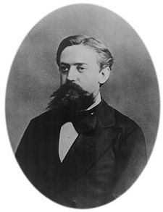
Markov Assumption
Simplifying assumption:
Or maybe
Andrei Markov

Slide 44
Markov Assumption
In other words, we approximate each component in the product

Slide 45
Simplest case: Unigram model
Some automatically generated sentences from a unigram model
fifth, an, of, futures, the, an, incorporated, a, a, the, inflation, most, dollars, quarter, in, is, mass
thrift, did, eighty, said, hard, 'm, july, bullish
that, or, limited, the

Slide 46
Bigram model
Condition on the previous word:
texaco, rose, one, in, this, issue, is, pursuing, growth, in, a, boiler, house, said, mr., gurria, mexico, 's, motion, control, proposal, without, permission, from, five, hundred, fifty, five, yen
outside, new, car, parking, lot, of, the, agreement, reached
this, would, be, a, record, november

Slide 47
N-gram models
We can extend to trigrams, 4-grams, 5-grams
In general this is an insufficient model of language
because language has long-distance dependencies:
“The computer which I had just put into the machine room on the fifth floor crashed.”
But we can often get away with N-gram models

Slide 48
Language Modeling
Introduction to N-grams

Slide 49
Language Modeling
Estimating N-gram Probabilities

Slide 50
Estimating bigram probabilities
The Maximum Likelihood Estimate

Slide 51

An example
<s> I am Sam </s>
<s> Sam I am </s>
<s> I do not like green eggs and ham </s>

Slide 52
More examples: Berkeley Restaurant Project sentences
can you tell me about any good cantonese restaurants close by
mid priced thai food is what i’m looking for
tell me about chez panisse
can you give me a listing of the kinds of food that are available
i’m looking for a good place to eat breakfast
when is caffe venezia open during the day

Slide 53
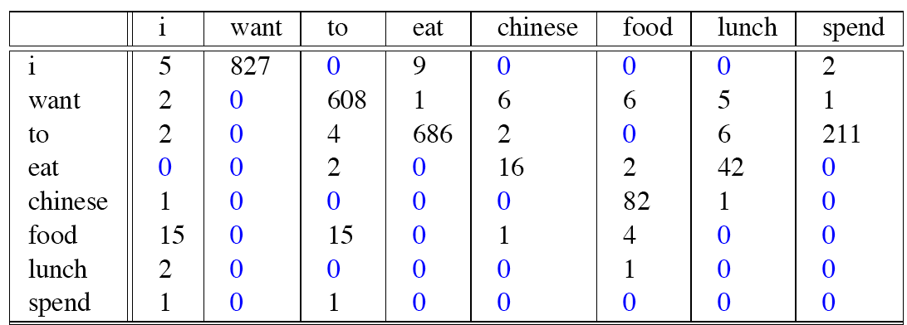
Raw bigram counts
Out of 9222 sentences

Slide 54
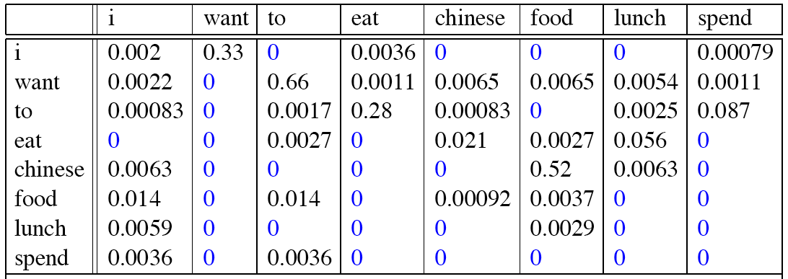
Raw bigram probabilities
Normalize by unigrams:
Result:

Slide 55
Bigram estimates of sentence probabilities
P(<s> I want english food </s>) =
P(I|<s>)
× P(want|I)
× P(english|want)
× P(food|english)
× P(</s>|food)
= .000031

Slide 56
What kinds of knowledge?
P(english|want) = .0011
P(chinese|want) = .0065
P(to|want) = .66
P(eat | to) = .28
P(food | to) = 0
P(want | spend) = 0
P (i | <s>) = .25

Slide 57
Practical Issues
We do everything in log space
Avoid underflow
(also adding is faster than multiplying)

Slide 58
Language Modeling
Estimating N-gram Probabilities

