Slide 1
nyc_citi_bike_challenge_tab
File created on: 9/19/2022 3:17:57 PM

Slide 2
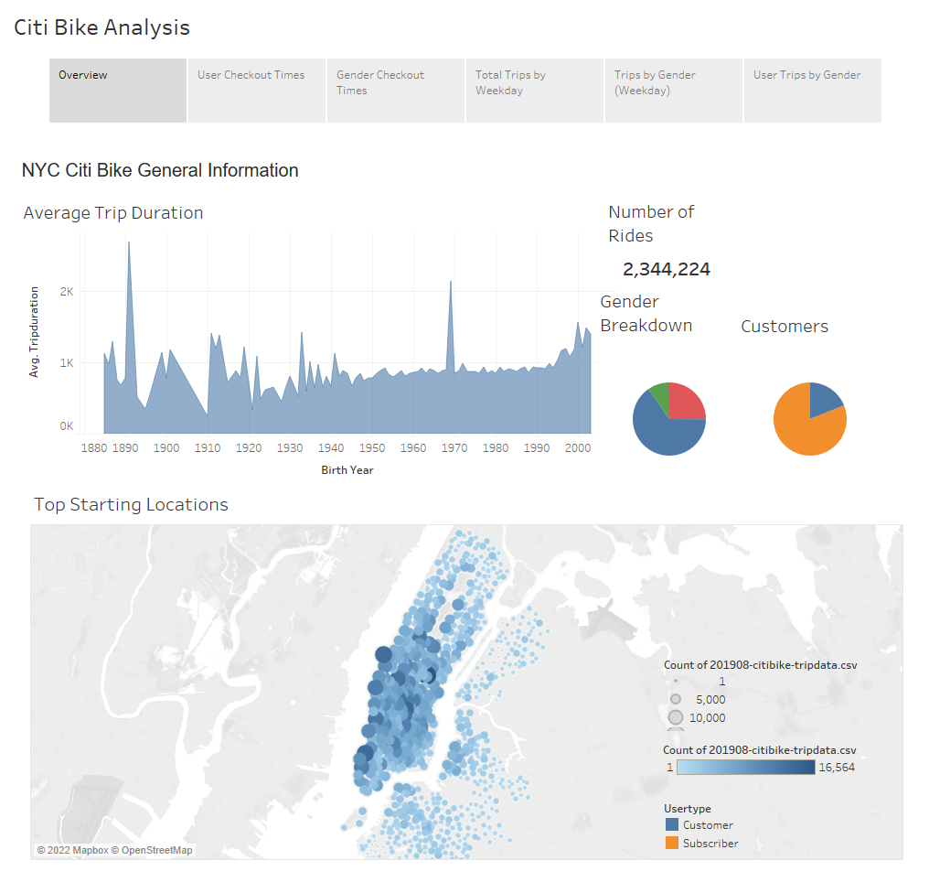

Slide 3
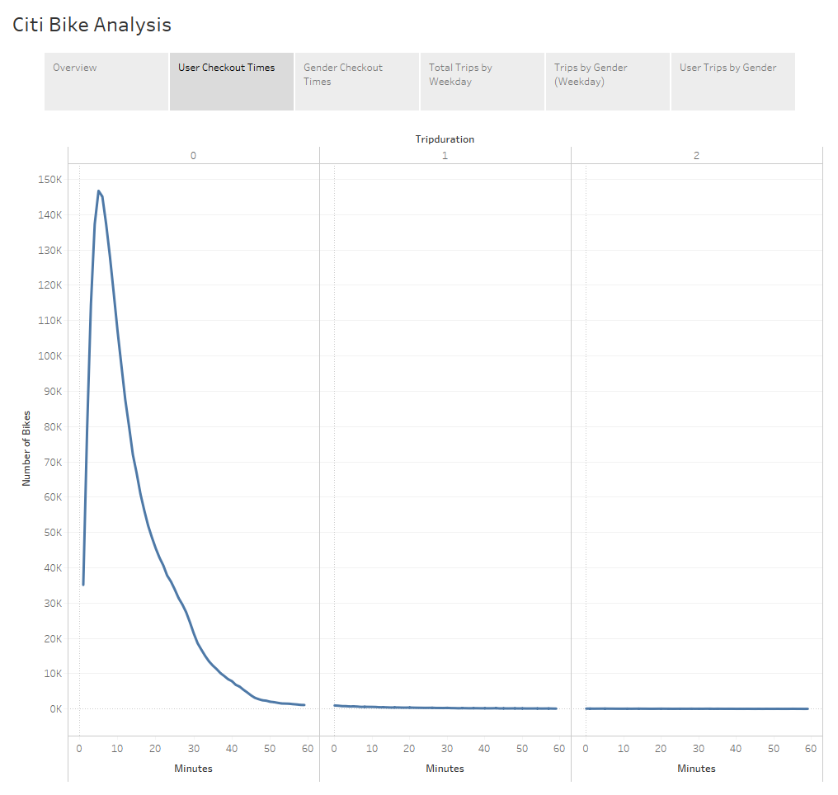

Slide 4
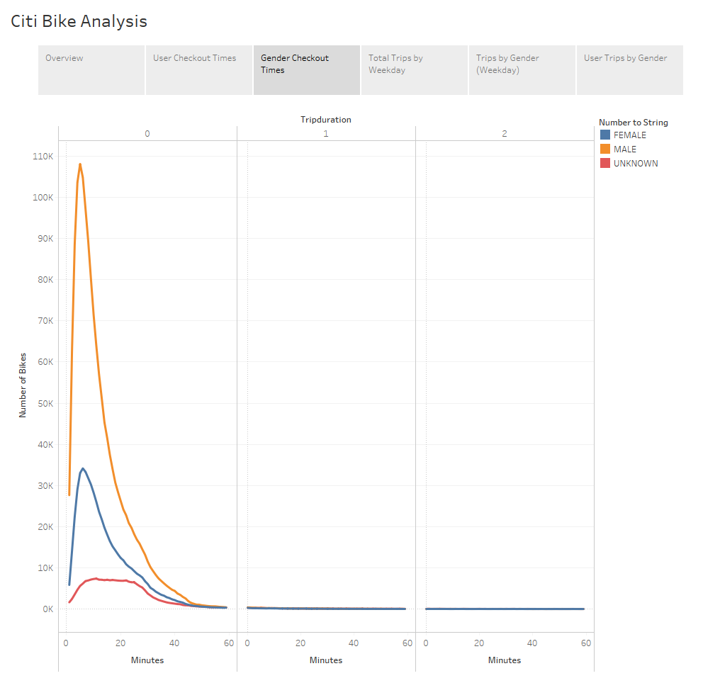

Slide 5
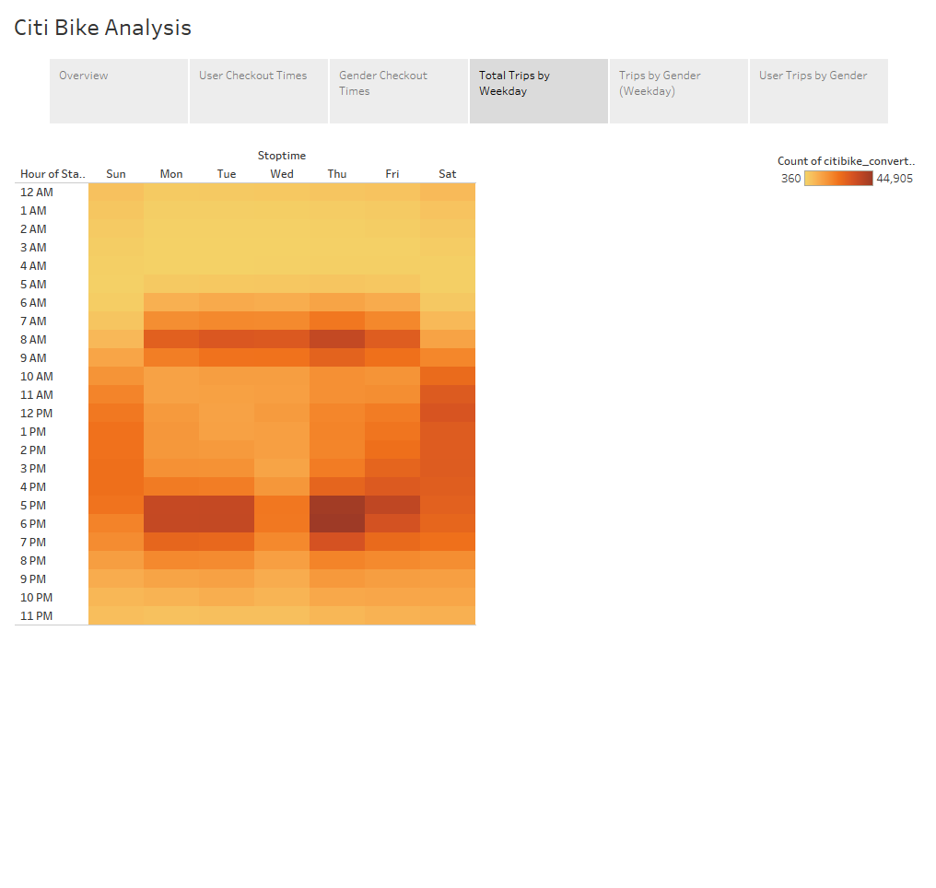

Slide 6
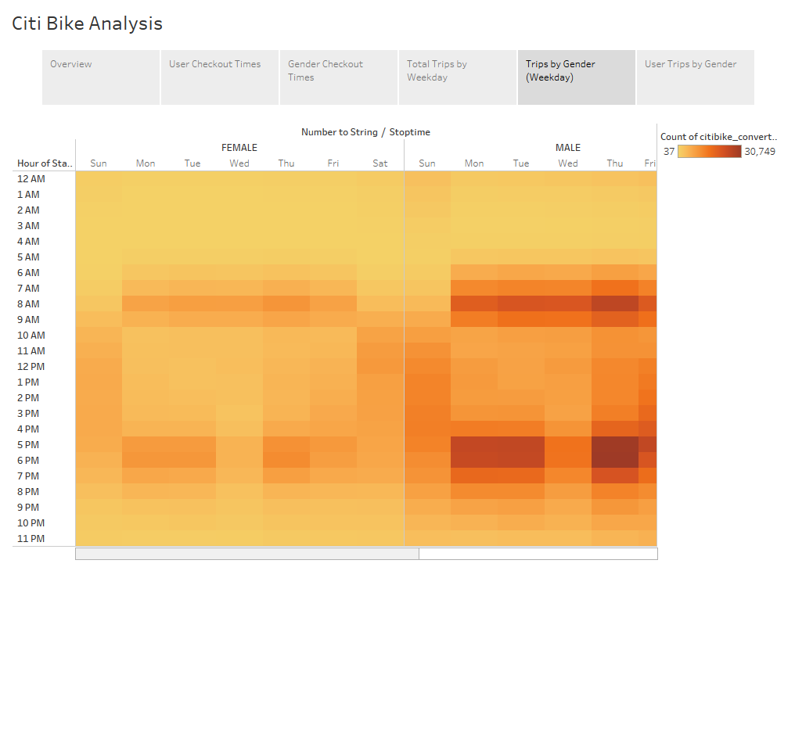

Slide 7
