Slide 1
Research and application of protein function prediction algorithms
Hancheng Liu
2024.07.11
Notes:
Good morning everyone, my name is [your name] and I am a PhD student. I am pleased to have the opportunity to work with you all on this project over the next two weeks.

Slide 2
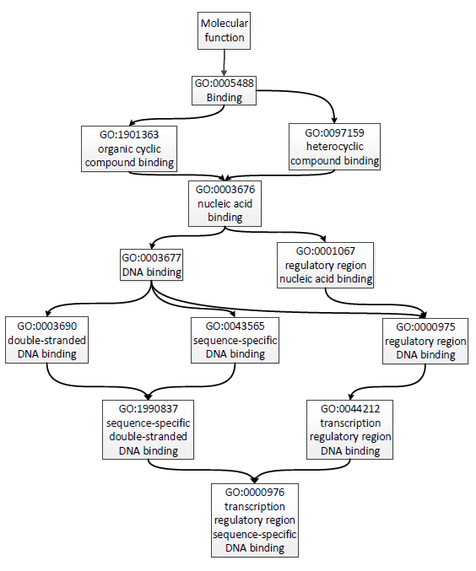
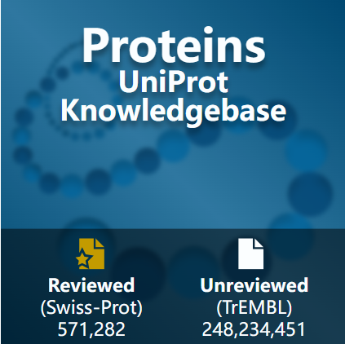
Background
Significance：
Elucidating disease mechanisms
Designing proteins and drugs.
Gene Ontology (GO)
Challenges：
Protein sequences: over 200 million.
Proteins with experimentally annotated functions: around 200,000.
The gap between the growing number of protein sequences and limited known functional annotations.
Notes:
First I will introduce the background of this project， In contemporary biological and medical research, understanding protein function is crucial for elucidating disease mechanisms and designing proteins and drugs. As shown on the right, Gene Ontology (GO) provides a structured and comprehensive framework to describe these functions. However, with the rapid expansion of sequence databases, many proteins lack detailed experimental annotations, so high-performance function prediction algorithms must be designed to fill the gap between the growing number of protein sequences and limited known functional annotations.

Slide 3
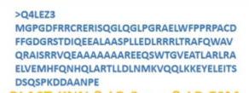
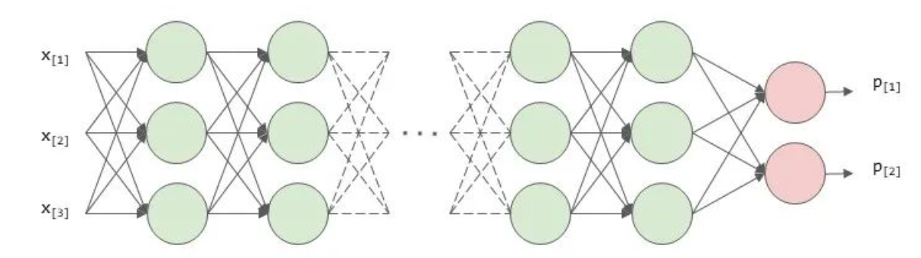
Multi-label classification
Input
Model
Output
GO:0005515
GO:0031490
...
label [1, 1, ..., 0]
encoding
loss
[1.4, 0.8, 0.3..., 1.5, 1.8]
output [0.6, 0.8, ..., 0.2]
···
Notes:
Protein function prediction can be viewed as a multi-label classification problem. First, we see the "input module", here is the amino acid sequence of a protein with id Q4LEZ3, each amino acid sequence is unique, just like the fingerprint of each person. We can use some methods to encode the amino acid sequences of proteins into vectors, which are then fed into a neural network model. A protein may have multiple biological functions at the same time, so the "output vector" is the model's predicted probability for each biological function of the current protein. In the process of training the model, we will use the true labels to optimise the model parameters, where in the "label vector", 1 means that the current protein has the function and 0 means that it does not, and optimise the model by calculating the loss between the predicted score and the true score. Overall, protein function prediction can be simply understood as inputting a sample and outputting the predicted probability of each function for that sample.

Slide 4
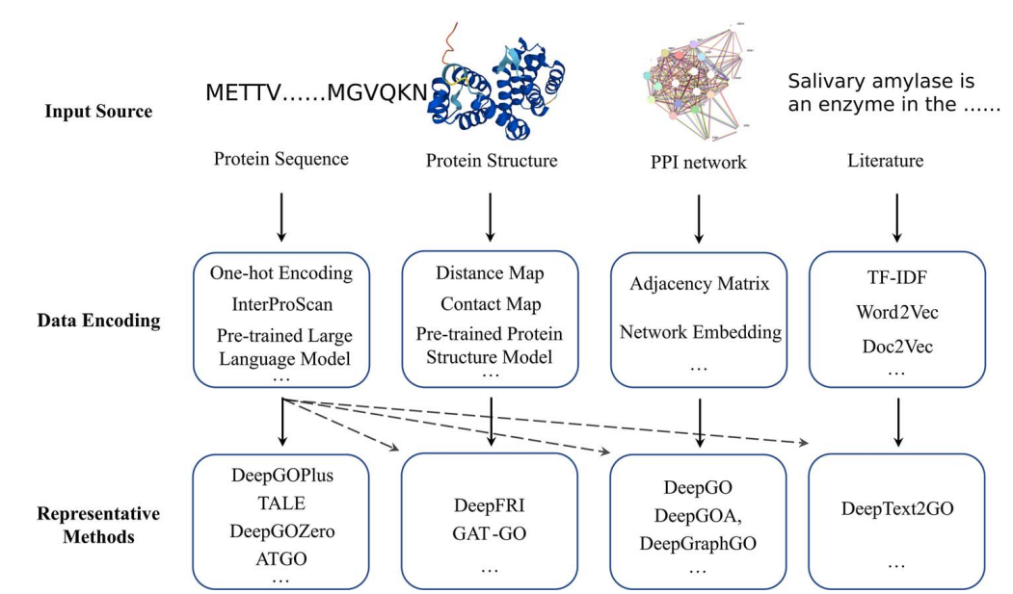
Protein function prediction methods
Wang W, Shuai Y, Yang Q, et al. A comprehensive computational benchmark for evaluating deep learning-based protein function prediction approaches[J].
Notes:
Over the past decades, research teams have developed a large number of computational methods for protein function prediction, and these methods can be summarized into four groups based on the type of biological data they use. Almost all existing methods use protein sequences as the representation of proteins, and there are other methods that try to incorporate other data about proteins, such as protein structure, protein-protein interaction networks, literature, and other information to improve the prediction performance, these different data types will be encoded in different ways to get the representation input into the model.

Slide 5
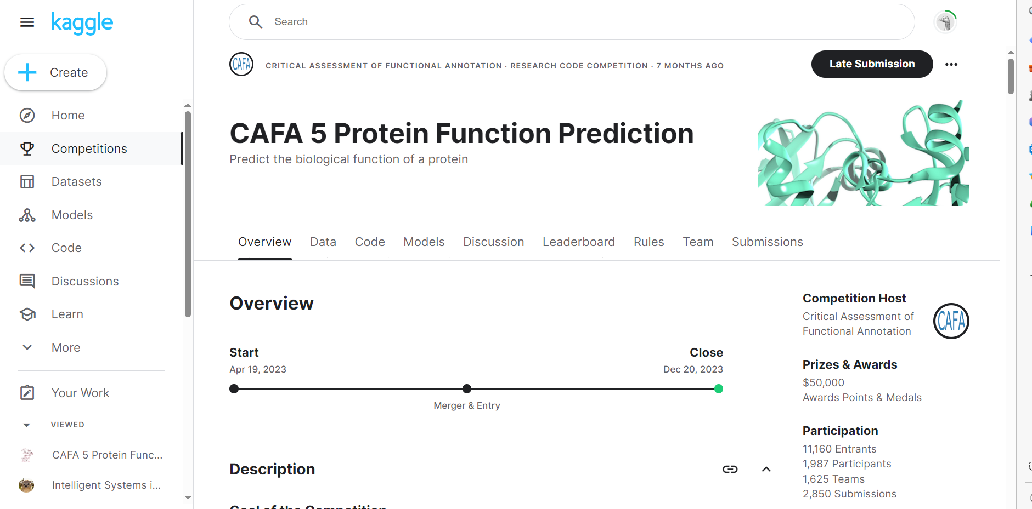
Protein Function Prediction Competition
Critical Assessment of Functional Annotation（CAFA）
Notes:
Critical Assessment of Functional Annotation (CAFA) is a protein function prediction competition, which is held roughly every three years, and the fifth competition just ended last year, but you can still submit the prediction results to assess the performance of the model, and there are also participating teams sharing their experience, so you can pay attention to it if you are interested.

Slide 6
Project Planning
1.Literature Search and Study
3.Results Analysis and Discussion
Learn the basic methods and latest research progress in protein function prediction
Evaluate model performance using test data
Analyze experimental results
2.Model Selection and Training
4.Project Summary and Report Writing
Discuss and select suitable predictive models
Train models
Summarize project outcomes and lessons learned
Write the project report, prepare presentation materials

Slide 7
Let's Make This Project a Success Together!
Liu Hancheng
23110850049@m.fudan.edu.cn
Notes:
We welcome any questions you may have

