Slide 1
Naive Algorithm in Context of Protein Function Prediction (PFP)
Definition: The Naive algorithm predicts protein functions based only on the relative frequency of Gene Ontology (GO) terms in training dataset. It doesn't incorporate sophisticated methods or optimizations.
Context: Used as one of the component methods in ensemble models for PFP, serving as a benchmark for more advanced algorithms.

Slide 2
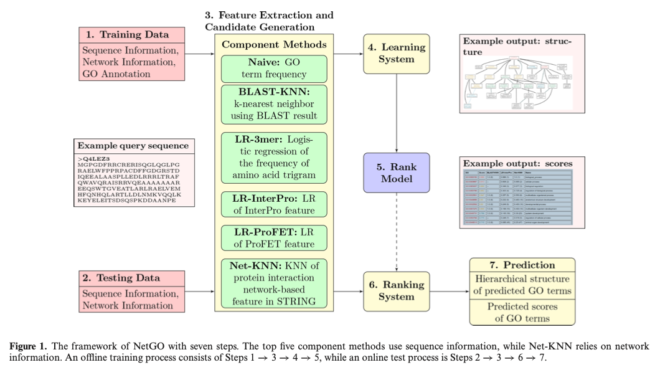
Naive Algorithm in Context of Protein Function Prediction (PFP)
Functionality: Naive algorithm assigns GO terms to proteins based on their frequency in the dataset.
→For a given protein Pj and a GO term Gi, the score S(Gi, Pj) is calculated as the relative frequency of Gi​ in the training data.
Examples of Use: In studies like NetGO, the Naive algorithm is integrated as a baseline method among other advanced techniques such as BLAST-KNN, LR-3mer, LR-InterPro, and LR-ProFET​(You 等 - 2019 - NetGO)​.

