Slide 1

Smart phone
- Albandari Alshudukhi
-Sultan Alharbi
- Essa Alhammad

Slide 2

Table of content
1-data set
2-The Libraries we used
3-Cleaning data set
4-EDA

Slide 3
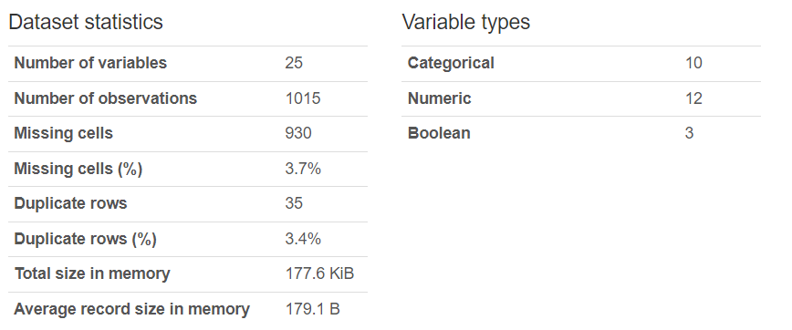
data set
The dataset we used is called the smartphone dataset and can be found on the Kaggle platform.

Slide 4

The Libraries we used:
Numpy: For numeric operations.
Pandas: For data cleaning and manipulation.
Matplotlib: For visualizations.

Slide 5


Cleaning data set
1.Remove Unwanted Columns.
2. Remove duplicates
3.Remove null values for string column
4. Replace the null values with mean for Numeric Column

Slide 6
EDA

Slide 7
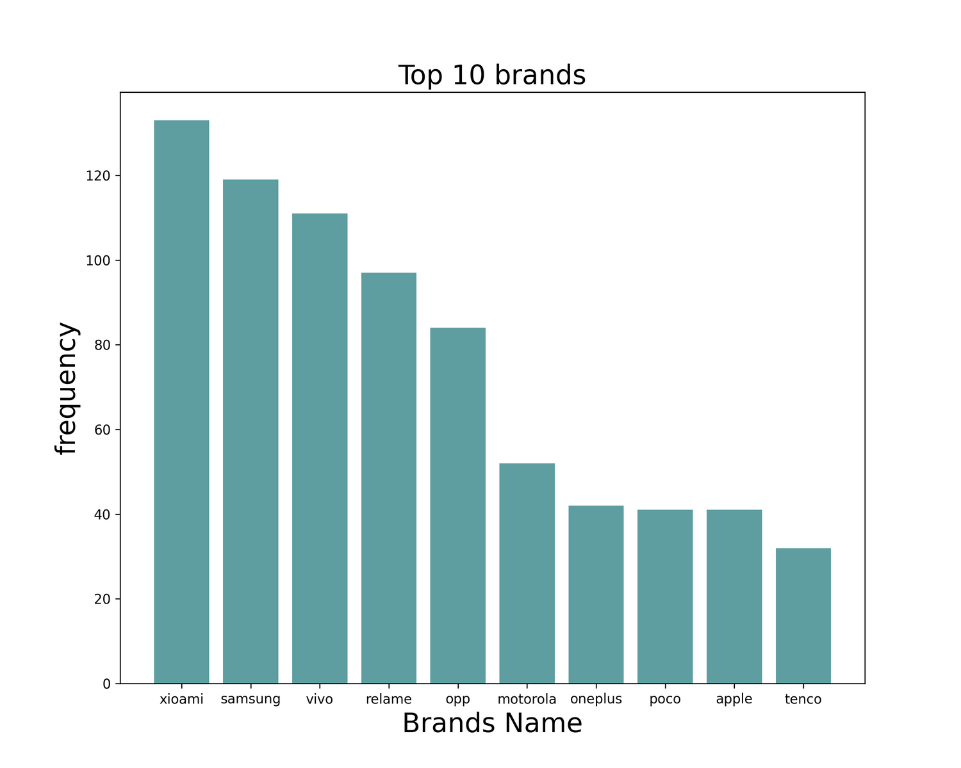
What are the 10 most frequent Brands?

Slide 8
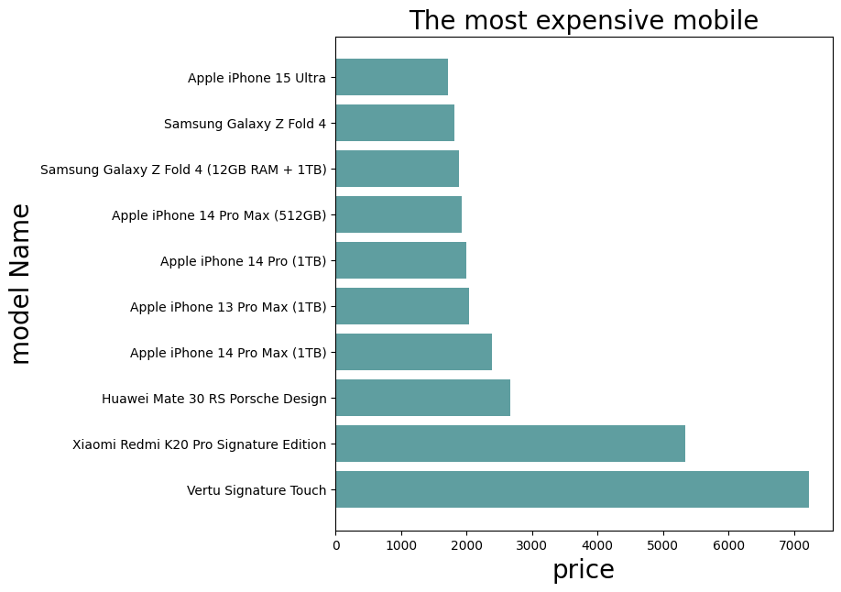
What are the 10 most expensive Models?

Slide 9
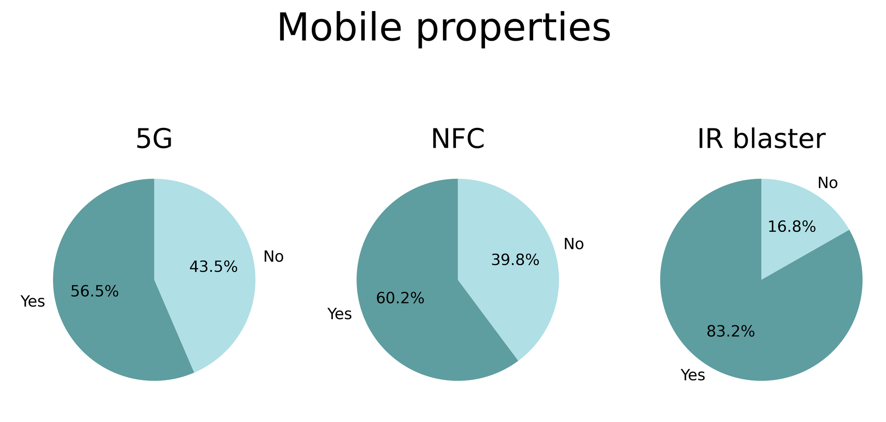
What are the percentages of Smart phones that support 5G & NFC &IR blaster?

Slide 10
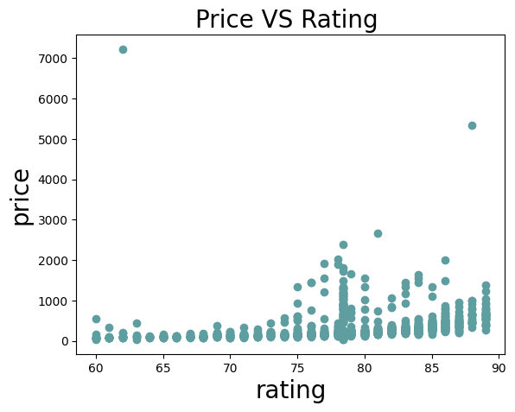
is there a correlation between Price and Rating ?

Slide 11
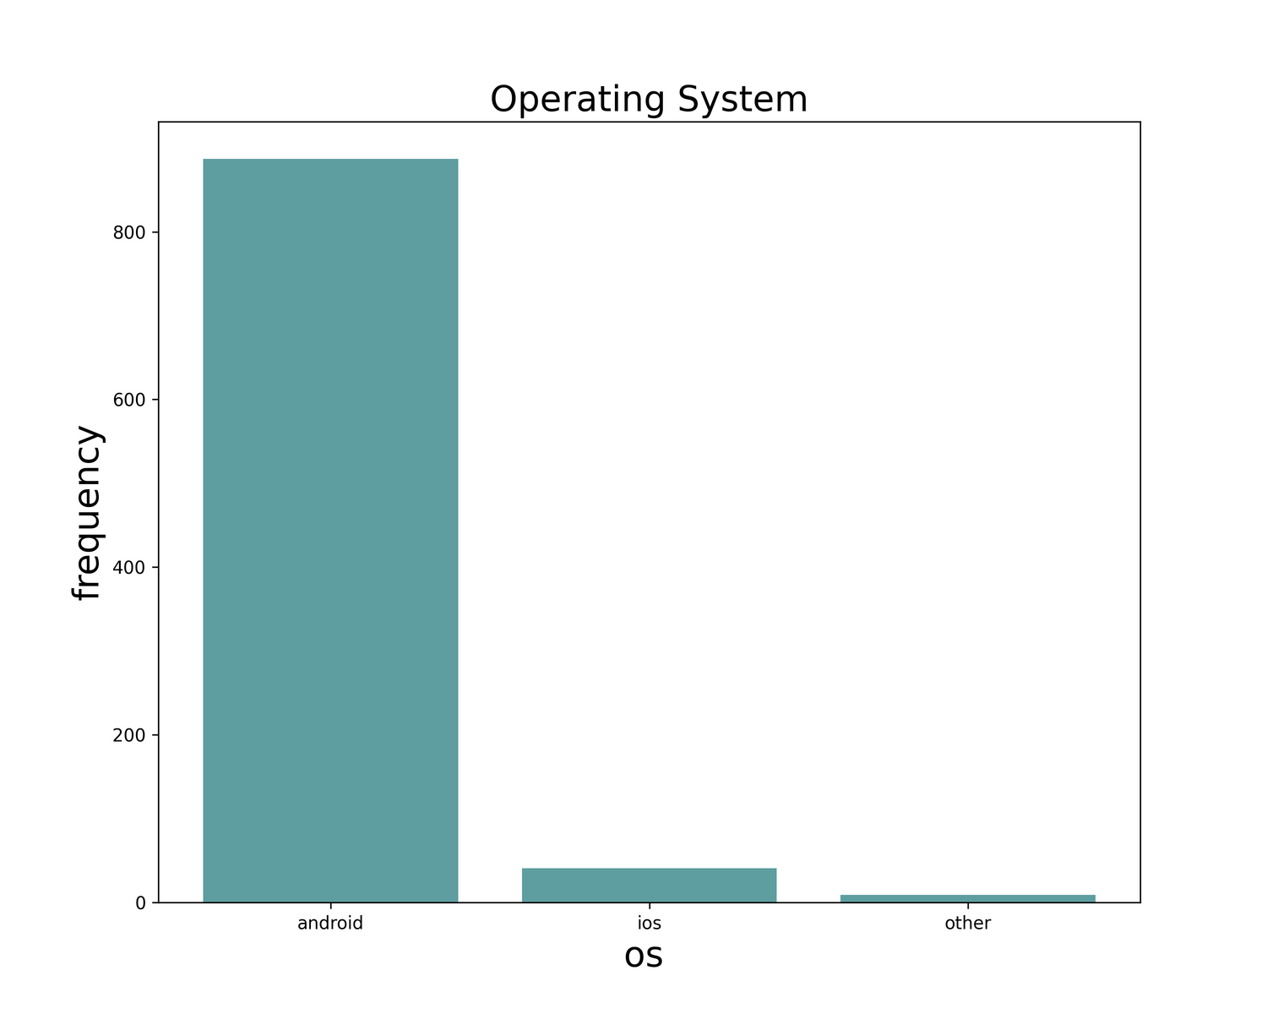
What is the most frequent operating system?

Slide 12
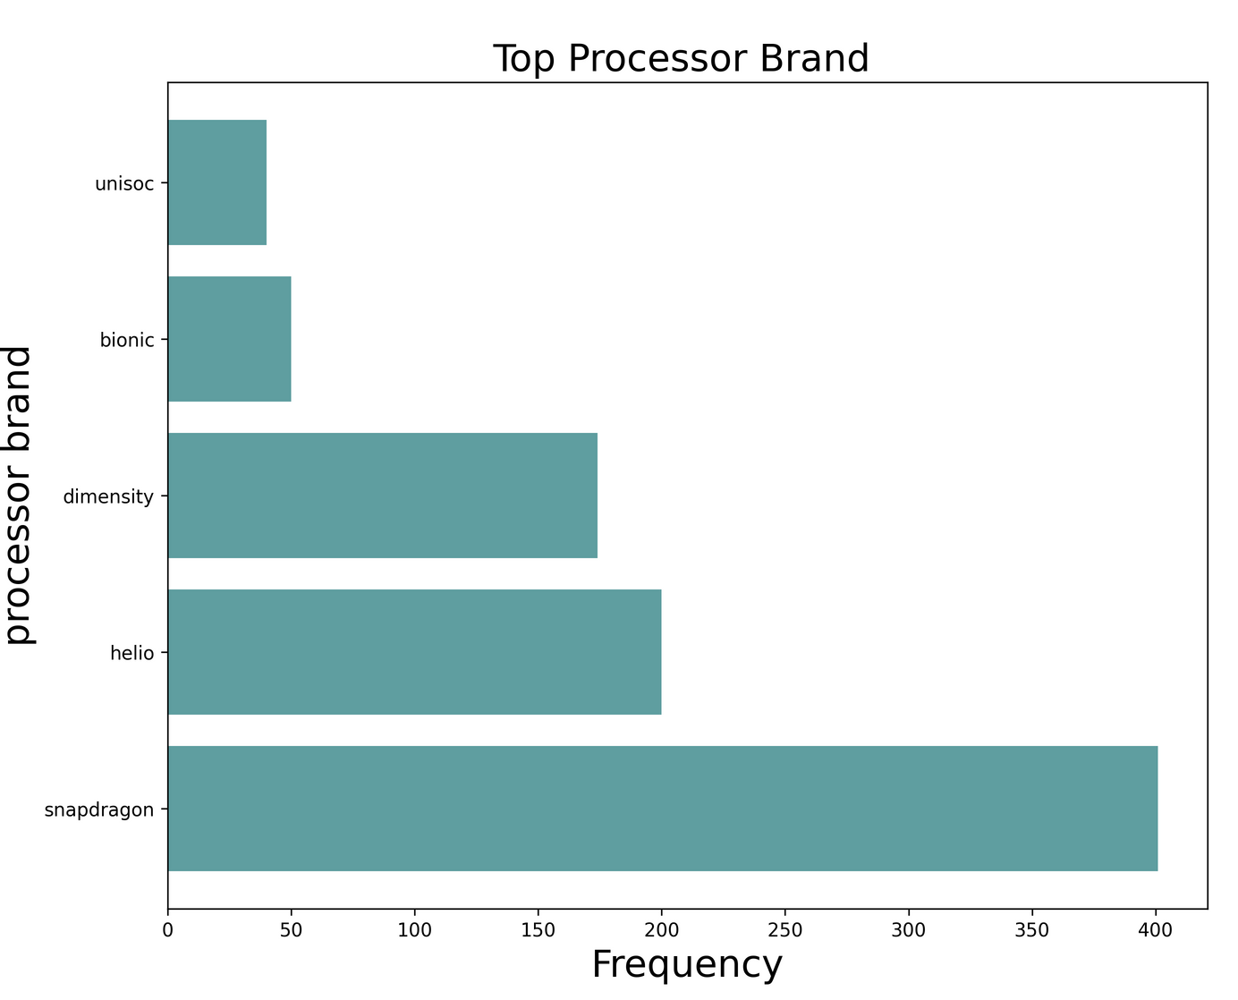
what is the Top 5 Processors Brand?

Slide 13
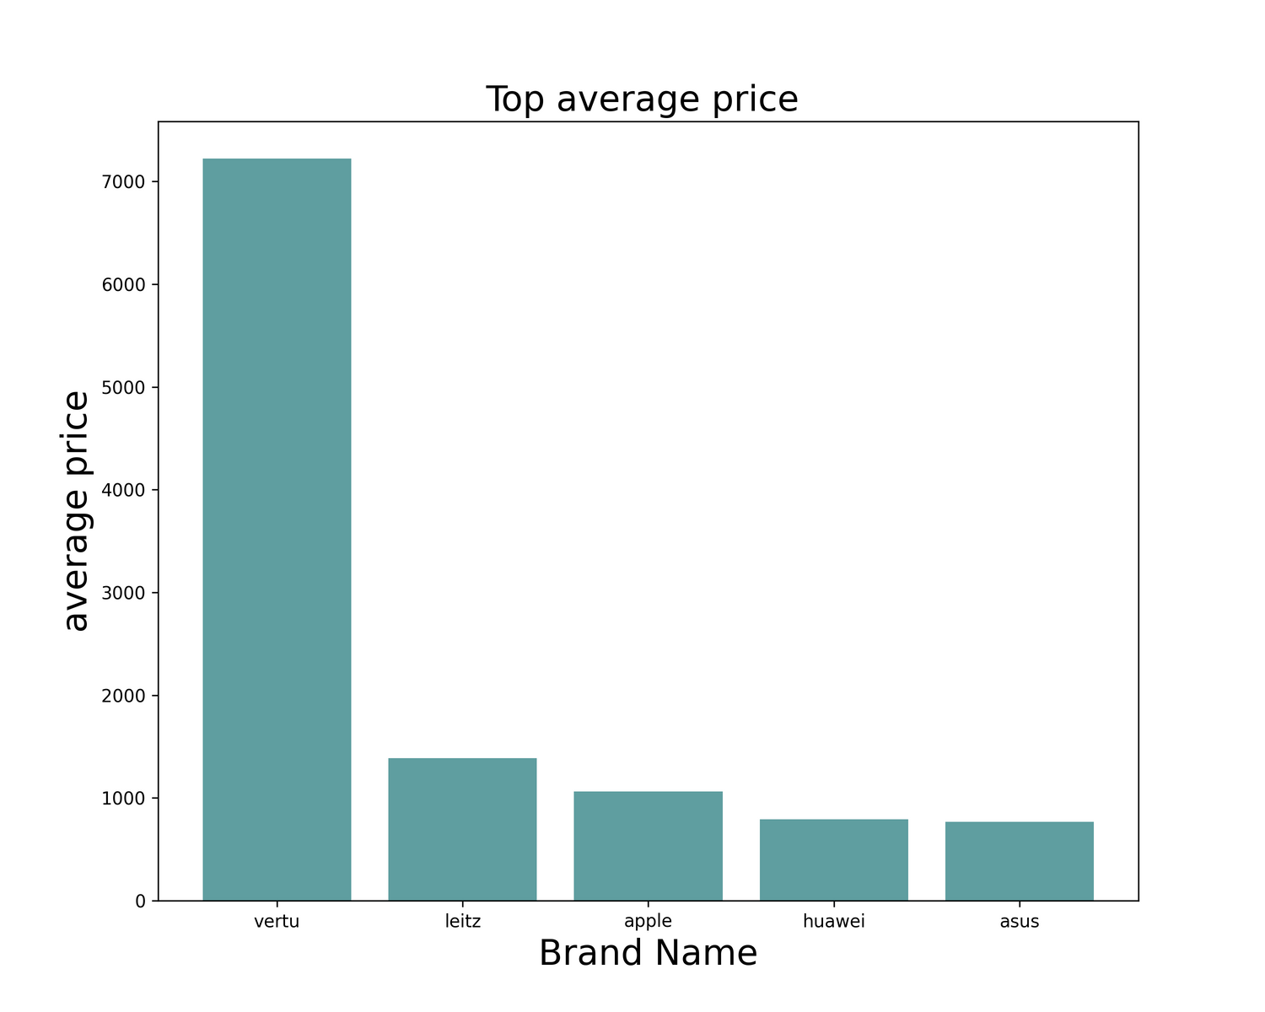
What are the top 5 companies in average prices?

Slide 14
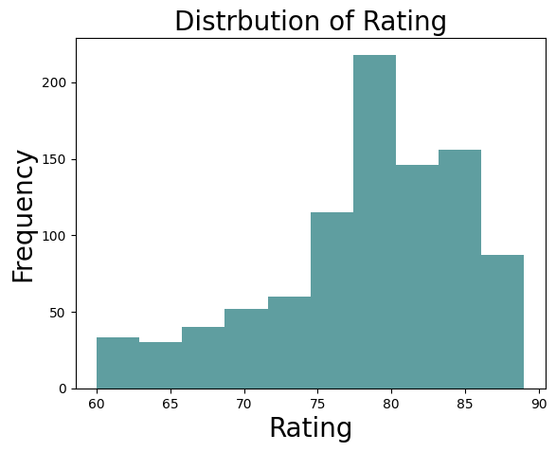
How is the Rating distributed in the data?

Slide 15
THANK YOU

