Slide 1

Azure Files and File Sync
Nathan Swift
Azure Specialist

Slide 2
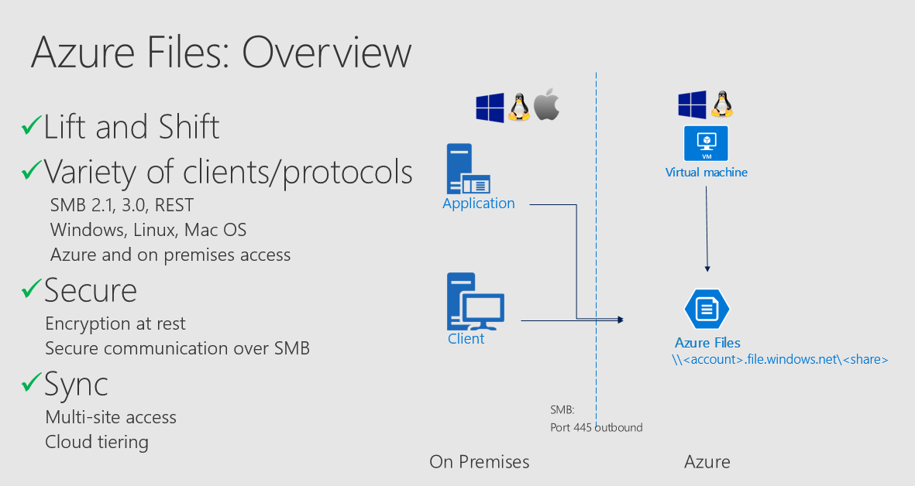

Slide 3
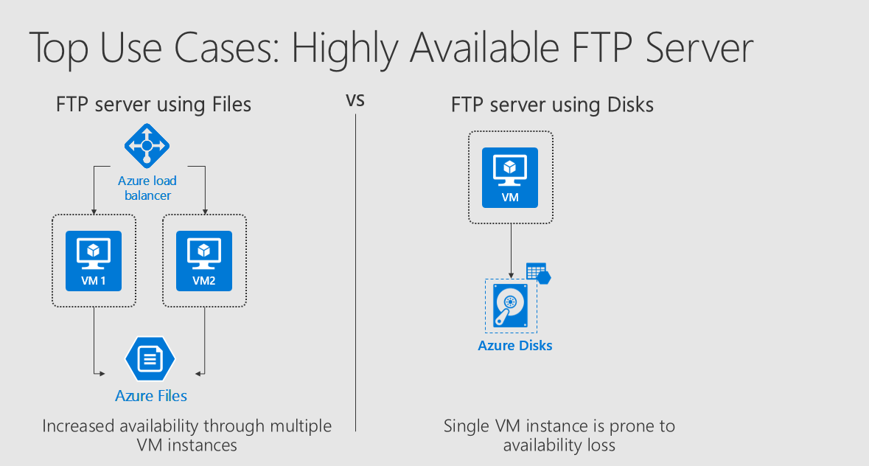
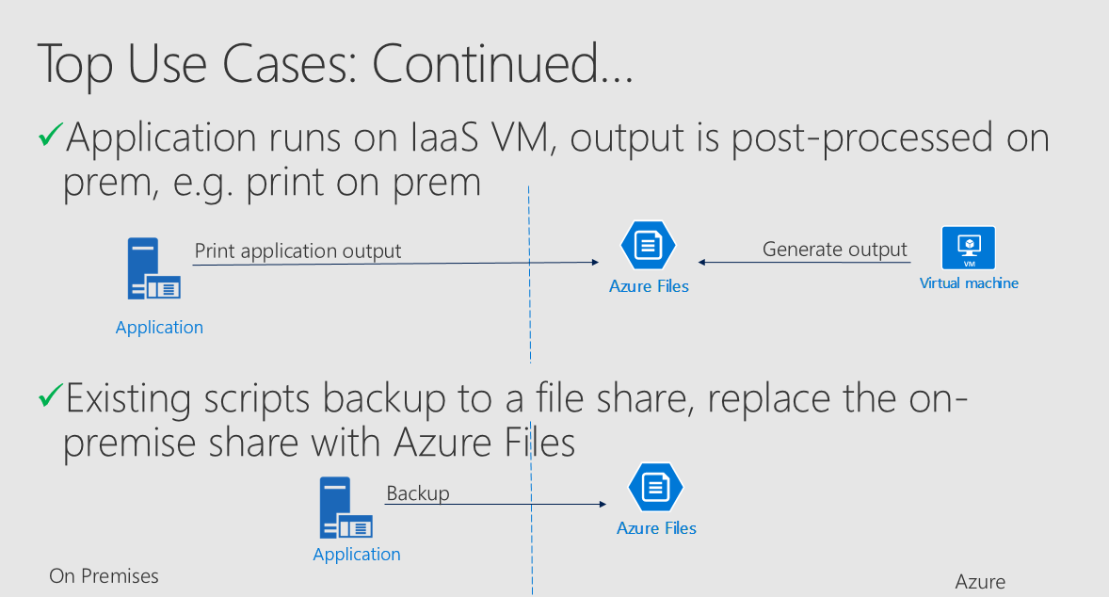

Slide 4
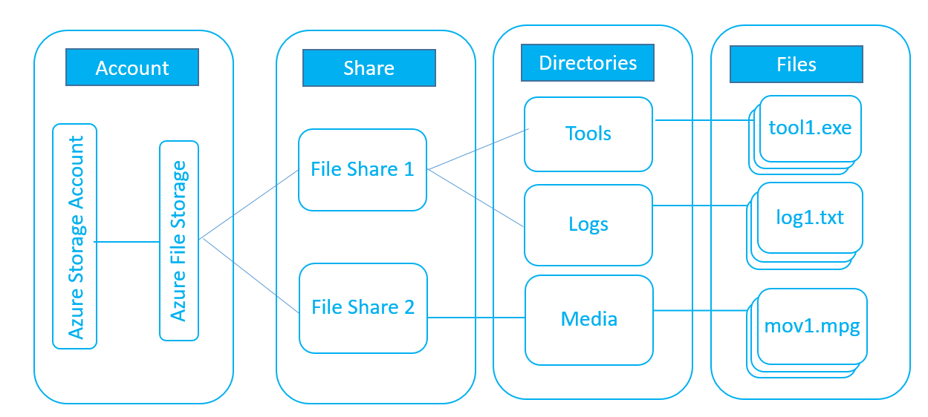
Azure File Structure

Slide 5
Planning for Azure File
Limits
5 TB per share (100TB in private preview)
500TB per storage account
Data Access Method
Direct access
Direct network mount for Windows, Linux, or MAC
REST API or Client API
Azure File Sync

Slide 6
Security
HTTPS for data in transit
AES 256 data encryption at rest
Enabled by default on new file data in storage account
MSFT managed or BYOK in Preview
Shared Storage Signature
Virtual Network Service Endpoint

Slide 7
Data Management
Getting the data to Azure file
Azcopy
Robocopy
Azure File Sync
Azure File Share Snapshot (Public Preview)
Backup with Recovery Services Vault

Slide 8
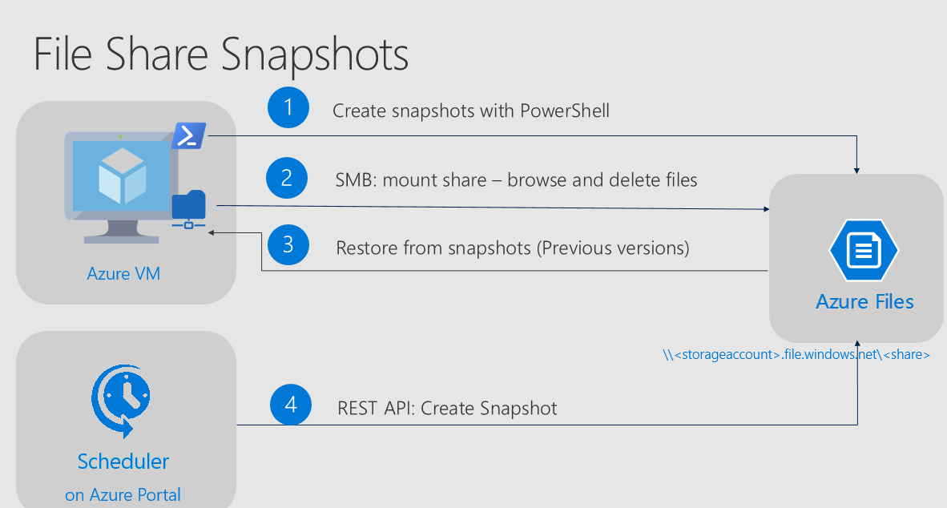

Slide 9
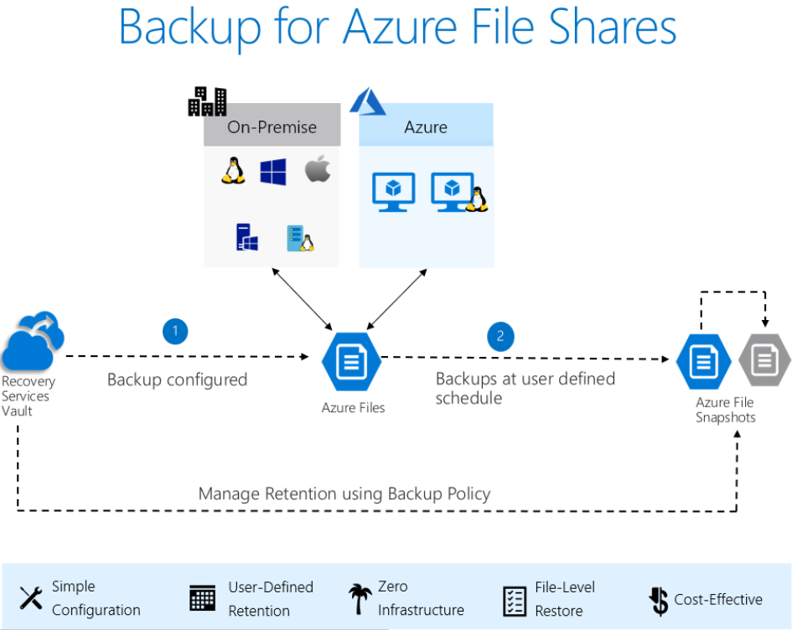

Slide 10
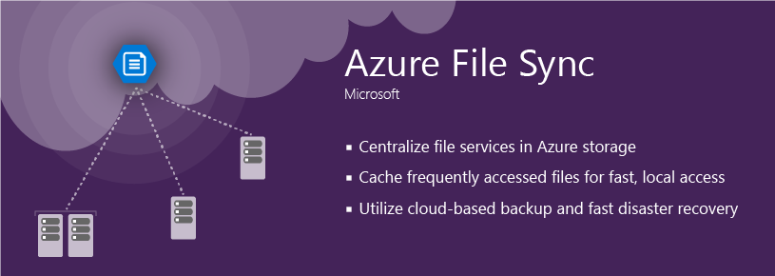
Azure File Sync (Public Preview)
New capability of Azure Files - allows customers to easily sync existing directories and files from Windows Server 2012R2 and 2016 to Azure Files.
Multi-site sync and access – Sync between Azure File Shares and Windows Servers and your branch offices.
Cloud tiering (server becomes cache) – Servers low on capacity can benefit from cloud-tiering feature. Less recently used data removed from the local server and recalled when used.
Integrated server data backup –File Sync works with Azure Backup to provide integrated backup and restoration.
Direct cloud data access – Moving a workload (lift and shift) can be done with sync to allow both on premise and cloud access to the same data during the migration.
Notes:
https://azure.microsoft.com/roadmap/azure-file-sync/
https://azure.microsoft.com/en-us/blog/announcing-the-public-preview-for-azure-file-sync/
Microsoft Azure File Sync: https://www.youtube.com/watch?v=r26jWDGF_rg
Azure File Sync Public Preview Field Announcement
Azure File Sync is a new capability of Azure Files that allows customers to easily synchronize existing directories and files from Windows Server 2012R2 and 2016 to Azure Files. The public preview blog announcement will be released on September 25th. See for blog post. Azure File Sync provides the following scenarios to our customers:
Multi-site sync and access – Azure File Sync synchronizes between Azure File Shares and Windows Servers. Customers with branches that require the same files to be accessed across these servers can use Azure File Sync to keep them consistent via a fully managed cloud service.
Cloud tiering (server becomes cache) – Servers that are low on capacity can benefit from Azure File Sync cloud-tiering feature where less recently used data is removed from the local server and then recalled when an application or user accesses the file. This allows the local server to provide the same application compatibility and performance while increasing the storage capacity and simplifying management.
Integrated server data backup – Azure File Sync works with Azure Backup to provide integrated backup and restoration. In the example of a branch office deployment instead of backing up each branch office file server, instead, use Azure Backup to backup the Azure File Share to safeguard the data. Azure File snapshots are supported where an entire share or a specific file version can be retrieved for point-in-time recovery.
Direct cloud data access – Moving a workload (lift and shift) can be done with sync to allow both on premise and cloud access to the same data during the migration. This can allow portions of the workload to be moved into the cloud.
Public Preview Structure
The Azure File Sync public preview will launch in US West, West Europe, Southeast Asia, and Australia East. After public preview launch we will add other public regions based on demand. The public preview launches with the following restrictions:
Cloud-Cloud sync is not supported but is being developed. Cloud to cloud sync allows 2 or more Azure File shares to also be in the same sync group. One common use case would be to provide a new type of replication across regions that offers read/write access to multiple regions. A second use case would be to optimize a replication latency where servers exist in multiple regions.
Azure Files LRS and GRS is supported. GRS will provide a copy of the data that can be used in the case of region failover. Should a region failover occur, the Azure File Sync deployment would have to be recreated using the ‘copy’ of the data from the backup region.
Current limits for Azure File Sync (if any of these are blocking, please do contact xsyncpm@microsoft.com as these will increase through time)
Storage Sync Service objects per subscription: 15
Sync Groups per Storage Sync Service: 30
Registered Servers per Storage Sync Service: 100
Cloud Endpoints per Sync Group: 1
Server Endpoints per Sync Group: 100
Items (files & directories) per Sync Group: 4M
Max File Size: 500GB

Slide 11
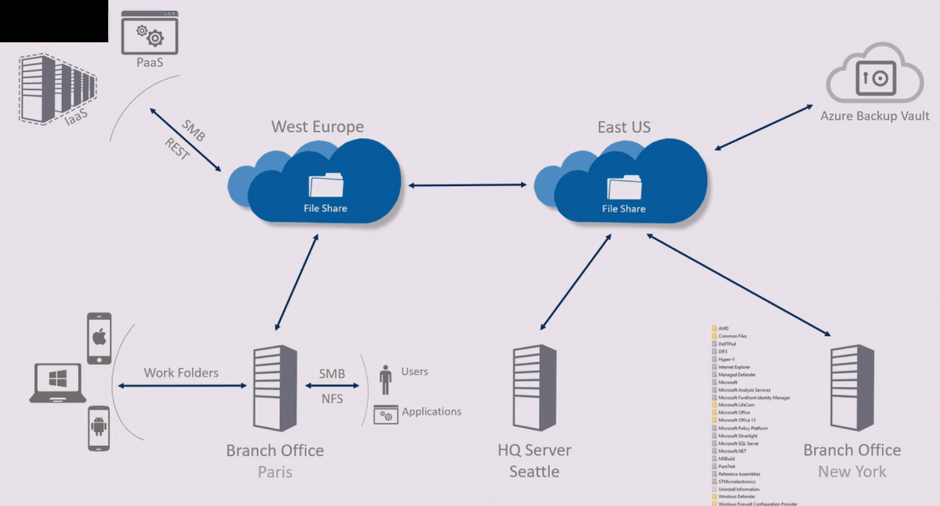
Notes:
Caveats: Synchronization between 2 Azure File locations not available, will GA at EOY | Azure Backup integration NA will be AT EOY, Consider Snapshots

Slide 12
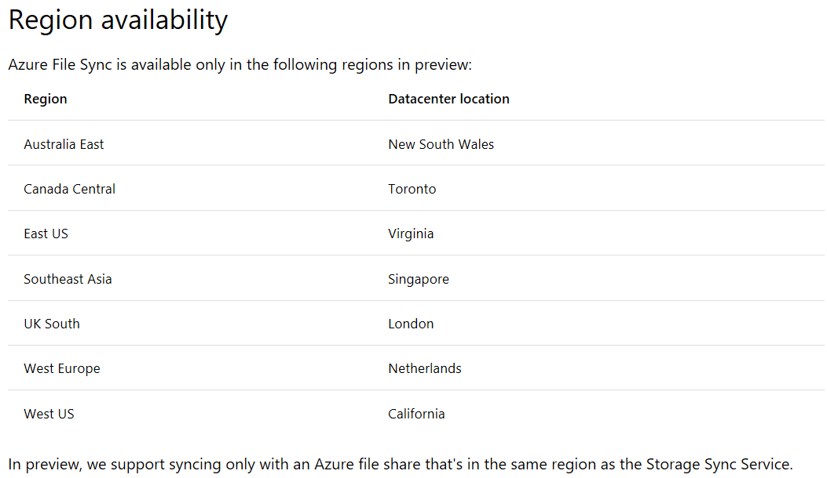

Slide 13
Pre Reqs on Azure File Sync
Windows Server: 2012 R2 or Server 2016
PowerShell 5.1 or Higher (Server 2016 has this)
Install-Module AzureRM on File Server
NTFS only

Slide 14
Other Considerations for Azure File Sync
Bandwidth to Internet from server endpoints
E.g. 50Mbits per second ~= 5 Mbytes per second
Allocate enough capacity on server endpoint to absorb peak changes
Throttle bandwidth for AFS with Powershell
Tiering based on last read
On-prem backup/anti virus software could rehydrate tiered files
Remove all components from Azure portal before uninstalling AFS agent

Slide 15
Read \ Experiment in Azure \ Deploy to Prod
WHY: Azure Files - https://docs.microsoft.com/en-us/azure/storage/files/storage-files-introduction#why-azure-files-is-useful
PLAN: For using Azure File Sync - https://docs.microsoft.com/en-us/azure/storage/files/storage-sync-files-planning
CONSIDER: Devil can be in the details please familiarize - https://docs.microsoft.com/en-us/azure/storage/files/storage-files-faq
CONSIDER: Another good article on considerations to Azure File Sync - http://windowsitpro.com/microsoft-azure/faqs-diving-new-azure-files-sync-capability
EXPERIMENT: Azure make a great place to test this out, spin up a Azure VM Windows Server 2016, create a file share, and put some documents and data in it. Deploy Azure Files and Azure File Sync and experiment. Once you're comfortable
EXPLORE: Azure File SnapShots - https://docs.microsoft.com/en-us/azure/storage/files/storage-how-to-use-files-snapshots
DEPLOY: Begin Deployment into a Pilot in production and expand https://docs.microsoft.com/en-us/azure/storage/files/storage-sync-files-deployment-guide
MISC:
Windows 10 - WorkAround \ WorkFolder - https://docs.microsoft.com/en-us/windows-server/storage/work-folders/work-folders-overview - https://feedback.azure.com/forums/217298-storage/suggestions/17879224-mobile-client-for-azure-files

Slide 16

DEMO

Slide 17
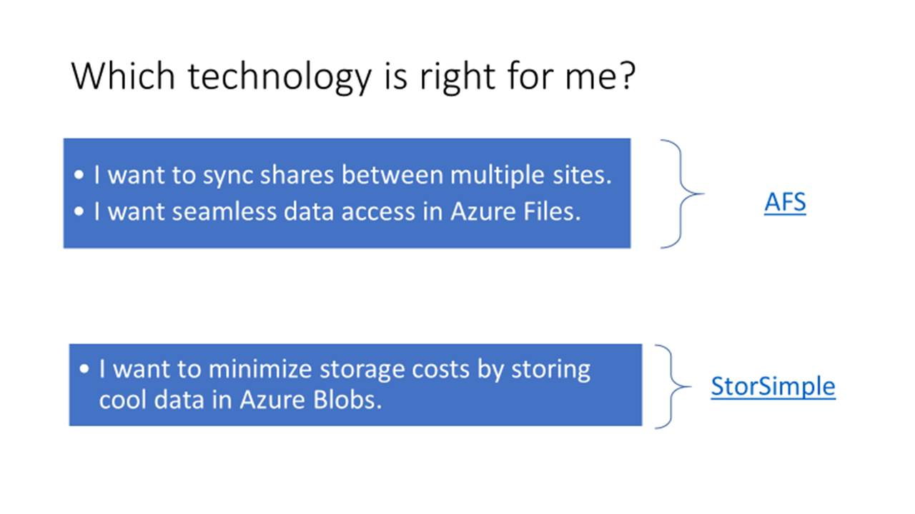

Slide 18
