Slide 1

Image from http://fc06.deviantart.net/fs71/f/2012/346/f/d/blueprint_3d_iphone_5_by_dracu_teufel666-d5nsnqe.jpg
Comparison of Open Source
Databases in Completing Common Queries
JUSTIN ALBANO • STEPHEN JONES • DOMINICK TOURNOUR

Slide 2
PERFORMANCE ANALYSIS
Albano, Jones, Tournour
Introduction
Project Overview
Team Members
Purpose and goal of analysis
Background information
Justin Albano
Stephen Jones
Dominick Tournour
Individual Comparisons
Graph database
NoSQL database
SQL database
Group Comparison
Group analysis and results
Alternative methods & conclusions
Embry-Riddle Aeronautical University

Slide 3
PERFORMANCE ANALYSIS
Albano, Jones, Tournour
Introduction
Purpose & Goals
Analyze a group of databases from each major category of databases in use today
Select the best from each group and then compare them head-to-head
Neo4j
Graph analysis
OrientDB
Redis
NoSQL analysis
Group analysis
“best” database
“best” databases
MongoDB
MySQL
SQL analysis
PostgreSQL
Embry-Riddle Aeronautical University

Slide 4
PERFORMANCE ANALYSIS
Albano, Jones, Tournour
Introduction
Design of Experiments
The specifics of the analysis for each database category varied, but some commonalities exist:
Use of algorithms common to the use cases of each domain
Generally read-intensive algorithms
Both algorithm, and the data set on which the algorithms were executed, varied
Scope & Constraints
All selected databases are open source
Allows the analyst to obtain a free version
Allows the analyst to see details that would otherwise be hidden
Embry-Riddle Aeronautical University

Slide 5



PERFORMANCE ANALYSIS
Albano, Jones, Tournour
Individual Comparisons
Graph Database
Selected databases:
Neo4j
OrientDB
A
C
Property Graphs
A graph containing nodes and edges
Nodes contain properties (key-value pairs)
Relationships contain properties
Relationships are named and directed, originating and terminating at a node
$$a$$
B
D
Embry-Riddle Aeronautical University

Slide 6
PERFORMANCE ANALYSIS
Albano, Jones, Tournour
Individual Comparisons
Selected Queries
Friend-of-friends: obtain all the friends of a single person in the database, repeated for every person
Get property: obtain a single property from each node in the graph, similar to obtaining the name of each person in the database
Friends
Friends-of-Friends
C
E
A
B
D
Embry-Riddle Aeronautical University

Slide 7
PERFORMANCE ANALYSIS
Albano, Jones, Tournour
Individual Comparisons
Conceptual Data Sizes
Actual Data Sizes
Node count Relationships
Node count Relationships
1,000 maximum 50 per node
10,000 maximum 50 per node
100,000 maximum 50 per node
1,000,000 maximum 50 per node
1,000 10,009
10,000 100,486
100,000 1,001,176
1,000,000 10,015,575
Neo4j
Data set generator
Implementation-agnostic data set
OrientDB
Embry-Riddle Aeronautical University

Slide 8
PERFORMANCE ANALYSIS
Albano, Jones, Tournour
Individual Comparisons
Results
Neo4j was only able to a create a graph using the first two data sets
OrientDB was only about to create a graph using the first three data sets
Embry-Riddle Aeronautical University

Slide 9
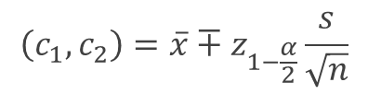
PERFORMANCE ANALYSIS
Albano, Jones, Tournour
Individual Comparisons
Results
All differences were found to be statistically significant to 95% confidence:
Pairwise comparisons were conducted
All resulting confidence intervals did not contain the value 0
$$\left(c_{1},c_{2}\right)=\overline{x}∓z_{1−\frac{α}{2}}\frac{s}{\sqrt{n}}$$
Effects of Caching
Neo4j clearly cached a large amount of data, which resulted in outliers
These outliers were not discarded, since they were valid data
Embry-Riddle Aeronautical University

Slide 10
PERFORMANCE ANALYSIS
Albano, Jones, Tournour
Individual Comparisons
Effects of Caching
Mean of remaining samples is 91.2 ms
Embry-Riddle Aeronautical University

Slide 11
PERFORMANCE ANALYSIS
Albano, Jones, Tournour
Individual Comparisons
Conclusion
Although Neo4j was not able to complete as many experiments as OrientDB, it is nonetheless the selected winner:
Although OrientDB scales better, the group comparison is in the range of small or medium data sets, thus this advantage is mute in the group comparison
In the pairwise experiments, Neo4j completely outperformed OrientDB
Selected: Neo4j
Embry-Riddle Aeronautical University

Slide 12
PERFORMANCE ANALYSIS
Albano, Jones, Tournour
Individual Comparisons
NoSQL Database
Data Models
Non-relational structure
Typically distributed system
Scale extremely well
Do not typically make ACID guarantees; instead focus on availability through BASE
Key-value Store
Document Store
Column Family
Graph Database
Selected Databases
Redis v2.8.19
MongoDB v2.4.9
Embry-Riddle Aeronautical University
Notes:
ACID = Atomicity, Consistency, Isolation and Durability
BASE = Basic Availability, Soft-state and Eventual Consistency

Slide 13
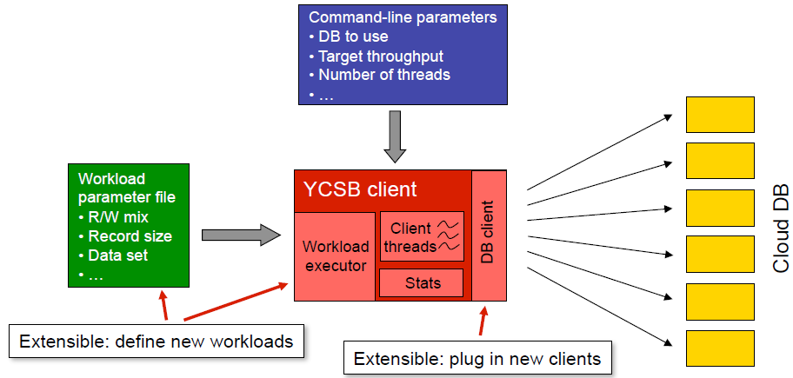
PERFORMANCE ANALYSIS
Albano, Jones, Tournour
Individual Comparisons
Yahoo! Cloud Serving Benchmark (YCSB) Tool
Automates development of consistent data sets and workloads
Widely accepted
Developed in Java language
Open-source
Highly extensible
Source: B.F. Cooper. “Yahoo! Cloud Serving Benchmark”. Yahoo! Inc. 2010. Web.
<http://labs.yahoo.com/files/ycsb-v4.pdf>
Embry-Riddle Aeronautical University

Slide 14
PERFORMANCE ANALYSIS
Albano, Jones, Tournour
Individual Comparisons
Selected Workloads
Core YCSB Workloads A, B and F
Workload | Operations | Application Example
A – Update heavy | Read: 50% Update: 50% | Session store recording recent actions in a user session
B – Read heavy | Read: 95% Update: 5% | Photo tagging; add a tag is an update, but most operations are to read tags
F – Read-Modify-Write | Read: 50% Read-Modify-Write: 50% | User database, where user records are read and modified by the user or to record user activity.
Embry-Riddle Aeronautical University

Slide 15
PERFORMANCE ANALYSIS
Albano, Jones, Tournour
Individual Comparisons
Data Size Tiers
Tier | Identifier | No. records | No. operations
1 | 1k | 1,000 | 1,000
2 | 10k | 10,000 | 1,000
3 | 100k | 100,000 | 10,000
4 | 1M | 1,000,000 | 100,000
Redis
Data set generator
Implementation-agnostic data set
MongoDB
Embry-Riddle Aeronautical University

Slide 16
PERFORMANCE ANALYSIS
Albano, Jones, Tournour
Individual Comparisons
Experiment Design Summary
Execution-time Performance Comparison
Two Databases
Three Workloads
Four Data Size Tiers
30 Repetitions of each Workload
Embry-Riddle Aeronautical University

Slide 17
PERFORMANCE ANALYSIS
Albano, Jones, Tournour
Individual Comparisons
Results
Redis completed all workloads in approx. 50% of the time MongoDB required
MongoDB could not load the largest data set size
Embry-Riddle Aeronautical University

Slide 18



PERFORMANCE ANALYSIS
Albano, Jones, Tournour
Individual Comparisons
Results
All differences were found to be statistically significant to 95% confidence:
Difference of means method for comparing alternatives was conducted:
All resulting confidence intervals did not contain the value 0, thus no evidence to suggest that the difference is not statistically significant
$$s_{x}=\sqrt{\frac{s_{1}^{2}}{n_{1}}+\frac{s_{2}^{2}}{n_{2}}}$$
$$(c_{1},c_{2})= \overline{x}∓z_{1−\frac{α}{2}}{ s}_{x}$$
Effect of Redis Backups to HDD
For large quantities of data modification operations, Redis regularly backed up data to HDD, which affected execution time
These outliers were not discarded, since they were valid data
Embry-Riddle Aeronautical University

Slide 19
PERFORMANCE ANALYSIS
Albano, Jones, Tournour
Individual Comparisons
Effect of Redis Backups to HDD
Embry-Riddle Aeronautical University

Slide 20
PERFORMANCE ANALYSIS
Albano, Jones, Tournour
Individual Comparisons
Conclusion
Redis had a significantly shorter execution time for all database sizes and all workloads
Redis could also handle larger quantities of data than MongoDB
Difference is statistically significant
Selected: Redis
Embry-Riddle Aeronautical University

Slide 21
PERFORMANCE ANALYSIS
Albano, Jones, Tournour
Individual Comparisons
Relational Database
Databases being compared
MySQL
PostgreSql
Tables
Database contains multiple tables.
Relating tables to one another with using primary and foreign keys.
Each table contains multiple values (columns).
Multiple rows in each table represent multiple entries.
Embry-Riddle Aeronautical University

Slide 22
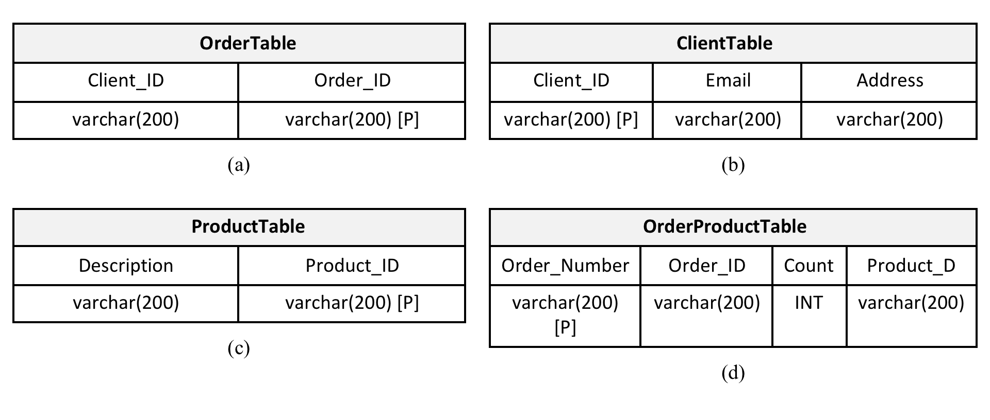
PERFORMANCE ANALYSIS
Albano, Jones, Tournour
Individual Comparisons
Embry-Riddle Aeronautical University

Slide 23
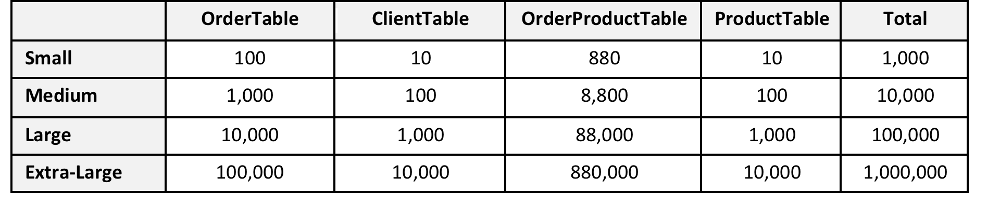
PERFORMANCE ANALYSIS
Albano, Jones, Tournour
Individual Comparisons
Database Configurations
Small: 1,000 cumulative rows between all tables
Medium: 10,000 cumulative rows between all tables
Large: 100,000 cumulative rows between all tables
Extra-Large: 1,000,000 cumulative rows between all tables
Embry-Riddle Aeronautical University

Slide 24
PERFORMANCE ANALYSIS
Albano, Jones, Tournour
Individual Comparisons
Queries
Select all information from OrderTable
Select all Orders and order them from higher to lowest count.
Find the number of orders per Client and order them most to least.
Update all orders where count is greater than 5 to have a count value of 5.
Nested selects to use all tables together in one large query. In the end will get the description of all items ordered from a certain email
Embry-Riddle Aeronautical University

Slide 25
PERFORMANCE ANALYSIS
Albano, Jones, Tournour
Individual Comparisons
Results Per Configuration
Embry-Riddle Aeronautical University

Slide 26
PERFORMANCE ANALYSIS
Albano, Jones, Tournour
Individual Comparisons
Results Per Configuration
Embry-Riddle Aeronautical University

Slide 27
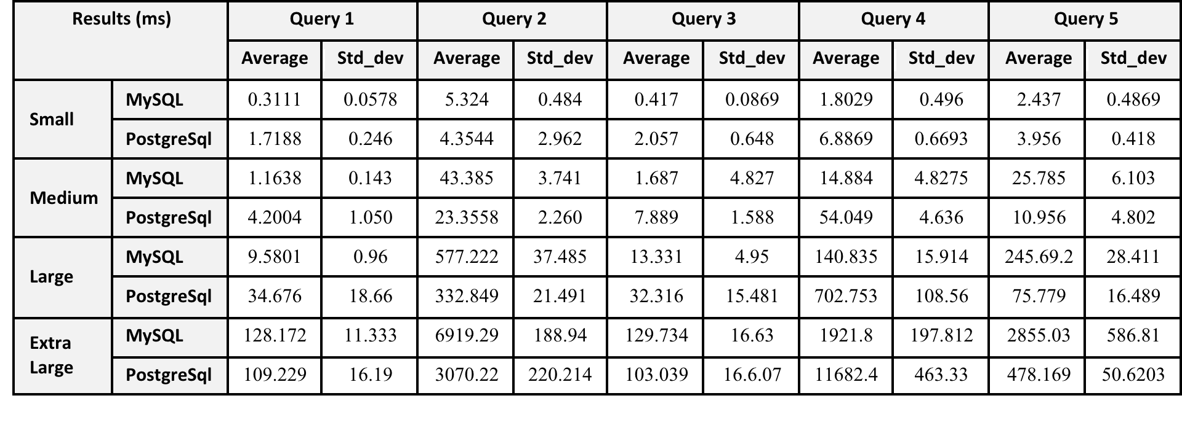
PERFORMANCE ANALYSIS
Albano, Jones, Tournour
Individual Comparisons
Execution Times
Embry-Riddle Aeronautical University

Slide 28
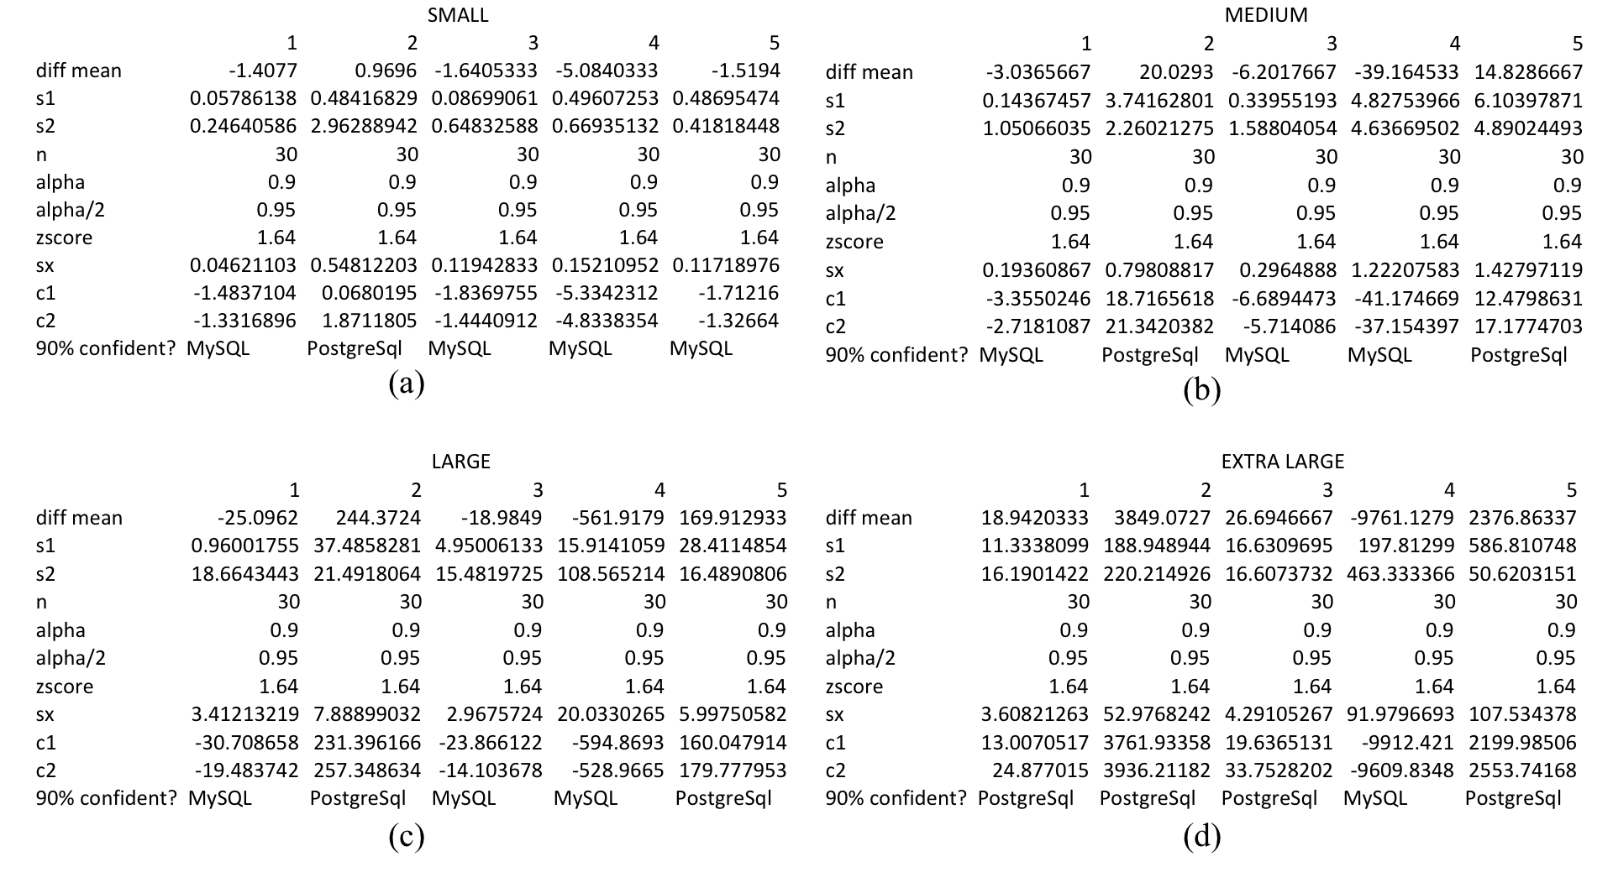
PERFORMANCE ANALYSIS
Albano, Jones, Tournour
Individual Comparisons
Confidence Intervals
Embry-Riddle Aeronautical University

Slide 29
PERFORMANCE ANALYSIS
Albano, Jones, Tournour
Individual Comparisons
Regression Analysis (Query 5)
-13.8889 + 0.0029x = 12.4078 + 0.0005x
.0024x = 26.2967
x = 10,956.9 => 10,957
Embry-Riddle Aeronautical University

Slide 30
PERFORMANCE ANALYSIS
Albano, Jones, Tournour
Individual Comparisons
Regression Analysis
Embry-Riddle Aeronautical University

Slide 31
PERFORMANCE ANALYSIS
Albano, Jones, Tournour
Individual Comparisons
Execution Time Comparisons
Embry-Riddle Aeronautical University

Slide 32
PERFORMANCE ANALYSIS
Albano, Jones, Tournour
Individual Comparisons
Execution Time Comparisons
Embry-Riddle Aeronautical University

Slide 33
PERFORMANCE ANALYSIS
Albano, Jones, Tournour
Individual Comparisons
Conclusion
MySQL and PostgreSql were both able to perform the queries on all four sizes of the database
MySQL was significantly better (90%) at the lower sizes
PostgreSql started to become more efficient after about 100,000 rows depending on the query
Small dataset for final comparison favored MySQL.
Selected: MySQL
Embry-Riddle Aeronautical University

Slide 34
PERFORMANCE ANALYSIS
Albano, Jones, Tournour
Group Comparisons
Group of Databases
Databases being compared
MySQL
Neo4j
Redis
Embry-Riddle Aeronautical University

Slide 35
PERFORMANCE ANALYSIS
Albano, Jones, Tournour
Group Comparisons
Group Dataset
Common dataset
1,000 people
1,000 interests to choose from
100 places of work
Suggestions of coworkers
Each person has 10 interests
Each person has worked at 5 jobs
Embry-Riddle Aeronautical University

Slide 36
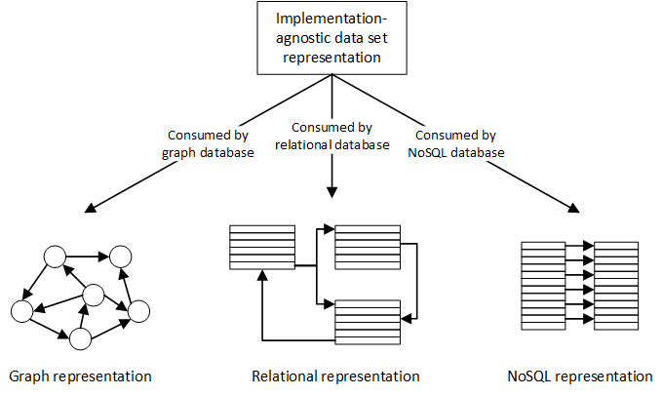
PERFORMANCE ANALYSIS
Albano, Jones, Tournour
Group Comparisons
Embry-Riddle Aeronautical University

Slide 37
PERFORMANCE ANALYSIS
Albano, Jones, Tournour
Group Comparisons
Database Layouts
MySQL
Use of table structure. People, Interest, Work, Employee, and Relationship Tables.
Redis
Use of key-value pairs. Lists of data saved for each persons workplace and interest and list of workers saved for each workplace.
Slight repetition of data.
Neo4j
Use of nodes and relationships. People and Interests are nodes. Relationships link people to other people and people to interests
Embry-Riddle Aeronautical University

Slide 38
PERFORMANCE ANALYSIS
Albano, Jones, Tournour
Group Comparisons
Group Queries
Get all interests of a person
Simple NoSQL query to simply get all of a persons interests.
Recommend interests based on interests of coworkers
Graphing Query that must relate coworkers and interest of those coworkers together.
Obtain all coworkers and common place of work
Relational Query that returns the workplace of an employee along with all people who worked at that workplace.
Embry-Riddle Aeronautical University

Slide 39
PERFORMANCE ANALYSIS
Albano, Jones, Tournour
Group Comparisons
Average Execution Times
Embry-Riddle Aeronautical University

Slide 40
PERFORMANCE ANALYSIS
Albano, Jones, Tournour
Group Comparisons
Conclusion
NoSQLQuery
Graph database is significantly faster than NoSQl and SQL. NoSQL is significantly faster than SQL. All done at 95% confidence
Graph Query
Graph database is significantly faster than NoSQl and SQL. Both done at 95% confidence
Relational Query
Graph database is significantly faster than NoSQl and SQL. NoSQL is significantly faster than SQL. All done at 95% confidence.
Selected: Neo4j
Embry-Riddle Aeronautical University

Slide 41
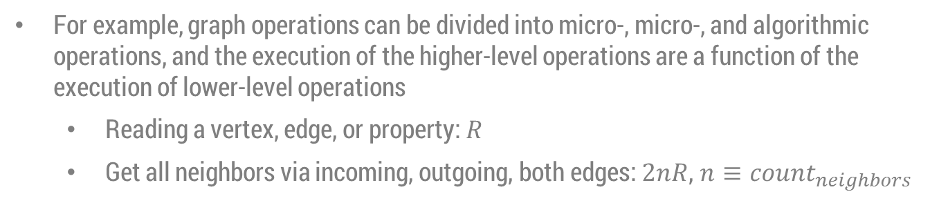
PERFORMANCE ANALYSIS
Albano, Jones, Tournour
Alternative Methods
Analytical Modeling
For example, graph operations can be divided into micro-, micro-, and algorithmic operations, and the execution of the higher-level operations are a function of the execution of lower-level operations
Reading a vertex, edge, or property: $R$
Get all neighbors via incoming, outgoing, both edges: $2nR$, $n≡count_{neighbors}$
Simulation
For transactional databases, the transactions of write, update, etc. can be simulated
Test how well a database will operate in the deployment environment
Provide a base-line for trade-off analysis between transactional databases
Embry-Riddle Aeronautical University

Slide 42
PERFORMANCE ANALYSIS
Albano, Jones, Tournour
Final Conclusions
Databases are essential components of many software applications
Multitudes of database types and end products exist
Performance analysis is important and required to determine an appropriate application solution
Graph, NoSQL and relational database types have been analyzed and compared both in isolation and in a final combined comparison through statistical analysis and empirical experimentation
Neo4j (graph), MySQL (SQL) and Redis (NoSQL) products were individual “best-in-class” performers
Neo4j (graph) consistently outperformed MySQL and Redis for read-centric queries executed in the combined performance comparison; Redis consistently came in second place
Alternative methods of performance analysis are possible but were not explored
Embry-Riddle Aeronautical University

