Slide 1


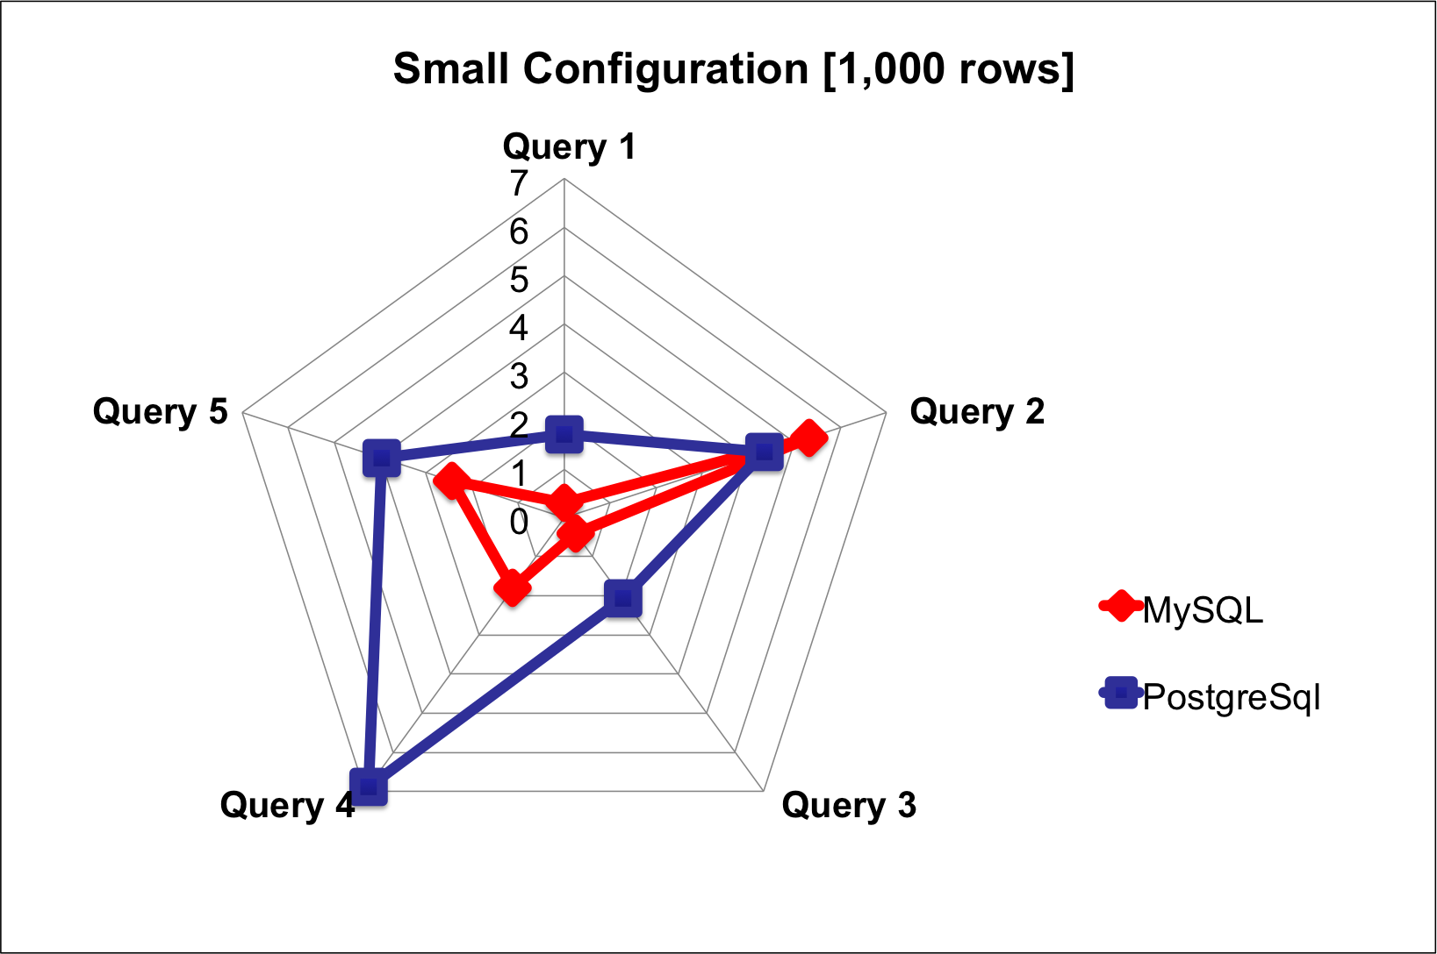
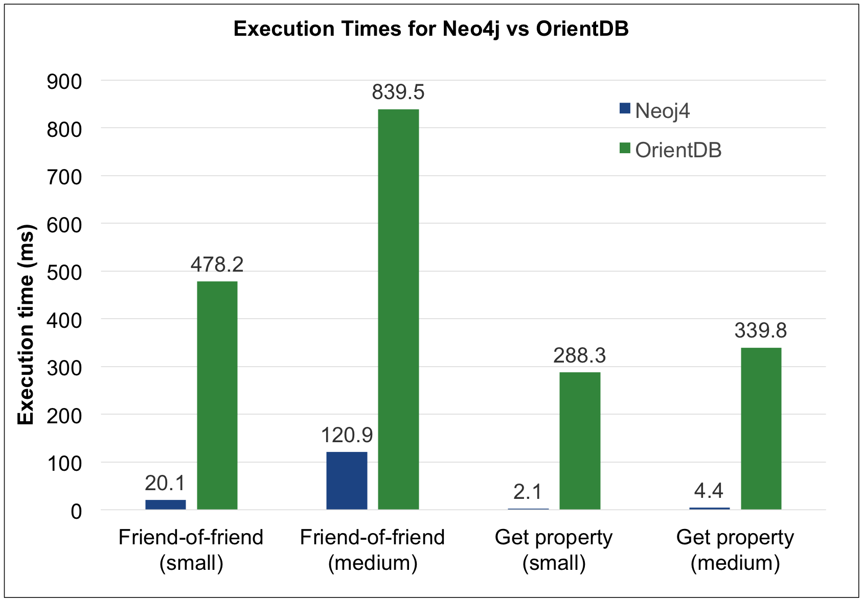
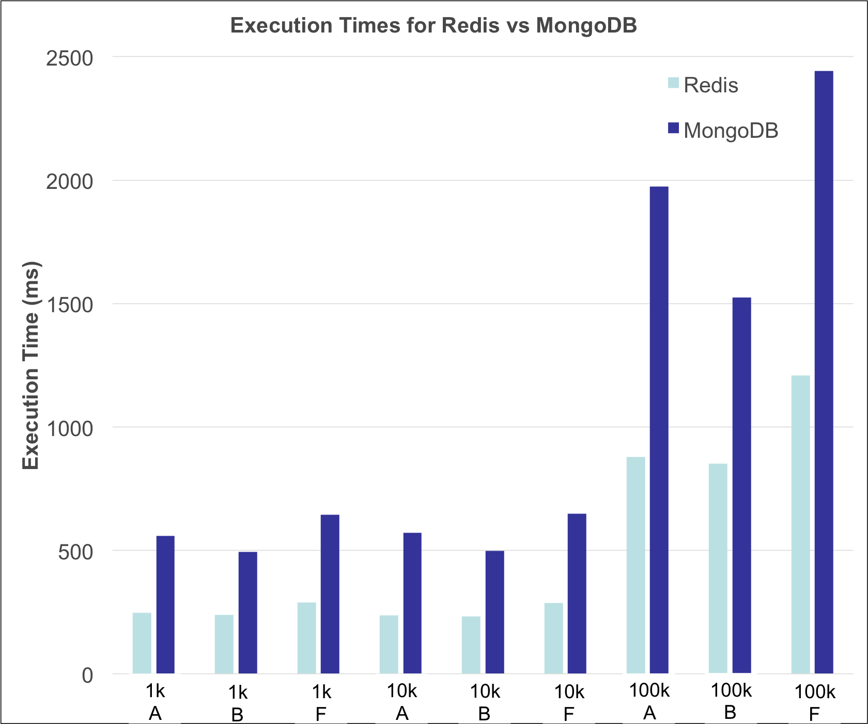
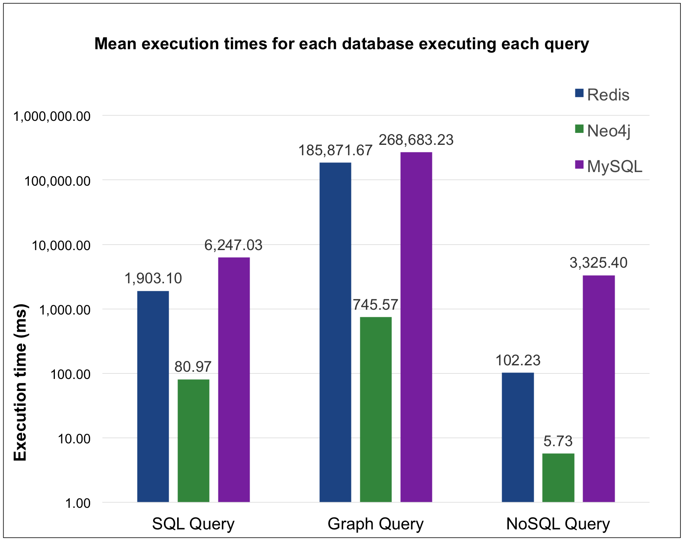
Title of the Project
SE655 Performance Analysis of Real-Time Systems, SP2015
Embry Riddle Aeronautical University, Electrical, Computer, Software & System Engineering
Introduction
Relational
Graph
Lessons Learned
Databases are one of the most popular way to store information for an application. There are many types of databases currently available and each one stores information in a different way. These different database types are specifically designed to excel at some unique scenario. The three most popular categories of databases are NoSQL, Relational, and Graphing. With the popularity of these database types there are a variety of different database choices within each of the categories. This abundance of choices can make it difficult to find which database should be used in a specific situation. This performance analysis will not only compare databases within each category, but also the best amongst of each of the three categories
The Relational Database comparison used 5 queries its its performance analysis. The five queries were a simple select all from table, an order by value, an order by count, an update, and a nested select using all tables. These queries were run on 4 different database sizes. A kiviat diagram is was used to visually show the difference in execution time between MySQL and PostgreSql for the smallest database configuration. In the end MySQL had a statistically-significantly lower execution time in more of the queries than PostgreSql.
The Graph Database performance analysis compared two popular, open source property graphs, Neo4j and OrientDB, using 4 data sets and 2 queries. Although Neo4j and OrientDB were unable to complete the two largest and the large data sets, respectively, it is clear that the mean execution time of Neo4j was vastly superior to that of the mean execution time of OrientDB (in both a qualitative and statistically significant sense). The results of this comparison are illustrated in the histogram below.
There were some issues that came up when trying to gather information for the analysis. For both the Graph and NoSQL databases there is the issue that not all the databases speak the same ‘language’. This required special tools that could translate generic requests/queries into the specialized request for each database. This wasn't an issue for the relational databases since they all use SQL.
The NoSQL and Graph performance analysis both planned on having four sets of data: 1,000 nodes, 10,000 nodes, 100,000 nodes, and 1,000,000 nodes. However there was an issue in loading that much information into some Graphing and NoSQL databases so the queries were only executed on datasets that both databases could support
Using common data between the three different types of databases was an interesting task. It allowed for different implementation of how data was stored. The NoSQL relied on lists of strings that referenced other resources. The Relational Database created tables that related data from one table to another. Finally the Graph database created nodes with connections between them. The different implementation of the dataset definitely have some effect on the execution time required to gather the data.
An issue that occurred with almost every database was how the installation of the database wasn't always straight forward. Getting a library to interface with the database to automatically record the execution times was even more difficult.
Two factor ANOVA of performance of database and queries can be reduced to single factor by looking at one factory (query) at a time. Since the real comparison was being done between databases the information between queries is not need.
Comparisons
Relational Database: Relational databases focus on relation of information by tables. These tables relate to each other by referencing keys that are stored in multiple tables. Tables are very efficient in reducing repetition of stored data.
The databases that were compared are:
  PostgreSql
  MySQL
NoSQL Database (Key-Value): Key-Value NoSQL databases were chosen to be compared. These database focus on fast transactions and rely on mostly simple get/set on a resource. There is no way to relate information within the database. This is also the only database type being compared that doesn’t use a query language.
The databases that were compared are:
  MongoDB
  Redis
Graph Database: Graphing databases save data as nodes and focus on the connections between the data. The connections are the primary information while the data being connected is viewed as secondary information.
The databases that were compared are:
  Neo4j
  OrientDB
Combined: The combined analysis is performed on the winners of the three categories of databases. This analysis will use queries from each category to test the overall efficiency of each database.
The databases that were compared are:
  MySQL
  Redis
  Neo4j
NoSQL
Combined
The NoSQL (Key-Value) Database comparison used three queries along with three different sized data sets.
The combined performance analysis used three queries to gain results. These queries were modeled for the three databases being compared: NoSQL, Graph, and Relational. In a surprising result the graphing database had the best execution time in all three queries. The NoSQL database came in second in every query. And the relational database performed poorly and had the worse execution time in every one of the queries by at least a magnitude of 3.
Conclusions
After the analysis was done on the final group of databases it was obvious that Neo4j was the best database of the group. It outperformed the other two databases in their own queries as well as outperforming them in the graph query. Neo4j was significantly faster than MySQL at 95% confidence for all three queries and was significantly faster than Redis at 95% confidence for the SQL and Graph queries.
Relative Change
 |  | Databases being compared
 |  | Graph -> NoSQL | Graph -> SQL | NoSQL-> SQL
Queries | NoSQL Query | 1,684% | 57,935% | 3,152%
 | Graph Query | 24,830% | 35,937% | X
 | SQL Query | 2,250% | 7,615% | 228%
Team
Justin Albano
Steve Jones
Dominick Tournour

