Slide 1


Auto-answering in the semantic space
Álvaro Barbero Jiménez
Chief Data Scientist
8 de noviembre de 2015

Slide 2
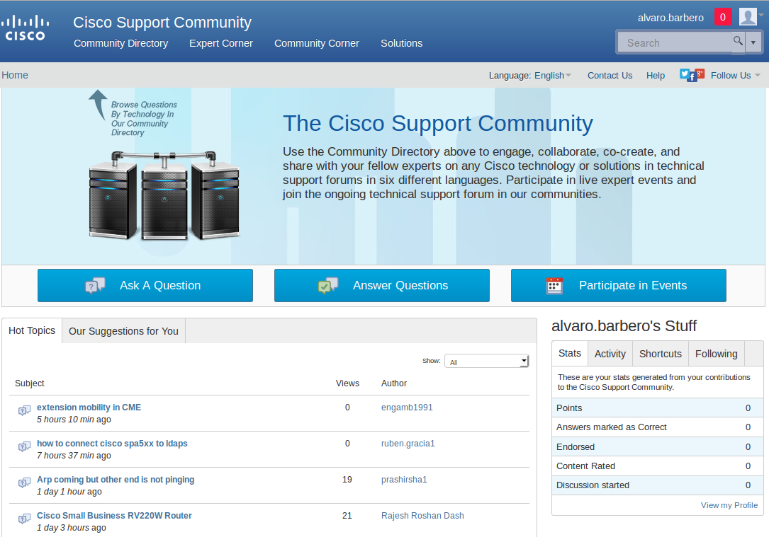
The problem
Customer service doesn't scale
Even with the use of online boards and communities!
x Users repeatedly ask the same or very similar questions
Q: how can we improve the speed of question answering?

Slide 3
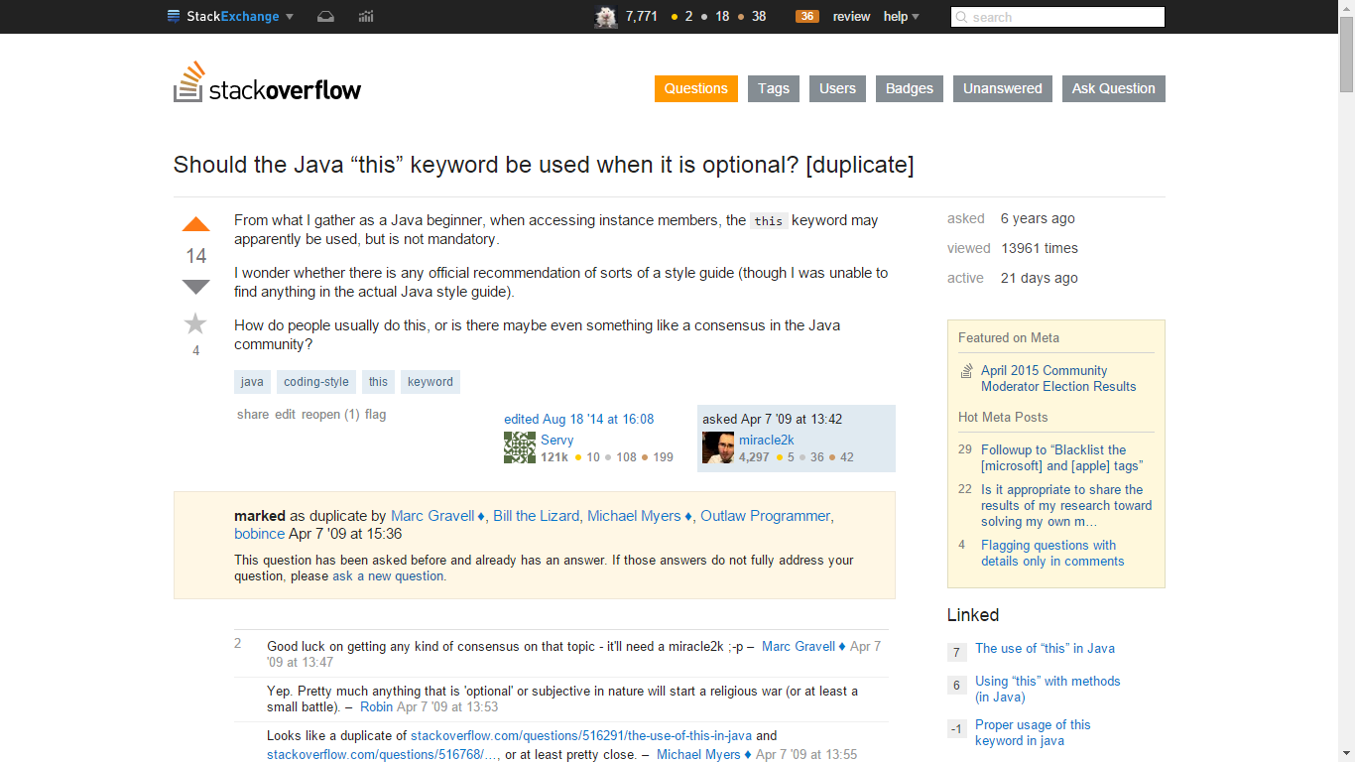
What stackoverflow did
…can we automate this?

Slide 4
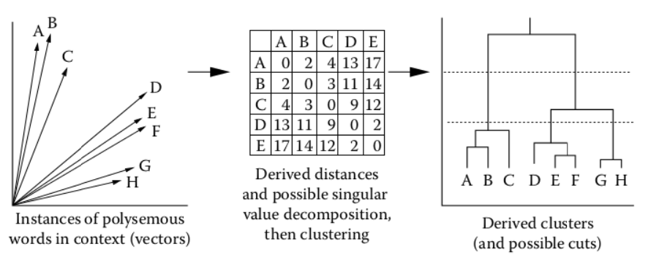
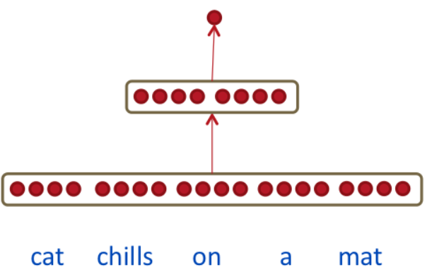
The key idea: semantic embeddings
✓
X

Slide 5
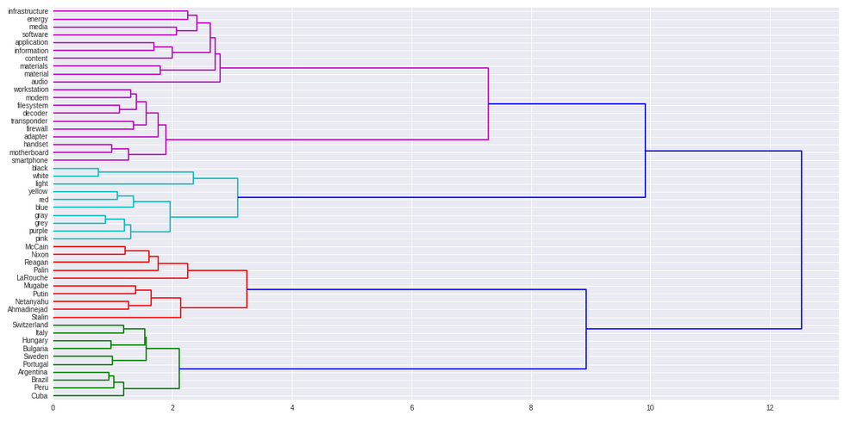

English Wikipedia semantic embedding
Polyglot embeddings: https://sites.google.com/site/rmyeid/projects/polyglot#TOC-Download-the-Embeddings

Slide 6


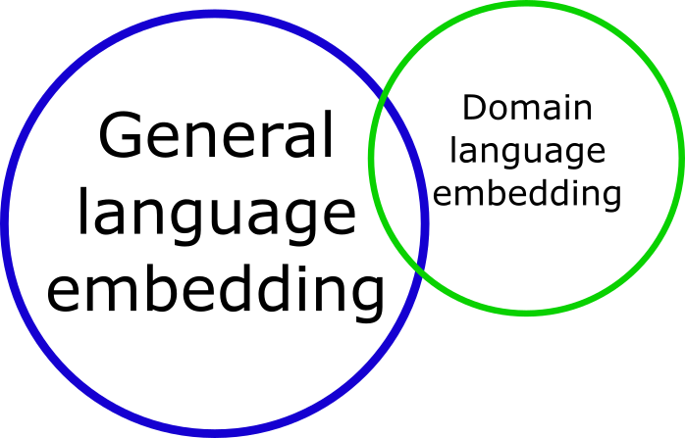

Combining embeddings

Slide 7
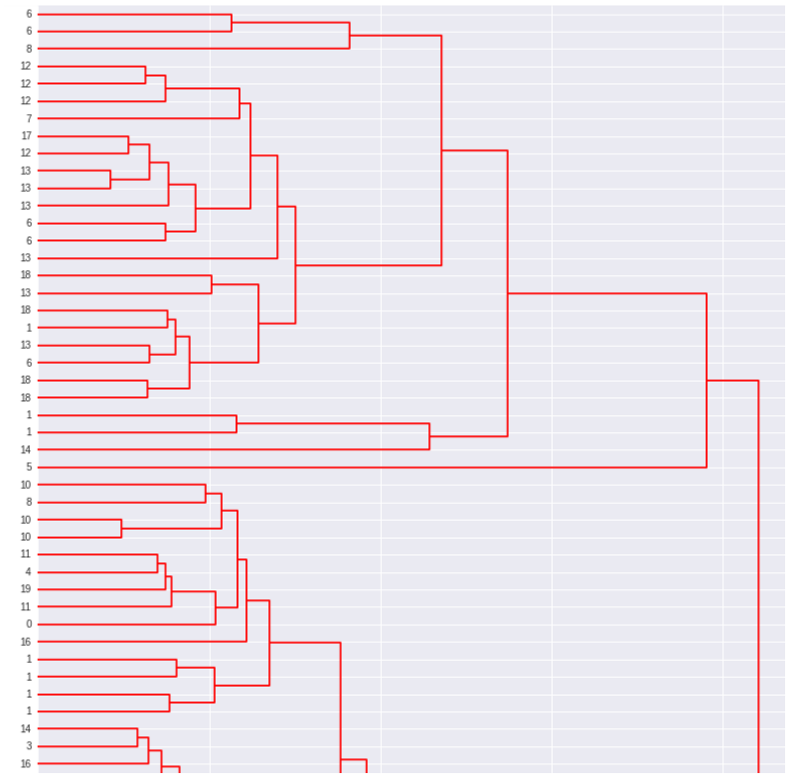
CISCO posts embedding
Post ID

Slide 8
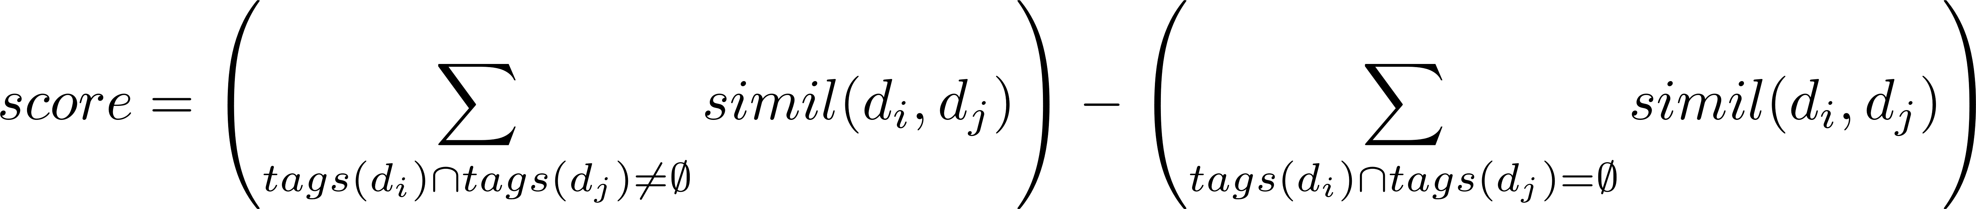


Label agreement score on StackExchange community
0.519 | 0.730

Slide 9

Fast search filtering
~100
Fast TF-IDF search
Horizontally scalable
Fine-detail search for semantics

Slide 10
Conclusions
Real-time recommendations for already existing solutions to new questions might be possible using semantic embeddings
Faster troubleshooting for users
→ Increase in customer satisfaction
Reduction of repetitive burden on technical support team
→ Increase in productivity

Slide 11







C/ Francisco Tomás y Valiente, nº 11
EPS, Edificio B, 5ª planta
UAM Cantoblanco. 28049 Madrid
Tel.: (+34) 91 497 2323
www.iic.uam.es blog.iic.uam.es
Elementos gráficos de apoyo obtenidos en:

