Slide 1
Auto-answering in the semantic space
Álvaro Barbero Jiménez

Slide 2
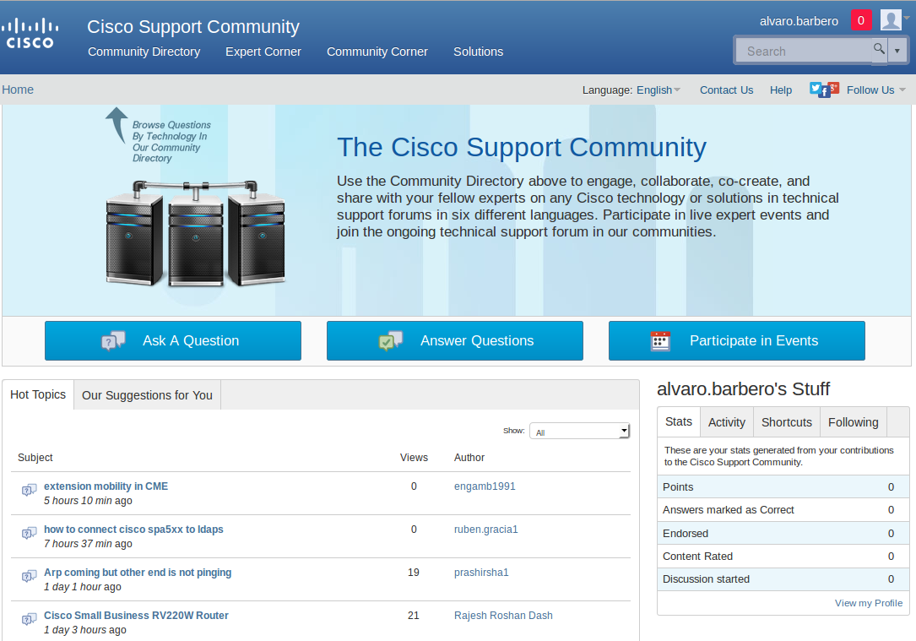
The problem
Customer service doesn't scale
  Even with the use of online boards and communities!
Users repeatedly ask the same or very similar questions
  How can we improve the speed of question answering?

Slide 3
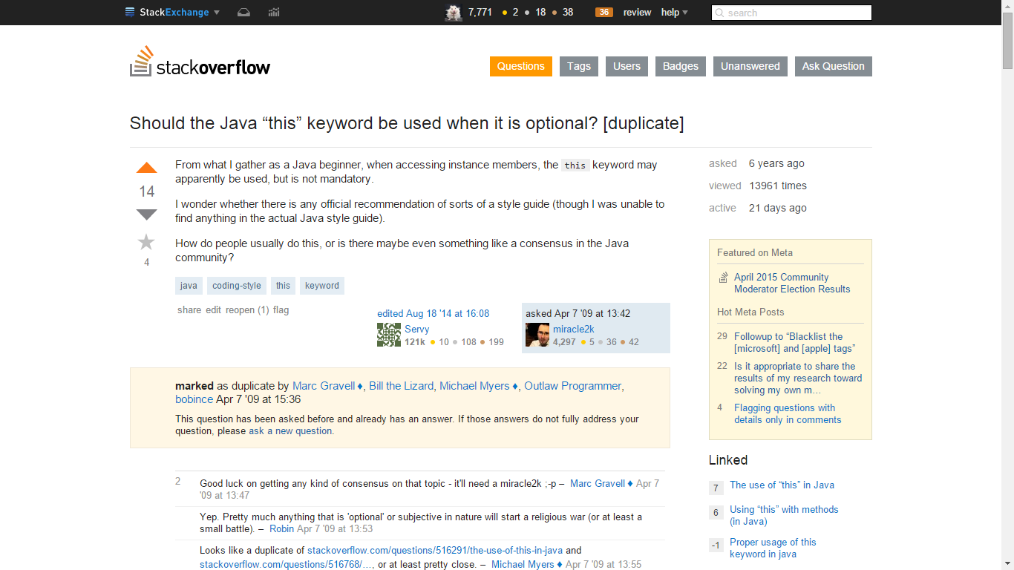
Solutions out there
Can we automate this?

Slide 4
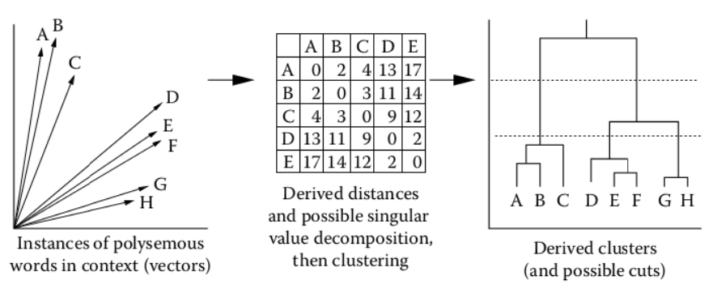
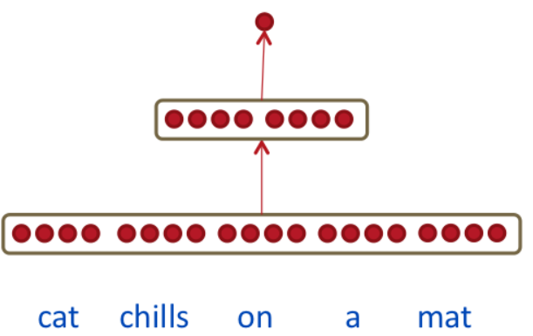
The key idea: semantic embeddings
x

Slide 5
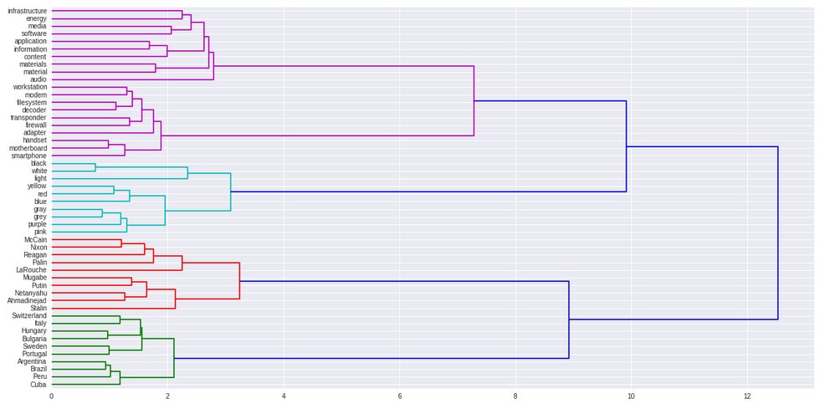
Wikipedia Embedding

Slide 6
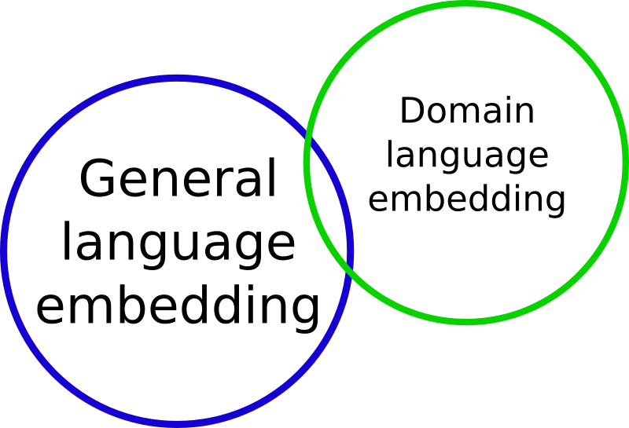
Combining embeddings

Slide 7
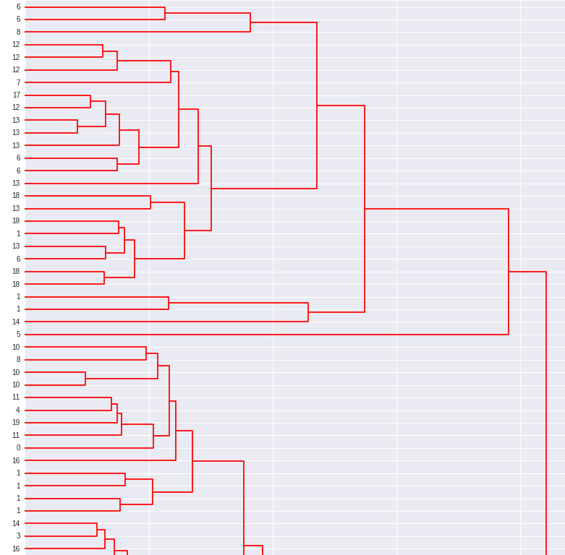
CISCO posts embedding
Post ID

Slide 8
Label agreement score on stackexchange community
With only Wikipedia embedding | With Wikipedia + CISCO + Stackexchange embedding
0.519374504602 | 0.7300018904

Slide 9

Fast search filtering

Slide 10
Conclusions
Recommendations for already existing solutions to new questions might be possible using this technology.
Scalability guaranteed by fast search.

