Slide 1

HOTEL RECOMMENDER
Albina Sitdikova
03/24/2021
Metis Bootcamp

Slide 2




Data
REVIEWS
SOURCE
60.000 reviews
TripAdvisor
HOTELS
USERS
1.000 hotels
7.000 users

Slide 3
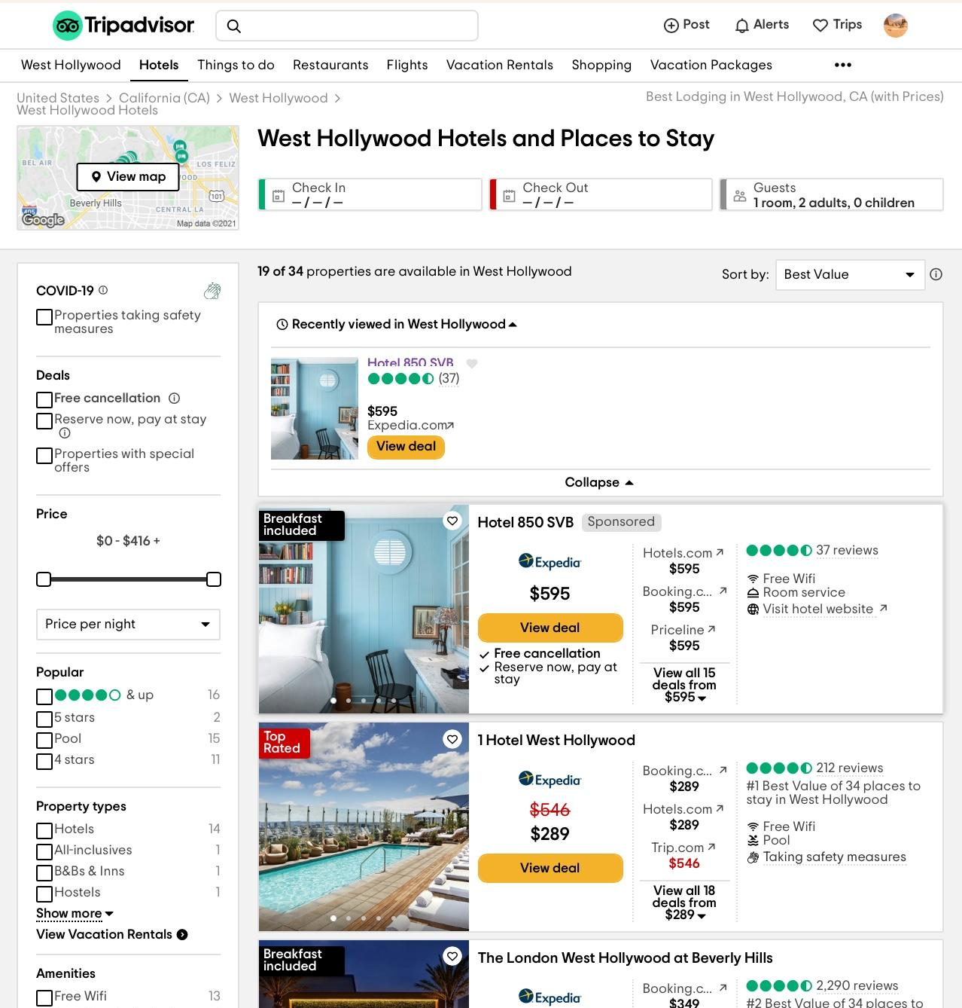
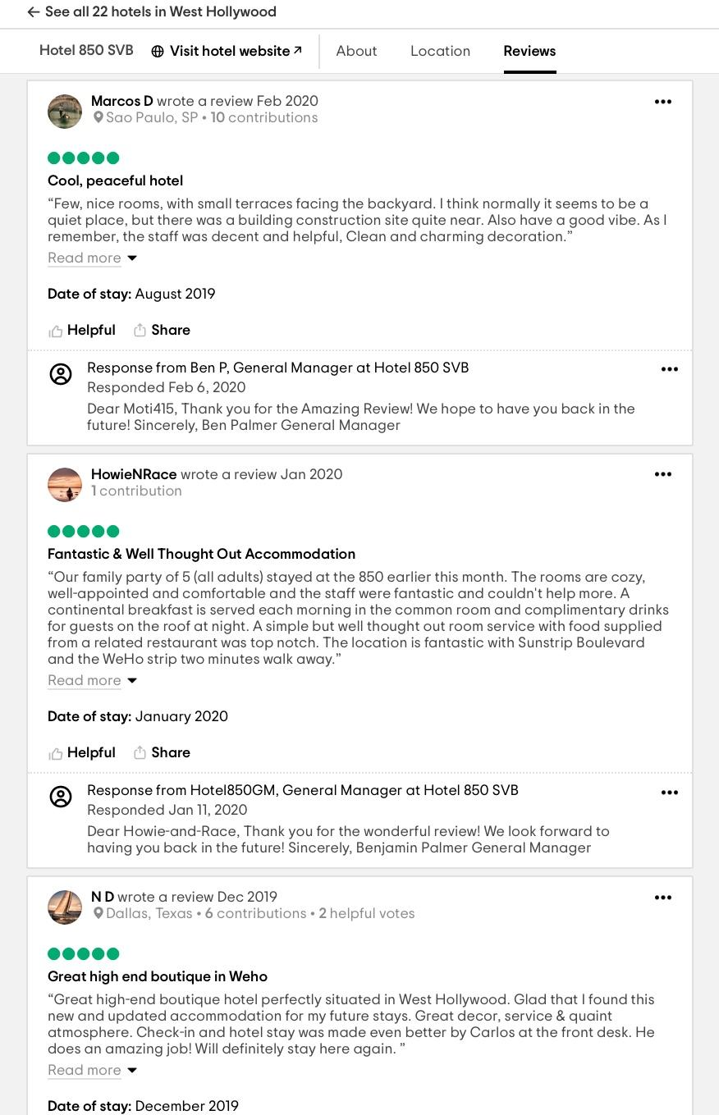

Slide 4
Hotel ratings

Slide 5
User ratings

Slide 6
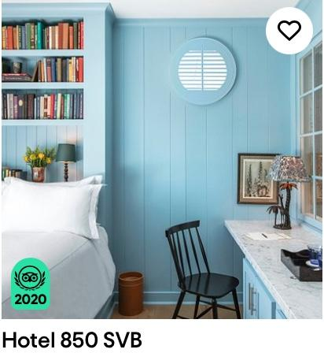
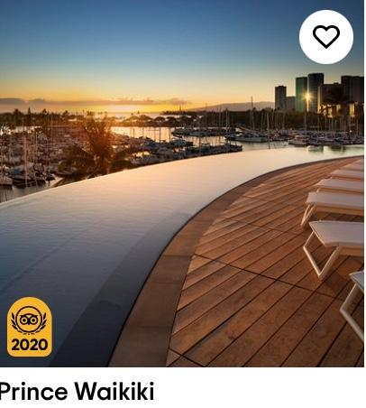
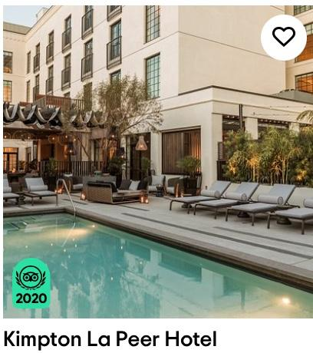
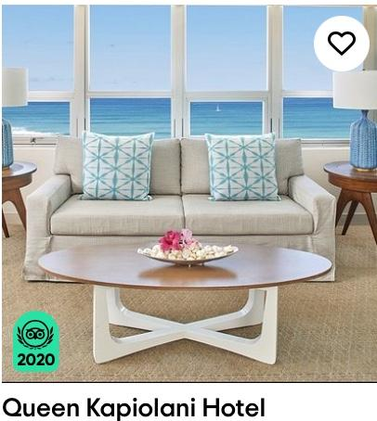
User-Based Collaborative Filtering
Rated high
Rated high
Rated high
Rated high
Rated high
Rated high
Rated high
Hotels
Notes:
Recommender system based on users raitng

Slide 7
User-Based Collaborative Filtering
Similarity
Rated high
Rated high
Rated high
Rated high
Rated high
Rated high
Rated high
Hotels
Notes:
Recommender system based on users raitng

Slide 8
User-Based Collaborative Filtering
Similarity
Rated high
Rated high
Rated high
Rated high
Rated high
Rated high
Recommend
Recommend
Rated high
Hotels
Notes:
Recommender system based on users raitng

Slide 9
Schema of top 10 recommendation
Training Set
Data
Anti-train set

Slide 10
Training set
Rated high
Rated high
Rated high
Rated high
Rated high
Rated high
Rated high
Hotels
Notes:
Recommender system based on users raitng

Slide 11
Anti-train set
Rated high
Rated high
Rated high
Rated high
Rated high
Rated high
Rated high
Hotels
Notes:
Recommender system based on users raitng

Slide 12
Schema of top 10 recommendation
Training Set
Data
Build algorithm (SVD)
Anti-train set

Slide 13
Schema of top 10 recommendation
Training Set
Data
Build algorithm (SVD)
Anti-train set
Predictions

Slide 14
Schema of top 10 recommendation
Training Set
Data
Build algorithm (SVD)
Anti-train set
Predictions
Top 10 recommendations

Slide 15
How to evaluate recommendations?

Slide 16
Evaluation
Collaborative Filtering Recommender
Training Set
Data
Test set

Slide 17
Evaluation
Collaborative Filtering Recommender
Training Set
Data
Build algorithm
Test set

Slide 18
Evaluation
Collaborative Filtering Recommender
Training Set
Data
Build algorithm
Test set
Compare predicted and real ratings

Slide 19
Evaluation
Collaborative Filtering Recommender
Training Set
Data
Build algorithm
MAE: 0.68
Test set
Compare predicted and real ratings
Performance measures: MAE

Slide 20
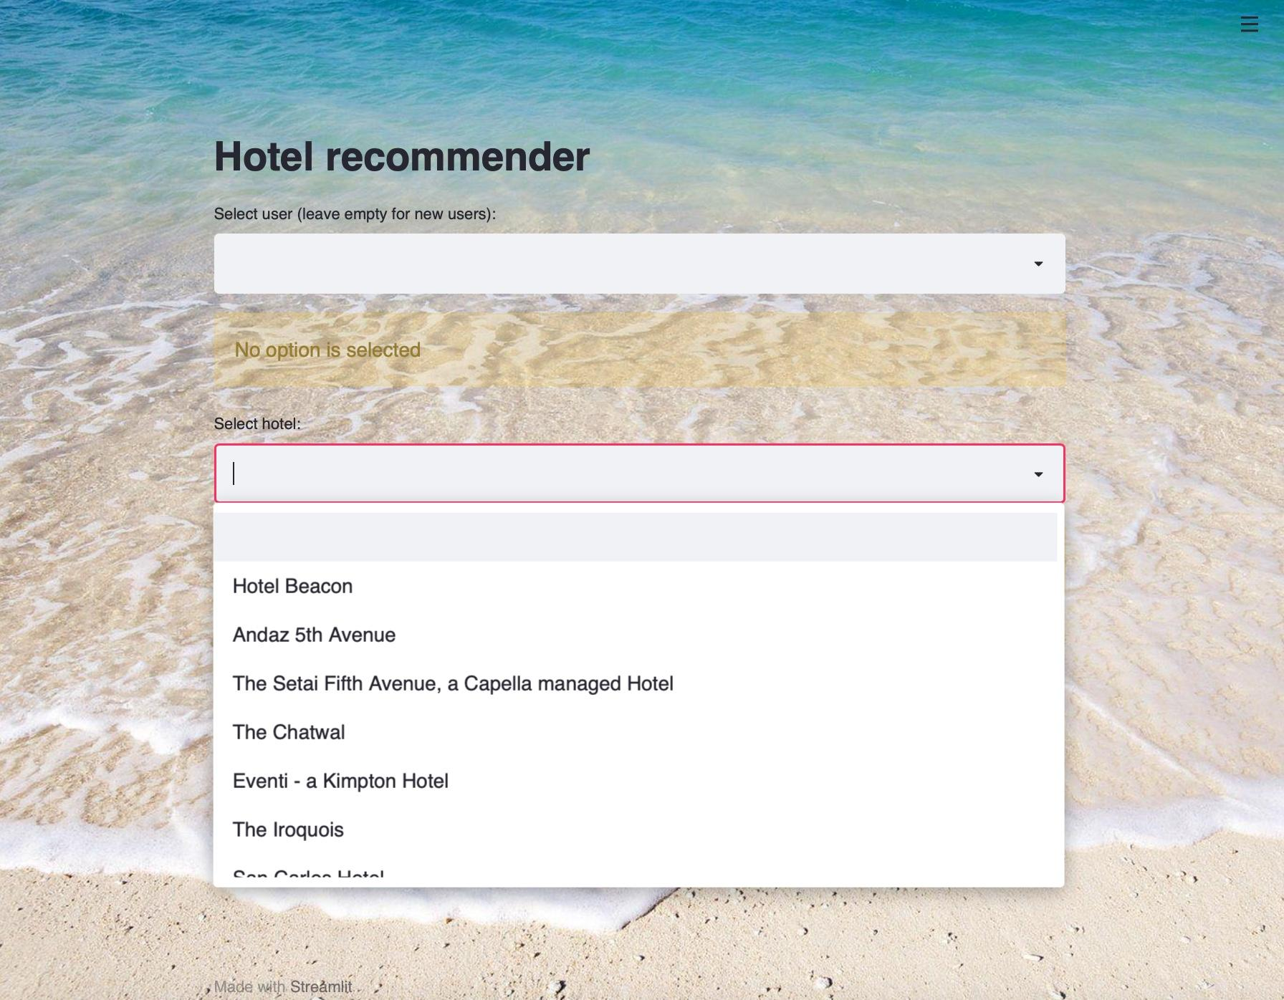
New user

Slide 21
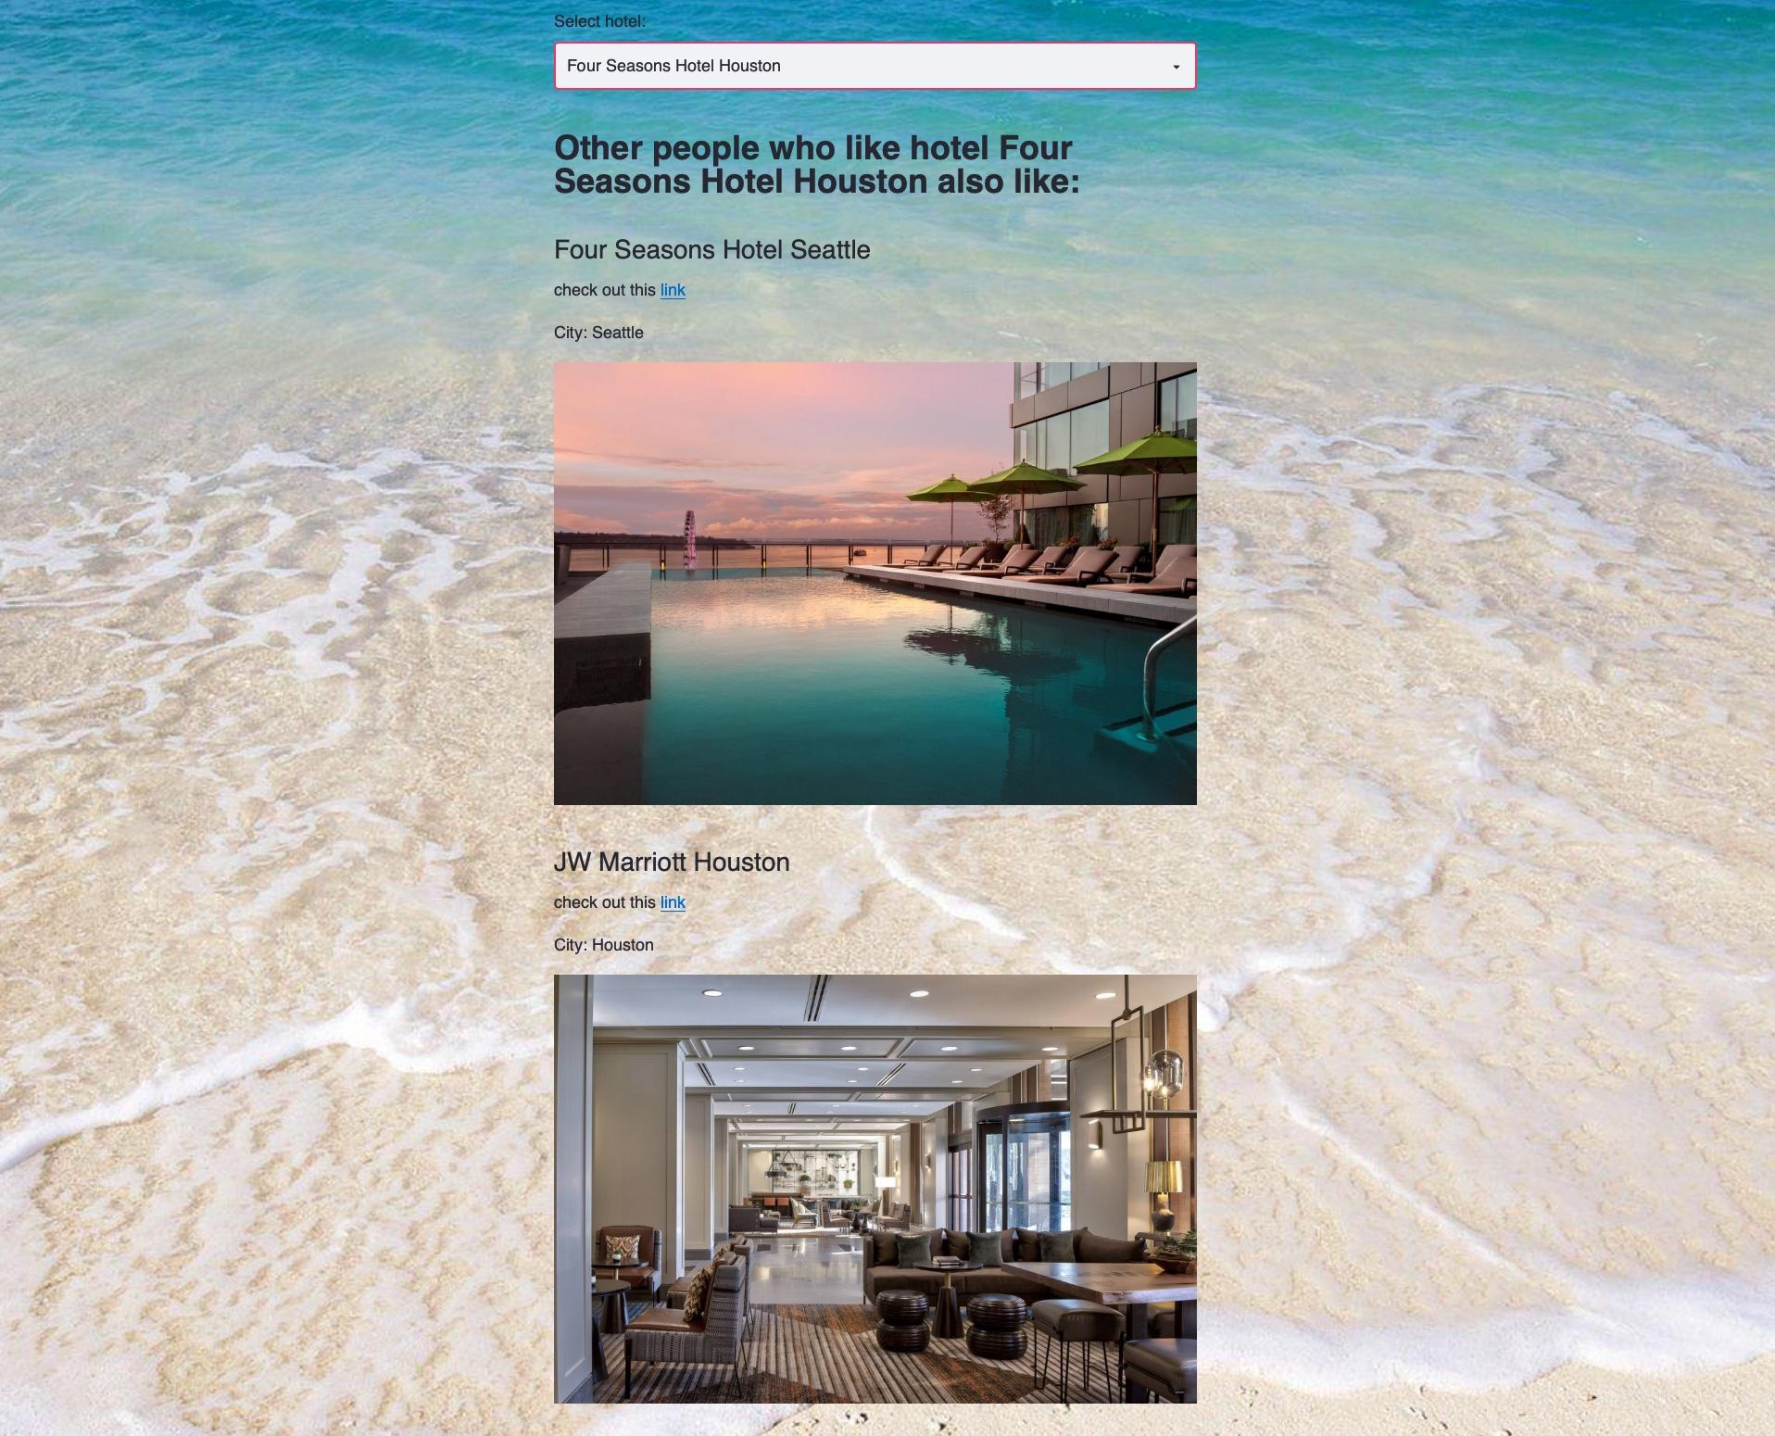
New user

Slide 22
KNN for hotel similarity
K=5

Slide 23
KNN for hotel similarity
K=5

Slide 24
KNN for hotel similarity
K=5

Slide 25


Cold start hotels
(new user + new hotel)

Slide 26
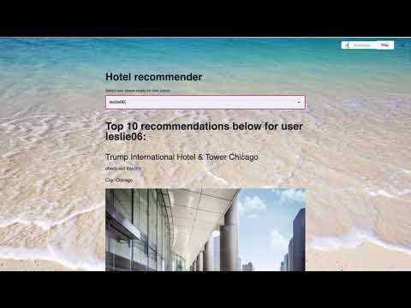
Web App

Slide 27

Result
Implemented Collaborative Filtering Recommendation System
Top 10 hotels recommendations for each user
KNN method for cold start problem
Created web app to demonstrate work of recommendation system

Slide 28
THANKS!
Albina Sitdikova
Email: alba.sitdikova@gmail.com
GitHub: /albasitdikova
LinkedIn: /in/albasitdikova

Slide 29
Appendix

Slide 30
TripAdvisor Dataset from:
https://www.cs.cmu.edu/~jiweil/html/hotel-review.html

Slide 31

Feature work
Use Spark or Dash to process all reviews
Use content based recommendation system for cold start problem
Add more features to the app

