Slide 1
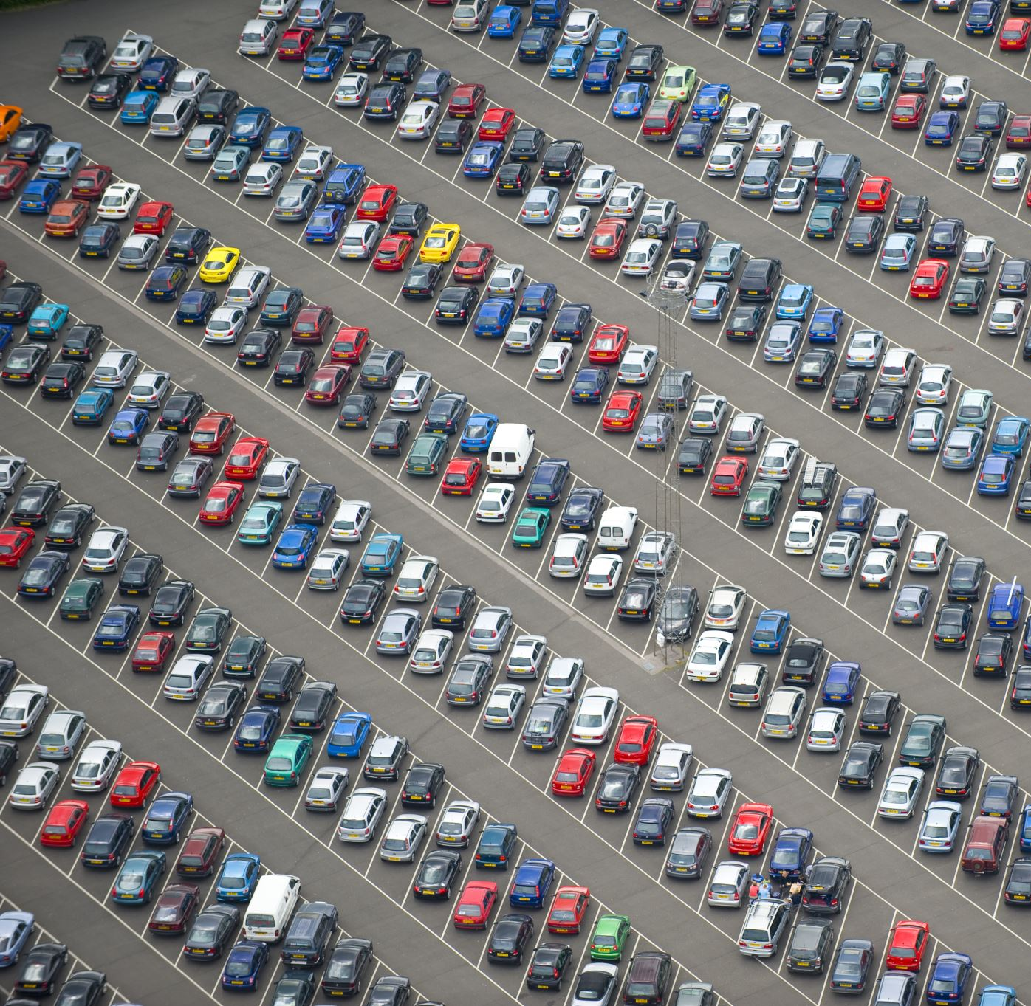
Lariat Car rental
By Alton Baugh
Data Analyst

Slide 2
LARIAT 2018 PERFROMACNE
Cost $30,320,298
Gross revenue $52,829,787
Profit $22,509,489
Notes:
Here is a chart illustrating the overall company's performance over 2018
The red bar indicates the cost, the blue bar indicates gross and the amount of separation or lack of separation between those two bars illustrates the profit margin.
Splitting the cars into tiers based on our monthly cost including insurance and lease separates the high-end cars versus the budget cars and everything in between.
The values are in percentages to relate the percent of cost spent to percent gross revenue gained.
Our cars under the 575 and around 675 are our most profitable while our cars 775 and become less profitable.
Macro point and micro point
What is driving up the cost and what can be done to increase profit ?

Slide 3
THE STEEP CLIMB UP
Analysis Of Loss-making Vehicles
Daily Rental Charge Cost ($) | Average Monthly Cost | Sum Profit January to November | Count of Cars in Range | Sum Days Rented
215-230 | $764.17 | -$358 | 1 | 50
185-200 | $797.66 | -$1,691 | 4 | 226
170-185 | $798.58 | -$21,684 | 18 | 958
155-170 | $763.62 | -$26,821 | 31 | 1,767
140-155 | $766.65 | -$28,480 | 34 | 2,150
125-140 | $783.74 | -$17,280 | 11 | 612
Grand Total | $774.63 | -$96,314 | 99 | 5,763
Notes:
When the Avg daily rent prices were analyzed there seems to be a disconnect.
The initial thought was car with higher monthly cost would correlate to higher average daily rent prices however X% of cars in the above 775 were being rented out in the lowe

Slide 4
CHOOSE YOUR FRIENDS WISELY
MOST PROFITABLE VEHICLES
LEAST PROFITABLE VEHICLES
VEHICLE MODEL | Sum Profit January to November | Average Days Rented | Average Monthly Total Cost
Pontiac Grand Prix | $138,748 | 82 | $667
Ford Ranger | $130,994 | 84 | $692
Mercury Grand Marquis | $129,392 | 83 | $704
Lincoln Town Car | $122,154 | 79 | $651
Mercury Sable | $121,540 | 82 | $655
Grand Total | $642,828 | 82 | $675
VEHICLE MODEL | Sum Profit January to November | Average Days Rented | Average Monthly Total Cost
Daewoo Nubira | -$3,271 | 53 | $836
Audi 5000CS | -$1,972 | 46 | $834
A5 | -$1,565 | 50 | $856
Saturn Relay | -$490 | 46 | $806
Plymouth Volare | -$393 | 35 | $727
Grand Total | -$7,692 | 46 | $812
Notes:
Removal of least profitable cars and addition of most profitable cars.

Slide 5
WHAT DOES FUTURE HOLD?
2018 Model
Average Daily Rate Tiers | Sum of profit | Count of cars | Days Rented
125-140 | 8,351,086 | 72 | 5,339
140-155 | 1,942,062 | 677 | 54,561
155-170 | 1,938,058 | 1732 | 143,134
170-185 | 1,668,285 | 1194 | 97,220
185-200 | 2,104,832 | 287 | 22,586
200-215 | 2,050,287 | 33 | 2,450
215-230 | 1,978,783 | 5 | 318
2019 Projections
Average Daily Rate Tiers | Sum of profit | Count of cars | Days Rented
125-140 | $223,384 | 76 | 6,407
140-155 | $3,067,634 | 711 | 57,289
155-170 | $10,246,263 | 1819 | 150,291
170-185 | $8,676,050 | 1254 | 111,803
185-200 | $2,165,546 | 301 | 25,974
200-215 | $229,446 | 35 | 2,818
215-230 | $19,391 | 5 | 366

Slide 6
WHAT DOES FUTURE HOLD?
2018 Baseline
Average Daily Rate ($) Tiers | Sum Profit ($) | Count of cars | Days rented
125-140 | $186,153.00 | 72 | 74
140-155 | $2,921,556.00 | 677 | 81
155-170 | $9,758,346.00 | 1732 | 83
170-185 | $7,544,391.00 | 1194 | 81
185-200 | $1,883,083.00 | 287 | 79
200-215 | $199,518.00 | 33 | 74
215-230 | $16,862.00 | 5 | 64
Grand Total | $22,509,909.00 | 4000 | 535
2019 Projections @ 5% Profit Growth
Avgerage Daily Rate ($) Tiers | Sum Profit | Count of cars | Days rented
125-140 | $195,461 | 76 | 74
140-155 | $3,067,634 | 711 | 81
155-170 | $10,246,263 | 1819 | 83
170-185 | $7,921,611 | 1254 | 81
185-200 | $1,977,237 | 301 | 79
200-215 | $209,494 | 35 | 74
215-230 | $17,705 | 5 | 64
Grand Total | $23,635,405 | 4200 | 535

Slide 7
Additional Insights
Coupons on customers rentals
Increasing bottom tier rental prices of 125-140
Notes:
Coupons offered automatically to customers not renting for the minimum rental days needed to cover monthly cost. 31% of customers did not rent for the minimum days needed to cover the monthly cost for a vehicle.
A slight increase on bottom tier rental prices could incentivize customers to reach for the higher tier cars since more to gain in value of car

Slide 8
QUESTIONS

