Slide 1


Group Project Seminar on Programming and Analysis
Seats selection algorithm
to ensure safety measures
Alba Vilanova Cortezón - m20201124
Fábio Miguel Domingues da Silva - r2016669
Matheus Lopes do Nascimento - g20200024

Slide 2
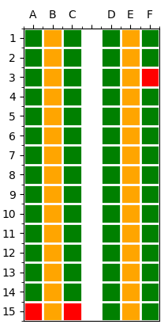

Introduction
Covid-19 pandemic brought the necessity of practicing social distance in planes
Most current booking systems are unnecessarily allocating people too close to each other.
Many airline companies consider blocking the seats in the middle.
Available
Blocked
Figure 1. Plane seats map with blocked seats in the middle (first 15 rows).
Occupied
Free

Slide 3
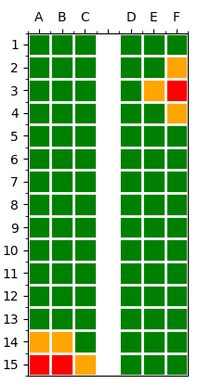
Main objectives
Provide an efficient solution to allocate seats considering safety measures.
Create an algorithm that is able to automatically select the furthest seat / seats from all occupied seats.
Suggest and try to keep, while possible, one empty seat in two directions.
Available
Blocked
Figure 2. Plane seats map with blocked seats next to occupied ones (first 15 rows).
Occupied
Free

Slide 4
Structure of the program
db_functions.py
- create_connection
- create_tables
- delete_tables
- delete_data
- create_plane
- create_seats
- change_seat_status
- delete_booking
visualization.py
user_details.py
- make_plot
- occupancy
- current_situation
- input_user_details
design.py
- block_seats
- create_seats_map
- characterize_seats
- update_seats_map
- update_seats
transformation.py
main.py
- transform_ref_to_xy
- transform_xy_to_ref
- transform_ref_to_xy_in_array
- transform_xy_to_ref_in_array
optimization.py
allocation.py
- furthest_seat_one
- sumabsdiff
- furthest_seat_all
- find_second_seat
- find_random_seat_all
- find_random_seat_blocked
- automatic_selection
- manual_selection

Slide 5
Database structure
Passengers
Booking_Reference VARCHAR
Passenger_Name text
Passenger_ID (pk) VARCHAR
Selection_Preference text
Seat (fk) VARCHAR
Seating
Seat (pk) VARCHAR
Plane_ID (fk) VARCHAR
X int
Y int
Occupied boolean
Planes
Plane_ID (pk) VARCHAR
Number_Corridors int
Number_Columns int
Number_Rows int
Passengers can only have one seat assigned to them.
A seat can be occupied by one passenger or not occupied at all.
A seat corresponds to one and only one plane.
A plane must have at least one seat.

Slide 6
Workflow: General
Are the tables created?
Read from DB:
Number of columns and rows
Position of corridor
Occupied seats
Transform:
References of the occupied seats into coordinates in a matrix
Start
Connect to database (DB)
Yes
e.g.: A1 → (0, 0)
Add data to tables (Planes, Seating)
Create initial seats map
Create tables in DB:
Passengers
Seating
Planes
Characterize seats:
Available seats
Free seats
No
Do you want to create a new booking?
False
Create new booking
Evaluate
initial occupancy
End *
Save to DB
True
* It is possible to delete a booking from the database by passenger ID or booking reference by calling the function delete_booking (in db_functions.py).

Slide 7
Workflow: Input data
Create new booking
Input details:
Number of passengers
Selection preference
Create booking reference
Input details:
Passenger full name
ERROR!
Yes
Is the passenger full name empty?
Selection preference
Is the passenger ID empty?
Seats selection
No
ERROR!
Yes
No
Input details:
Passenger ID
Manual selection
Automatic selection

Slide 8
Workflow: Manual selection
Is the seat free?
Yes
Transform:
Reference of the seat into coordinates
Start
Show initial seats map
Ask for (first) seat
No
Update seats and
seats map
ERROR!
Is the seat free?
Is the number of passengers 2?
Transform:
Reference of the seat into coordinates
Yes
Yes
Ask for second seat
End
Update seats and
seats map
No
No
ERROR!

Slide 9
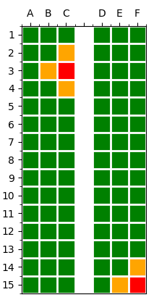
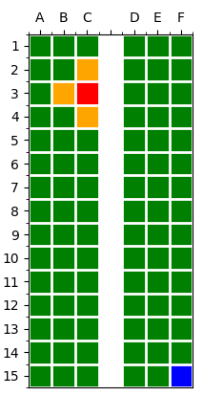
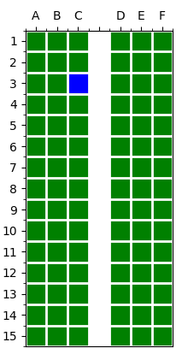
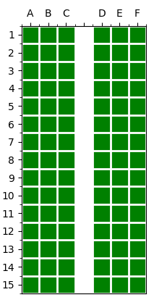
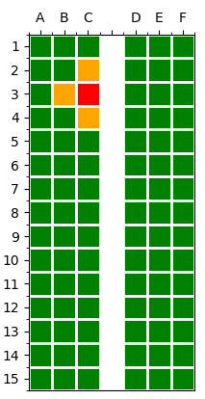
Workflow: Automatic selection
Early stage: With available seats (in green) → 1. Find first seat
Are there available seats?
Is the plane empty?
Start
Show initial seats map
Yes
Yes
Update seats and
seats map
Transform:
Coordinates of the seat into reference
Find first seat randomly from available seats
No
Is the number of passengers 2?
Find first seat that has an available one next to it
(considering the distance criteria)
Find first seat at furthest distance from all

Slide 10
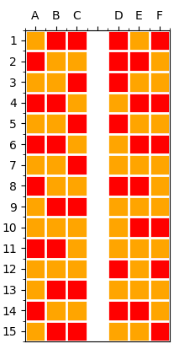
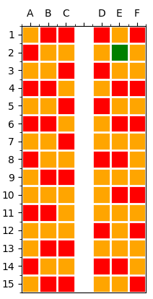
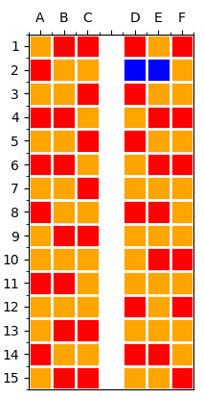

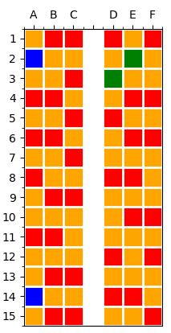
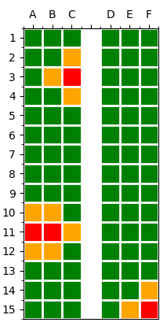
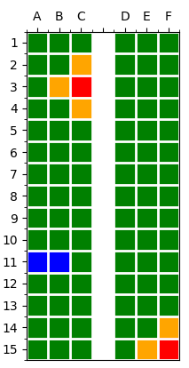
Workflow: Automatic selection
Early stage: With available seats (in green) → 2. Find second seat
Is the number of passengers 2?
Is there an available seat next to the first seat?
Update seats and
seats map
Yes
Yes
Transform:
Coordinates of the seat into reference
Update seats and
seats map
Find second seat
next to first seat
No
Find second seat at furthest distance from all
Are there available seats?
Yes
Find second seat randomly from free seats
No

Slide 11
Evaluation of furthest distance
 | A | B | C | Corridor | D | E | F
1 | [0, 0] | [0, 1] | [0, 2] | [0, 3] | [0, 4] | [0, 5] | [0, 6]
2 | [1, 0] | [1, 1] | [1, 2] | [1, 3] | [1, 4] | [1, 5] | [1, 6]
3 | [2, 0] | [2, 1] | [2, 2] | [2, 3] | [2, 4] | [2, 5] | [2, 6]
4 | [3, 0] | [3, 1] | [3, 2] | [3, 3] | [3, 4] | [3, 5] | [3, 6]
5 | [4, 0] | [4, 1] | [4, 2] | [4, 3] | [4, 4] | [4, 5] | [4, 6]
6 | [5, 0] | [5, 1] | [5, 2] | [5, 3] | [5, 4] | [5, 5] | [5, 6]
 | [0, 0] | [0, 2] | [2, 0] | [5, 6] | ∑ DIST | ∑|DIFF₁| | DIFF₂ = ∑DIST - ∑|DIFF₁|
[4, 5] | 9 | 7 | 7 | 2 | 25 | 21 | 4
[5, 2] | 7 | 5 | 5 | 4 | 21 | 9 | 12
[5, 1] | 6 | 6 | 4 | 5 | 21 | 7 | 14
… | … | … | … | … | … | … | …
3
2
1
Available
Blocked
Occupied
Free

Slide 12
Conclusions
The proposed algorithm performs as it was planned.
When the plane is not full, we provide a better solution that ensures safety measures than the ones found in the current booking systems.
Various libraries (pandas, numpy, matplotlib, re, math, random, uuid and PyInquirer), Python and SQLITE (sqlite3) were used to develop the code.
Limitations:
- The user interface should be further developed.
- The bookings can only be made by one or two passengers.
- The plane design is simplified and different layouts could be implemented.

Slide 13
References
Hipp, R. D. (2020). SQLite. Retrieved from https://www.sqlite.org/index.html.
John D. Hunter. Matplotlib: A 2D Graphics Environment, Computing in Science & Engineering, 9, 90-95 (2007).
McKinney, W. et al. (2010). Pandas: Data structures for statistical computing in python. In Proceedings of the 9th Python in Science Conference (Vol. 445, pp. 51–56).
Oliphant, T. E. (2006). A guide to NumPy (Vol. 1). Trelgol Publishing USA.
PyInquirer 1.0.3. Retrieved from https://github.com/CITGuru/PyInquirer/releases/tag/1.0.3.
Van Rossum, G. (2020). The Python Library Reference, release 3.8.2. Python Software Foundation.

Slide 14
Thank you for your attention!

