Slide 1
Lab 1: AWS S3, Java and JSON
Jesús A. Omaña Iglesias jesusalberto.omana@upf.edu | Pablo Martín Castagnaro pablo.castagnaro@upf.edu

Slide 2
Summary
Part 1: AWS & S3
Motivation
Access
The web console
The CLI
The Java SDK
Services: S3
Part 2: AWS Academy
Part 3: More on Java & Maven
Part 4: The JSON format & the GSON library

Slide 3
Intro to AWS

Slide 4
What is AWS?
From AWS documentation:
Amazon Web Services (AWS) provides on-demand computing resources and services in the cloud, with pay-as-you-go pricing.
Also known as:
IAAS: Infrastructure As A Service

Slide 5
A bit of history
Project born in 2002, officially started in 2006 with only 3 services: Storage (S3), Computing (EC2), Queues (SQS)
Today it comprises now more than 90 different services spanning multiple areas of computing
In 2015 AWS was reported as profitable!
Notable customers: NASA, Netflix
Instagram migrated to Facebook infrastructure shortly after acquisition

Slide 6
What is AWS?
Integrated constellation of services that span many categories and purposes
Computing resources (EC2)
Storage (S3)
Database storage (RDS, Redshift, ...)
NoSQL Storage (DynamoDB, ...)
Analytics & Data processing (EMR, ElasticSearch, Athena, ...)
Security and Policy (IAM, ...)
Networking (VPC, Route53, CloudFront, ...)
Machine Learning (Lex, Forecast, ...)
More categories: Robotics, Blockchain, Satellite, Media Services, ...
More goodies added every week!

Slide 7
Regions and Availability Zones
Amazon services are hosted in multiple locations world-wide.
These locations are composed of Regions and Availability Zones. Each Region is a separate geographic area. Each Region has multiple, isolated locations known as Availability Zones.
Amazon EC2 provides you the ability to place resources, such as instances, and data in multiple locations.
Resources aren't replicated across regions (unless you do so specifically).

Slide 8
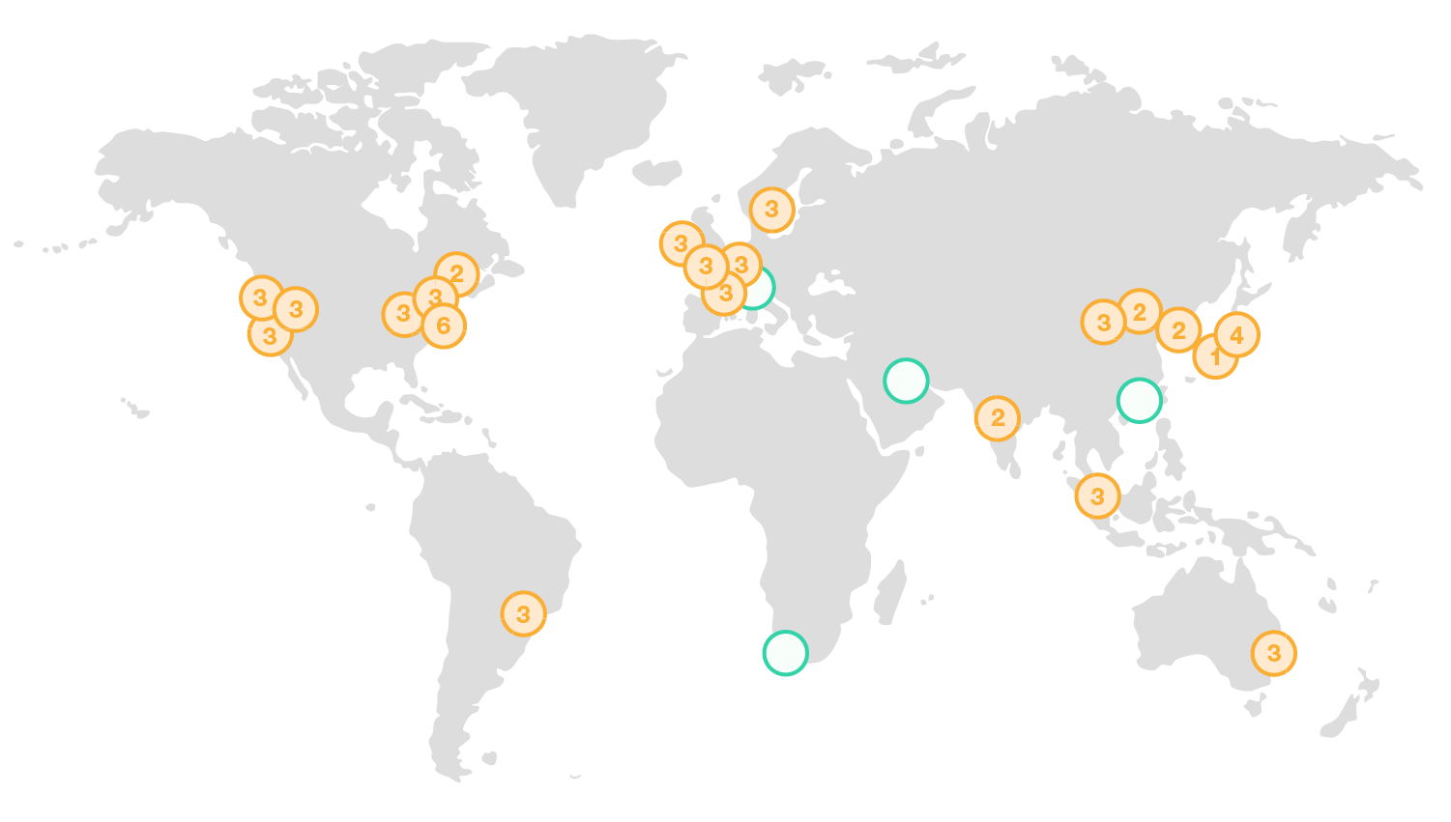

Slide 9
Benefits
On demand: Pay-as-you-go (each service billed differently)
Scaling: easily go up and down horizontally or vertically from 0 to massive
Faster time-to-market: little to no set-up needed, especially for common use cases

Slide 10
Elastic
can handle “any” load
scales up-and-down

Slide 11
Access
To access AWS services you need to authenticate
Username and password are called aws_access_key_id and aws_secret_access_key
For AWS Educate: you’ll need also a aws_session_token

Slide 12
Access
The AWS console is a web interface
The AWS CLI is a command line interface to most AWS services
The AWS SDKs provide embeddable AWS parts for most services in popular languages

Slide 13

AWS Academy

Slide 14
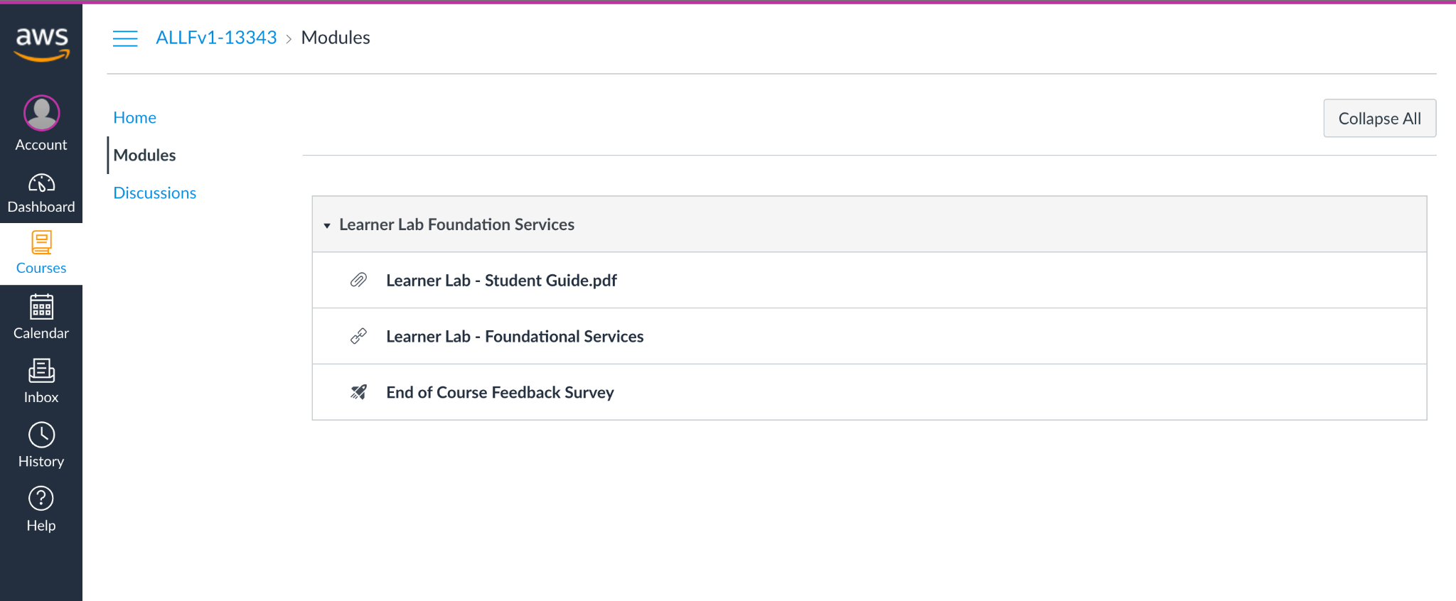
Access to AWS Academy and its resources
0. Check your email and register in AWS Academy with the provided link
1. Click on Courses to access the AWS resources
2. Click on Academy Learner Lab and access terms and conditions

Slide 15
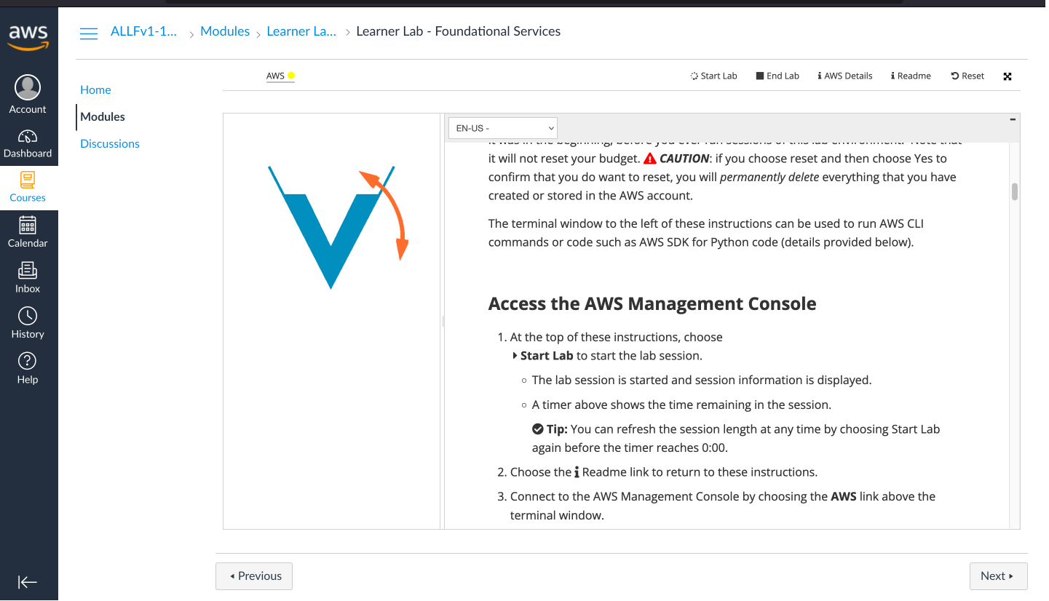
Access to AWS Academy and its resources
3. Click on Start Lab to access the AWS resources
4. Wait until your lab is ready
5. Click AWS Details to access your account credentials

Slide 16
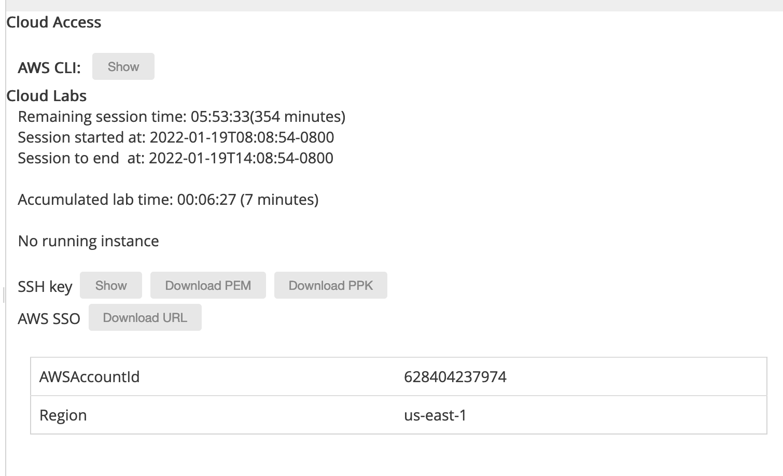

What does AWS Academy offer?
“Student” version of the AWS console
Pre-loaded with some expendable credit ($100)
The CLI credentials expire every 3 hours
7. Click on AWS Console to open the Web Console
6. Click on Show to get CLI Credentials

Slide 17
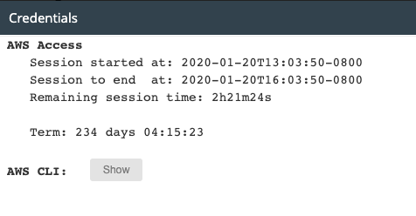
Account Details
Provides the credentials and the token you’ll need to copy into ~/.aws/credentials on your workstation
1. Click on Show to get your credentials
2. Copy them to the expected file
3. Try a CLI command from your shell, for instance: aws s3 ls

Slide 18
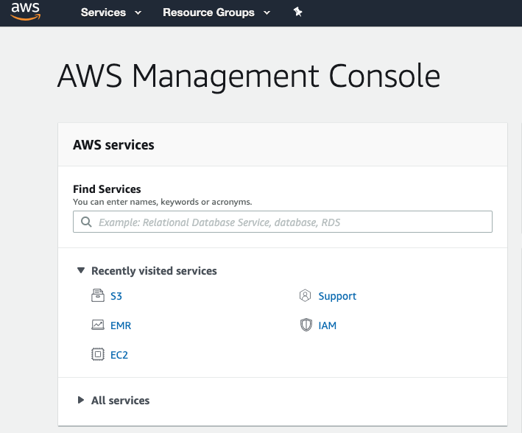
AWS Console
Provides access to all available services (including S3)

Slide 19
AWS CLI
Command Line Interface to interact with AWS services

Slide 21

S3: Simple Storage Service

Slide 22
What is AWS S3?
File System in the cloud, accessible with HTTP interface
HTTP Requests are authenticated

Slide 23
Bucket
equivalent to a disk in a “traditional” filesystem
Amazon S3 has a global namespace. (i.e. No two S3 buckets can have the same name.)
Notes:
Global namespacing is similar to how DNS works where each domain name must be unique.

Slide 24
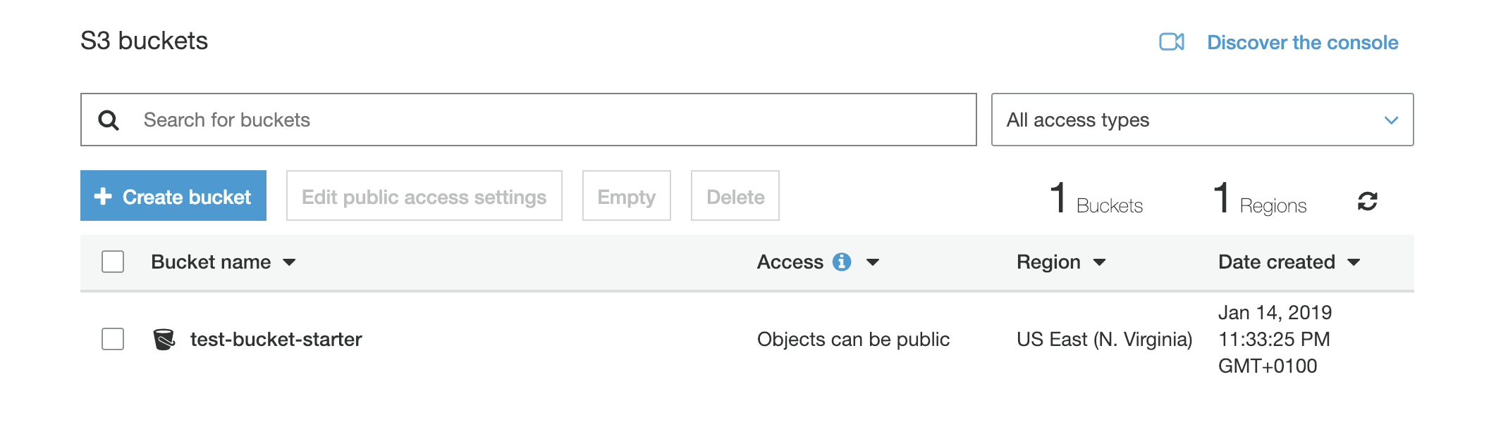

Slide 25
Key
equivalent to a path in a “traditional” file system

Slide 26
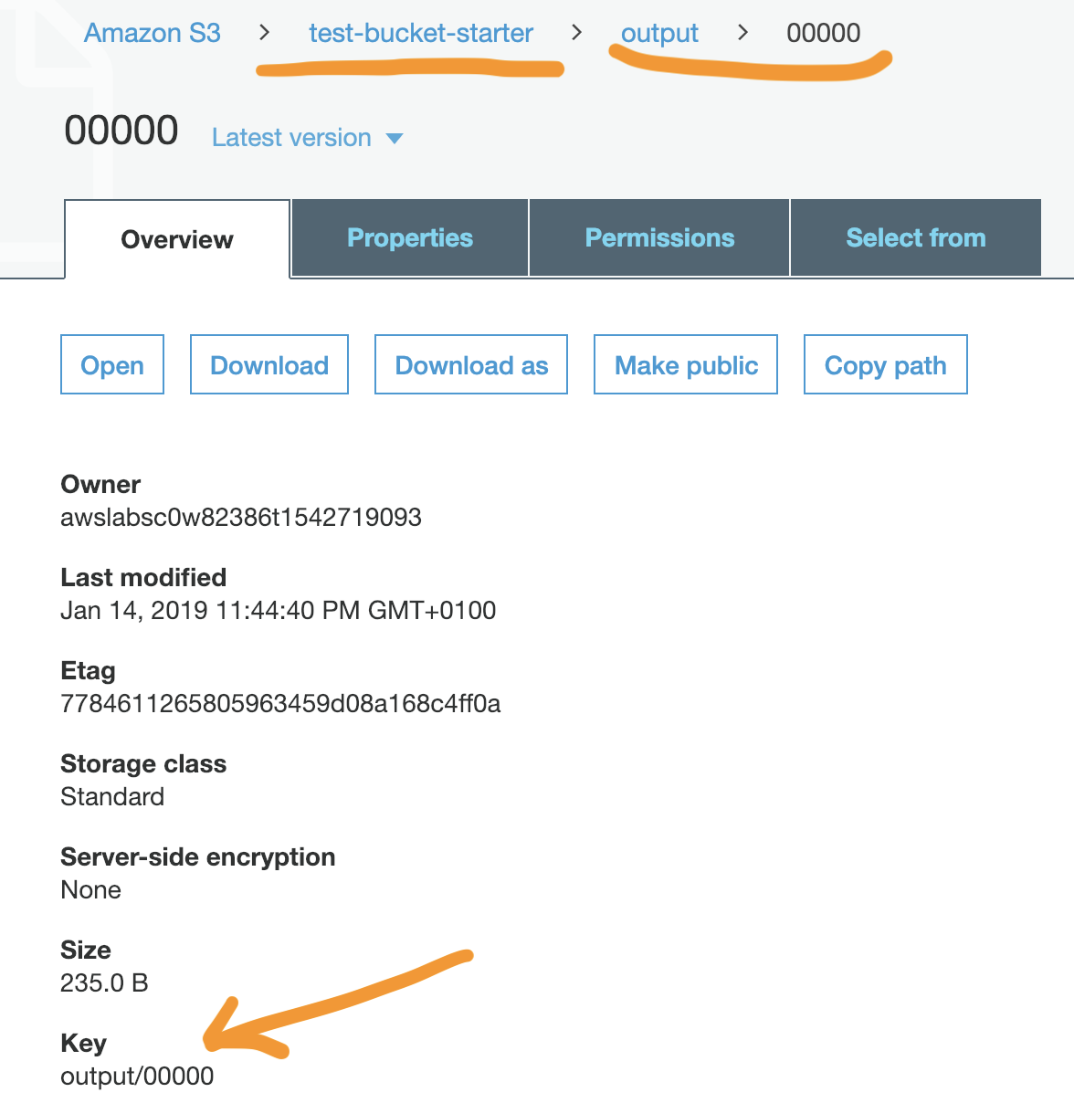

Slide 27
Permissions
Access can be: private, for a specific account or list of accounts, or public

Slide 28
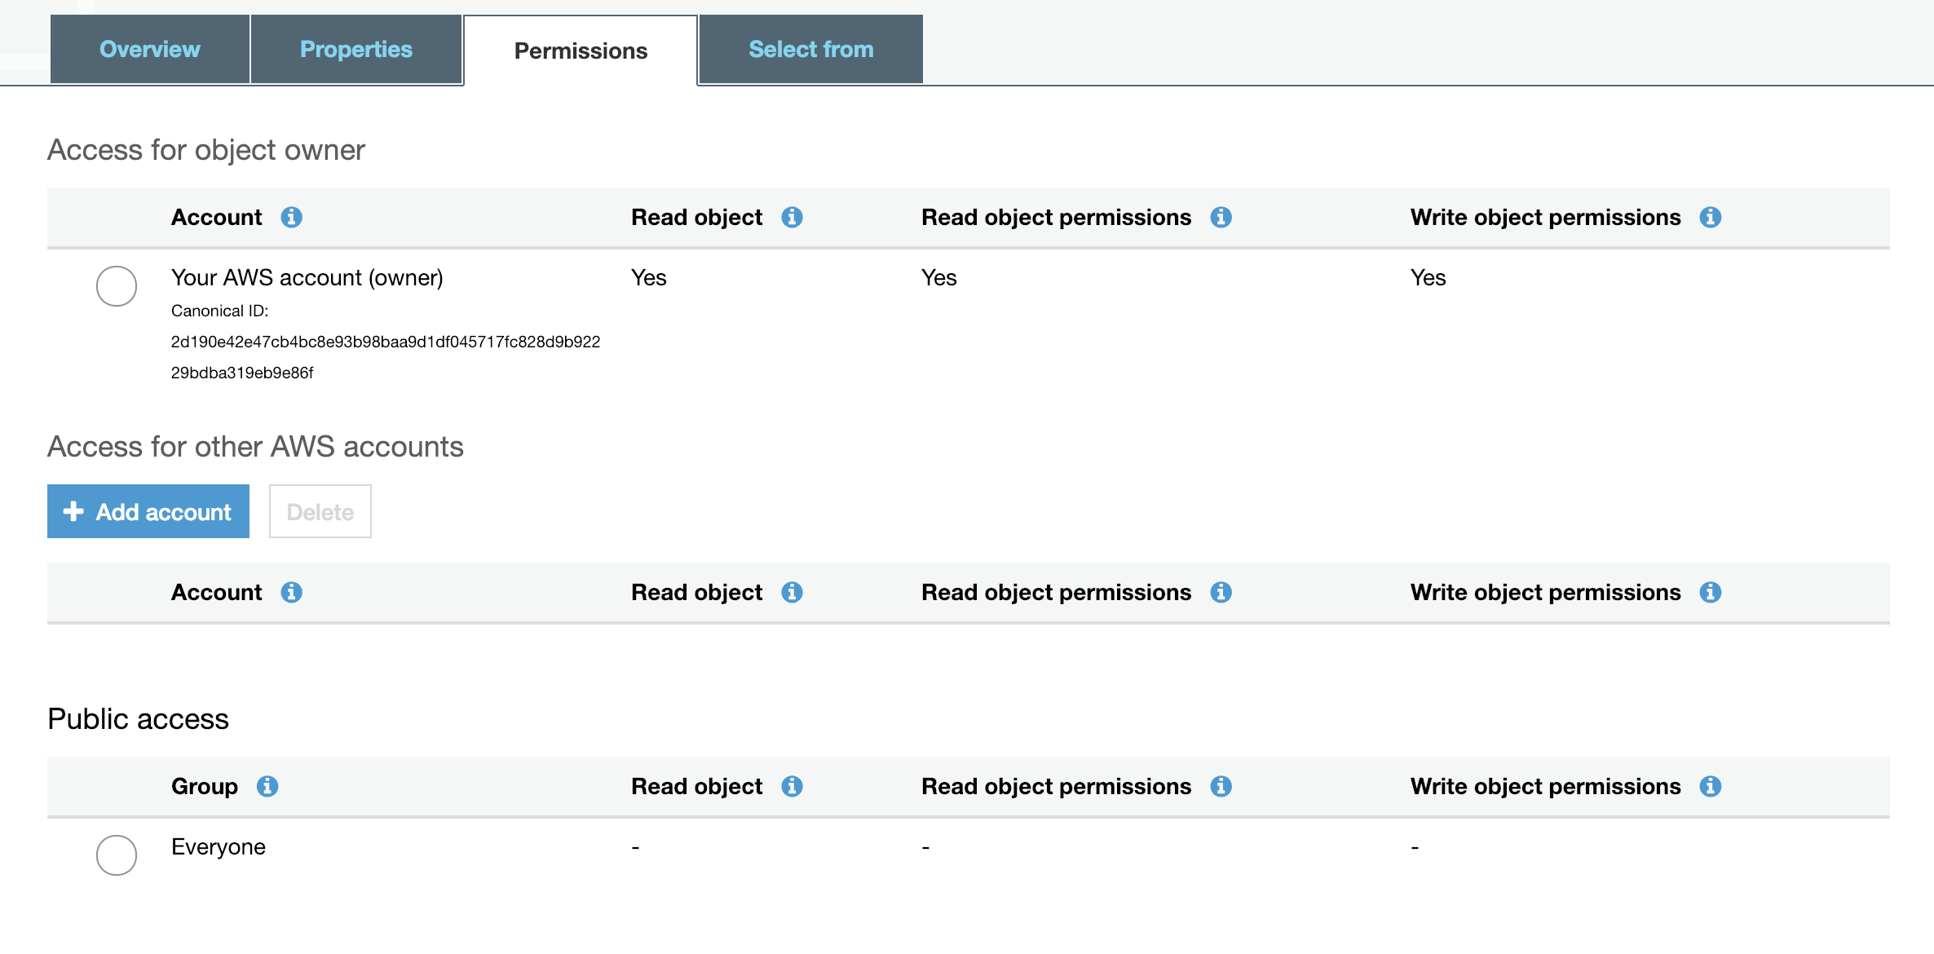

Slide 29
S3 using the CLI

Slide 30
S3 through CLI
aws s3 ls s3://bucket-name
List content of bucket bucket-name
aws s3 cp s3://bucket-name/dir1/file1 /tmp/
Copy remote key /dir1/file1 from bucket bucket-name into local directory /tmp/. cp from local to s3 is also a valid operation; in that case you should provide the full key name
aws s3 cp --recursive s3://bucket/dir2/ /tmp/dir2.local
Copy all keys under /dir2 from bucket bucket-name into local directory /tmp/dir2.local
aws s3api create-bucket --bucket test-bucket
Create bucket test-bucket in the default account and region
aws s3api list-buckets
List all the created buckets in the default account. Additionally, displays the canonical id.

Slide 31
Giving custom access to a bucket
To give access to another account for a bucket, you need to know the canonical ID of that account. It’s a long alphanumeric string.
Hint! The list-buckets operations provides you with such information
As usual, you can perform the operation through the CLI, or the web interface, or programmatically
From the cli, the command is something like:
Warning! This overrides any existing policy! See: https://docs.aws.amazon.com/cli/latest/reference/s3api/put-object-acl.html
aws s3api put-bucket-acl --bucket <bucket-name> --grant-read id=<canonical-id>

Slide 32
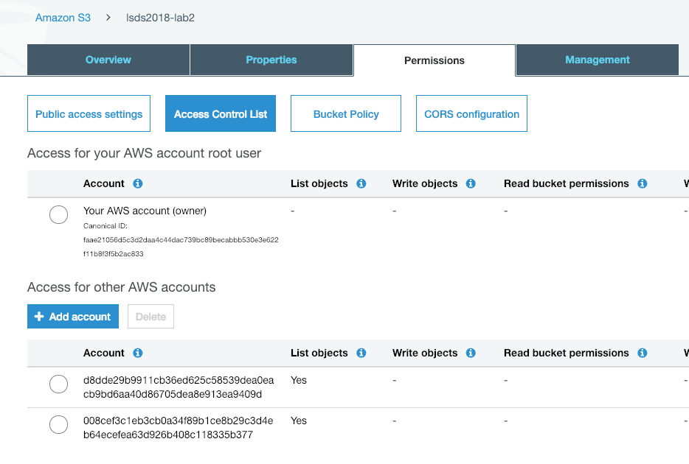
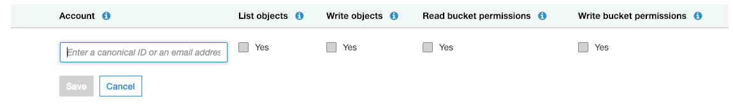
1. Select bucket
2. Select Permissions
3. Select ACL
4. Select Add Account
5. Insert the Canonical ID and select List Objects

Slide 33
Objectives of Lab 1
Create a fully functional portable program in Java + Maven
Learn and use the JSON format with an off-the-shelf library
Get acquainted with AWS, AWS authentication, S3
Benchmark the performance of a sequential application
Functional programming: use Java 8 Optional type
Notes:
Create a program in Java + Maven
- Make use of S3
- Check low performance
- Use optional type

Slide 34
More on Java & Maven

Slide 35

Introduction to Maven
Is a build automation tool primarily used in Java projects
Maven addresses two aspects of building software:
How the software is built
Its dependencies
Configuration done in an XML file: pom.xml
The project is hosted by the Apache foundation

Slide 36
Maven
Manage lifecycle of an artifact
Handle dependencies and possible conflicts
Compile and generate portable artifacts
<dependencies> <dependency> <groupId>junit</groupId> <artifactId>junit</artifactId> <version>4.11</version> <scope>test</scope> </dependency>
<dependency>
... </dependency> </dependencies>
Notes:
What is a dependency? External java liobraries required for building and running a project. Maven automatically downloads them
What is an artifact? Is basically the output of the building process, e.g., a JAR file

Slide 37
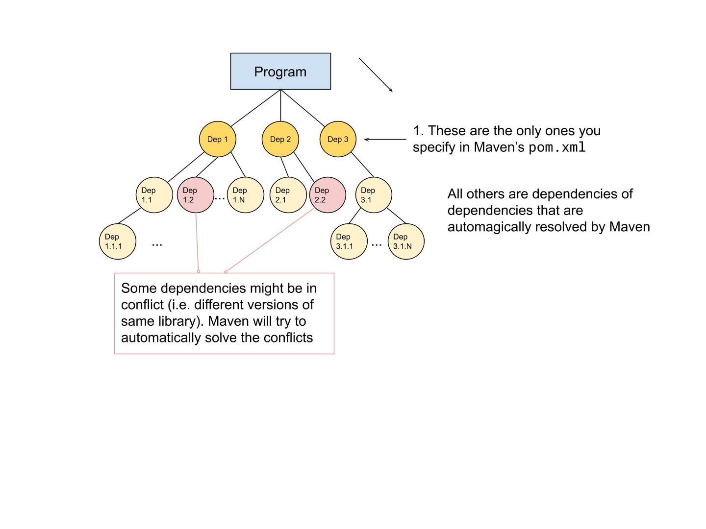
Dependency tree
Notes:
What is a dependency?
What is an artifact?

Slide 38
Running Java Applications
2 options when running a Java program:
Retrieve and add all dependencies into the classpath
Build a jar containing all dependencies (a.k.a Fat Jars or Shadow Jars)
java -cp dep1:dep2:dep3 my.application.executable
java -cp fat.jar my.application.executable
Notes:
Can you think of any drawback when building fat jars?

Slide 39
maven-shade-plugin
<build> <plugins> <plugin> <groupId>org.apache.maven.plugins</groupId> <artifactId>maven-shade-plugin</artifactId> <version>3.2.1</version> <configuration> <!-- put your configurations here if need be --> </configuration> <executions> <execution> <phase>package</phase> <goals> <goal>shade</goal> </goals> </execution> </executions> </plugin> </plugins> </build>
maven plugin to build “fat” jars
mvn package: the build will run the shade “goal” on this plugin
Shade will take all dependencies, extract all files, put them in a single jar, together with project classes
Notes:
Maven-shade-plugin_ this is used to create the artifact

Slide 40
The Optional type

Slide 41
Bits of Functional Programming
Functional programming dislikes modifying variables:
Can lead to unexpected application state
Can lead to complicated branching
Functional programming dislikes the null value
Can’t call methods on it
Can lead to complicated branching
Functional programming promotes function as first-class citizens, like variables
Instead of changing a variable to a new value, functional programming prefers to transform a variable of type T into a variable of type U using a function f: T -> U (T can be equal to U)
Examples:
f: Int -> Int = x -> x + 1
Same as: f(x) = x + 1
f: String -> Int = s -> Integer.parseInt(s)
Same as: f(s) = Integer.parseInt(s)

Slide 42

The Optional type
Optional<T> (Java 1.8+) is a generic container for type T, with two possible values:
Optional.empty(), if the value is null
Optional with value of type T, if not null
Equivalent to a “box”, either empty or with something in it: can continue the computation on if it’s not empty, otherwise it stays empty
Optional provides, among others, the following methods:
ofNullable(T val): constructor. if val is null, return Empty, else Optional(val)
isPresent(): true if “box” contains a value
get(): retrieve val or except
orElse(T other): retrieve val if present, otherwise return other
map(f: T->U): Optional<U>: apply f on val if present, transforming type T to type U

Slide 43
The Optional type: a simple example
Return the integer value of a String representing an Integer or a default value (-1)
String intStr = null;
int val1 = -1;
if(intStr != null) {
val1 = Integer.parse(intStr)
}
return val1;
Without
Optional
String intStr = null;
Integer val1 = Optional
.ofNullable(intStr) //Optional<String>
.map(s -> Integer.parse(s)) //Optional<Integer>
.orElse(-1); //Integer
With
Optional

Slide 44
The Optional type: a more complex example
Accessing a nested field within a hierarchy of classes
Without Optional
With Optional
if (userId != null) {
User u = phoneBook.getUser(userId);
if (u != null) {
Address a = u.getAddress(u);
if (a != null) {
City c = a.getCity()
return city;
}
}
}
if (city != null) {
// do something
}
Optional<City> = Optional
.ofNullable(userId) // Optional<UserId>
.flatMap(id -> Optional
.ofNullable(phoneBook.getUser(id)) //Optional<User>
.flatMap(u -> Optional
.ofNullable(u.getAddress(u))
.map(a -> a.getCity())
;
if(city.isPresent()) {
// do something
}
Notes:
flatMap is a map followed by a flatten

Slide 45
What’s JSON?

Slide 46
What’s JSON?
JSON (from JavaScript Object Notation) is a widely used lightweight format used for data representation and exchange on the Internet
Main advantages are:
it’s human readable
JSON serialisation produces text
aims to be self-describing (like XML)
it’s compact (unlike XML)
it’s easy to read, write and manipulate

Slide 47
What’s JSON?
JSON has 3 type of structures:
Objects (contained within curly brackets {})
Arrays (contained within square brackets [])
Simple values
Simple values can be of 4 types: strings, numerical values, booleans, null
In an object, each value has a name, in an array it doesn’t
Sequence of values are separated by comma

Slide 48
Examples of valid JSON
{} | Empty JSON object
[] | Empty JSON array
false | The boolean value false
[1, 2, 3] | Json array of numbers
{“age”: 12} | Object with a single numerical field
{ “name”: “tom”, “friends”: [“jerry”, “jack”] } | Object with 2 fields, one is a string, the other is an array of strings
[ {“name”: “ted”, “IBAN”: 123}, {“name”: “bob”, “IBAN”: 456} ] | Array of objects: each object contains one numerical field (“IBAN”) and one string field (“name”), that is: the two objects have the same structure.

Slide 49
Examples of invalid JSON
{1} | The numerical value is missing a name!
[“age”: 11] | Values don’t have a name in arrays!
false, true | An array of boolean would be missing the square brackets
[1, 2, 3, “four”] | This is actually valid, but you should think twice before writing it!
{“age”: 12 | Missing closing bracket
{“name”: “tom” “friends”: [“jerry”, “jack”]} | The values are not separated by comma
{“name”: “jerry”, true} | The boolean value doesn’t have a name

Slide 50
Parsing JSON with GSON

Slide 51
Parsing JSON
There are plenty of libraries used to parse JSON for any language
In Java, very common choices are:
Jackson
GSON
JSON simple
In this Lab, we’ll use GSON
Gson provides two way to parse JSON:
Directly into a java class (POJO)
Abstractly into a JSON object
Notes:
Moodle:
P101: Error en el módulo de entregas
P101: Error en el foro
Ejercicio de self-evaluation
Code/GitHub:
think that someone might download that code
PRs?
Did you use the checklist? I’ll be using it for grading

Slide 52
Parsing with GSON
Parse JSON... | ...using Gson() | ...using JsonParser()
When? | Parsing structured objects directly into Java classes (all objects have same structure) | Unknown Objects or object that do not map directly to Java classes
Sample JSON | var jsonStr = “{\”name\”: \”tom\”}”
Deserialization Example | new Gson() .fromJson(jsonStr, User.class) | JsonParser. parseString(jsonStr)
Returns | An instance of the target class | An instance of JsonElement
Expectations | The target class exists. JSON string and target class have same structure (including nested objects) | None, tries to parse the string into JSON directly
Type casting | Automatic conversion to target class member type | “manual” with JsonElement class methods to expected types
Retrieve fields | Use the target class accessors (getters) | each field has to be checked for existence and retrieved manually
Notes:
Moodle:
P101: Error en el módulo de entregas
P101: Error en el foro
Ejercicio de self-evaluation
Code/GitHub:
think that someone might download that code
PRs?
Did you use the checklist? I’ll be using it for grading

Slide 53
Parsing with GSON using JsonParser
Java | class User { String name; int age; String phoneNumber; } | JsonElement je = JsonParser.parseString(jsonStr); JsonObject jo = je.getAsJsonObject(); String user = null; if (jo.has(“user”)) { JsonObject userObj = jo.get(”user”) .getAsJsonObject(); // cast method if (userObj.has(“name”)) { user = userObj.get(“name”) .getAsString(); // cast method } } … // parse for age and phoneNumber return new User(user, age, phoneNumber);
JSON | { “user”: { “name”: “john”, “age”: 22 }, “Contacts”: { “Email”: “john@gmail.com”, “Mobile”: “777-654-321” } }
Notes:
Moodle:
P101: Error en el módulo de entregas
P101: Error en el foro
Ejercicio de self-evaluation
Code/GitHub:
think that someone might download that code
PRs?
Did you use the checklist? I’ll be using it for grading

