Slide 1
Introduction to Simulation Based Inference
Enhancing synthetic models with Artificial Intelligence
Alina Bazarova, Jose Robledo, Stefan Kesselheim

Slide 2
Tutorial overview
What is Simulation Based Inference (SBI) and how it is connected to classical
Bayesian Inference
Basic concepts of the classical Bayesian Inference
Setting-up an SBI framework and adapting classical Bayesian inference examples to it.
Hands-on experience with python sbi package within a Jupyter environment
SBI inference at different levels of model granularity
Distributing SBI to run on multiple nodes

Slide 3
What is the Simulation Based Inference?
Also known as Likelihood-free Bayesian Inference

Slide 4
What is the Simulation Based Inference?
Also known as Likelihood-free Bayesian Inference
One step back: Let us talk about Classical Bayesian Inference! What is it good for?

Slide 5
What is the Simulation Based Inference?
Also known as Likelihood-free Bayesian Inference
One step back: Let us talk about Classical Bayesian Inference! What is it good for?
General concepts of Bayesian Inference
Essentially a type of statistical inference (different from classical/frequentist statistical inference)

Slide 6
What is the Simulation Based Inference?
Also known as Likelihood-free Bayesian Inference
One step back: Let us talk about Classical Bayesian Inference! What is it good for?
General concepts of Bayesian Inference
Essentially a type of statistical inference (different from classical/frequentist statistical inference)
Bayesian approach to inference is about preserving uncertainty

Slide 7
What is the Simulation Based Inference?
Also known as Likelihood-free Bayesian Inference
One step back: Let us talk about Classical Bayesian Inference! What is it good for?
General concepts of Bayesian Inference
Essentially a type of statistical inference (different from classical/frequentist statistical inference)
Bayesian approach to inference is about preserving uncertainty
The outputs are not point estimates, but rather probability distributions.

Slide 8
What is the Simulation Based Inference?
Also known as Likelihood-free Bayesian Inference
One step back: Let us talk about Classical Bayesian Inference! What is it good for?
General concepts of Bayesian Inference
Essentially a type of statistical inference (different from classical/frequentist statistical inference)
Bayesian approach to inference is about preserving uncertainty
The outputs are not point estimates, but rather probability distributions.
Bayesian approach is based on observed data and the estimates are updated as more
data arrive (usage of conditional probability)

Slide 9
What is the Simulation Based Inference?
Also known as Likelihood-free Bayesian Inference
One step back: Let us talk about Classical Bayesian Inference! What is it good for?
General concepts of Bayesian Inference
Essentially a type of statistical inference (different from classical/frequentist statistical inference)
Bayesian approach to inference is about preserving uncertainty
The outputs are not point estimates, but rather probability distributions.
Bayesian approach is based on observed data and the estimates are updated as more
data arrive (usage of conditional probability)
Therefore, more flexibility, possibly more information

Slide 10
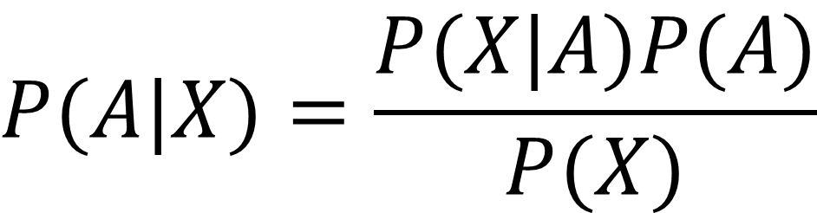
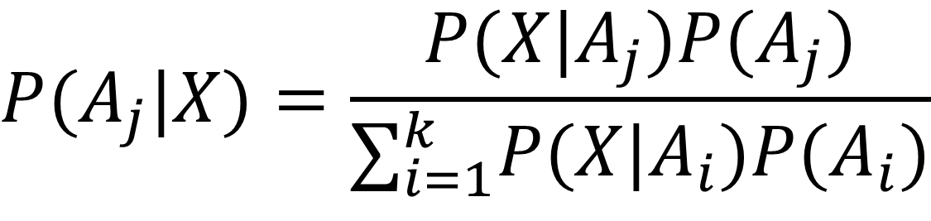
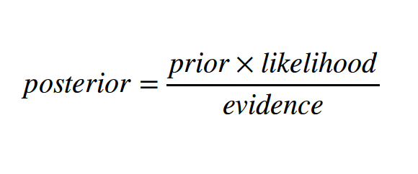
Formalism. Bayes rule (theorem).
Reformulated in Bayesian language

Slide 11
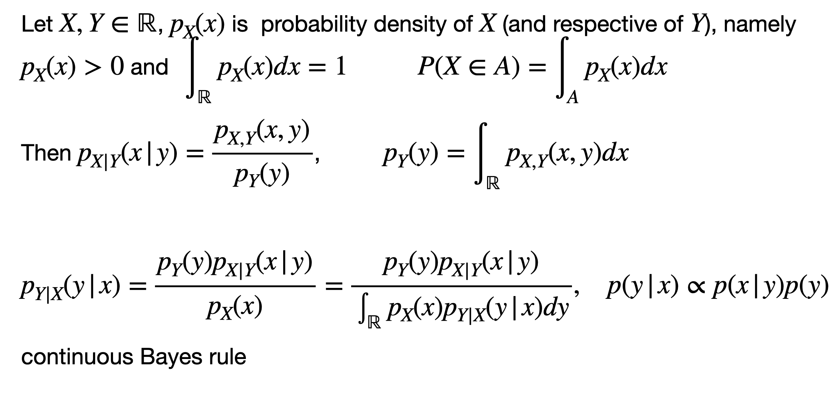
Continuous space

Slide 12
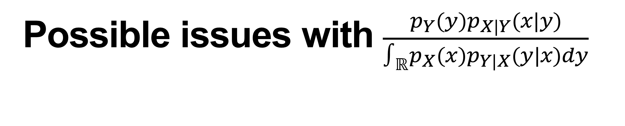
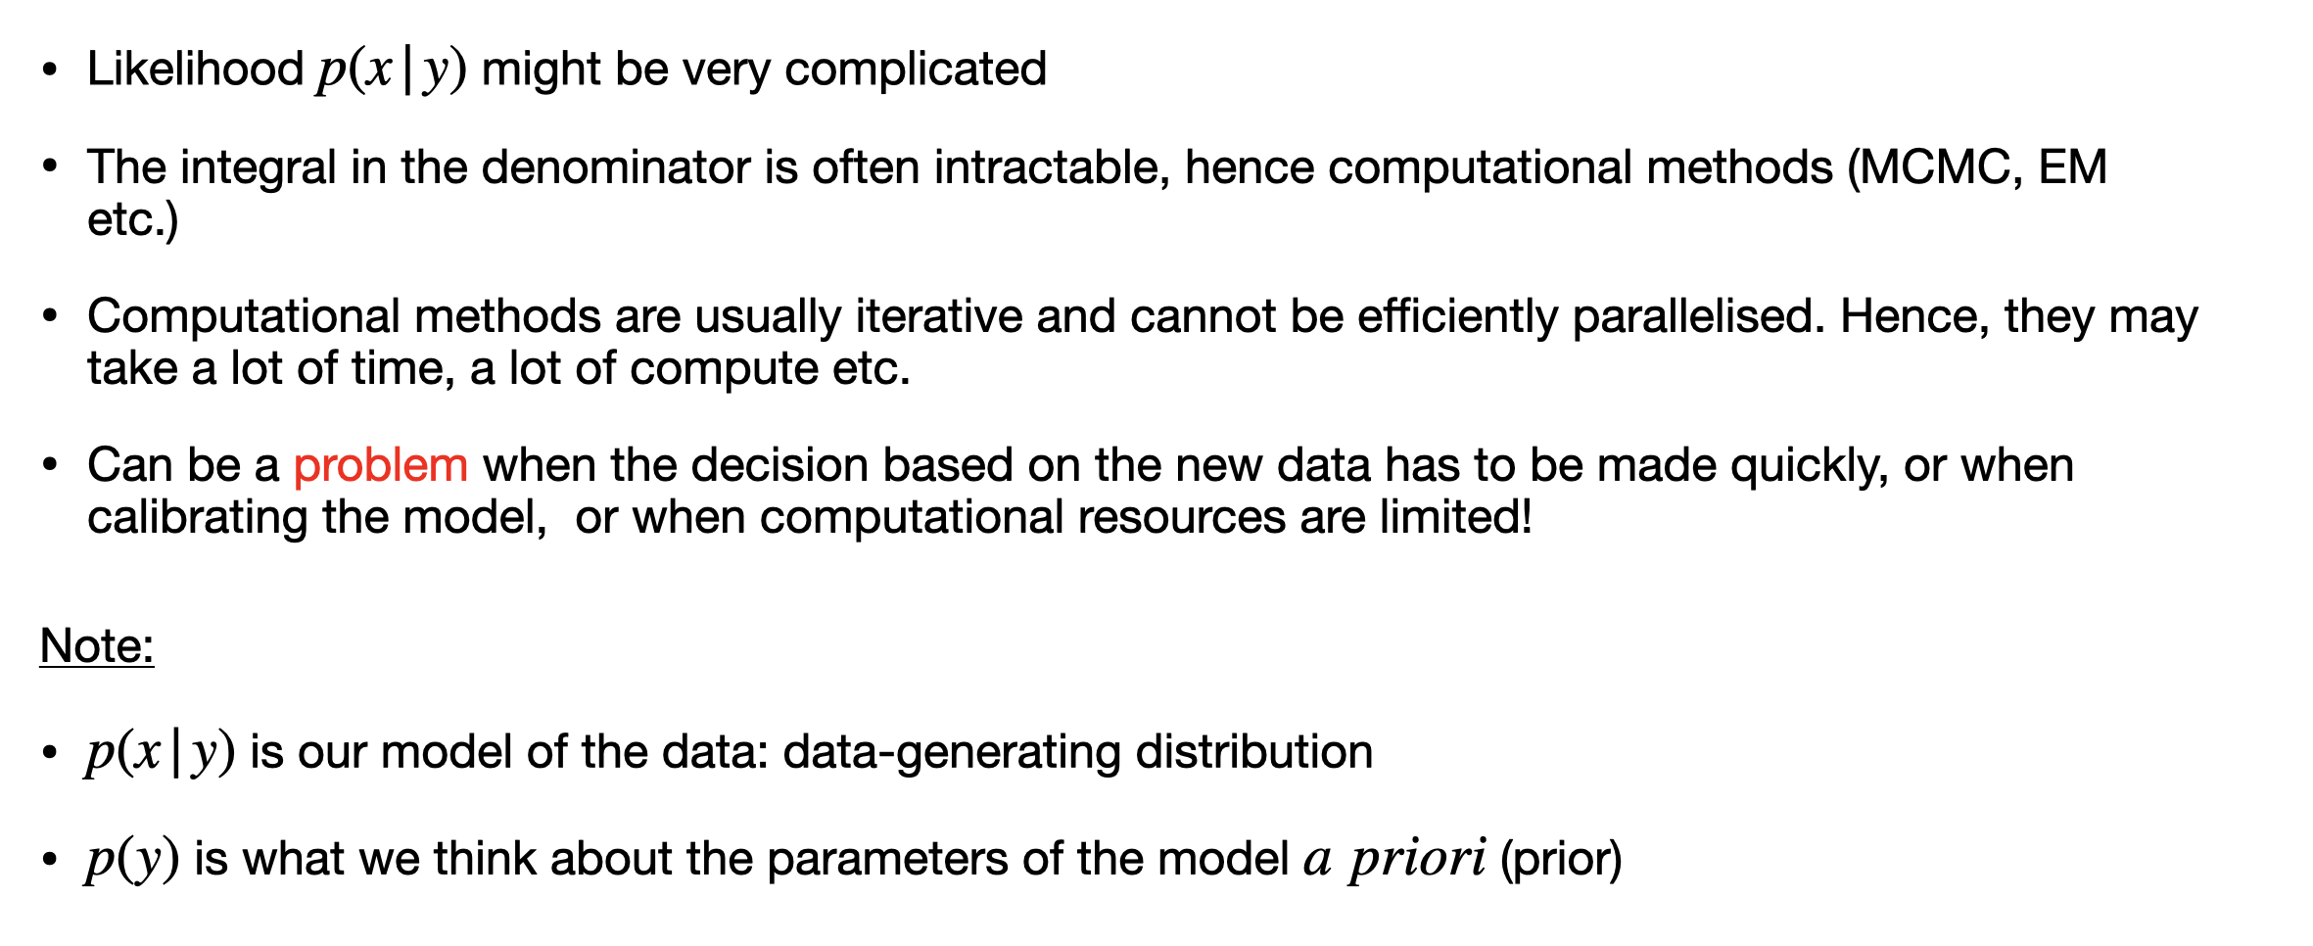

Slide 13
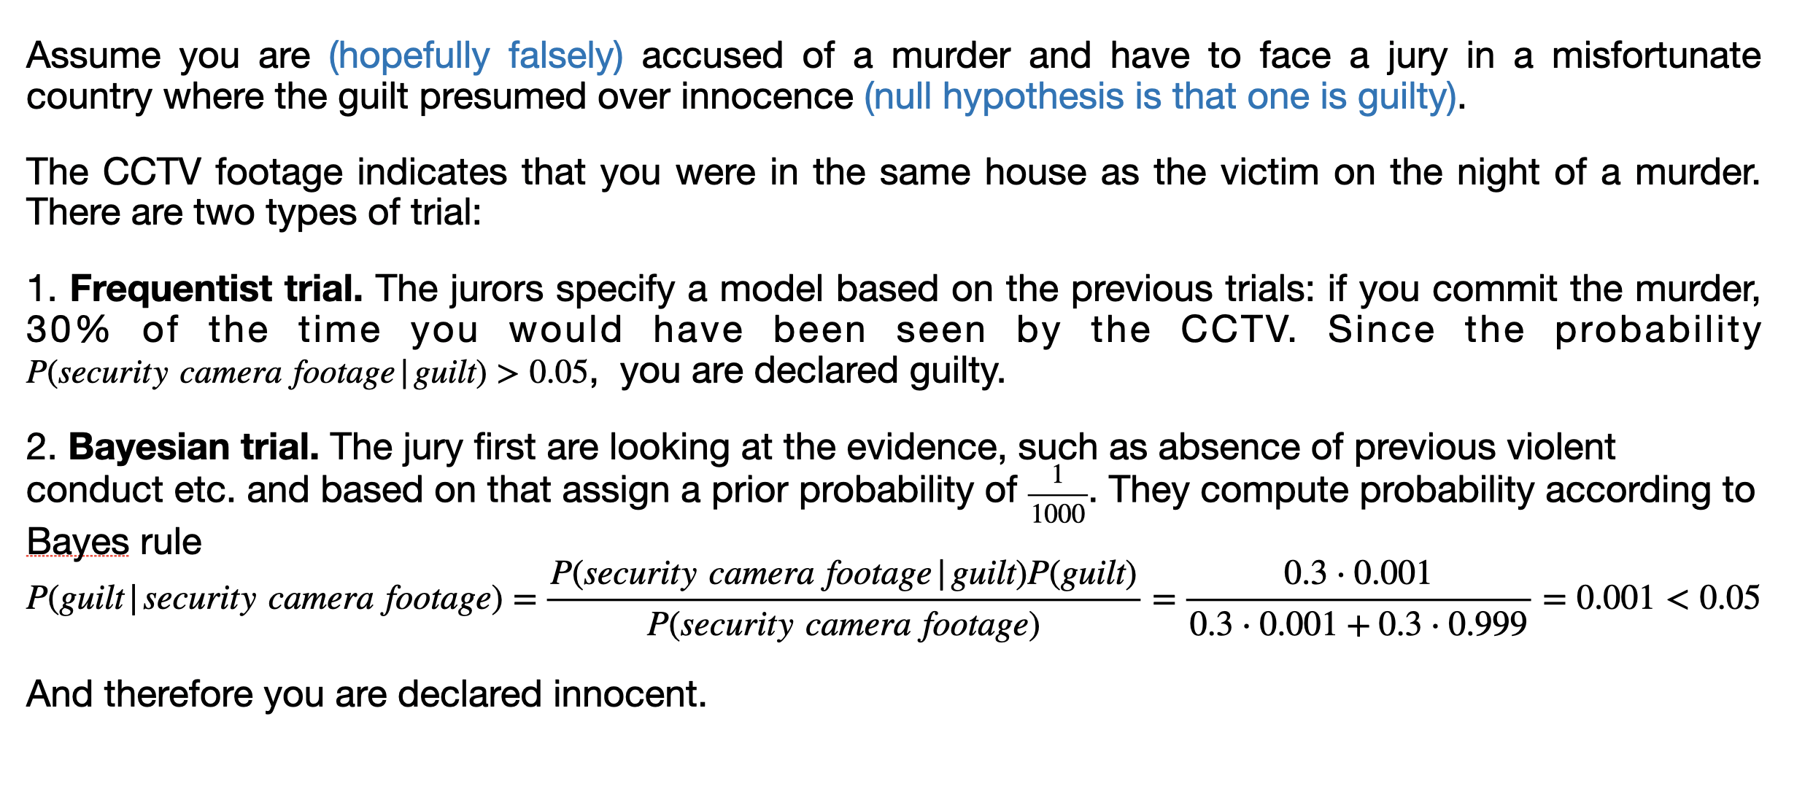
Bayesian vs Frequentist murder trial

Slide 14
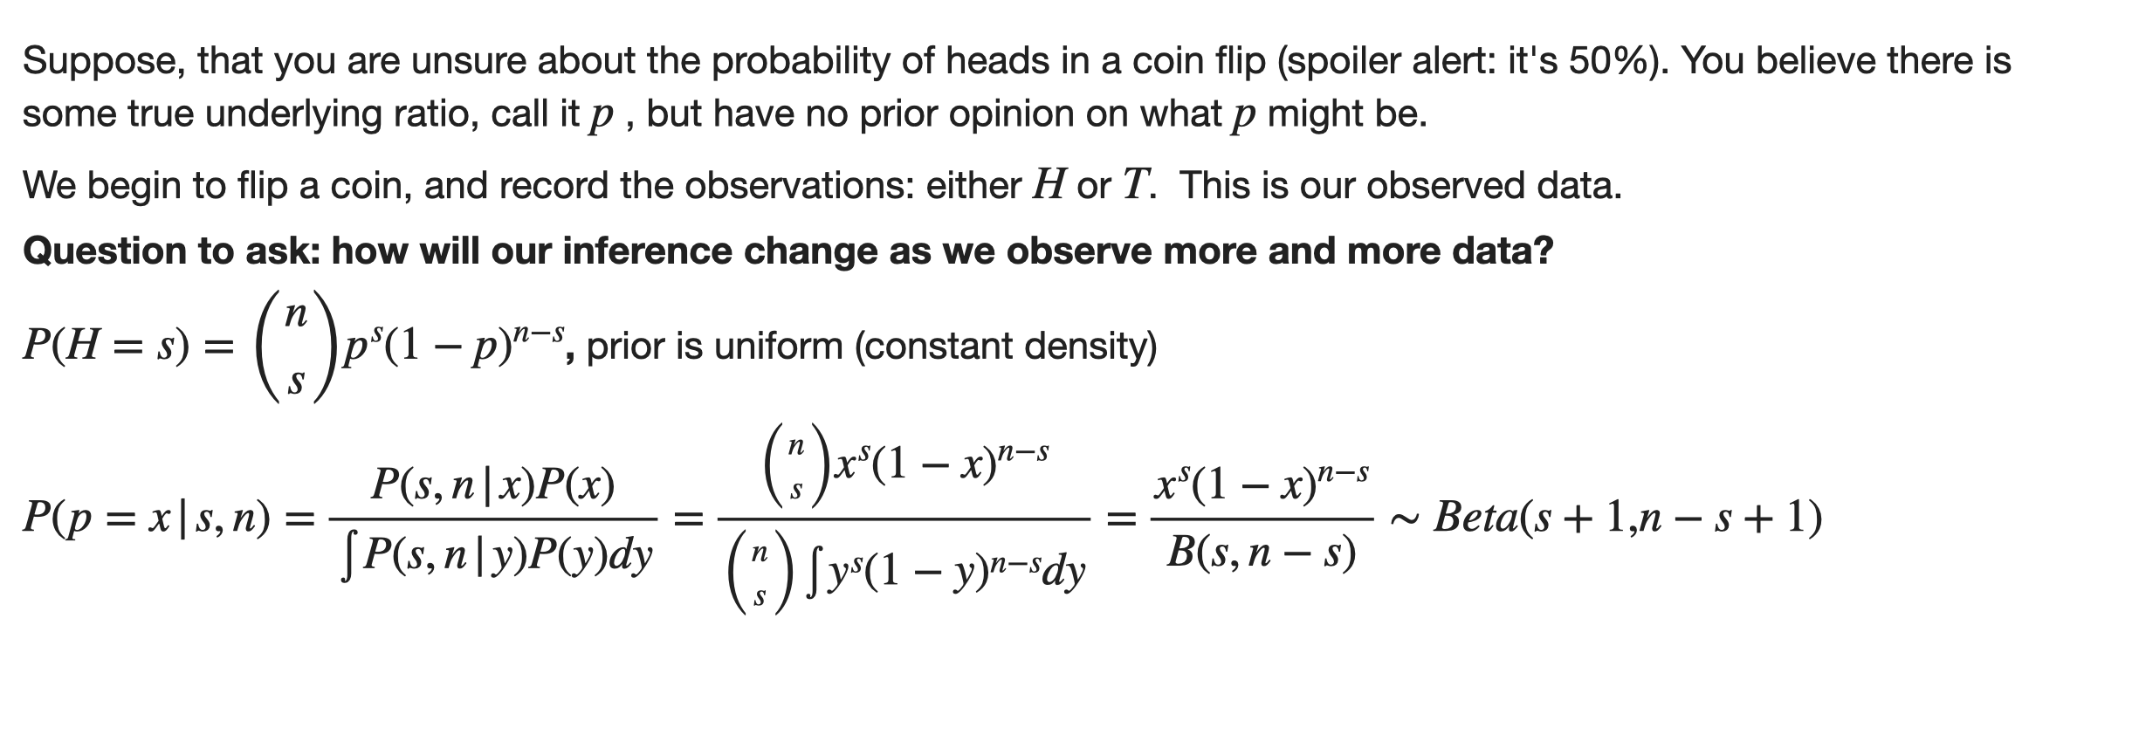
Coin-flipping example

Slide 15
What is Simulation Based Inference?
Here is where the SBI come in: Why don’t we use an efficient approximation of the posterior with AI?
A simple example: amortized inference

Slide 16
What is Simulation Based Inference?
Here is where the SBI come in: Why don’t we use an efficient approximation of the posterior with AI?
A simple example: amortized inference
Generate A LOT of simulation outputs
Optional: do a summary statistics on those

Slide 17
What is Simulation Based Inference?
Here is where the SBI come in: Why don’t we use an efficient approximation of the posterior with AI?
A simple example: amortized inference
Generate A LOT of simulation outputs
Optional: do a summary statistics on those
Feed them into a neural network -> obtain an approximate posterior distribution

Slide 18
What is Simulation Based Inference?
Here is where the SBI come in: Why don’t we use an efficient approximation of the posterior with AI?
A simple example: amortized inference
Generate A LOT of simulation outputs
Optional: do a summary statistics on those
Feed them into a neural network -> obtain an approximate posterior distribution
Feed the actual observations into the model

Slide 19
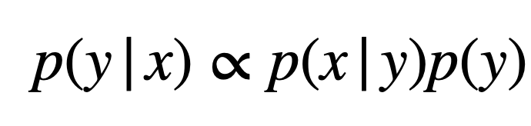
How to estimate posterior distribution?
Three main methods:
Neural Posterior Estimation, (NPE) : we estimate the whole thing and can immediately use it!

Slide 20
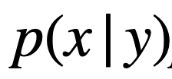
How to estimate posterior distribution?
Three main methods:
Neural Posterior Estimation, (NPE) : we estimate the whole thing and can immediately use it!
Neural Likelihood Estimation (NLE): we estimate only the likelihood and
We sample from the posterior distribution using sampling algorithm (e.g. MCMC)

Slide 21
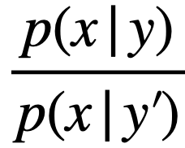
How to estimate posterior distribution?
Three main methods:
Neural Posterior Estimation, (NPE) : we estimate the whole thing and can immediately use it!
Neural Likelihood Estimation (NLE): we estimate only the likelihood and
We sample from the posterior distribution using sampling algorithm (e.g. MCMC)
Neural Likelihood-Ratio Estimation (NRE): a bit more complicated, we estimate
Requires a deeper insight into sampling algorithm y is the current value of the parameters, and y’ is
the one proposed by the sampler.

Slide 22
How to estimate posterior distribution?
Three main methods:
Neural Posterior Estimation, (NPE) : we estimate the whole thing and can immediately use it!
Neural Likelihood Estimation (NLE): we estimate only the likelihood and
We sample from the posterior distribution using sampling algorithm (e.g. MCMC)
Neural Likelihood-Ratio Estimation (NRE): a bit more complicated, we estimate
Requires a deeper insight into sampling algorithm y is the current value of the parameters, and y’ is
the one proposed by the sampler.
Can also be used for frequentist inference!

Slide 23
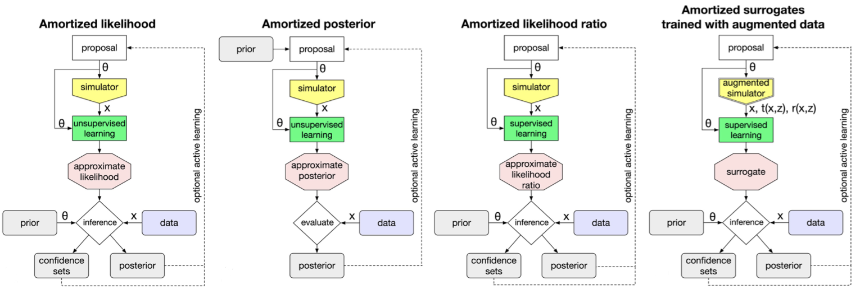
Graphical representation
Figure from Frontier of simulation-based inference, Cranmer et al. 10.1073/pnas.191278911
Jupyter notebook 1 – warm-up example in an SBI framework
Jupyter notebook 2 – data example, comparison with the classical Bayesian inference based on MCMC

Slide 24
Deep Learning component
1. Approximating posterior or likelihood with normalizing flows:

Slide 25
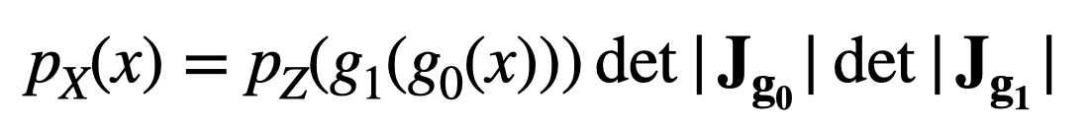
Deep Learning component
1. Approximating posterior or likelihood with normalizing flows:
Transforms a simple source distribution p_{Z} (e.g. normal distribution) into any arbitrary target distribution p_{X} by a chain of bijective transformations g_{i}, where J_{g} is a Jacobian

Slide 26
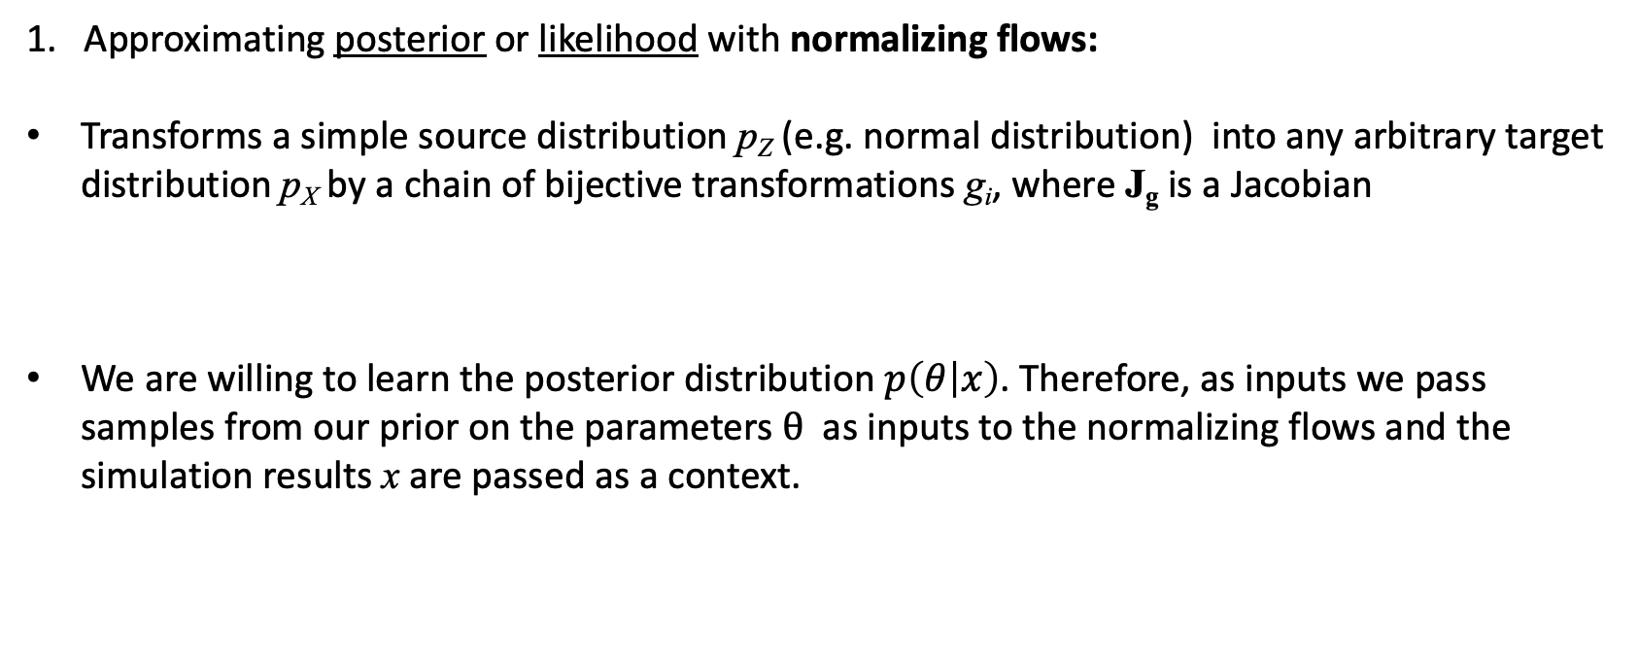
Deep Learning component
1. Approximating posterior or likelihood with normalizing flows:
Transforms a simple source distribution p_{Z} (e.g. normal distribution) into any arbitrary target distribution p_{X} by a chain of bijective transformations g_{i}, where J_{g} is a Jacobian
We are willing to learn the posterior distribution $p\left(θ | x\right)$. Therefore, as inputs we pass samples from our prior on the parameters $θ$ as inputs to the normalizing flows and the simulation results x are passed as a context.

Slide 27
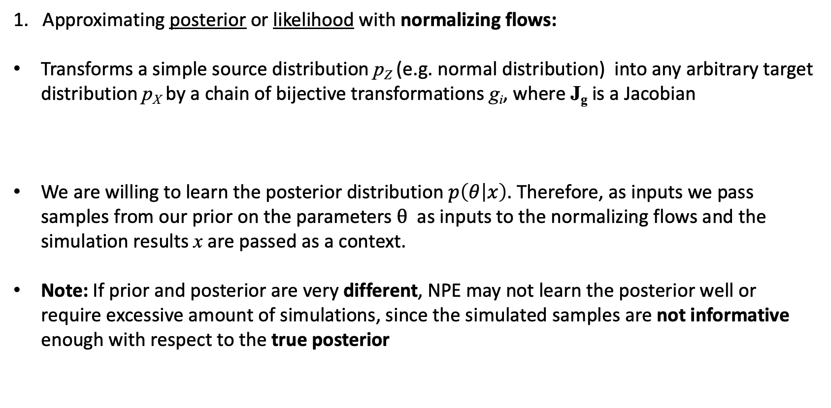
Deep Learning component
1. Approximating posterior or likelihood with normalizing flows:
Transforms a simple source distribution p_{Z} (e.g. normal distribution) into any arbitrary target distribution p_{X} by a chain of bijective transformations g_{i}, where J_{g} is a Jacobian
We are willing to learn the posterior distribution $p\left(θ | x\right)$. Therefore, as inputs we pass samples from our prior on the parameters $θ$ as inputs to the normalizing flows and the simulation results x are passed as a context.
Note: If prior and posterior are very different, NPE may not learn the posterior well or require excessive amount of simulations, since the simulated samples are not informative enough with respect to the true posterior

Slide 28
Deep Learning component
Estimate the likelihood-ratio , as a part of sampling algorithm, using a neural network classifier:

Slide 29
Deep Learning component
Estimate the likelihood-ratio , as a part of sampling algorithm, using a neural network classifier:
Classifier learns to discriminate samples from p(x | y) from samples from p(x | y’)

Slide 30
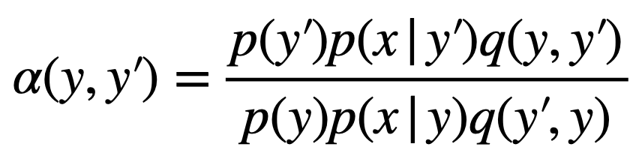
Deep Learning component
Estimate the likelihood-ratio , as a part of sampling algorithm, using a neural network classifier:
Classifier learns to discriminate samples from p(x | y) from samples from p(x | y’)
Note: likelihood-ratio is a part of the probability of proposal state y’ acceptance 𝛼(y, y’) in e.g. MCMC algorithm
where q(y’,y) is the proposal distribution density at y’ given the state y’ and cancels out if symmetrical.

Slide 31
Deep Learning component
Estimate the likelihood-ratio , as a part of sampling algorithm, using a neural network classifier:
Classifier learns to discriminate samples from p(x | y) from samples from p(x | y’)
Note: likelihood-ratio is a part of the probability of proposal state y’ acceptance 𝛼(y, y’) in e.g. MCMC algorithm
where q(y’,y) is the proposal distribution density at y’ given the state y’ and cancels out if symmetrical.
To summarize: NPE is a somewhat more straightforward method, however the least efficient in case of false assumptions on the model. NRE aims to tackle the latter problem.

Slide 32
On the Sequential estimation
Another way to tackle the situation when the prior is far a way from the true posterior:
Jupyter notebook 3: flexible interface of the SBI package
Jupyter notebook 4: using summary statistics

Slide 33
On the Sequential estimation
Another way to tackle the situation when the prior is far a way from the true posterior:
Sequential estimation
Initially proposal prior is set to the actual prior (everything the same as before)
Jupyter notebook 3: flexible interface of the SBI package
Jupyter notebook 4: using summary statistics

Slide 34
On the Sequential estimation
Another way to tackle the situation when the prior is far a way from the true posterior:
Sequential estimation
Initially proposal prior is set to the actual prior (everything the same as before)
After the network is trained and an approximated posterior is obtained, proposal prior is replaced
by the approximate posterior and retrained.
Jupyter notebook 3: flexible interface of the SBI package
Jupyter notebook 4: using summary statistics

Slide 35
On the Sequential estimation
Another way to tackle the situation when the prior is far a way from the true posterior:
Sequential estimation
Initially proposal prior is set to the actual prior (everything the same as before)
After the network is trained and an approximated posterior is obtained, proposal prior is replaced
by the approximate posterior and retrained.
Repeat until proposal prior has converged
Jupyter notebook 3: flexible interface of the SBI package
Jupyter notebook 4: using summary statistics

Slide 36

If you do a lot of simulations, the resulting posterior is more likely to be close
to the true one (provided you have a good, model)!
Distribute the tasks to multiple nodes.
SBI package is already using joblib palckage for parallelisation over multiple cpus, it is easy to use Ray backend
in order to distribute the tasks over multiple nodes
Note: one simulation has to be long enough (at least ~10 secs)!
Example on the terminal

