Slide 1

Identifying At-Risk School Districts with Machine Learning
Albert Lee

Slide 2
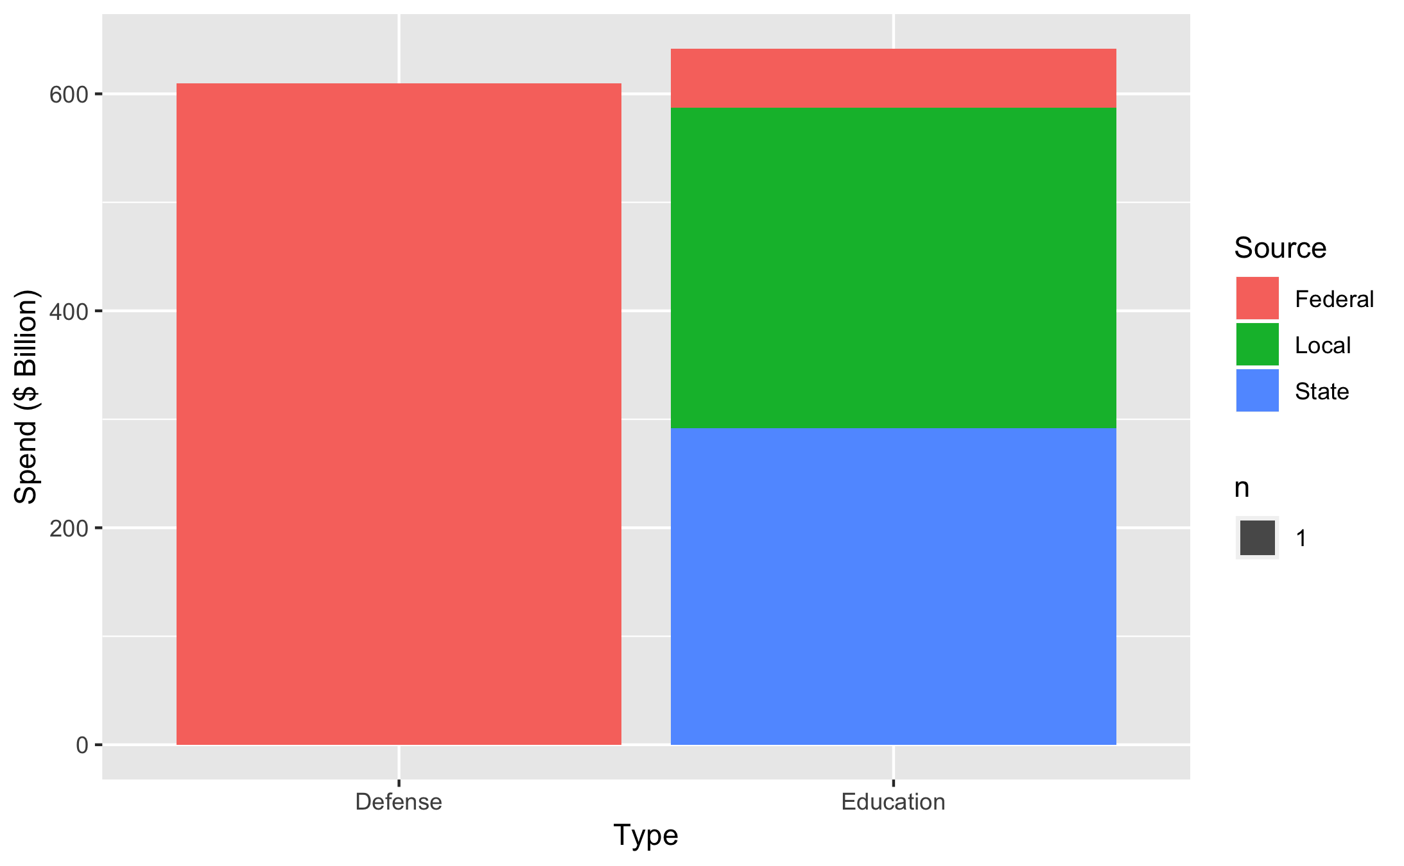
US Primary/Secondary Education is very large
Facts (2017-2017)
18,811 Local Education Agencies
100,077 Schools
50,812,380 Students
Combined local, state, and federal spending on education is comparable to the federal defense spending.
Notes:
In the 2016-2017 school year, there were: 18811 local education agencies, 100077 operational schools, 50812380
In the 2013-2014 school year, spending was: total revenue 641523073000, total federal revenue 54157134000, total state revenue 291634800000, total local revenue 295731139000, total expenditures 638512248000

Slide 3
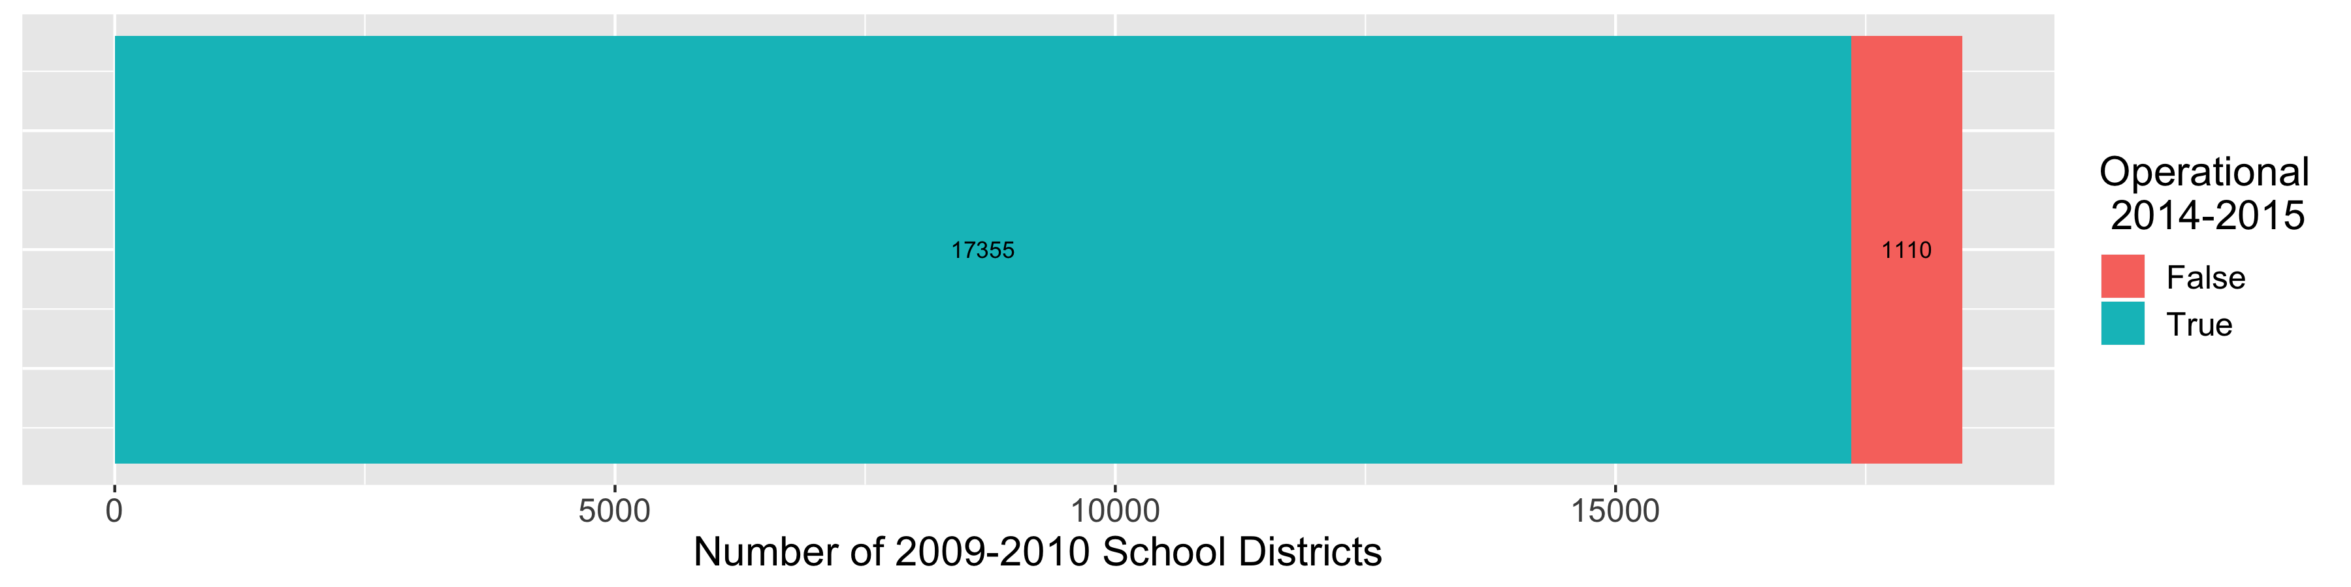
At-risk school districts make up small percentage, but have large impact
6 Percent of Local Education Agencies in 2009-2010 closed within 5 years. This represents
381,248 Students
$4,032,423,000 Spending
Notes:
17355 out of 18465 LEAs in 2009-2010 remained open in 2014-2015
381248 students
4032423000 total revenue
671101000 federal
1811154000 state
1550168000 local

Slide 4

Identifying at-risk school districts with data driven approach could lead to more effective action
Machine Learning Approaches
Clustering
Classification
Evaluation Metrics
Recall: Proportion of at-risk school districts that were correctly identified
Precision: Proportion of school districts identified as at-risk that were actually at-risk
Common Core Dataset
Provided by National Center for Education Statistics
Over 200 variables on all US local education agencies (~18 thousand) for years 1990-2015
Available for public use

Slide 5
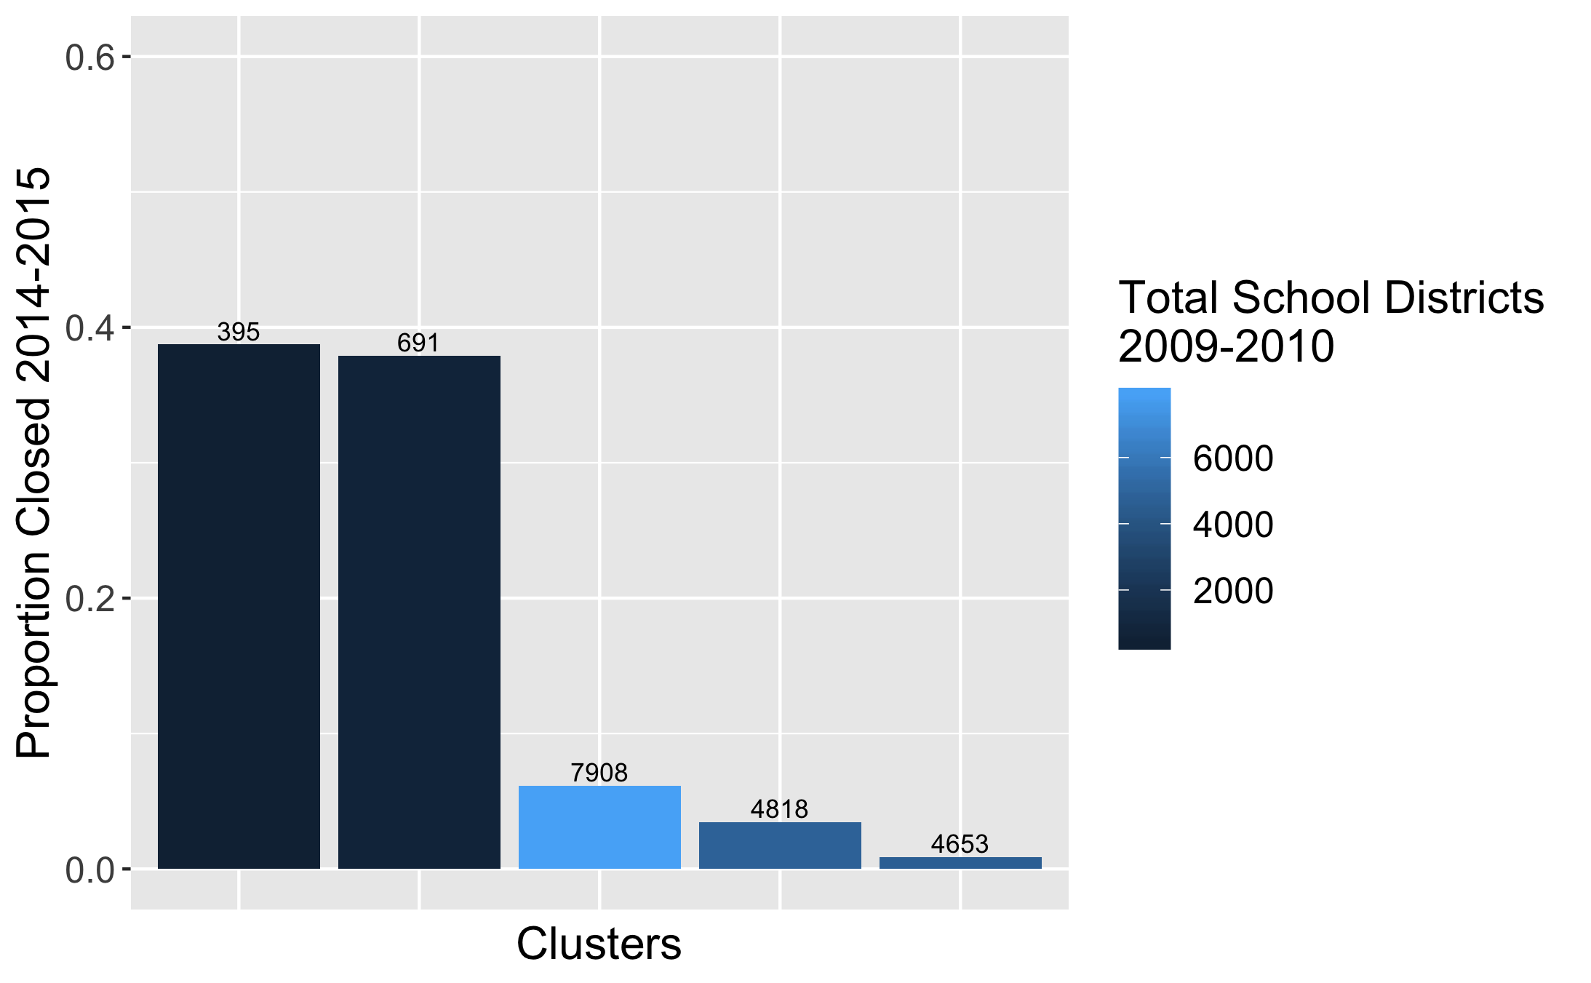
Even without labels, clustering identified school districts more likely to close
Applied K-Mean clustering to create 5 clusters.
Identified Clusters with higher ”risk.”
Results:
Recall: 0.398
Precision: 0.411
Notes:
Note:
Graph not good because it doesn’t capture size of the clusters

Slide 6
Classification achieved high recall with precision tradeoff
Model | Recall | Precision
Logistic Regression 155 features, 387 with dummy variables | 0.043 | 0.429
Logistic Regression 155 features, 387 with dummy variables Min-Max Scaling | 0.116 | 1.000
Logistic Regression 155 features, 387 with dummy variables Min-Max Scaling Balanced Weighting | 0.841 | 0.221
XG Boost 155 features, 387 with dummy variables Min-Max Scaling Balanced Weighting PCA Imputation (median) | 0.810 | 0.239
XG Boost 15 features, 95 with dummy variables Min-Max Scaling Balanced Weighting Imputation | 0.848 | 0.232
AutoML with TPOT Optimize recall | 1.0 | 0.057
AutoML with TPOT Optimize f1-weighted | 0.4 | 0.84
Key Model Parameters:
Balanced Weighting
XG Boost Classifier
Reduced Feature Set
Results (on test set):
Recall: 0.798
Precision: 0.325
AutoML (TPOT) resulted in significantly higher precision (but lower recall)

Slide 7
Recommendation
Determine correct level of recall/precision tradeoff.
Set precision as satisficing constraint and recall as optimizing constraint.
Create heuristic to determine “cost” of type I error (false positive) relative type II error (false negative).

Slide 8
Challenges and Lessons Learned
Allocate sufficient time to data wrangling tasks.
1
Use sklearn pipelines during model selection phase.
2
Experiment with AutoML.
3
Provide AutoML with appropriate optimizing metric.

Slide 9

For additional information, visit the github repository.
https://github.com/albemlee/Springboard/tree/master/SchoolDistrictRecommendation

