Slide 1
Project documentation for supercross_learner
Table of contents:
Background info and motivation
Description of environment physics
Description of tracks
Environment validation
Description of .py file interaction
Progress of the learner
TODO and ideas for improvement

Slide 2
Background and Motivation:
RedBull Moto 8 movie narrator “supercross is like a game of chess” alluding to the strategic part of jumping relative to your opponent.
If we can teach a computer to play chess, then can we teach a compute to race supercross.
Kawasaki “Science of Supercross” episodes describe some techniques of the strategy of supercross.
on/off - episode 8
scrub - episode 12, but this needs many DOFs. greater take off speed, less height, less time in air, same size jump.
Jump timing. episode 23. Backside, in the flat, on the face, Hang the back wheel.
rhythm section, ep34. double, triple, quad, on/off combinations
Why make my own environment?
Was not aware of a 2D motocross/supercross game that had realistic track profiles (features types, approach radii, landing radii, etc.), and realistic bike performance (suspension behavior, power and drag characteristics, etc.).
Did not want a degree of freedom allowing the bike+wheel body to rotate.
3D moto/supercross games offer too many degrees of freedom for this initial work.
It was a good learning experience, and it was fun.

Slide 3
Free body diagrams for environment model (supercross_env). The bike model has only one wheel. There is only 1 DOF between wheel and bike.
The wheel does have a “magic formula” style slip vs grip behavior.
bike
-Fdragx
-Fg
-Fdragy
Fs
-Fs
Wheel Free Body
If inAir
Fn=Ft=whlFx=0
whlFy =(-Fg-Fs)
Else
Fn=(-Fg-Fs)*cos(theta)
Ft=min(trq/whlRad,Fn*nu)+(-Fg-Fs)*sin(theta)
whlFx = -Fn*sin(theta)+Ft*cos(theta)
whlFy = Fn*cos(theta)+Ft*sin(theta)
Axw=axb, there is no x-dir DOF between wheel and bike
Mw*ayw = whlFym but this is irrelevant since wheel ayw is a function of following track profile.
Ft
wheel
-Fg
Fn
theta
Bike Free Body
Mb*axb = -Fdragx + whlFx
Mb*ayb = -Fdragy - Fg + Fs

Slide 4
Describe (supercross_track_maker). The track maker feeds track profiles to supercross_env. Track profiles are 2D, viewed from the side. The track maker makes track features: flats, triple jumps, table tops, on/offs, whoops, etc, it then combines these features in either pre-ordered sequences, or random sequences to make tracks of specific length.
This could be improved, but the code does a pretty good job, so look there if this is inadequate.

Slide 5
Environment validation
Table of contents:
Power and drag characteristics
Jumping and suspension behavior
Drop test (not yet shown)

Slide 6
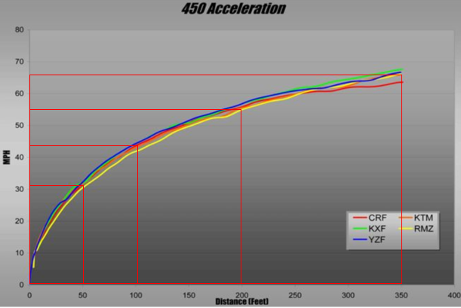
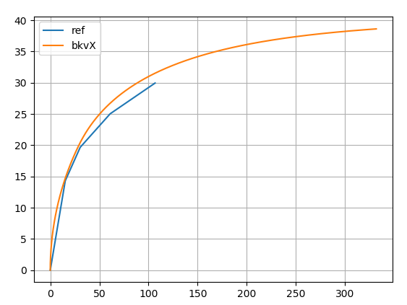
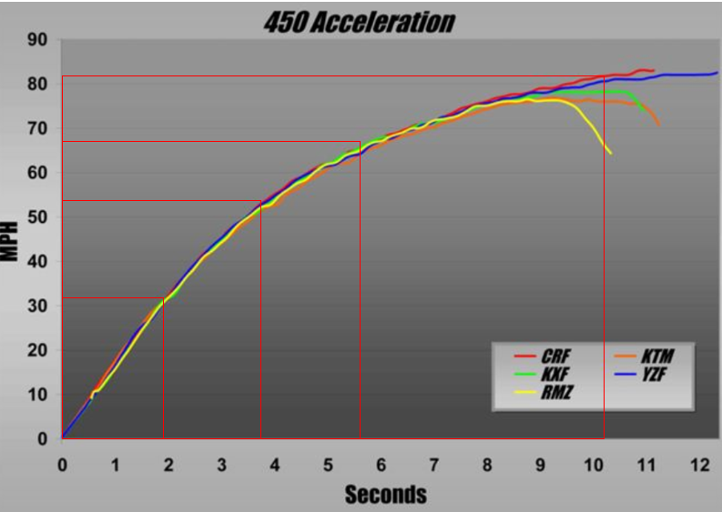
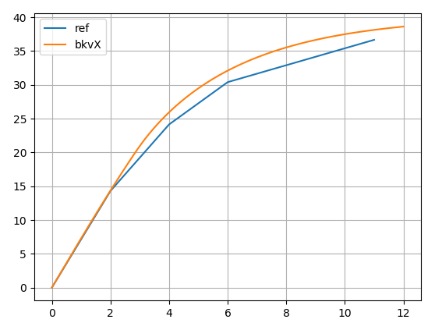
Environment validation. Is the environment realistic relative to a real supercross bike and track?
Comparison between test data and model
(no learning agent, full throttle input to environment).
Speed(m/s)
Distance (meters)
Testing data obtained from internet.
Speed(m/s)
Time (s)

Slide 7
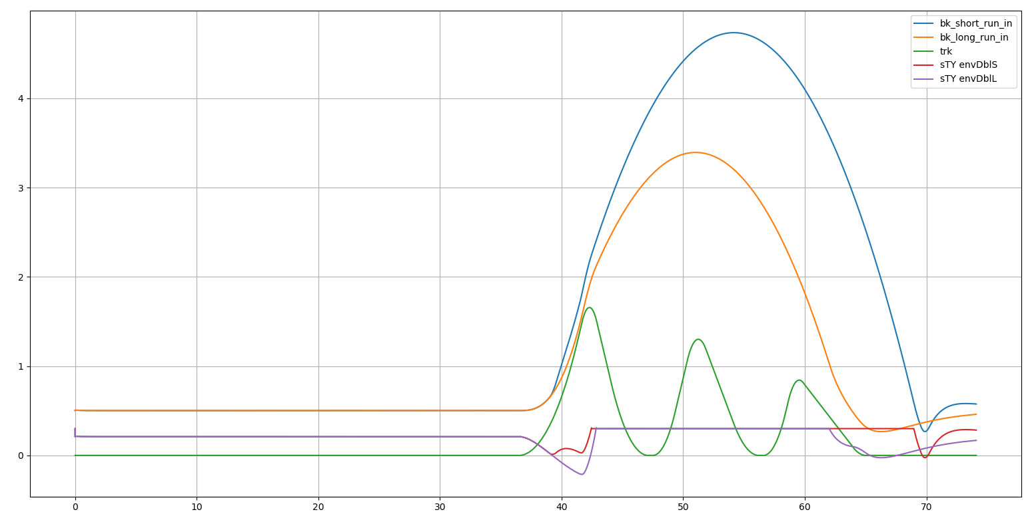
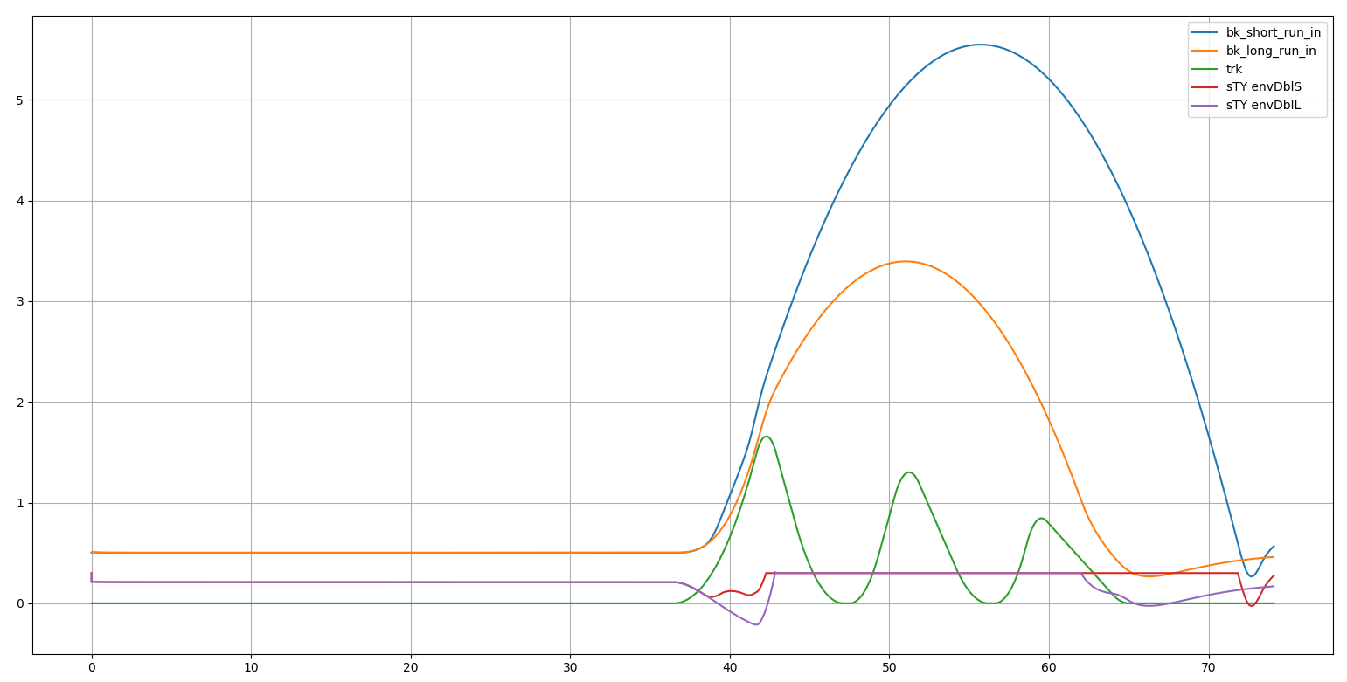
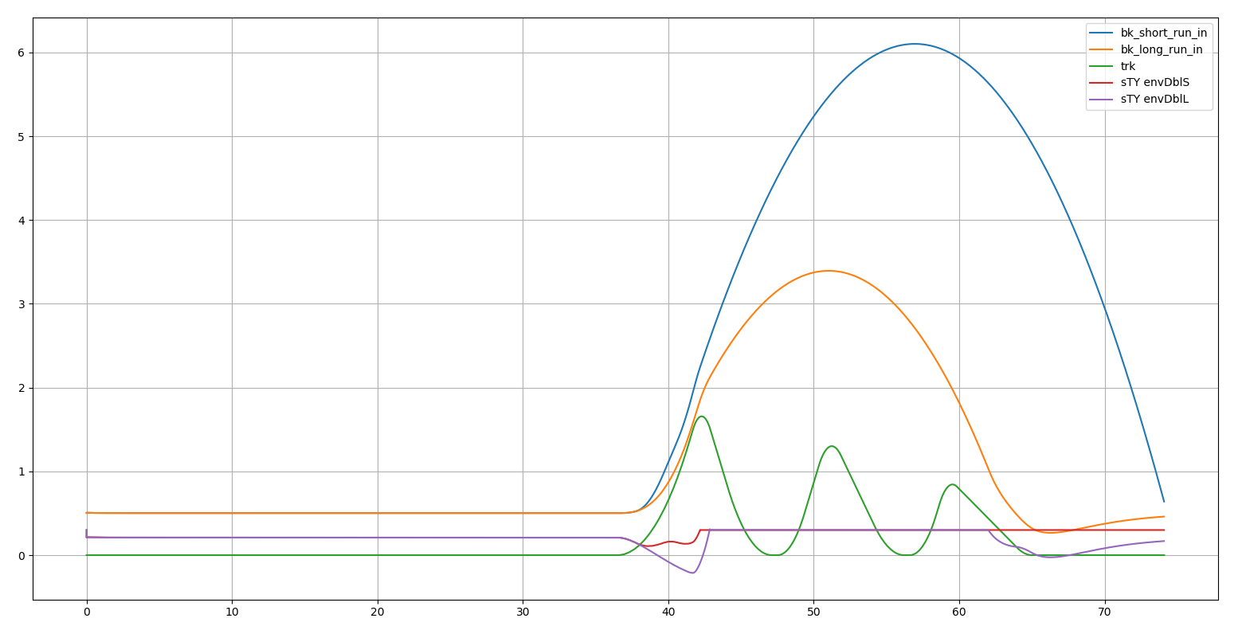
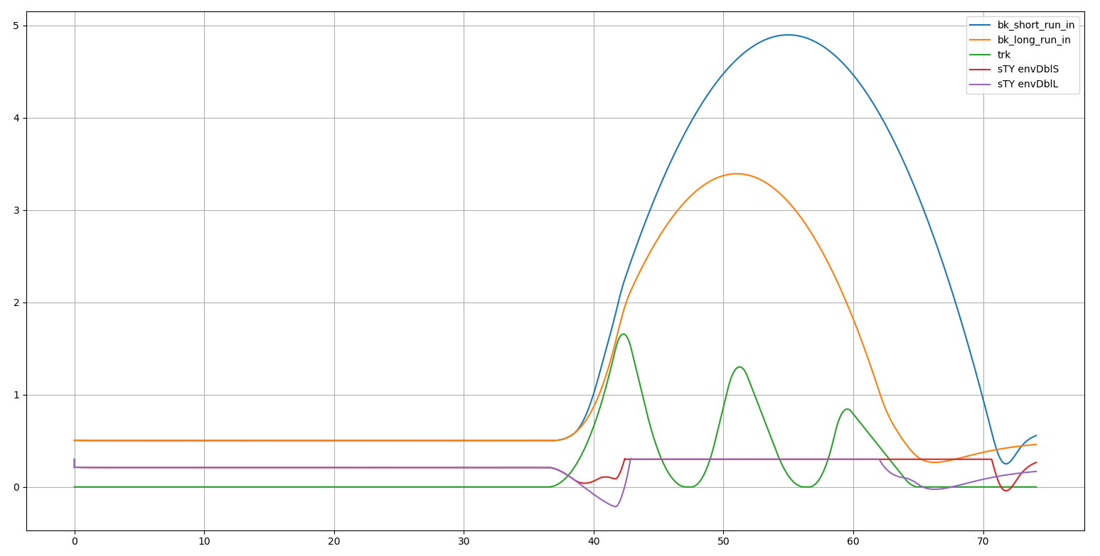
Exploring the behavior of progressive suspension stiffness.
As suspension nears bottoming, ramp up stiffness [1x -> ?x] as travel goes [?% -> 100%]
10% and 10x
30% and 10x
50% and 10x
30% and 5x
Selected by visual inspection

Slide 8
Description of .py file interaction NOT DONE

Slide 9
Section for progress of the learner

Slide 10
SubSection for progress of the learner with this neural net. Name=net03
Input layer:
# state is vector concatenated of vectors and scalars
# [sampled track elevation points for some distance ahead, e.g. 30 meter ahead, sampled every 1 meter ...
# distance between wheel and track surface ...
# bike speed ...
# suspension travel]
…
…
throttle
32
32
I assumed this based on the input and output sizes, and the "network_spec” fed to the agent model.

Slide 11
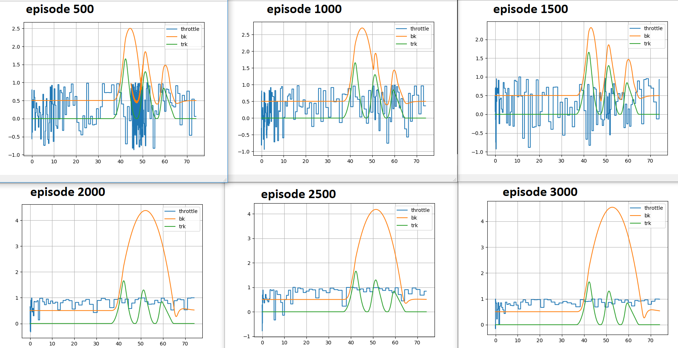
First success with tensorForce
Uses default PPO agent from OpenAI gym Cart Pole example.
Env is just the track with single triple jump (i.e. mk_trk1()). Plot show throttle and bike X position vs time.
We can see the trend towards more full throttle, not rolling backwards on jump face. Still some ambiguity with what to do at start. Obviously because it only see 30m ahead, and 30m ahead of start there is nothing. But what's nice about that is we see that as soon as it does see a feature like jump face, high throttle actions predominate.
Reward at ep3000=3.4
Best reward =4.1
Worst reward = approx. -1e6

Slide 12
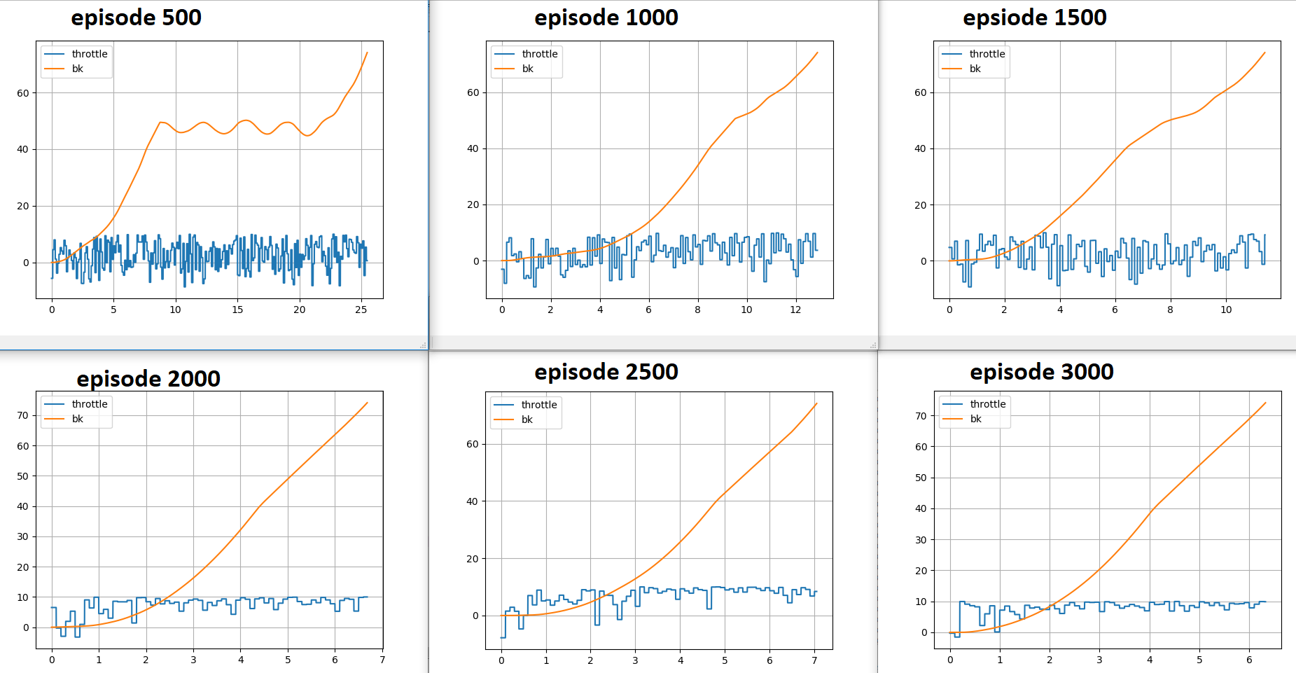
First success with tensorForce
Uses default PPO agent from OpenAI gym Cart Pole example.
Env is just the track with single triple jump (i.e. mk_trk1()). Plot show throttle and bike X position vs time.
We can see the trend towards more full throttle, shorter episode time, and monotonic Xpos increase over episode (i.e. no rolling back down jump face)
Reward at ep3000=3.4
Best reward =4.1
Worst reward = approx. -1e6

Slide 13
Shortened mk_trk1 starting flat section to be closer to agent look ahead distance, and this might be the cause of the almost no learning for that test
Order of figures: Ep3000←ep1
Why is this? I think it could be because learning is a stochastic process, due the random element of the explore/exploit process, which means running the same experiment twice will not result in the same learning rate. So maybe this was just a bad experiment in terms of global learning rate (i.e. how much better agent gets over 300 episodes).

Slide 14
Mk_trk1 in run = 120ft
Order of figures: Ep1->ep3000
Here, global learning rate was slower than for the test on slides 6 & 7
Continue training after stop at ep3000, to ep6000
We can see that here it took about 3500 episodes to achieve similar performance as we saw after only 2000 episodes on slides 6 & 7
Finished episode 2986 after 134 timesteps (reward: -3.2999999999999687)
Finished episode 2987 after 91 timesteps (reward: 1.000000000000016)
Finished episode 2988 after 109 timesteps (reward: -0.7999999999999776)
Finished episode 2989 after 122 timesteps (reward: -2.099999999999973)
Finished episode 2990 after 100 timesteps (reward: 0.10000000000001918)
Finished episode 2991 after 108 timesteps (reward: -0.699999999999978)
Finished episode 2992 after 104 timesteps (reward: -0.2999999999999794)
Finished episode 2993 after 106 timesteps (reward: -0.4999999999999787)
Finished episode 2994 after 184 timesteps (reward: -8.29999999999999)
Finished episode 2995 after 164 timesteps (reward: -6.299999999999962)
Finished episode 2996 after 96 timesteps (reward: 0.5000000000000178)
Finished episode 2997 after 122 timesteps (reward: -2.099999999999973)
Finished episode 2998 after 96 timesteps (reward: 0.5000000000000178)
Finished episode 2999 after 119 timesteps (reward: -1.799999999999974)
Finished episode 3000 after 140 timesteps (reward: -3.8999999999999666)
INFO:tensorflow:Saving checkpoints for 632416 into ./savedTest02/model.ckpt.
Learning finished. Total episodes: 3000. Average reward of last 10 episodes: -2.289999999999977.
cummulative execution time: 3585.5566997528076
Finished episode 5985 after 58 timesteps (reward: 4.300000000000004)
Finished episode 5986 after 59 timesteps (reward: 4.200000000000005)
Finished episode 5987 after 58 timesteps (reward: 4.300000000000004)
Finished episode 5988 after 58 timesteps (reward: 4.300000000000004)
Finished episode 5989 after 59 timesteps (reward: 4.200000000000005)
Finished episode 5990 after 59 timesteps (reward: 4.200000000000005)
Finished episode 5991 after 58 timesteps (reward: 4.300000000000004)
Finished episode 5992 after 58 timesteps (reward: 4.300000000000004)
Finished episode 5993 after 59 timesteps (reward: 4.200000000000005)
Finished episode 5994 after 59 timesteps (reward: 4.200000000000005)
Finished episode 5995 after 59 timesteps (reward: 4.200000000000005)
Finished episode 5996 after 58 timesteps (reward: 4.300000000000004)
Finished episode 5997 after 58 timesteps (reward: 4.300000000000004)
Finished episode 5998 after 58 timesteps (reward: 4.300000000000004)
Finished episode 5999 after 57 timesteps (reward: 4.400000000000004)
Finished episode 6000 after 57 timesteps (reward: 4.400000000000004)
INFO:tensorflow:Saving checkpoints for 858269 into ./savedTest02/model.ckpt.
Learning finished. Total episodes: 6000. Average reward of last 10 episodes: 4.2900000000000045.
cummulative execution time: 1252.185539007187

Slide 15
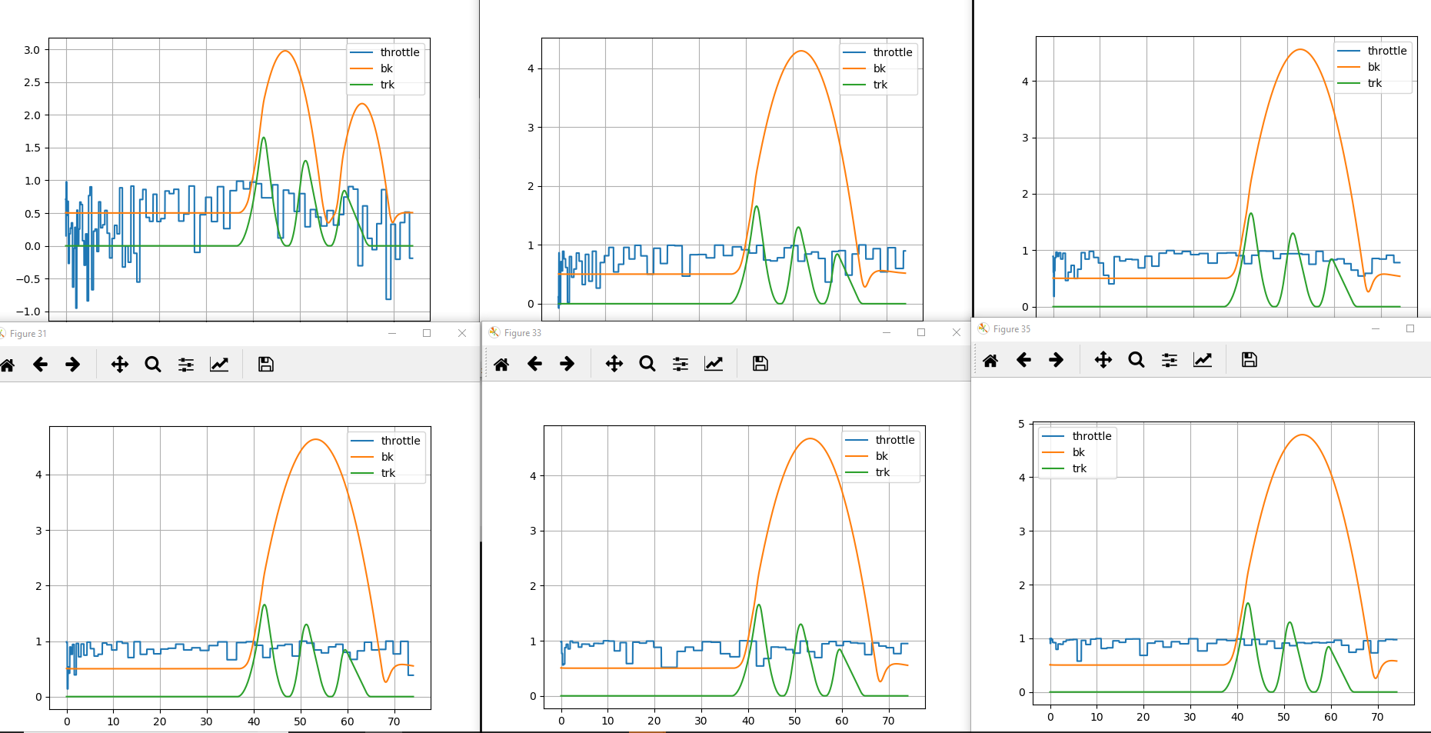

Slide 16
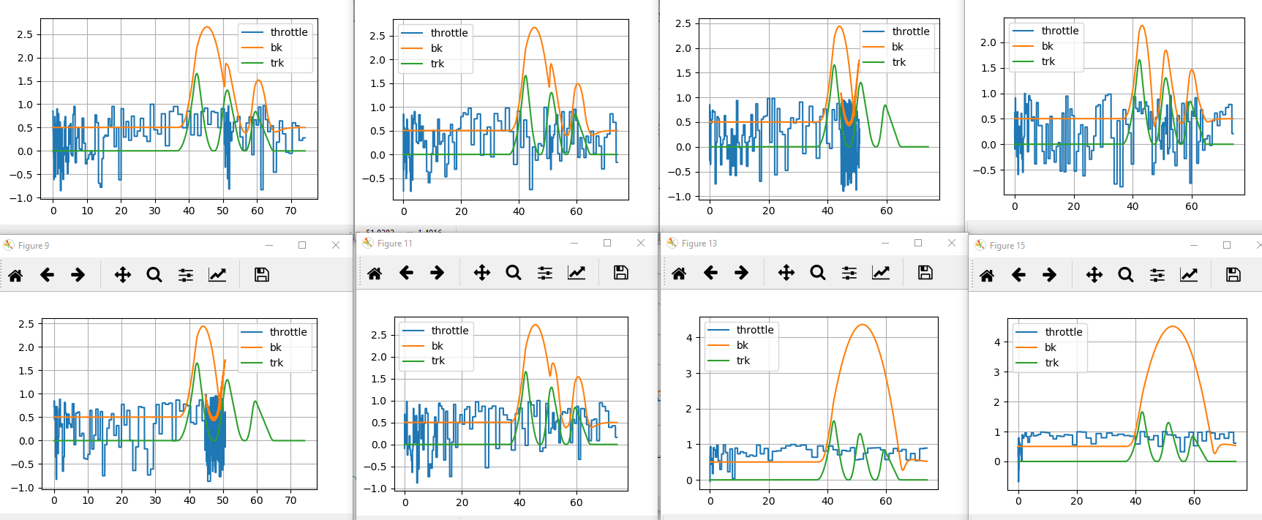
4000 episode run with reward model that employed: 1] increased negative step reward for each step after race is longer than shortest time, 2] positive reward at end of episode if new best time was set.

Slide 17
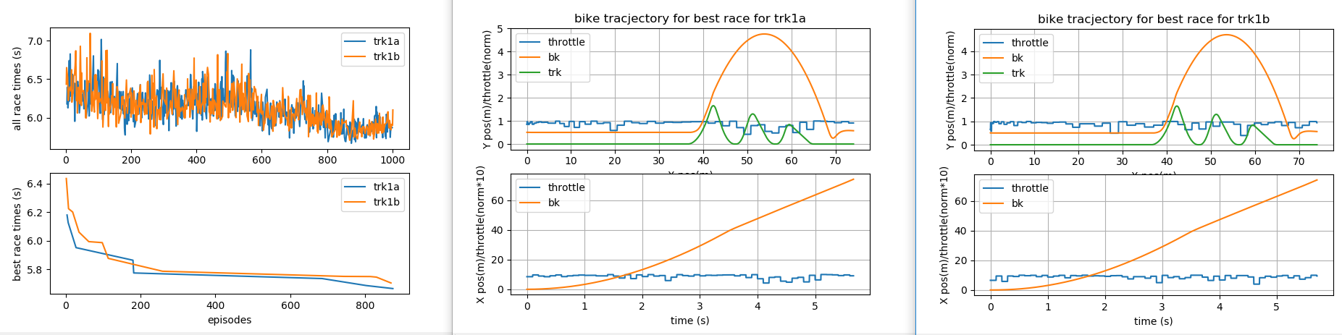
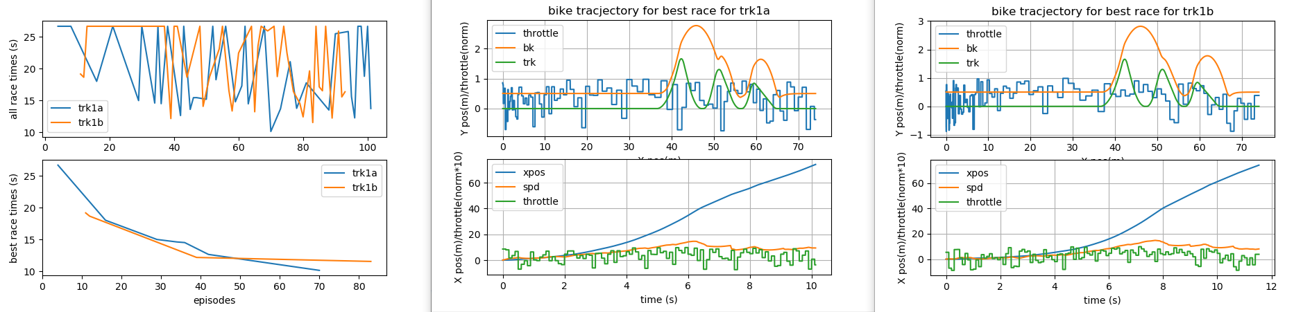
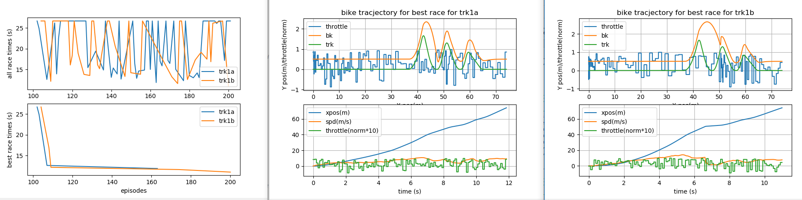
Added model saving, so that learning sessions can continue from where the last session with same model left off. The results here are from a continuation of the previous 4500 episodes. I then realized that the episode counter needed restart at the last episode from the last session, and updated it. But the issue was that the learner was so good, that it was rarely making better times, so I deleted some of the past TF checkpoints, only to learn that TF doesn’t handle that well, and it started from the beginning again.
Added feature to allow any number of tracks, for a learning session, and for each episode, a track is selected randomly. All race time and best times are track on a per track basis, so we can see full details of the learners progress on each track. Also, for each track, a copy of the environment is constantly updated each time a new best time is set on that track. These env copies are used to draw the race at the end of the session.
What is still not great is that there is no check for if this sessions is a restart, and if so, to load the best times previously set for each track. This is actually important, since we use best time of each track to control the reward signal.
Above: before TF checkpoints was wiped. Below, consecutive 100 ep runs with better plots

Slide 18
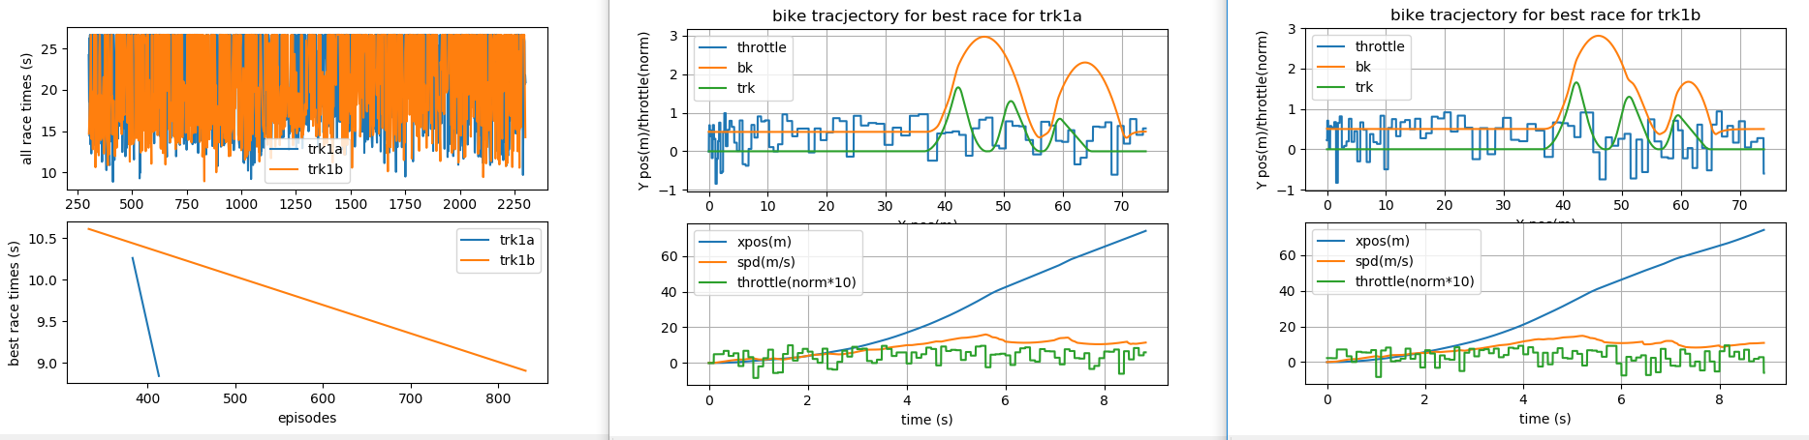
What is still not great is that there is no check for if this sessions is a restart, and if so, to load the best times previously set for each track. This is actually important, since we use best time of each track to control the reward signal.
Above: before TF checkpoints was wiped. Below, consecutive 100 ep runs with better plots

Slide 19
SubSection for progress of the learner with this neural net. Name=net04
Input layer:
# state is vector concatenated of vectors and scalars
# [sampled track elevation points for some distance ahead, e.g. 30 meter ahead, sampled every 1 meter ...
# distance between wheel and track surface ...
# bike speed ...
# suspension travel]
…
…
…
throttle
32
20
8
I assumed this based on the input and output sizes, and the "network_spec” fed to the agent model.

Slide 20
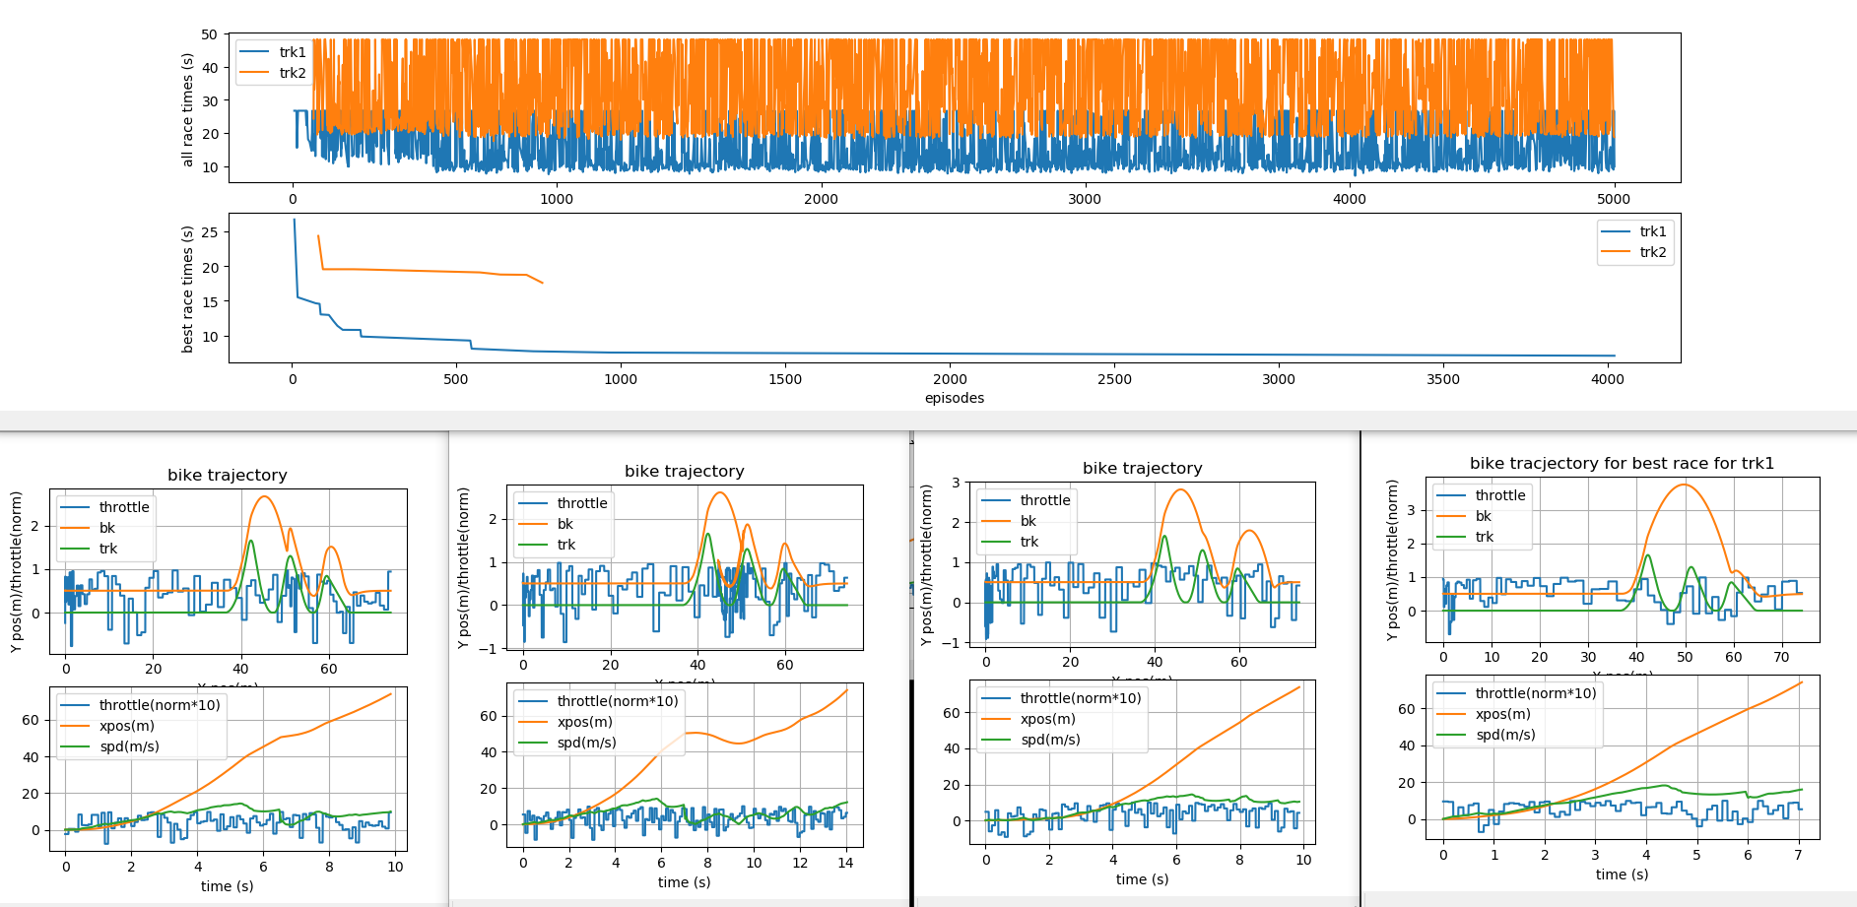
network_spec = [
# dict(type='embedding', indices=100, size=32),
# dict(type'flatten'),
dict(type='dense', size=32),
dict(type='dense', size=20),
dict(type='dense', size=8)
]
Race progress for trk1 shown.

Slide 21
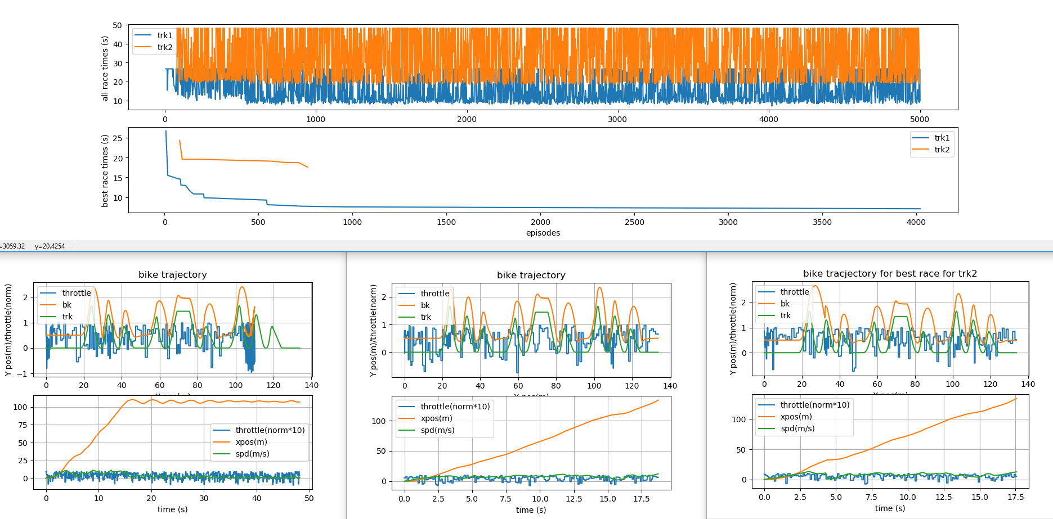
network_spec = [
# dict(type='embedding', indices=100, size=32),
# dict(type'flatten'),
dict(type='dense', size=32),
dict(type='dense', size=20),
dict(type='dense', size=8)
]
Race progress for trk2 shown.

Slide 22
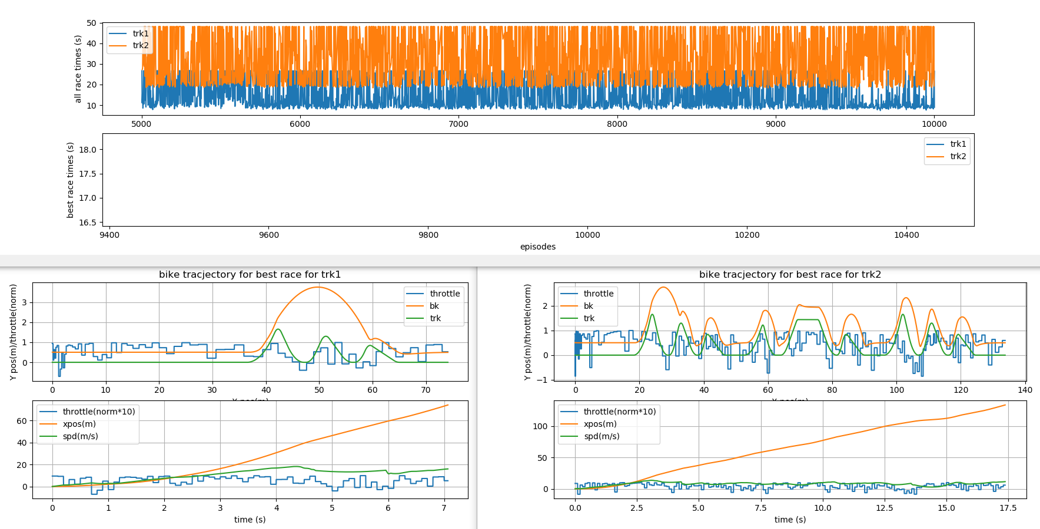
network_spec = [
# dict(type='embedding', indices=100, size=32),
# dict(type'flatten'),
dict(type='dense', size=32),
dict(type='dense', size=20),
dict(type='dense', size=8)
]
Lack of progression on track1 and 2

Slide 23
Lack of progression on track2. the best time of episode 5000, was 17.5, while the best time after episode 10000 was only slightly shorter.
We must conclude that either the state formulation, the evolution of the reward signal as agent performance improves, or the NN architecture, or some subset of the above items.
I suspect that for trk2, the state is inadequate, to tell the learner about what is ahead, and hence preventing it from making. I think that maybe a non-linear sampling of the track elevation ahead of the bike might work better. E.g. at 1m the sample resolution is 1m, and at 800m, it’s 5m. (800m is the length of redbull straight rhythm track). The outcome is much larger state space.
network_spec = [
# dict(type='embedding', indices=100, size=32),
# dict(type'flatten'),
dict(type='dense', size=32),
dict(type='dense', size=20),
dict(type='dense', size=8)
]

Slide 24
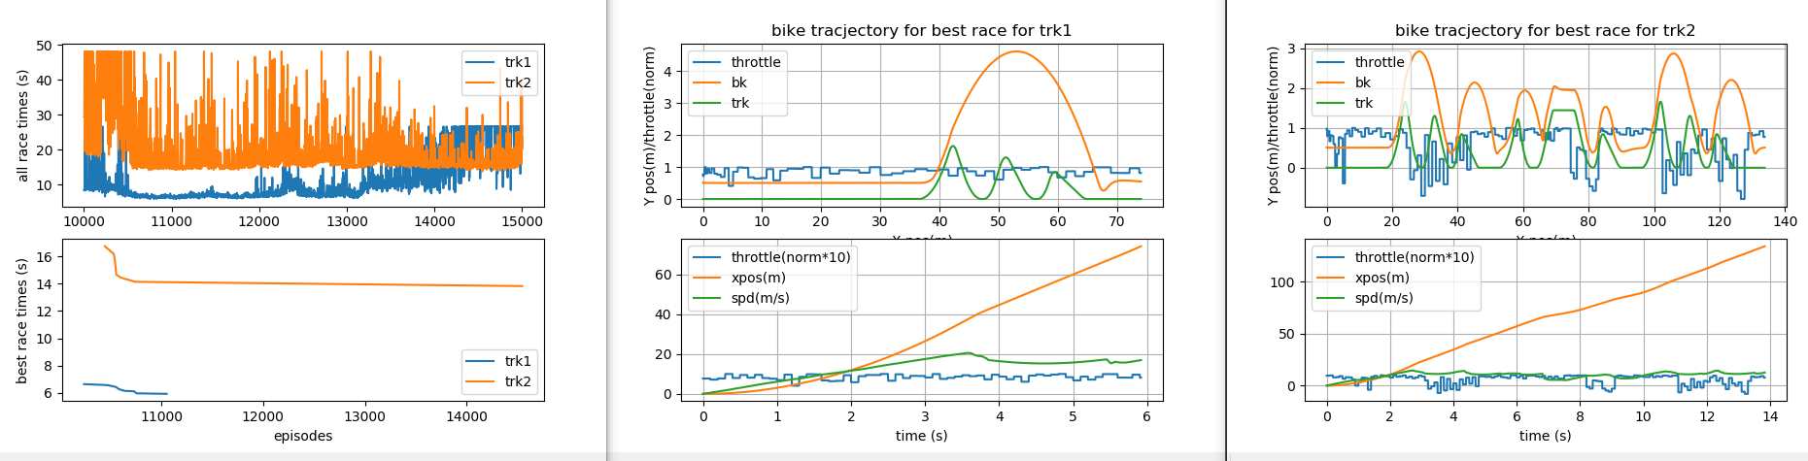
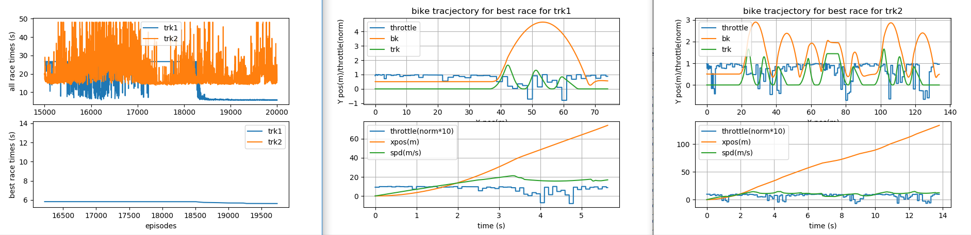
For the sake of being thorough, I let it run to 15000 episodes and it got a bit better at trk1, and significantly better(~3sec faster) on trk2. at 10500ep. The agent learns something bout trk2, and after demonstrates a noticeable frequency of ~14s races.
Another up to 20000 episodes, we see an interesting change in trk1 performance at 18500ep, where the agent now gets consistently good ace times. Might we be able to say that the agent has “learned” trk1, or overfitted to trk1? Could it have overfitted to trk2 at 10500 before? Whats happening? Whats clear is that the agent is NOT applying its trk1 skills to trk2, despite trk2 having the same first feature (a triple jump)

Slide 25
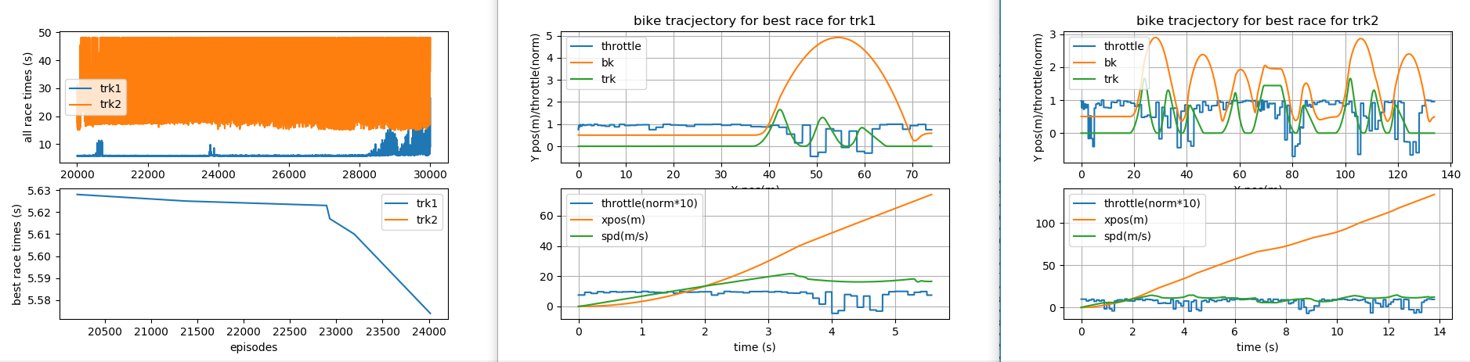
For the sake of being very thorough, I let it run to 30000 episodes and there was incremental improvement on trk1 for best time, but at ep21000,24000,and28000, we see trk performance consistency drop. I have no idea what might cause that. No improvement on trk2.
<enter notes for content below>

Slide 26
SubSection for progress of the learner with this neural net. Name=net04
Input layer:
# state is vector concatenated of vectors and scalars
# [sampled track elevation points for some distance ahead, e.g. 30 meter ahead, sampled every 1 meter ...
# distance between wheel and track surface ...
# bike speed ...
# suspension travel]
…
…
…
throttle
53
36
20
I assumed this based on the input and output sizes, and the "network_spec” fed to the agent model.

Slide 27
TODO:
Environment:
Create random track generator
This should have a target total length argument. I think it will be important to have tracks not be too long at first, but as the agent gets better, then tracks can get longer without risk of losing the necessary rewards signal.
Create whoops section feature
The rewards are “working”, but are not necessarily what we want. Some places to improve:
As the agent gets better, and tracks get longer, eventually the difference between a fast race and slow race will be small fractions of total time it takes to complete the whole race. As such, we want to amplify the “betterness” of a race that takes just a tiny fraction less time than another, which means a “win” in the context of racing. So maybe keep track of the best time so far, and then once the time for the present race is longer, scale the per step rewards to be a larger negative reward?
This only works if the track is the same for every episode. Even for 2 tracks with same feature, and same length, but with different feature order, we should expect a different best possible time. So the only way this could work is if each track were given a index, and the best times were tracked for each tracked index.
Does the +10 at the terminal state make sense? I think that, if this is only awarded when the race time is shorter than the best, this could be a ok way to provide a strong rewards signal for doing “just a bit better”.
Solver performance
Check Momentum conservation across change in direction at jump face transition.
Variable step solver? As bike or wheel acceleration in either X or Y direction goes from [lwr_thr -> upr_thr], time steps goes [dt -> dt/n], where n is positive integer. Still only record data every dt, so run sub-loops at dt/n until a dt size step is complete, then record data
State ideas: Thinking about what mental model a rider would have for the track, these are some state ideas that could work well.
Include a vector which maps out the track features. E.g. 00102040100203, some flat, some flat, a table top, some flat, a double triple jump, some flat, some whoops, etc. this vector encodes the track layout for the agent, so the agent can plan its strategy. A rider would not commit a high fidelity layout to memory, but surely would be able to tell someone the sequence of features from memory.
Have the track profile portion of the state vector be variable length. A minimum length, but if there is a long flat section, the resolution would drop, so seeing further in distance space with same number of sample points. This would help the agent start moving at the beginning for tracks that have a start section that is flat for longer distance than the minimum length. This is sort of attune to how humans look ahead, the more features there are ahead, the less far we look, if there are few or no feature in the near distance, we sort of turn our focus away from that, and look far ahead, with poor resolution, to see what features we can.
I think that maybe a non-linear sampling of the track elevation ahead of the bike might work better. E.g. at 1m the sample resolution is 1m, and at 800m, it’s 5m. (800m is the length of redbull straight rhythm track). The outcome is much larger state space.
For the look ahead distance part, the values for sample that are after the finish line should be -1, to indicate to the agent where the end of the track is.
Agent and hyper parameters
Setup multi-treading
Setup Bayesian optimization
Model architecture
Add drop out. Will this be helpful in this context?

