Slide 1
Free body diagrams for environment model. The bike model has only one wheel. There is only 1 DOF between wheel and bike.
bike
-Fdragx
-Fg
-Fdragy
Fs
-Fs
Ft
wheel
Wheel Free Body
If inAir
Fn=Ft=whlFx=0
whlFy =(-Fg-Fs)
Else
Fn=(-Fg-Fs)*cos(theta)
Ft=min(trq/whlRad,Fn*nu)+(-Fg-Fs)*sin(theta)
whlFx = -Fn*sin(theta)+Ft*cos(theta)
whlFy = Fn*cos(theta)+Ft*sin(theta)
Axw=axb, there is no x-dir DOF between wheel and bike
Mw*ayw = whlFym but this is irrelevant since wheel ayw is a function of following track profile.
-Fg
Fn
theta
Bike Free Body
Mb*axb = -Fdragx + whlFx
Mb*ayb = -Fdragy - Fg + Fs

Slide 2
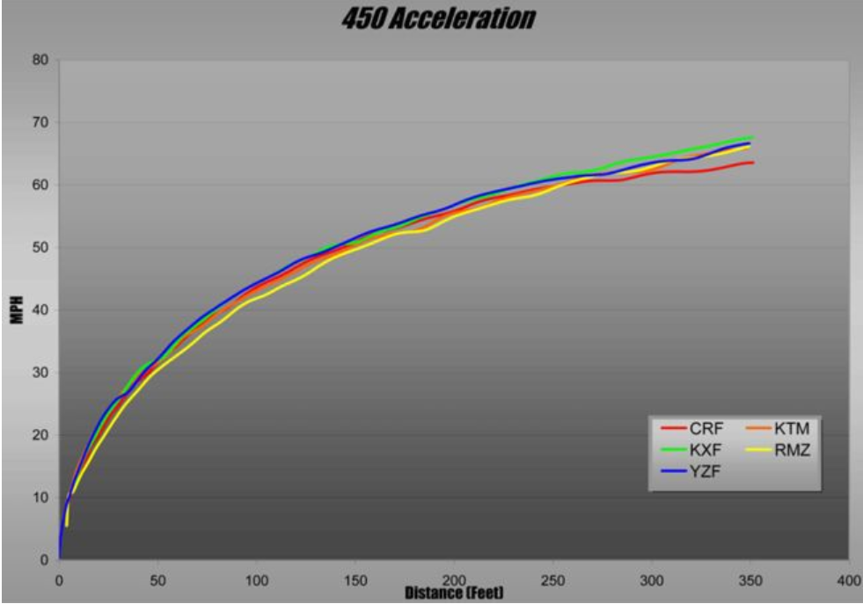
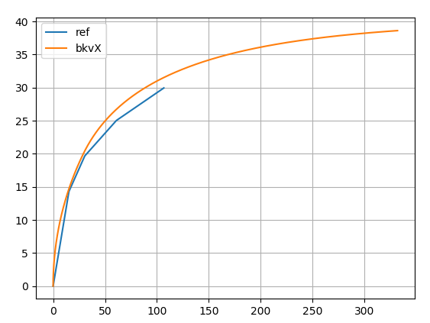

Slide 3
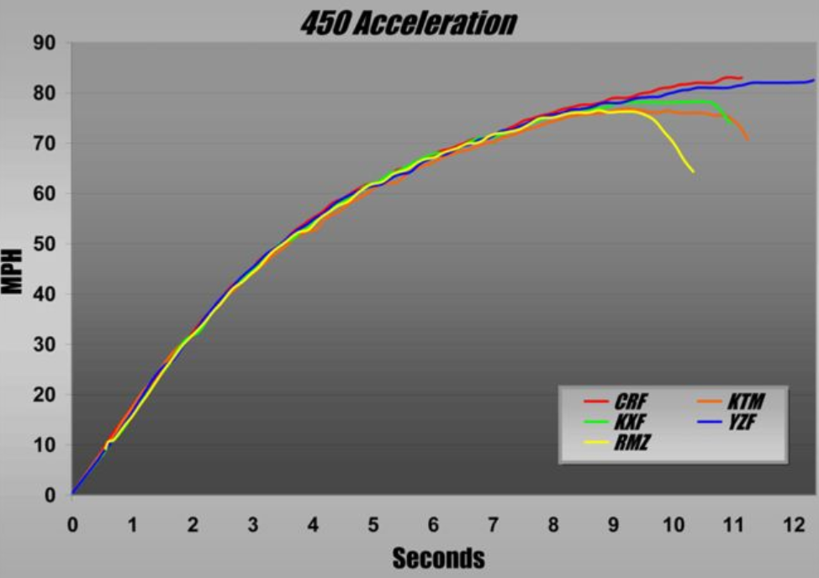
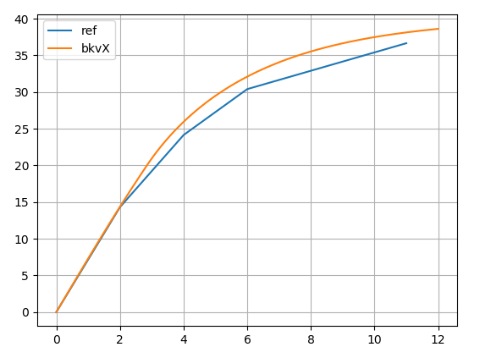

Slide 4
Check Momentum conservation across change in direction at jump face transition.
Variable step solver? As bike or wheel acceleration in either X or Y direction goes from [lwr_thr -> upr_thr], time steps goes [dt -> dt/n], where n is positive integer. Still only record data every dt, so run sub-loops at dt/n until a dt size step is complete, then record data

Slide 5
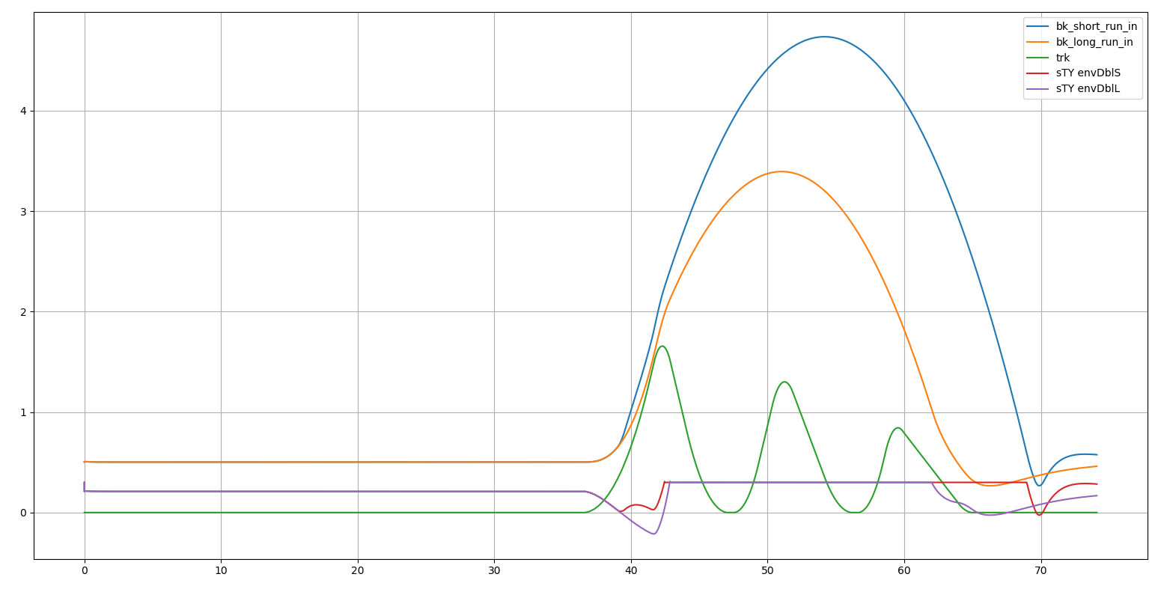
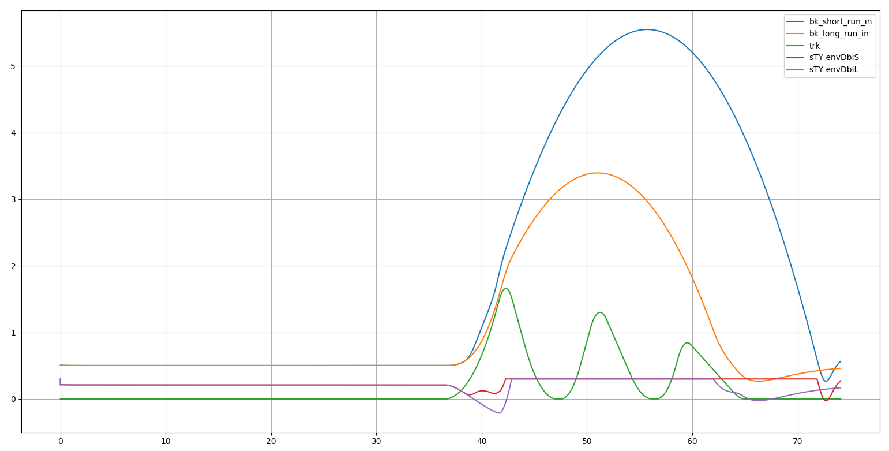
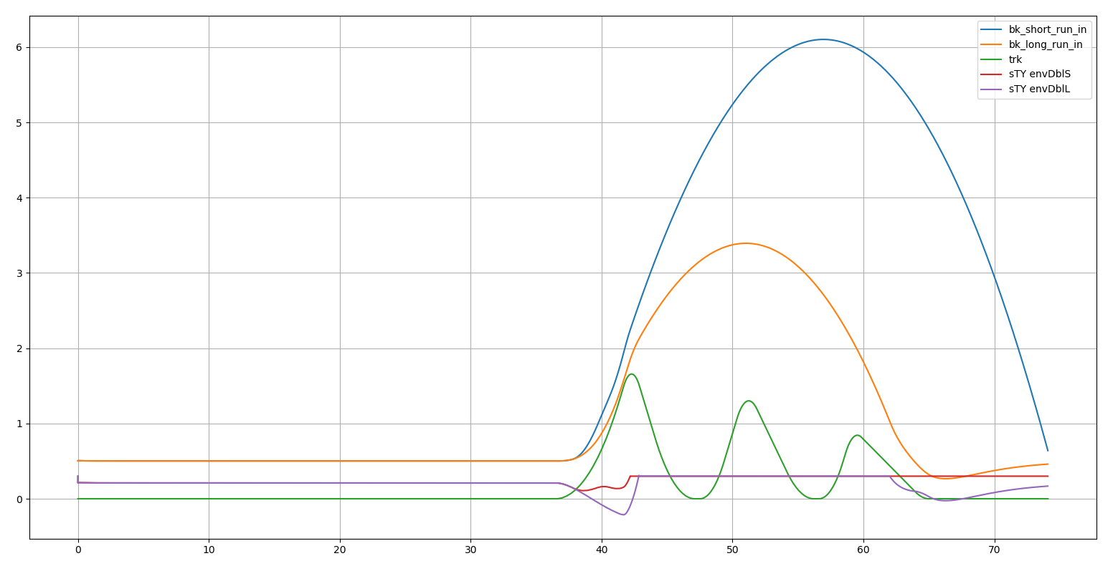
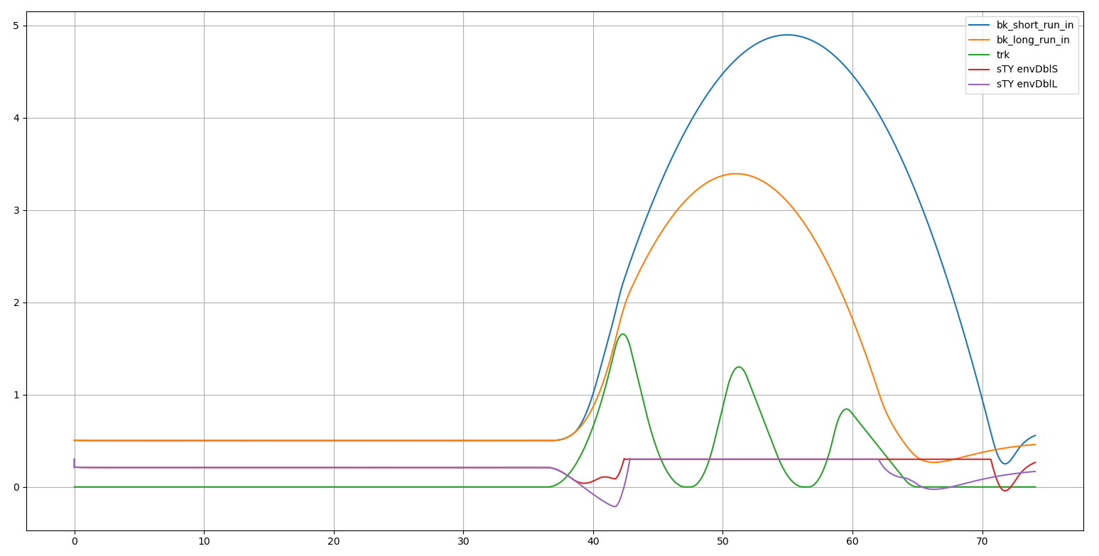
10% and 10x
30% and 10x
50% and 10x
30% and 5x
Selected by visual inspection
Suspension bottoming, ramp up stiffness [1x -> ?x] as travel goes [?% -> 100%]

Slide 6
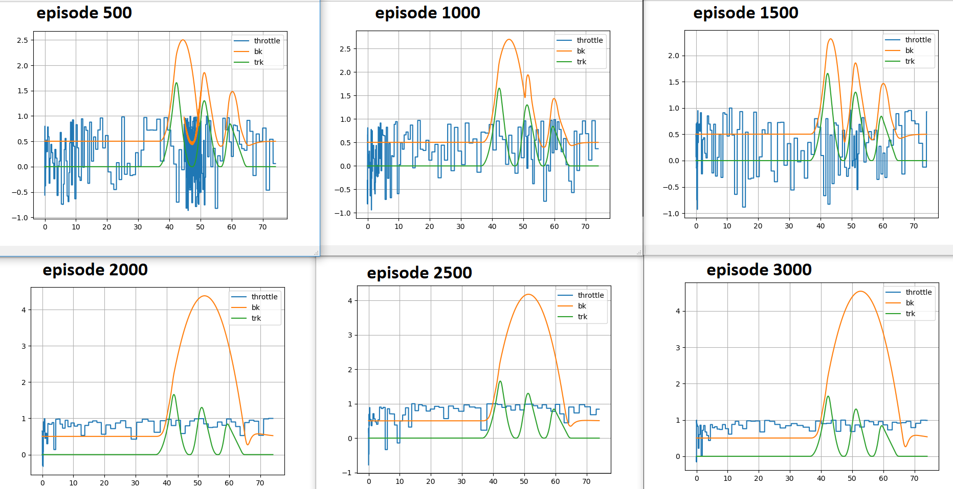
First success with tensorForce
Uses default PPO agent from OpenAI gym Cart Pole example.
Env is just the track with single triple jump (i.e. mk_trk1()). Plot show throttle and bike X position vs time.
We can see the trend towards more full throttle, not rolling backwards on jump face. Still some ambiguity with what to do at start. Obviously because it only see 30m ahead, and 30m ahead of start there is nothing. But what's nice about that is we see that as soon as it does see a feature like jump face, high throttle actions predominate.
Reward at ep3000=3.4
Best reward =4.1
Worst reward = approx. -1e6

Slide 7
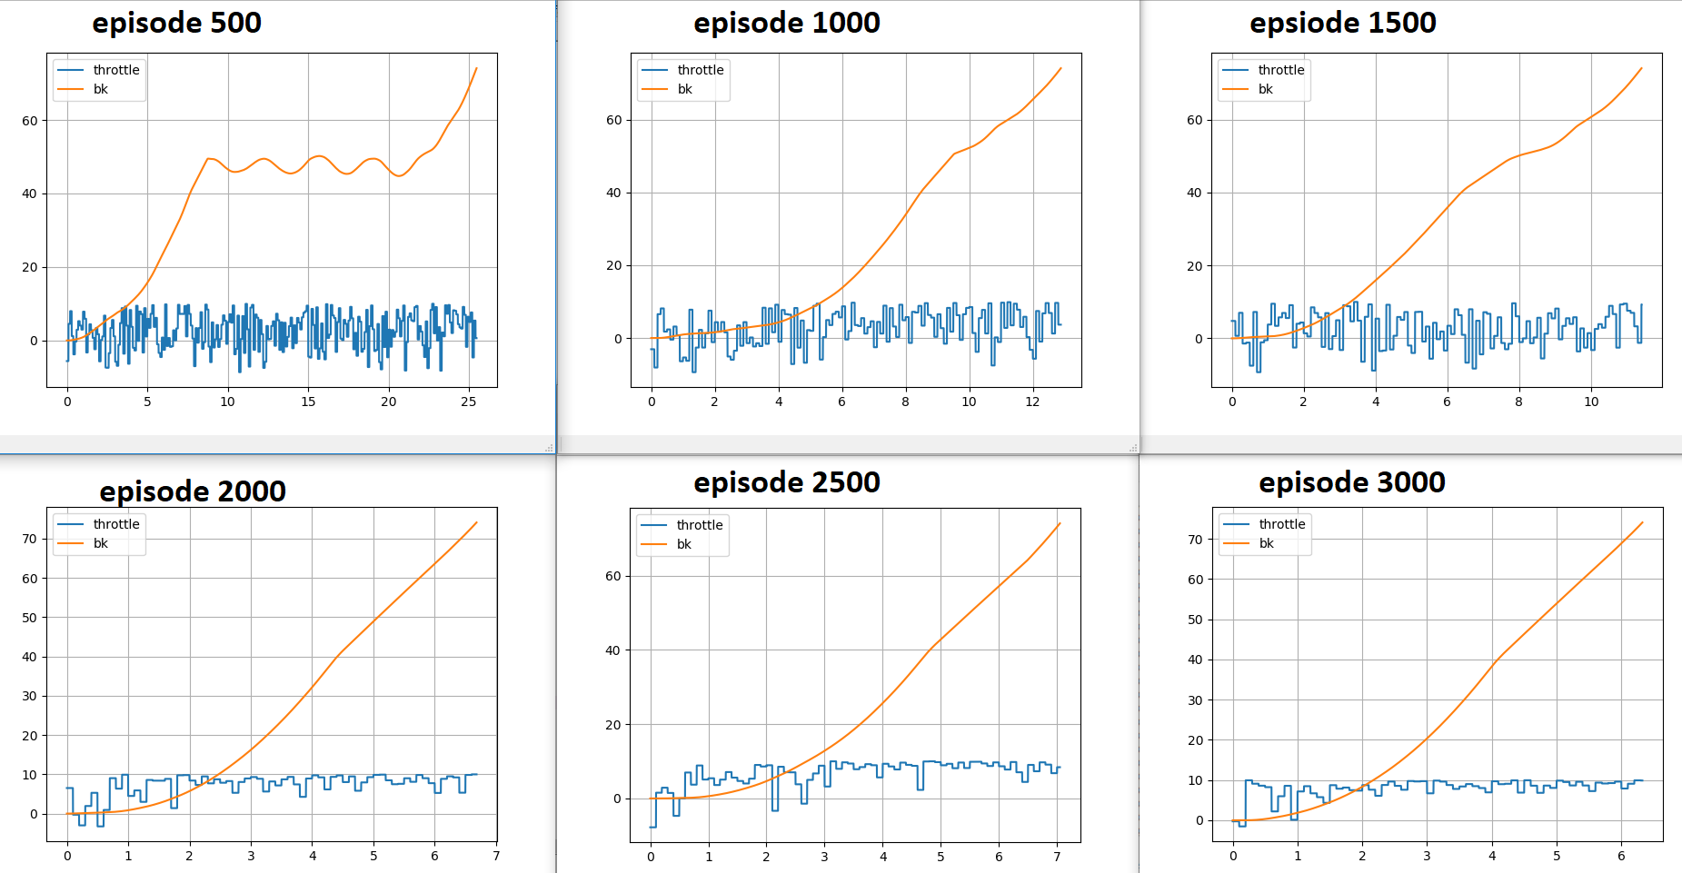
First success with tensorForce
Uses default PPO agent from OpenAI gym Cart Pole example.
Env is just the track with single triple jump (i.e. mk_trk1()). Plot show throttle and bike X position vs time.
We can see the trend towards more full throttle, shorter episode time, and monotonic Xpos increase over episode (i.e. no rolling back down jump face)
Reward at ep3000=3.4
Best reward =4.1
Worst reward = approx. -1e6

Slide 8
State ideas
Thinking about what mental model a rider would have for the track, these are some state ideas that could work well.
Include a vector which maps out the track features. E.g. 00102040100203, some flat, some flat, a table top, some flat, a double triple jump, some flat, some whoops, etc. this vector encodes the track layout for the agent, so the agent can plan its strategy. A rider would not commit a high fidelity layout to memory, but surely would be able to tell someone the sequence of features from memory.
Have the track profile portion of the state vector be variable length. A minimum length, but if there is a long flat section, the resolution would drop, so seeing further in distance space with same number of sample points. This would help the agent start moving at the beginning for tracks that have a start section that is flat for longer distance than the minimum length. This is sort of attune to how humans look ahead, the more features there are ahead, the less far we look, if there are few or no feature in the near distance, we sort of turn our focus away from that, and look far ahead, with poor resolution, to see what features we can.

