Slide 1
Free body diagrams for environment model. The bike model has only one wheel. There is only 1 DOF between wheel and bike.
bike
-Fdragx
-Fg
-Fdragy
Fs
-Fs
Ft
wheel
Wheel Free Body
If inAir
Fn=Ft=whlFx=0
whlFy =(-Fg-Fs)
Else
Fn=(-Fg-Fs)*cos(theta)
Ft=min(trq/whlRad,Fn*nu)+(-Fg-Fs)*sin(theta)
whlFx = -Fn*sin(theta)+Ft*cos(theta)
whlFy = Fn*cos(theta)+Ft*sin(theta)
Axw=axb, there is no x-dir DOF between wheel and bike
Mw*ayw = whlFym but this is irrelevant since wheel ayw is a function of following track profile.
-Fg
Fn
theta
Bike Free Body
Mb*axb = -Fdragx + whlFx
Mb*ayb = -Fdragy - Fg + Fs

Slide 2
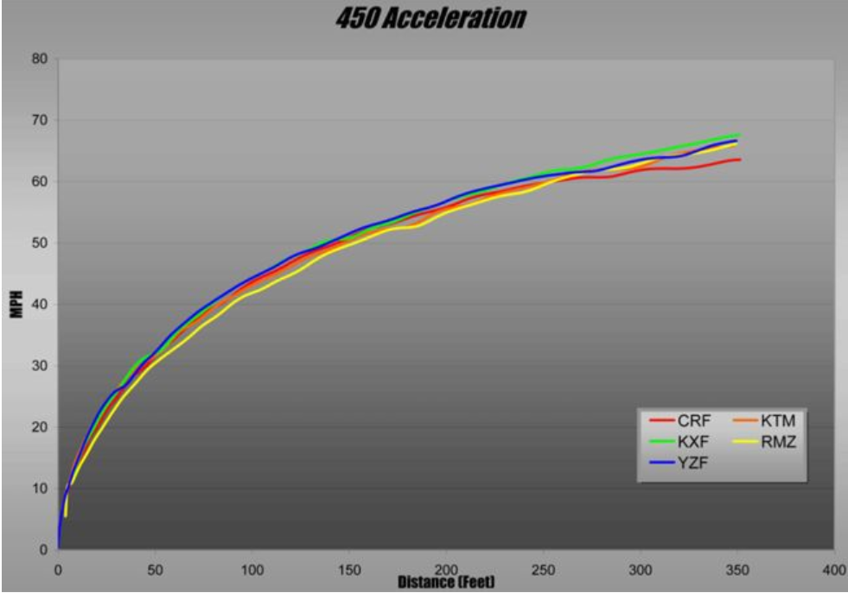
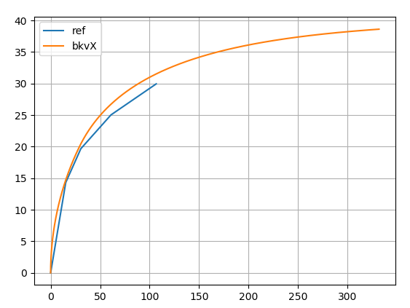

Slide 3
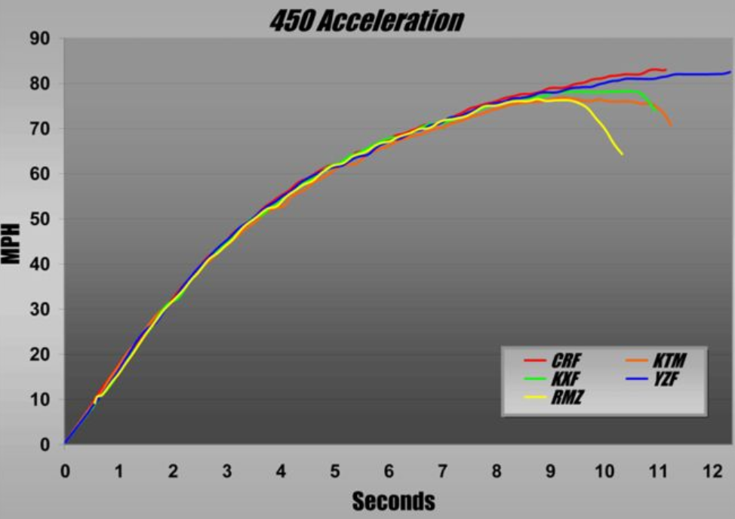
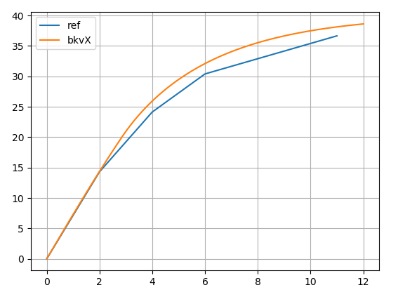

Slide 4
Check Momentum conservation across change in direction at jump face transition.
Variable step solver? As bike or wheel acceleration in either X or Y direction goes from [lwr_thr -> upr_thr], time steps goes [dt -> dt/n], where n is positive integer. Still only record data every dt, so run sub-loops at dt/n until a dt size step is complete, then record data

Slide 5
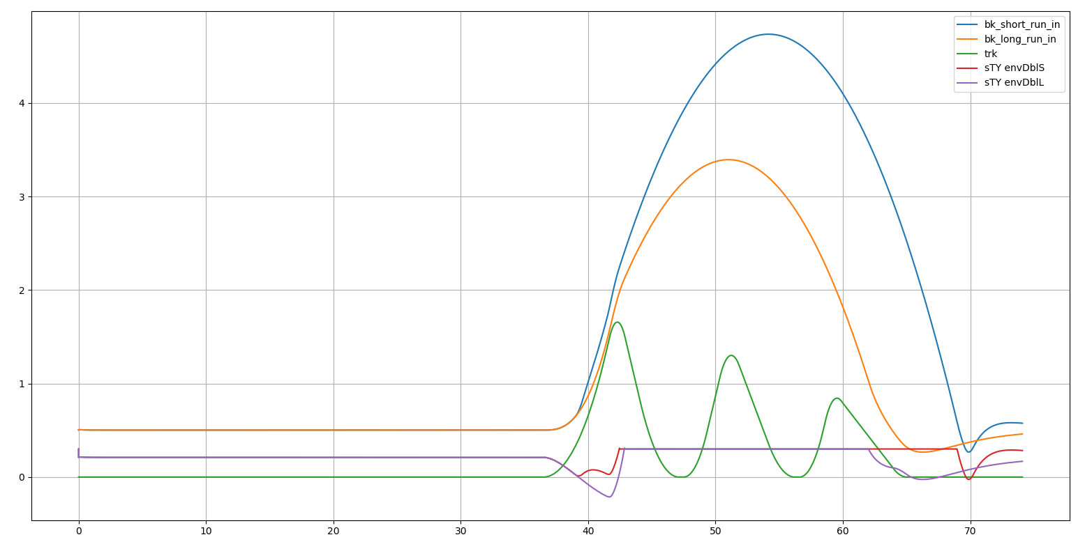
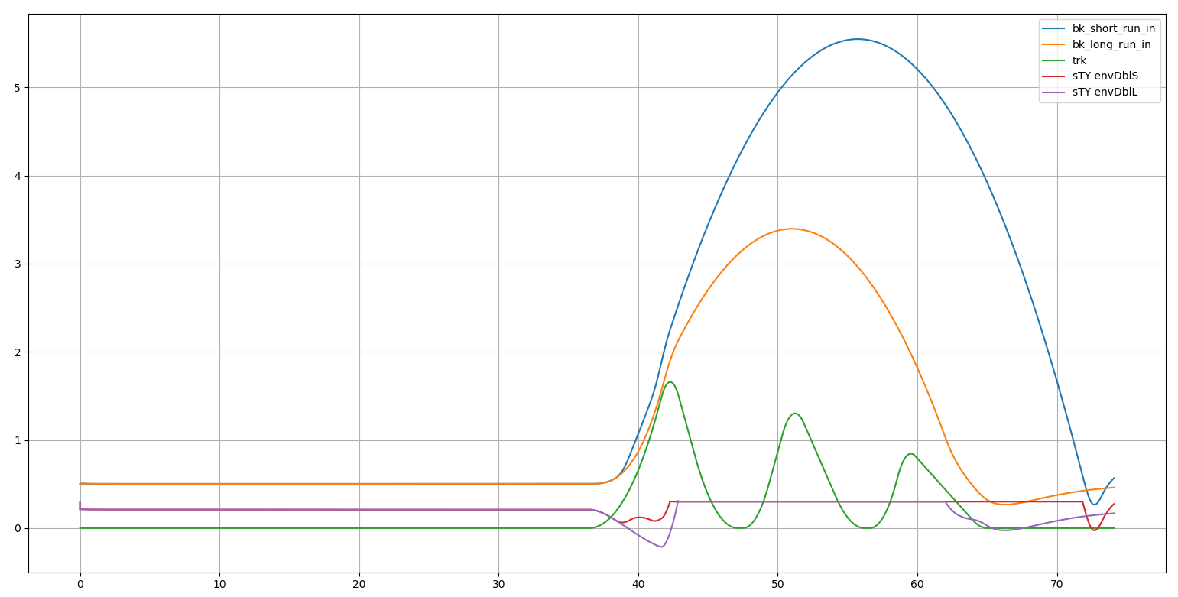
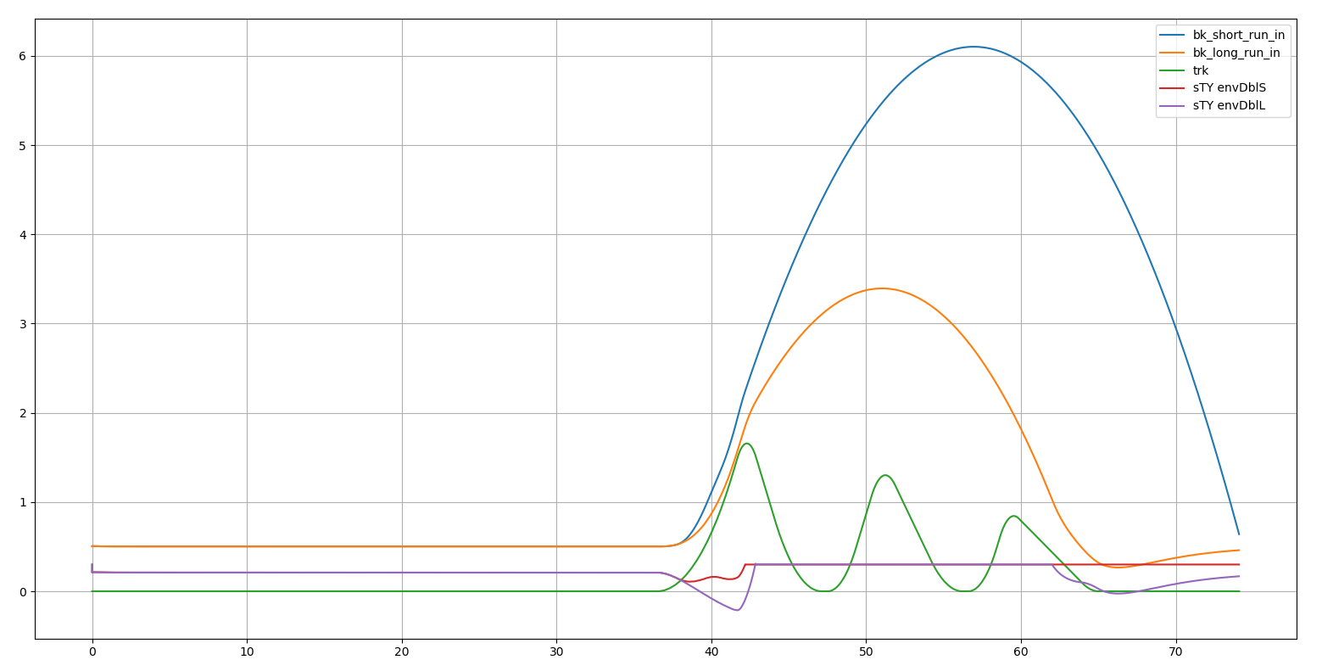
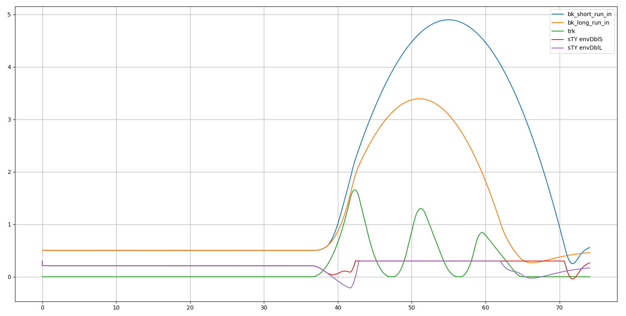
10% and 10x
30% and 10x
50% and 10x
30% and 5x
Selected by visual inspection
Suspension bottoming, ramp up stiffness [1x -> ?x] as travel goes [?% -> 100%]

