Slide 1
Amazing Title Slide
Machine Learning Fundamentals
Héctor Del Manzano
11 Nov 2018

Slide 2
Proceedings & Table of Contents
Exploration of Dataset
Visualize the Data
Question 1
Augmenting the Dataset
Classification Approach
Question 2
Regression Approach 1
Conclusions & Next Steps

Slide 3
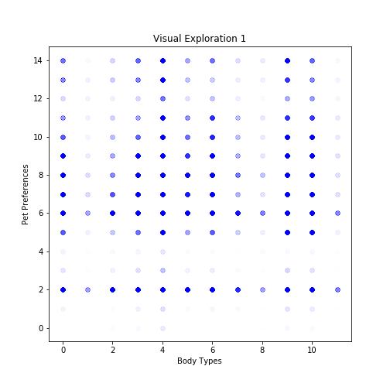
Visualize the Data*
Scatter of one feature against another: On the x-axis we have encoded the body_type answers as integer numbers; low means underweight high means overweight highest means jacked! On the y-axis we encoded the multitude of pet preferences as an integer; low hints preference ("likes") while high hints commitment ("owns, has"). Diving in, we find:
"Dislikes dogs dislikes cats" people (y=2) exist across all body types.
"Dislikes dogs and likes cats", "dislikes dogs and has cats", "dislikes dogs", "dislikes cats" answers are almost non existent (y=3,4,1,2). Across any body types.
People with "used up"(x=1) body type can't handle pets
"Overweight" (x=8) people don't want to fuss with pets
"Jacked" (x=11)people are too busy at the gym for pets!
*: For "Explore the Data" see the Jupyter Notebook, just a bunch of .head() and .value_counts()

Slide 4
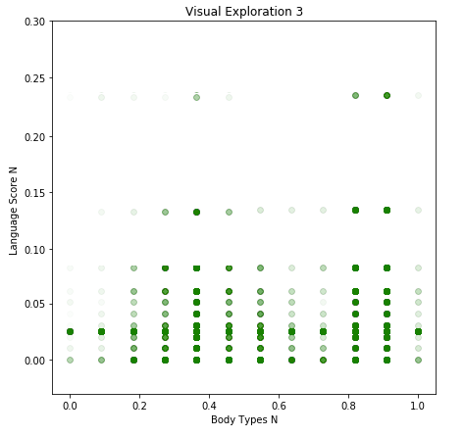
Visualize the Data 2
Silly me normalized the body_type codes and the language_score (see Augmenting Data slide) and scattered one feature against the other.
Perhaps the other Normalization (not MinMax, as shown) technique would have been more productive, since the ranges are not evenly distributed.
If we can infer something (weakly shown) from this, it may be that there's a hint suggesting that "fit, athletic, jacked" people show higher Language aptitude (upper right). This Hypothesis makes sense from the standpoint of commitment: withholding from pizza and learning multiple languages both take strong commitment.

Slide 5
Question 1: Can we come up with a classifier for body_type from pet and language information?
body_type_code: 0 is no-answer/NaNs, low is "used up"/"skinny", high is "overweight", top values is "fit, athletic, jacked".
pets_code: encoded from low commitment to high commitment.
speaks: Scoring function awarded points for quantity of languages spoken and also considered the usefulness of the language by awarding higher points to the languages with more speakers (See Code Line @@@)
essays: were parsed for mentions of pets or pet related vocabulary
income: simple map keeps the original value except when unanswered it is set to the national average of $44,564
Original Features Chosen:
body_type (labels, target)
pets
speaks
essays 0 through 9
income
These Features Were transformed as explained to the Right.

Slide 6
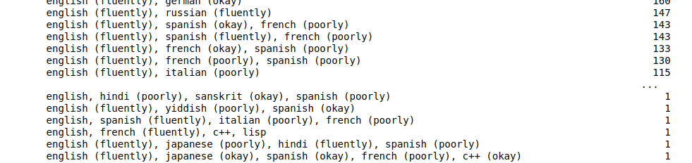
Augmenting the Dataset
def numerate_speaks(lang_str):
A function that uses the Wikipedia top-20 spoken languages around the world as a map, where the most spoken gets a 20 value and the 20th spoken receives a 1 value.
The final score takes this popularity value and adds to it a bonus for the raw number of languages you've listed. So if you've listed 3 languages the language_score will be 3 + 20 + 19 + 18 if they were Mandarin, Spanish and English (the top-3 spoken languages around the world).
If the language is not in the top-20 list ("c++, cool story") or, the entry is a NaN it gets assigned to "other" and that component contributes 0. Fluency ratings (parenthesis) are completely ignored.
"speaks" feature is orignally testy:
What a mess!
Assigning a unique integer code to each answer seems like a way to treat similar stuff as different stuff … So, we create the numerate_speaks function (right).
"essay0" through "essay9" parsed for pet synonyms and the count was saved as new feature.

Slide 7
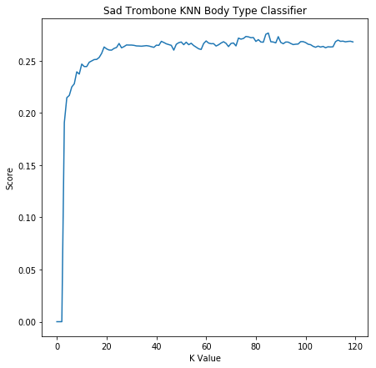
Classification Approach: KNearestNeighbor
KNN Classifier Chosen:
All the features were Normalized with the MinMaxScaler() (preprocessing package)
train_test_split function used to split the 54650 records on the 4-feature ('income', 'langscore', 'pets', 'petscore') DataFrame into 80% training 20% validation groups.
The target (labels) classifications were the body_type codes from 1 through 11.
An Instantiate(k=variable), .fit(), .score loop was developed in order to find optimal K value (see right).
Optimal K value found to be K=85
Best Score was 0.2764

Slide 8
Question 2: Can we turn this around and infer income from body_type, language and pets information?
After National Average substitution, income.value_counts()
Features used as prepared for the Classifier.
The only difference is that now 'body_type' is an input/feature and "income" is the output/target
The scoring function for the Regressor chosen would not cooperate; was roadblocked, shamed, shunned, trashed by it. Something with the shapes and dimensions… until it worked and the score was awful.
Own Simple scoring function developed.
44564 | 48442
20000 | 2952
100000 | 1621
80000 | 1111
30000 | 1048
40000 | 1005
50000 | 975
60000 | 736
70000 | 707
150000 | 631
1000000 | 521
250000 | 149
500000 | 48

Slide 9
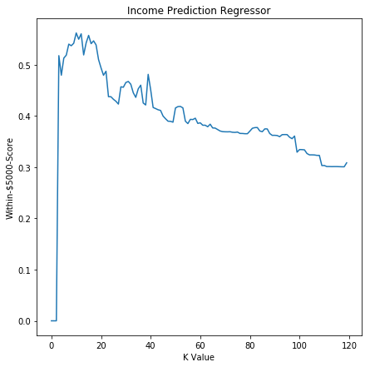
Regression Approach: KNearestNeighbor
All features were Normalized with the MinMaxScaler from preprocessing package
train_test_split function for an 80/20 split used again.
Features were: 'body_type', 'pets', 'langscore' and 'petscore'
Looking to predict the 'income' figure target
Initially K=85 chosen since this was "optimized" from the Classifier exercise. The .score() function for that yielded -0.10434 which according to documentation *checks notes* just plain sucks.
An Instantiate(K=variable), .fit(), .score() loop was executed to find optimal K value (right).
Optimal K value found at K=10

Slide 10
Conclusions and Next Steps
About the body_type Classifier:
At first I was discouraged by the 0.27 score result. But then I remembered we're trying to classify among 11 different category types which means that the Pure-Chance rate should be 1/11 = 0.09…
So this means our Classifier is 3 times better than Pure Chance. Please disregard the fact that I will get 3 out of 4 guesses wrong!
We could explore reducing the target labels to just 3: underweight, in-shape, overweight. This may increase our classifiers' success
We should also create an SVM Classifier with the same featureset and compare results.
About the Income Regressor
Group size was significantly smaller than on the Classifier (K=85 vs K=10) this to me suggests that the feature added ("body_type") is information rich, we can say more with less neighbors in the group … if that makes sense.
A custom scoring function was found beneficial in the sense that it encapsulates a tolerance: The income prediction is considered "good" if it is off by up to $5k
Look, the Regressor is garbage. Even with the $5k tolerance, the predictions score at 0.5617. If opened to $10k it is 0.6863.
My conclusion is the "pet love/obsession", "body type" and "language aptitude" are not good predictors of Income

Slide 11
Final Notes
Answering the Income question in OKCupid is not popular; as seen on the Question-2 Slide, close to 45 out of 60 thousand people just don't answer. Perhaps substituting those no-shows and NaNs with the National Average was not the best strategy. This exercise should be run again but using the remaining ~15k records from people that did answer, and the results compared.
But assuming success, will we have a general predictor for personal Income, or a predictor for Income for the type of people that like to answer the "how much to you earn" question?
A second LinearRegressor exercise was performed but results are unworty... let's call it inconclusive. It can be found in the Notebook, towards the end.
Please do review the Jupyter Notebook for any questions you have about the reasoning or process or code. I was verbose with the comments.
I had a blast, and I am grateful for your teaching efforts. Best regards. -h.

