Slide 1

ULTRA SHORT PULSES AND LOW JITTER FOR TIME-RESOLVED EXPERIMENTS AT SEALAB
Beñat Alberdi, Ji-Gwang Hwang, Axel Neumann and Thorsten Kamps
September 09, 2022 | Helmholtz-Zentrum Berlin
Member of the Helmholtz Association

Slide 2
Outlook
Introduction:
Sealab
Ultrafast Electron Diffraction and Temporal Resolution.
The SRF Photoinjector in HZB.
Methods and Results:
Time of Flight Jitter.
Bunch Compression and Linearization.
MOGA Optimization.
How to increase time resolution further.
Conclusions and Outlook

Slide 3
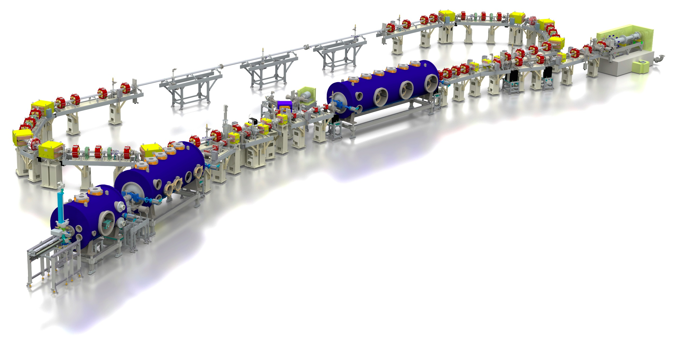
SEALAB
test and
diagnostic line
beam dump
6.5 MeV, 100 mA
= 650 kW
linac module
3 x 7 cell SRF cavities
44 MeV
merger
dogleg
High average power machine to test ERL technologies and applications in Helmholtz-Zentrum Berlin.
Commissioning of SRF photo-injector on-going: high quantum efficiency cathodes preparation, laser system, high-power RF conditioning of SRF. Booster module couplers are on track to allow first beam from the injector spring 2023.
However, main LINAC missing for now. Looking for new science cases :
Ultrafast Electron Diffraction with the injector!
modified Cornell booster
3 x 2 cell SRF cavities
4.5 MeV
srf-gun
1.4 cell SRF cavities
2.0-2.7 MeV, single SC solenoid,
VISIT THIS AFTERNOON !!

Slide 4
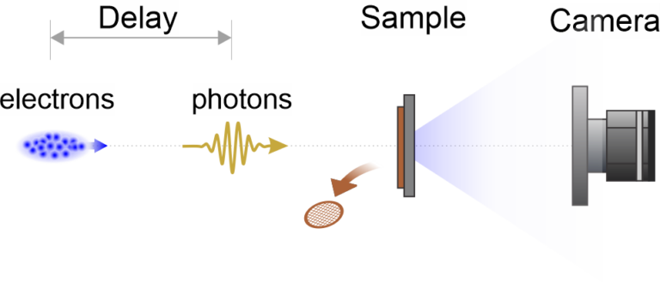
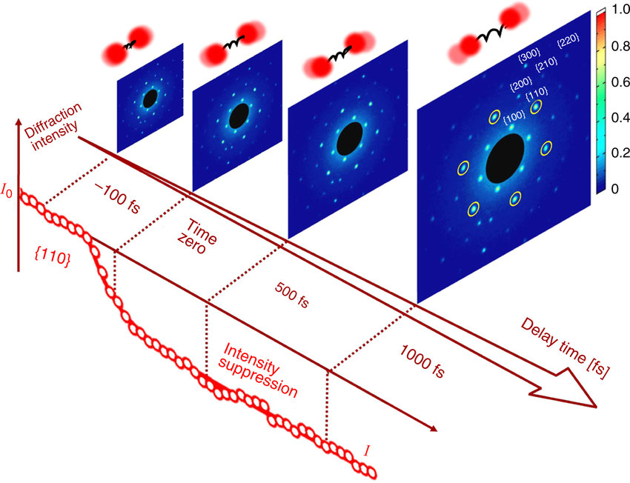
Ultrafast electron diffraction
Step by step description of the UED pump-probe process:
A photon pulse excites the target.
After some time delay, an electron bunch scatters in the same target.
The diffraction pattern of the scattered electrons is recorded.
The process is repeated for a different time delay.
Goal: To obtain a “video“ of the photo-induced structural dynamics.
M.-F. Lin et al., Nat. Commun. 8, 1745 (2017).

Slide 5
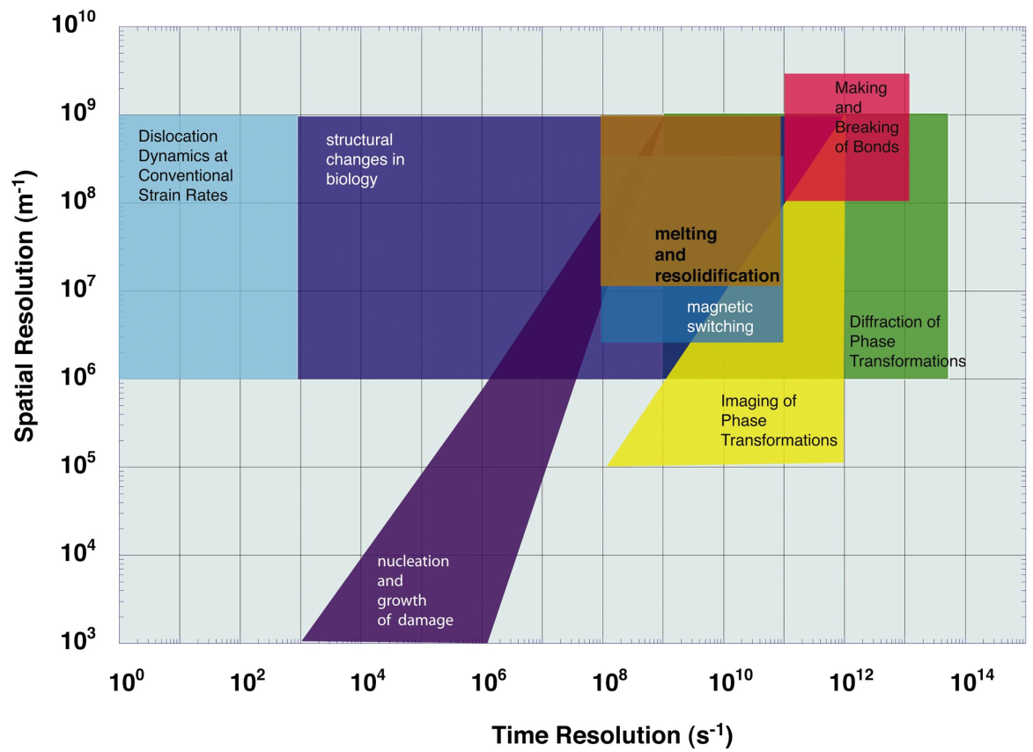
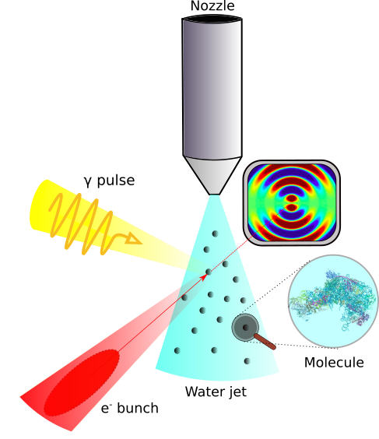
Ultrafast electron diffraction – goal?
Needed for molecular
UED:
Spatial resolution > 10⁸ m⁻¹.
Time resolution > 10¹³ s⁻¹.
Bunch charges in the fC range.
High repetition rate, MHz range.
Hence, we need an accelerator with:
MeV energy (reduces space-charge forces, compression )
nm-rad emittances
Bunch length smaller than 100fs
Better ToF stability than 100fs
W. E. King et al., J. Appl. Phys. 97, 111101 (2005).

Slide 6
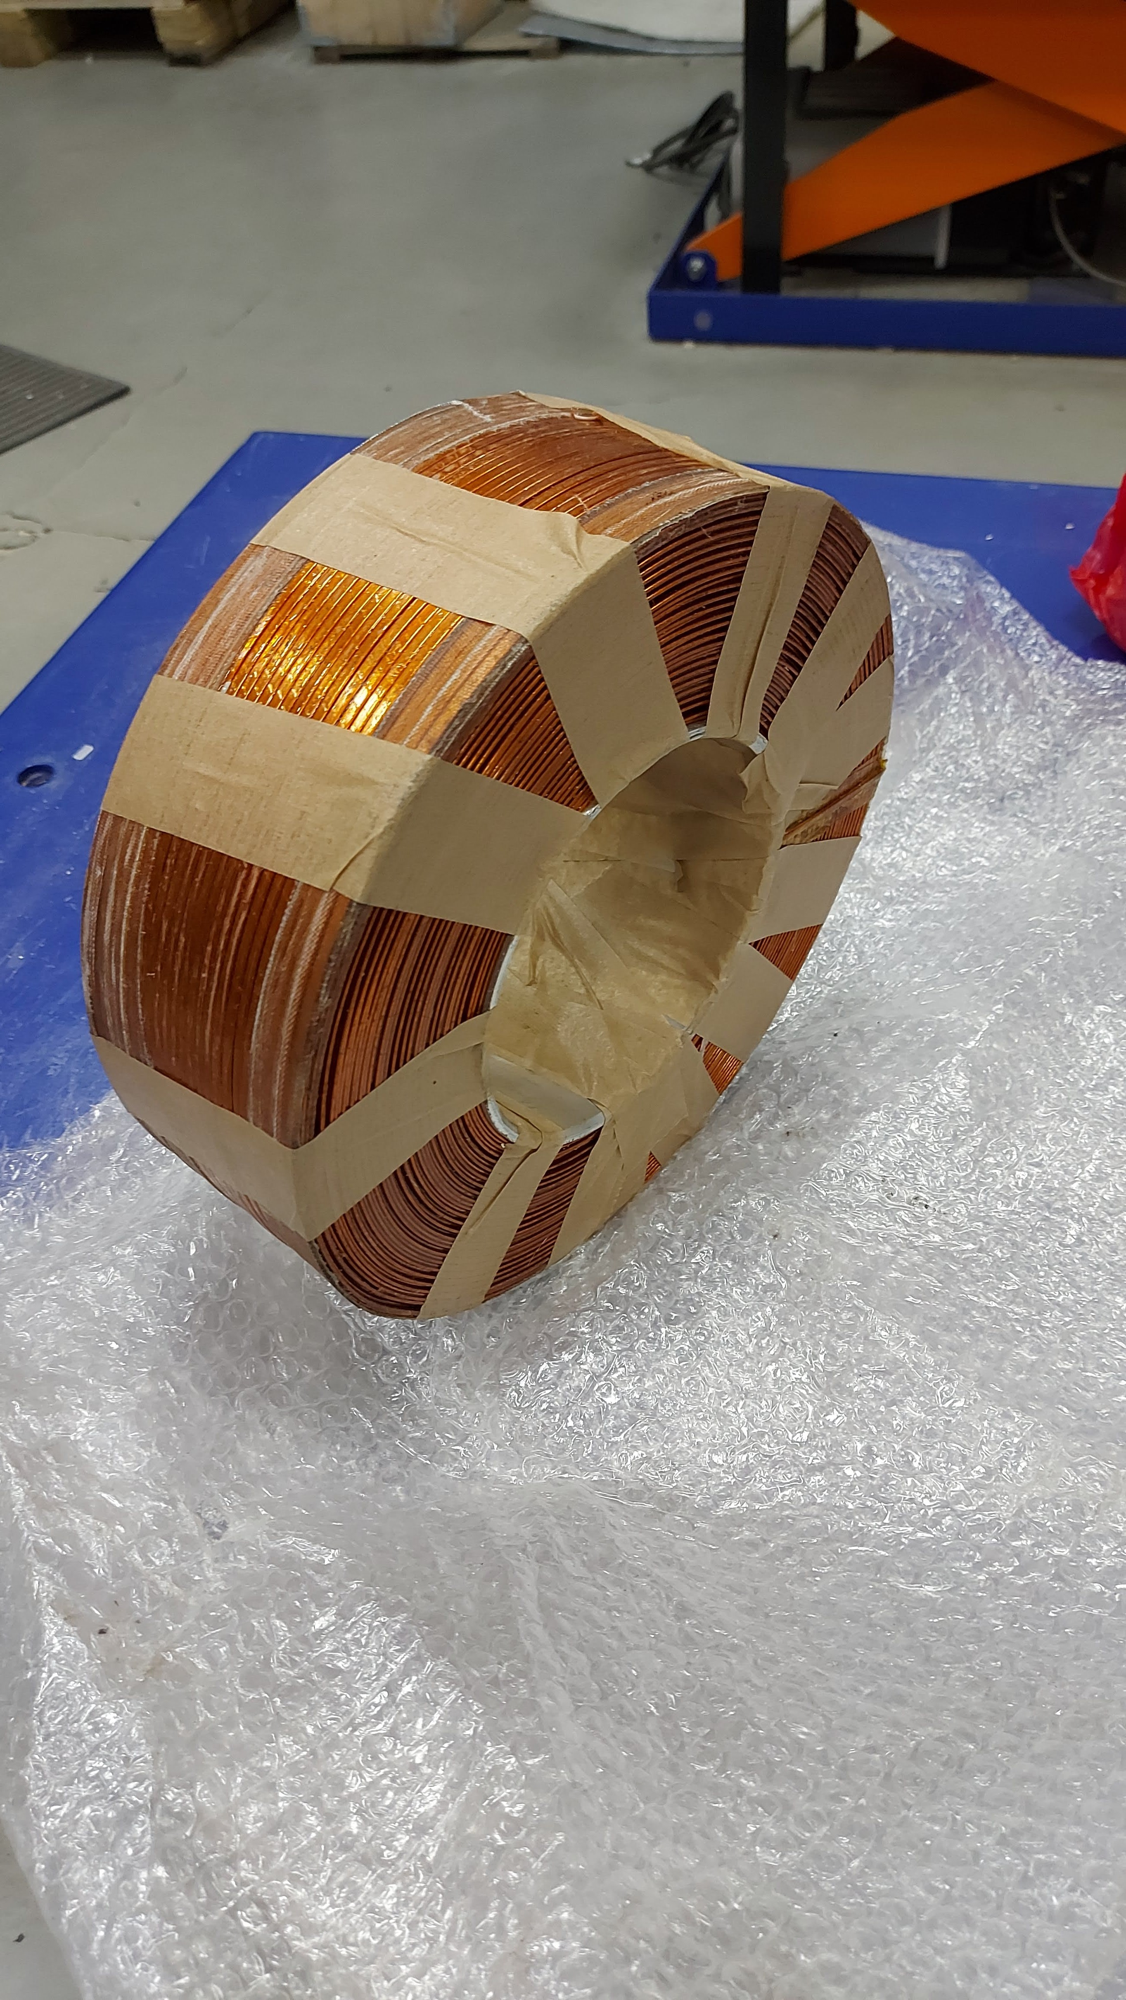
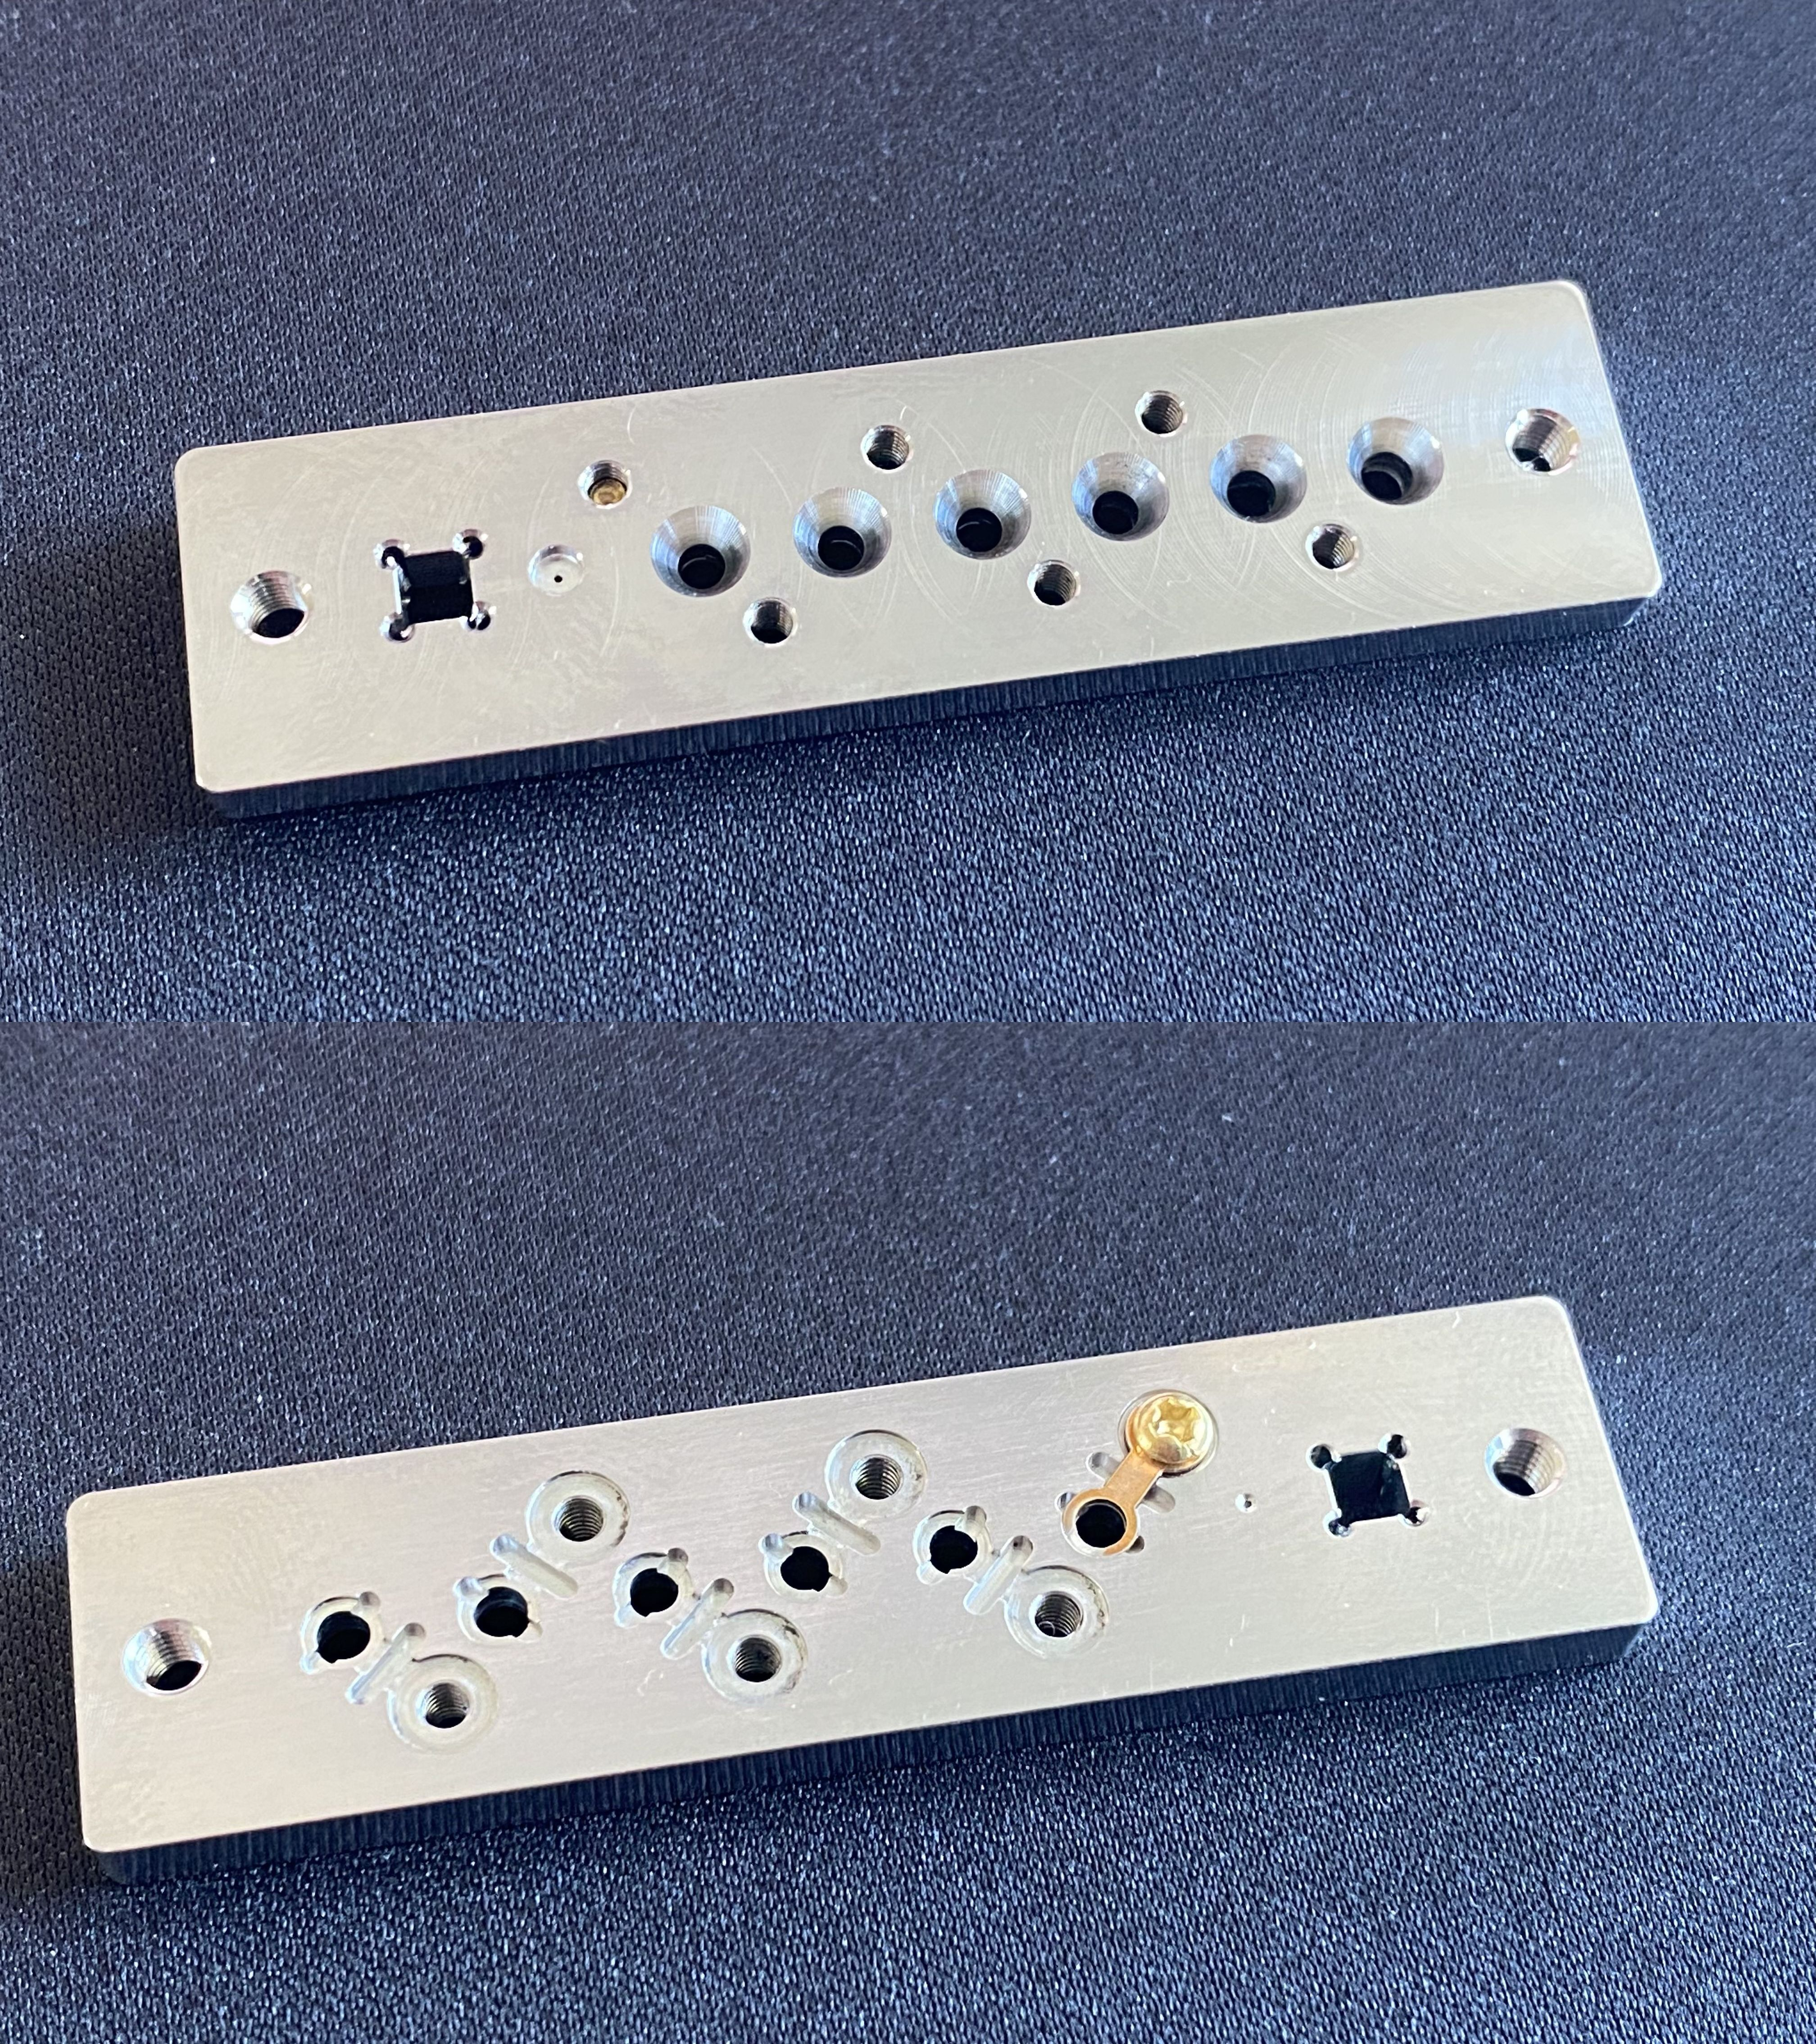
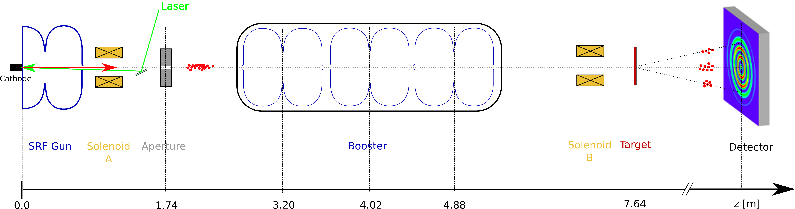
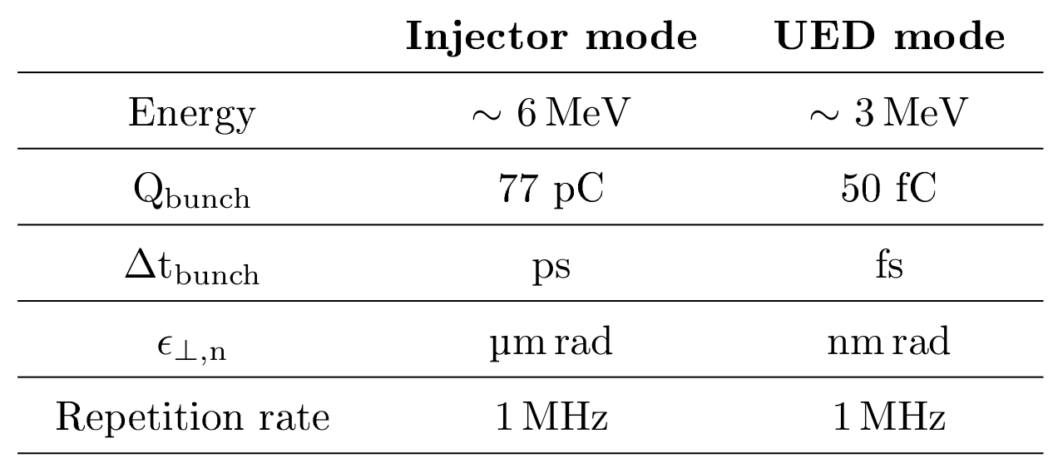
The SRF Photoinjector in hzb
Aperture
Solenoid
Target station
The beamline:
Superconducting L-band electron gun and 3 booster cavities.
MHz repetition rate (initially, GHz later).
515nm drive laser. Minimum pulse length 1ps.
Trans. norm. emittances mm-mrad range.
Energy between 1MeV and 3.5MeV.
Bunch charge pC to nC range.
Not every parameter is ideal for UED!!
Emittance too large → Aperture
Laser pulse too long
Fluctuations in cavities
First constraint: Extract more charge
than needed close and collimate!

Slide 7
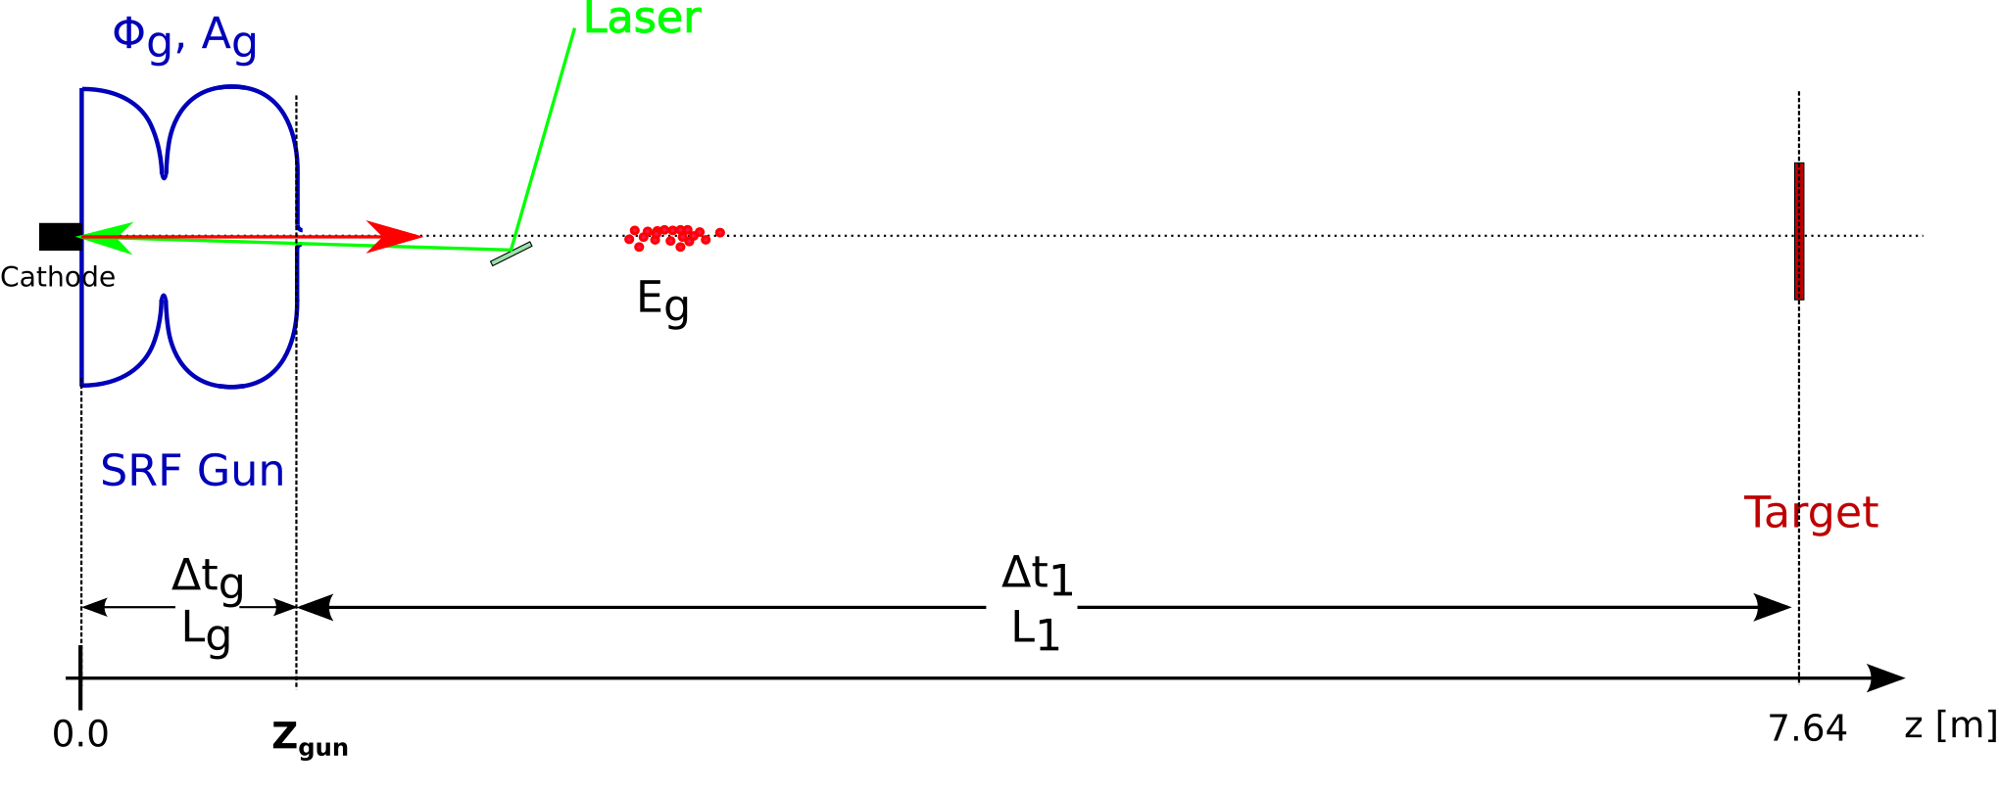
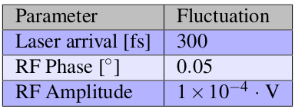
Time of flight jitter
The electron bunches sample different fields than the nominal in the gun. The reasons are:
The laser pulse arrival jitter at the cathode
The phase jitter in the gun
The amplitude jitter in the gun.
Timing jitters in the gun can be combined:
We develop an analytical model of the time of flight jitter:
Astra simulations are used to calculate beam energy and time to exit the gun as a function of gun amplitude and phase

Slide 8
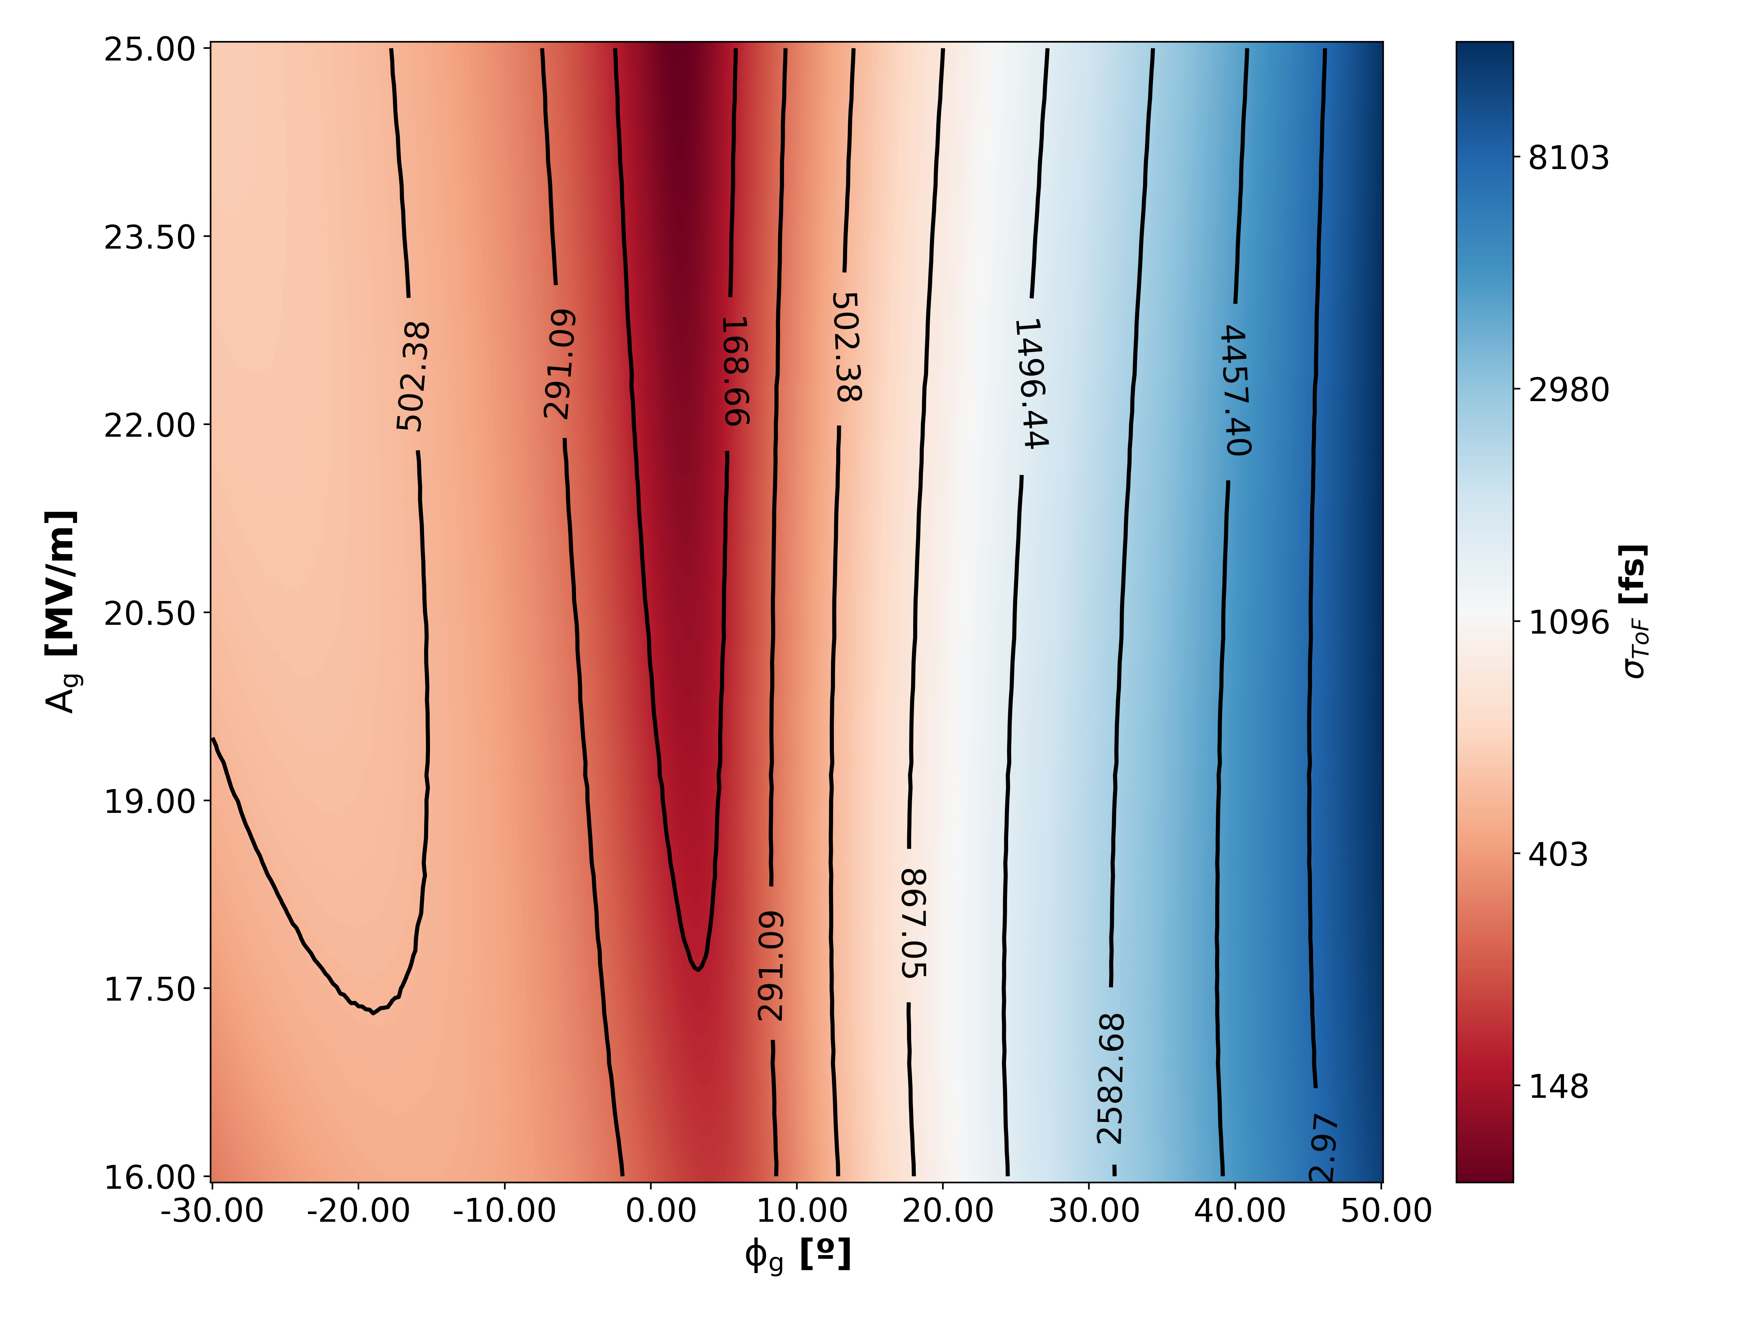
Time of flight jitter
B. Alberdi et al., Sci. Rep. 12, 13365 (2022).
We develop an analytical model of the time of flight jitter:
Astra simulations are used to calculate beam energy and time to exit the gun as a function of gun amplitude and phase

Slide 9
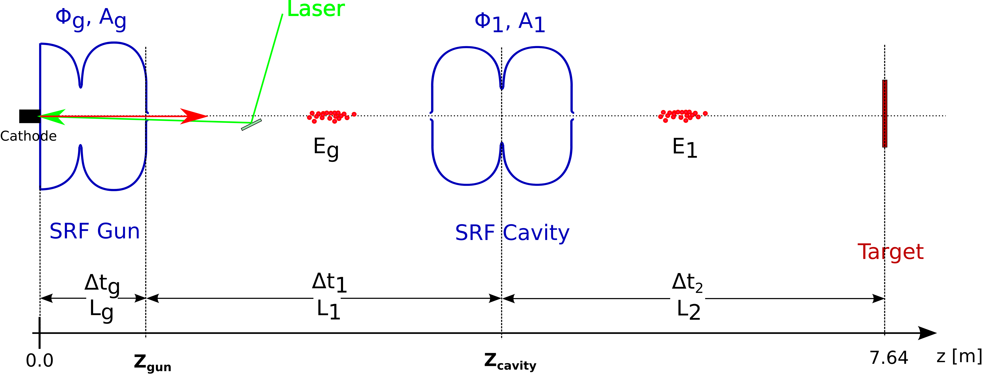
Time of flight jitter – further cavities
Energy gain after a booster cavity:
Where:
Which depend on the energy at/after the gun.
One can then calculate E1, t2 and express the ToF = tg + t1 + t2 as a function of all cavity parameters in the beamline and the previously simulated derivatives of the gun flight time and energy. Then:
This can be extended to an arbitrary number of cavities

Slide 10
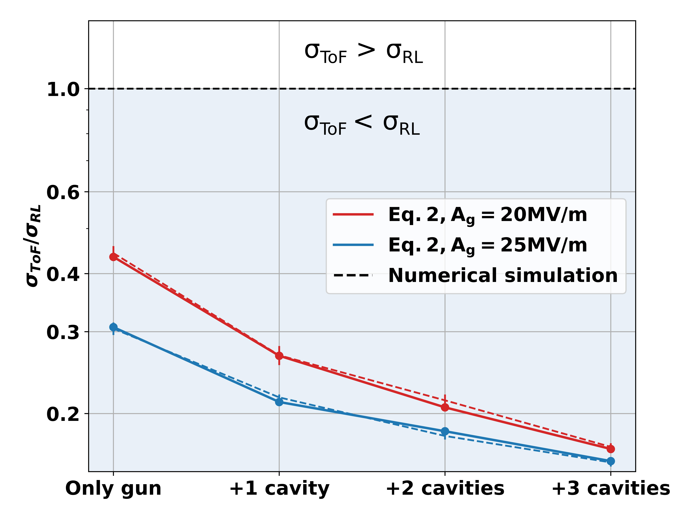
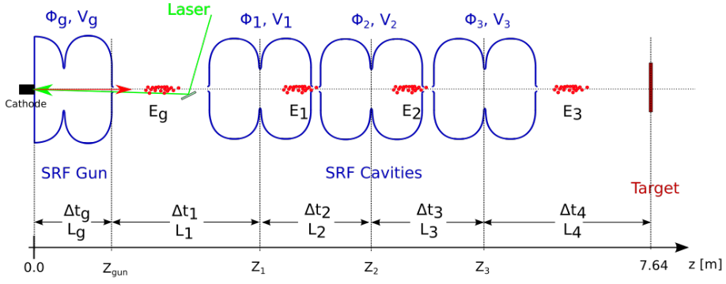
Time of flight jitter – srf photoinjector
The minimums are achieved at working points with nearly on-crest gun emission, this surpresses the effect of laser to RF mismatch in the ToF jitter.
Second constraint: Emission close to on-crest!
B. Alberdi et al., Sci. Rep. 12, 13365 (2022).

Slide 11
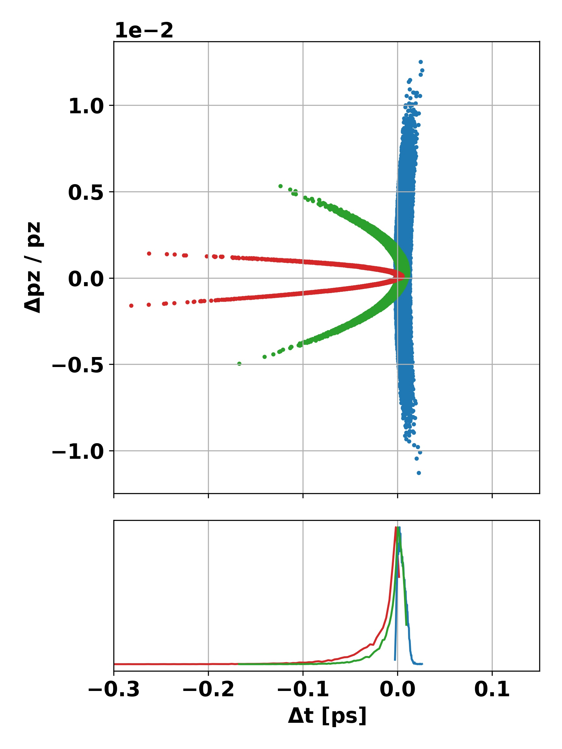
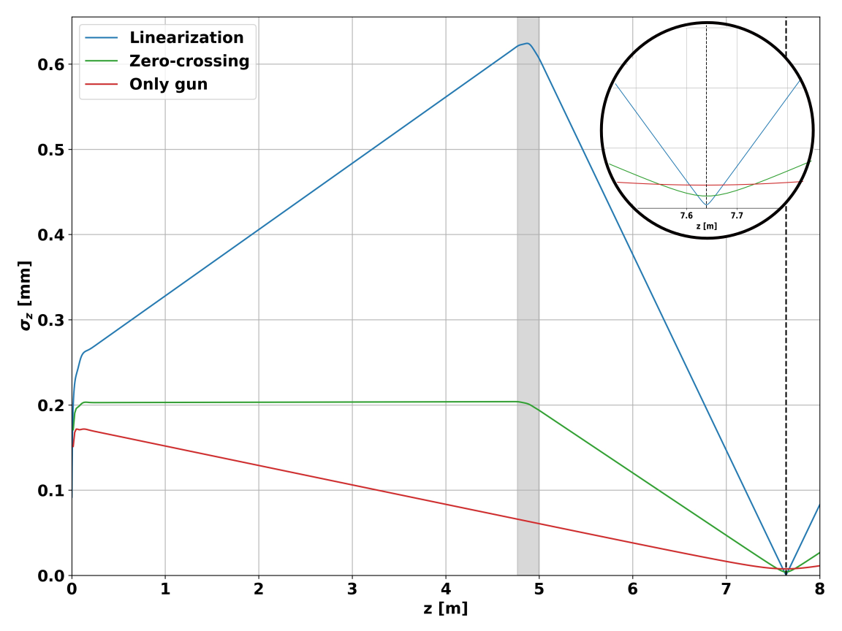
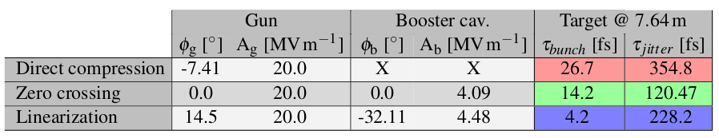
Bunch compression – no Space charge
First, study a very simple case to achieve the shortest bunch possible at the target.
Initial condition is 1ps laser pulse at the cathode, no space-charge forces for the moment.
Linearization [1] using stretcher mode provides the shortest bunch at target.
However, the emission from the gun needs to be done far from the on-crest phase, which increases the ToF jitter → We want to emit close to on-crest!
[1] B. Zeitler et al., Phys. Rev. ST Accel. Beams 18, 120102 (2015)

Slide 12
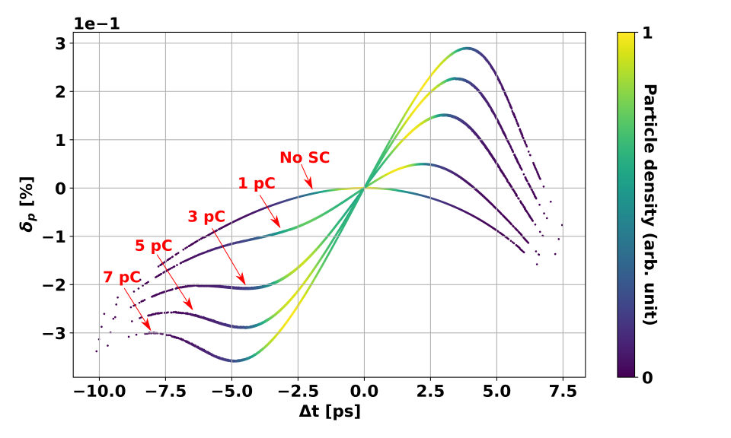
Bunch compression – Space charge
Constrain 1
Constrain 2
Space charge plays a big role.
We want: Collimation for emittance reduction, close to on-crest emission for laser to RF jitter surpression and compression at the same time!
Constrain 3
The requirement of extracting more charge than necesary leaves its signature in form of longitudinal phase-space curvature.
We will use the three booster cavities to correct the longitudinal phase space curvature by linearizing it using the stretcher mode [1].
[1] B. Zeitler et al., Phys. Rev. ST Accel. Beams 18, 120102 (2015)

Slide 13
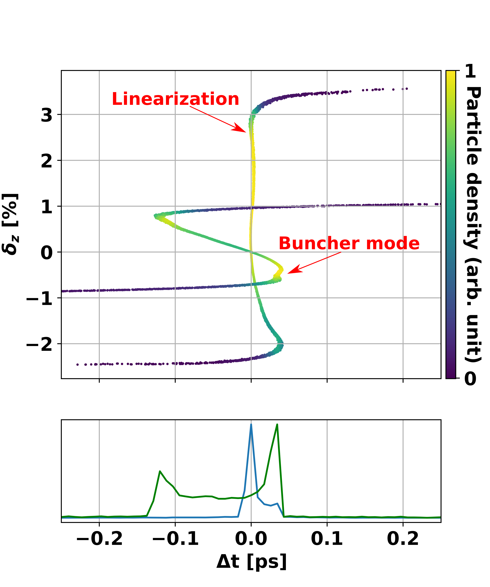
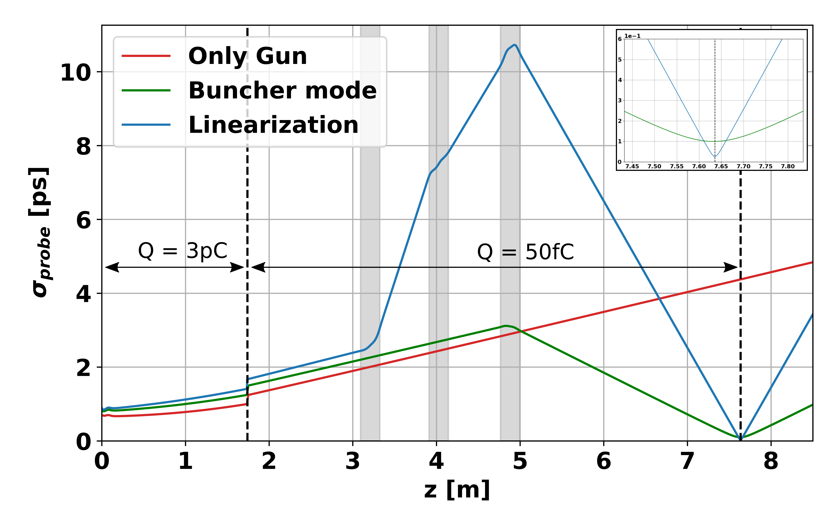
Bunch compression – linearization
B. Alberdi et al., Sci. Rep. 12, 13365 (2022).
The use of the three cavities allows us to emit on-crest and still linearize the bunch at the target, from 1ps → 21fs.
The buncher mode, on the other hand, is limited to 96fs bunch length.

Slide 14
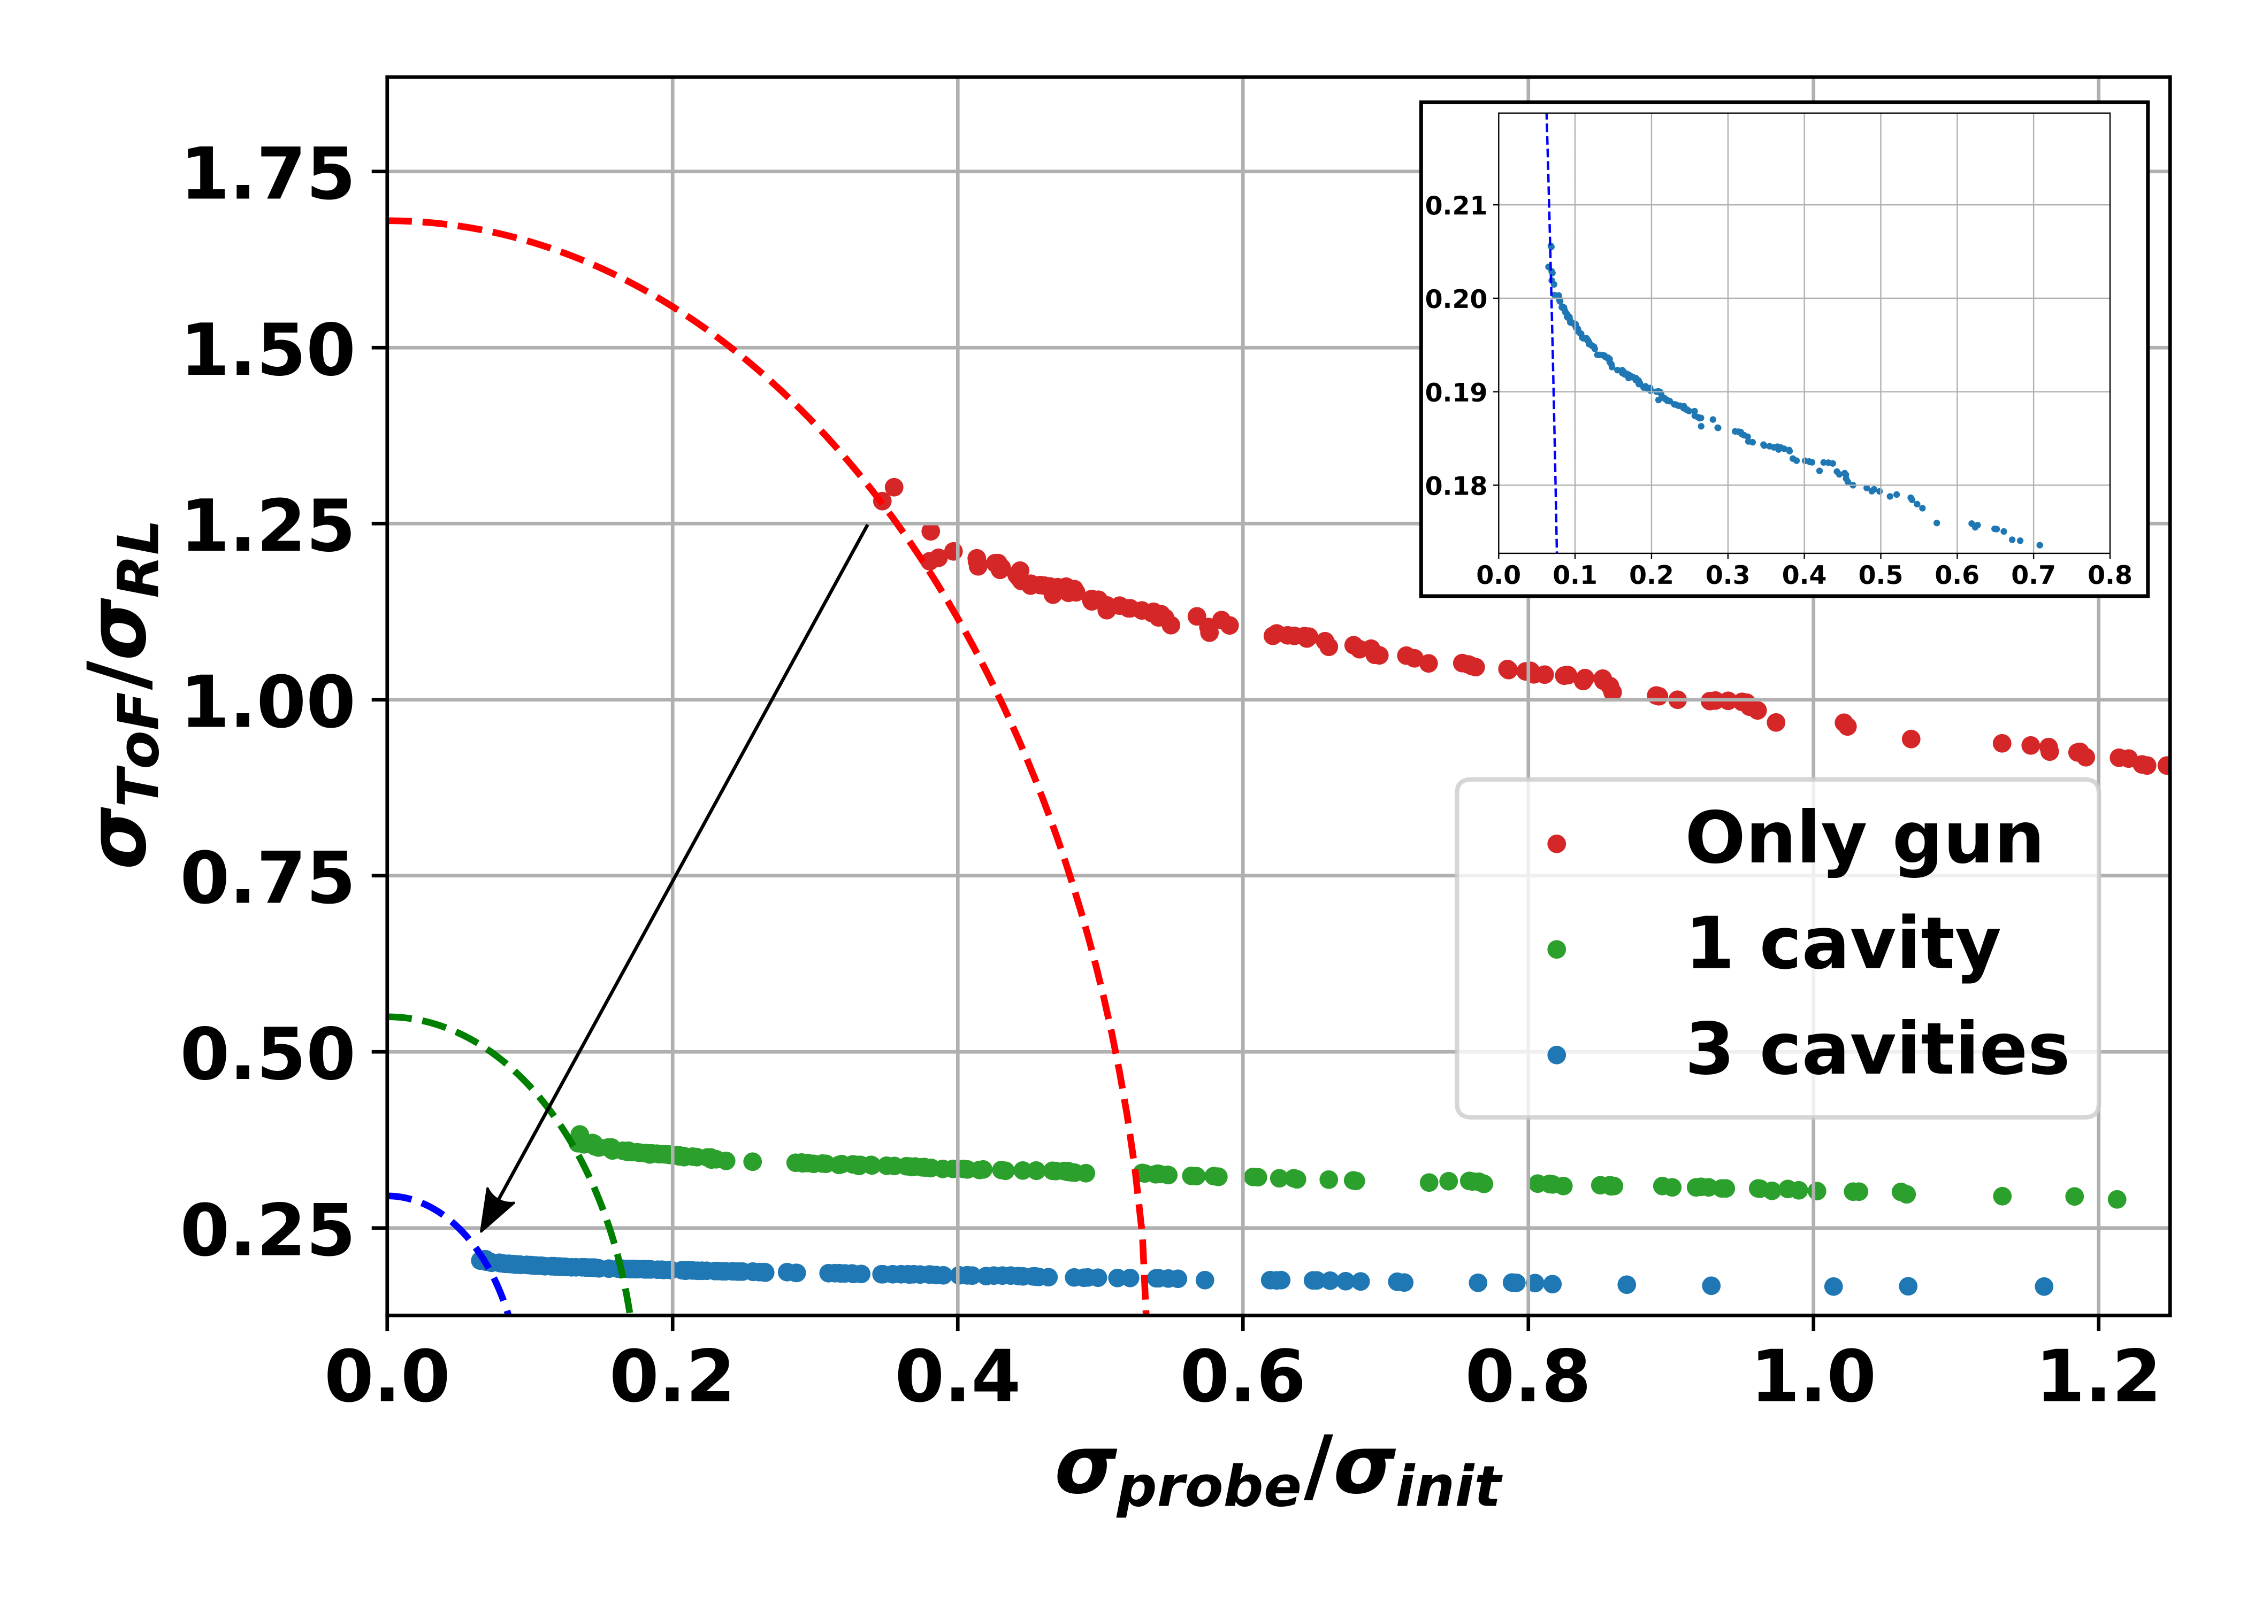
Moga optimization of time resolution
So we have achieved:
Emittance reduction
Bunch compression
Laser to RF jitter effect minimization
However… the linearization requires to use certain working point of the additional cavities which are not benefitial for the ToF jitter. Hence:
Find trade off: compression ↔ ToF jitter
Find the compromise that reduces the overal time resolution (minimize both together).
For this we use MOGA algorithms (with constrains for charge, emittance).
B. Alberdi et al., Sci. Rep. 12, 13365 (2022).

Slide 15
Conclusions and summary
The best solutions from MOGA result in nearly linearized bunches with low ToF jitter, compromising the total linearization to reduce ToF jitter considerably.
Even though we have unfriendly UED parameters in the beamline, playing with the RF cavities we get time resolution of around 100fs (91fs ToF jitter and 43fs bunch length) together with 3 nm spatial resolution → This is a competitive UED machine!
The time-resolution is then governed by the phase stability of the additional cavities, which can be reduced with improvements in the LLRF [1]. A factor 2 improvement in phase stability would bring the time resolution to 60fs, lower than some dedicated UED facilities [2].
!
We are here!
OUTLOOK:
Everything shown here are simulations and calculations, this has to be brought to reality.
Commisioning is ongoing, first beams are expected by 2023.
[1] S. Posen, Phys. Rev. Accel. Beams 25, 042001 (2022).
[2] S. P. Weathersby, Rev. Sci. Instrum 86, 073702 (2015).
W. E. King et al., J. Appl. Phys. 97, 111101 (2005).

