Slide 1

PROGRESS REPORT @ 18 MONTHS
Beam Dynamics and Instrumentation for Extreme Beams
March 10, 2022 Beñat Alberdi Helmholtz-Zentrum Berlin
Member of the Helmholtz Association

Slide 2
PhD Thesis – Motivation and Goal
The SRF Photoinjector is capable of operating in the extreme bunch mode. What does this mean?
      Bunch lengths in the fs length scale.
      Bunch charge in the fC range.
      Transverse emittances in the nm-rad magnitude.
      Superb beam stability at MHz repetition rate.
The playground
What are the questions I should answer during in this thesis?
      How can we achieve the mentioned beam parameters?
      What are the applications of such operation modes?
      How can we measure the extreme beam parameters?
SRF Photoinjector
The goal
Design and develop the necessary tools for the succesful operation of the SRF Photoinjector extreme beam mode and its applications.

Slide 3
Outlook of Progress Report
Completed tasks
  Beam-line modifications for enabling extreme beam operation of the SRF Photoinjector.
  Optimization of transverse parameter space for static diffraction experiment.
  Longitudinal phase-space manipulation scheme using the booster section.
  Development of ToF jitter model and time resolution optimization.
  Simulations for beam spot size retrieval from interferometric pattern.
Task in progress
  Target sample production and testing for static diffraction experiment.
  Arrival time monitor cavity design.
  Machine learning model for the SRF Photoinjector.
  Study and implement emittance minimization alternatives: The Spatial Light Modulator
To do!!
  Measurement campaign: beam characteristics and static diffraction experiment.

Slide 4
Outlook of Progress Report
Completed tasks
  Beam-line modifications for enabling extreme beam operation of the SRF Photoinjector.
  Optimization of transverse parameter space for static diffraction experiment.
  Longitudinal phase-space manipulation scheme using the booster section.
  Development of ToF jitter model and time resolution optimization.
  Simulations for beam spot size retrieval from interferometric pattern.

Slide 5
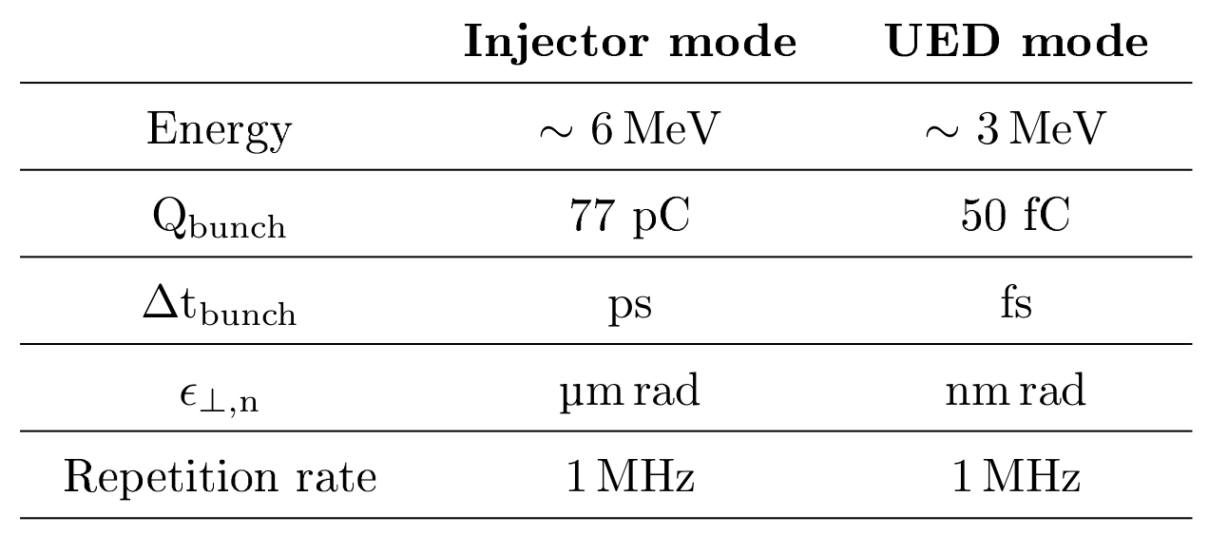
SRF Photoinjector– Beam-line Modifications
TCAV and diagnostics
Booster section
Gun and solenoid

Slide 6
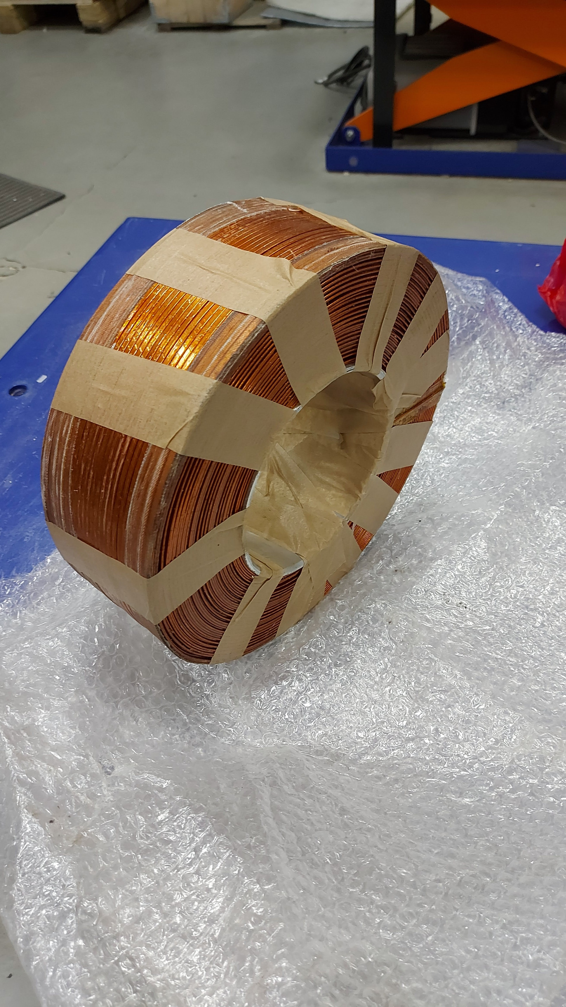
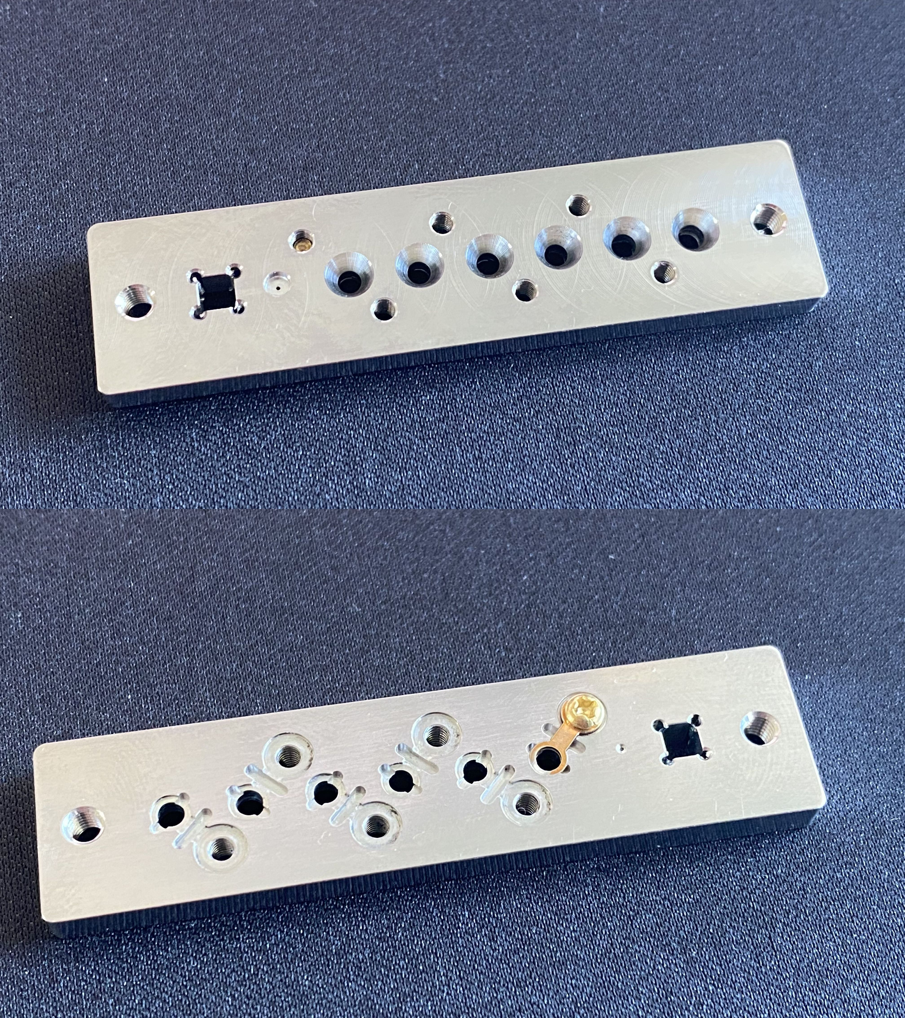
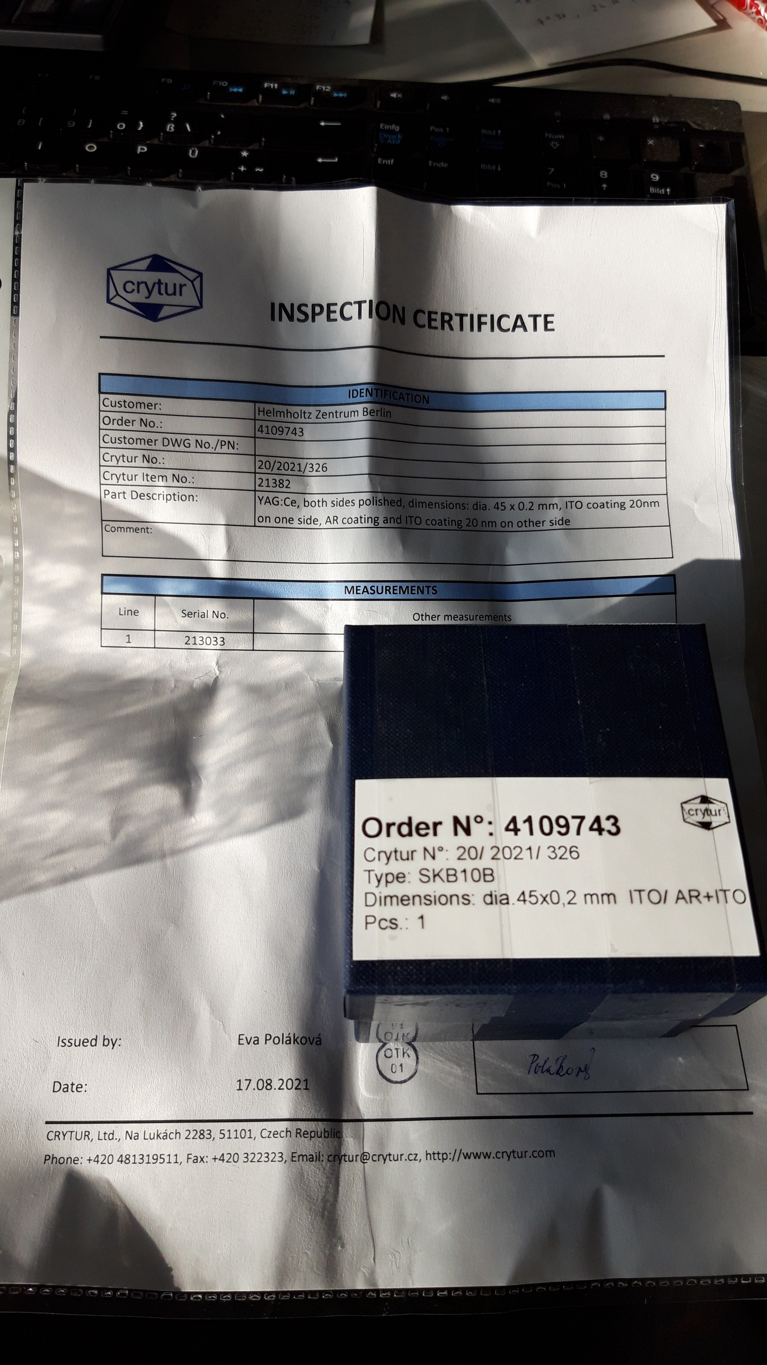
SRF Photoinjector– Beam-line Modifications
Solenoid
Detector
Target station
Solenoid
Aperture
Aperture
Detector
Target station
TCAV and diagnostics
Booster section
Gun and solenoid

Slide 7


Static Diffraction Experiment – Beam-line Optimization
The transverse beam parameters are mainly dependent on the gun, gun solenoid and initial laser parameters.
How can one optimize the 'quality' of a static diffraction experiment?
How can we increase lateral and longitudinal coherence lengths?
  Multi-parameter space optimization.
    Identify which input parameter affects which output parameter.
    Set priorities and targets for the outputs.
    Perform the optimization step by step, first fixing the input
parameters that affect the highest priority output parameters.
Input parameters one can adjust:
Laser spot size
Laser pulse length
Gun amplitude and phase
Solenoid A and B strength
Initial bunch charge
Lateral coherence length
Longitudinal coherence length
Output parameters for static exp.:
Bunch charge (= 50 fC)
Trans. Emittance (as low as pos.)
Energy spread (as low as pos.)
Bunch spot size (around 300um)
Beam energy (2 to 3 MeV range)

Slide 8
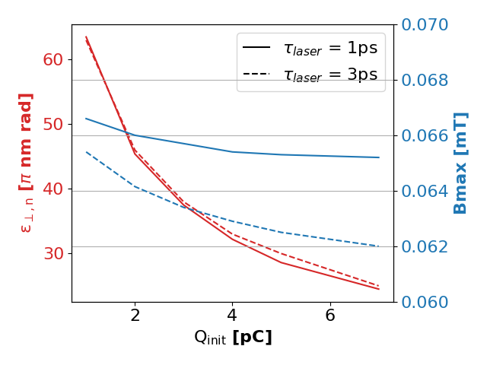
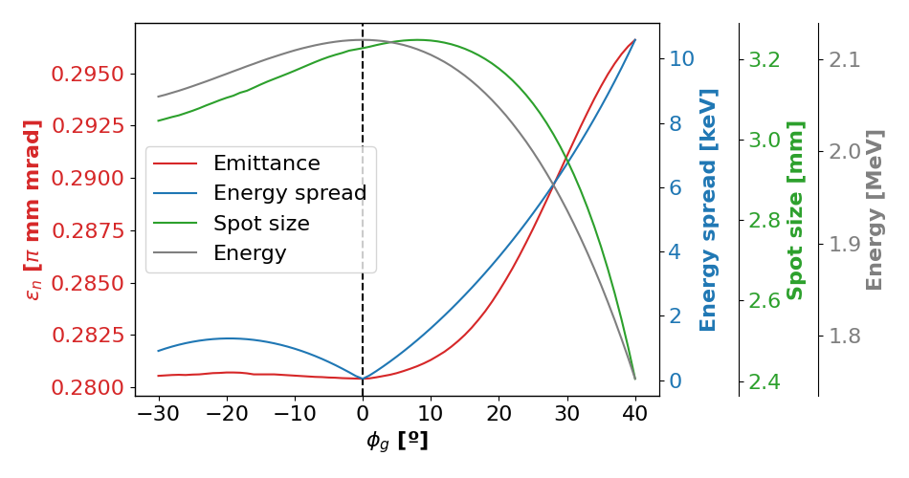
Static Diffraction Experiment – Beam-line Optimization
The transverse beam parameters are mainly dependent on the gun, gun solenoid and initial laser parameters.
How can one optimize the 'quality' of a static diffraction experiment?
How can we increase lateral and longitudinal coherence lengths?
  Multi-parameter space optimization.
    Identify which input parameter affects which output parameter.
    Set priorities and targets for the outputs.
    Perform the optimization step by step, first fixing the input
parameters that affect the highest priority output parameters.
Lateral coherence length
Longitudinal coherence length

Slide 9
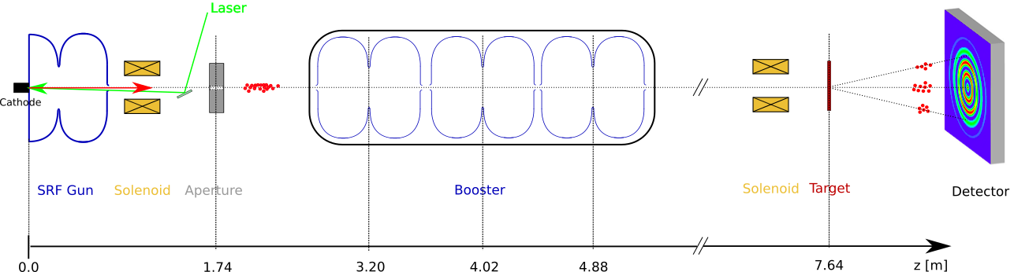
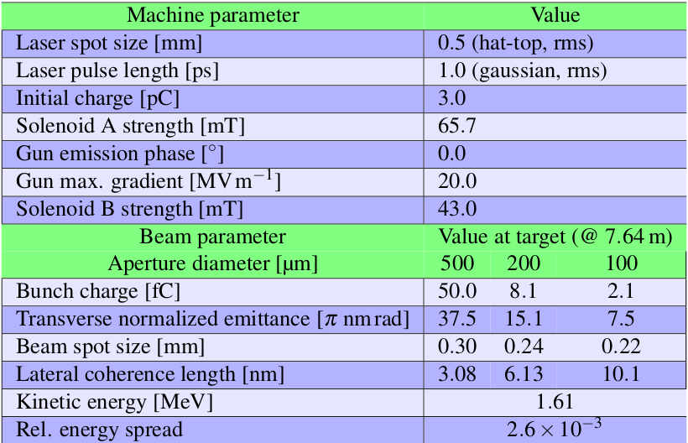
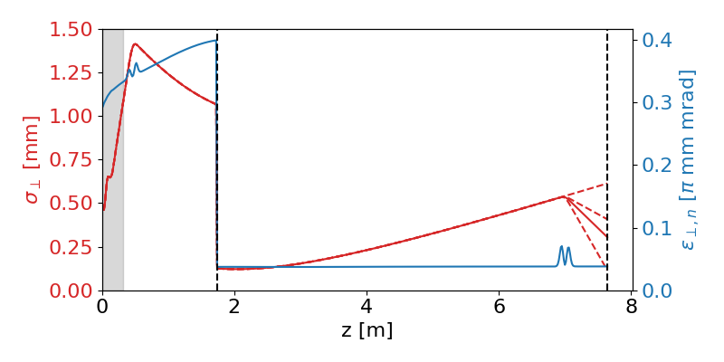
Static Diffraction Experiment – Beam-line Optimization

Slide 10
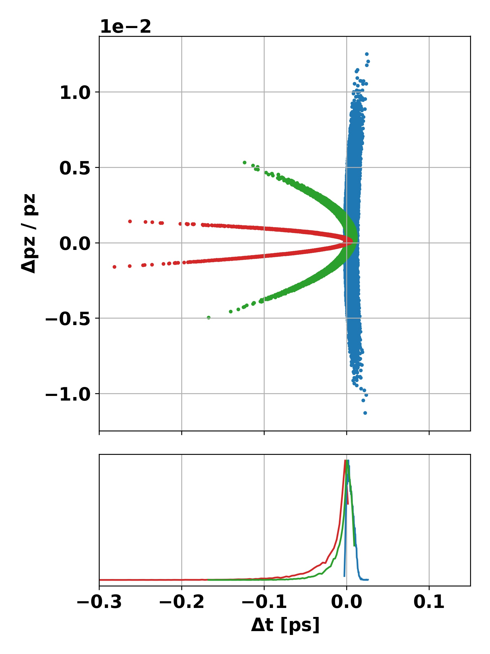
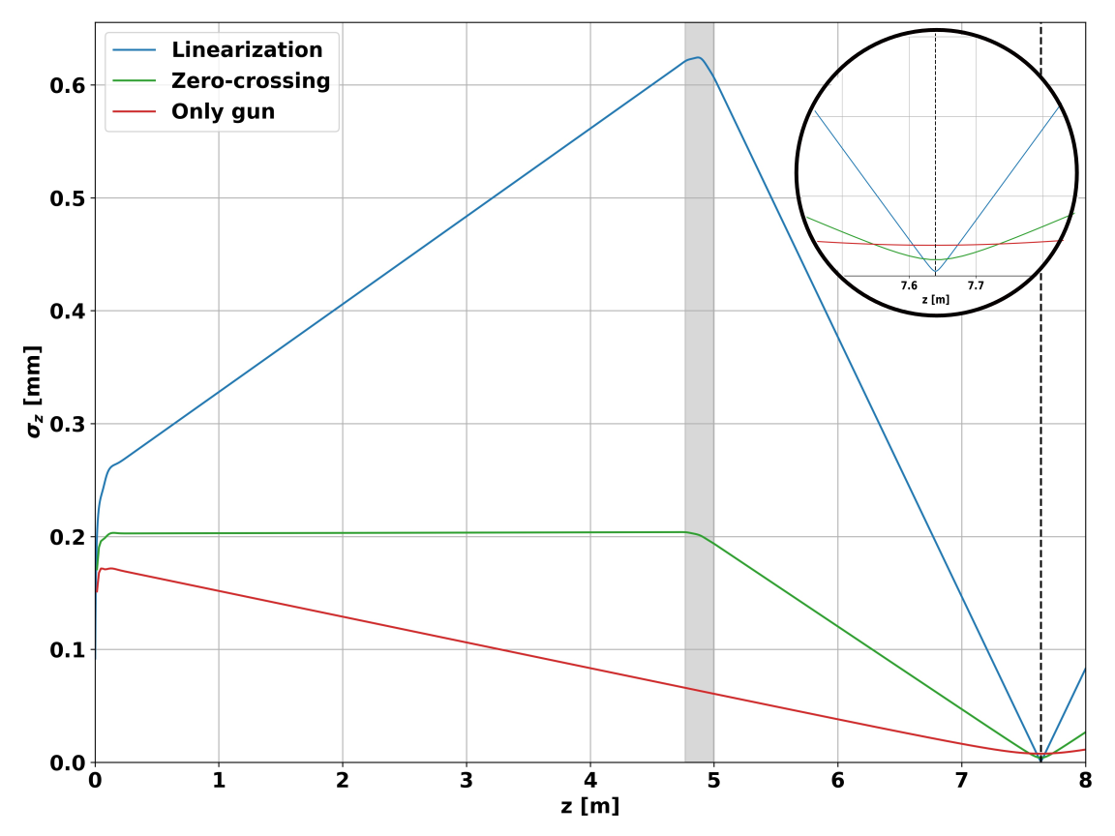
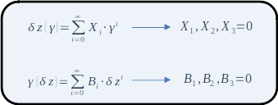
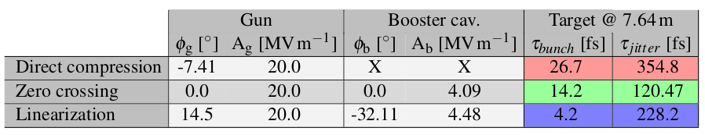
Longitudinal Phase-space Manipulation
Study of the different bunch compression methods in the SRF Photoinjector (here without SC and without aperture):
How does one perform the linearization?
Use same freq. Cavities
Things get more complicated when space-charge and the collimation are included.

Slide 11
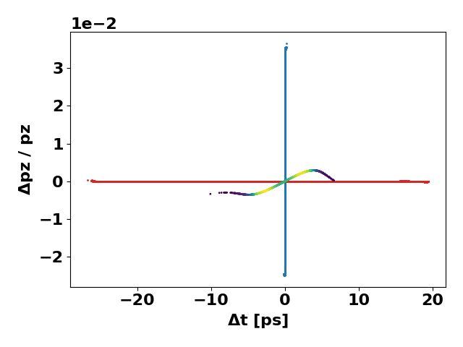
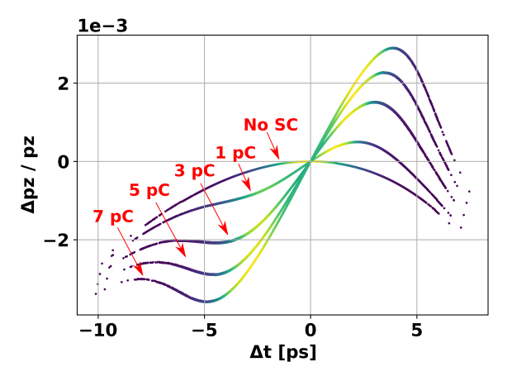
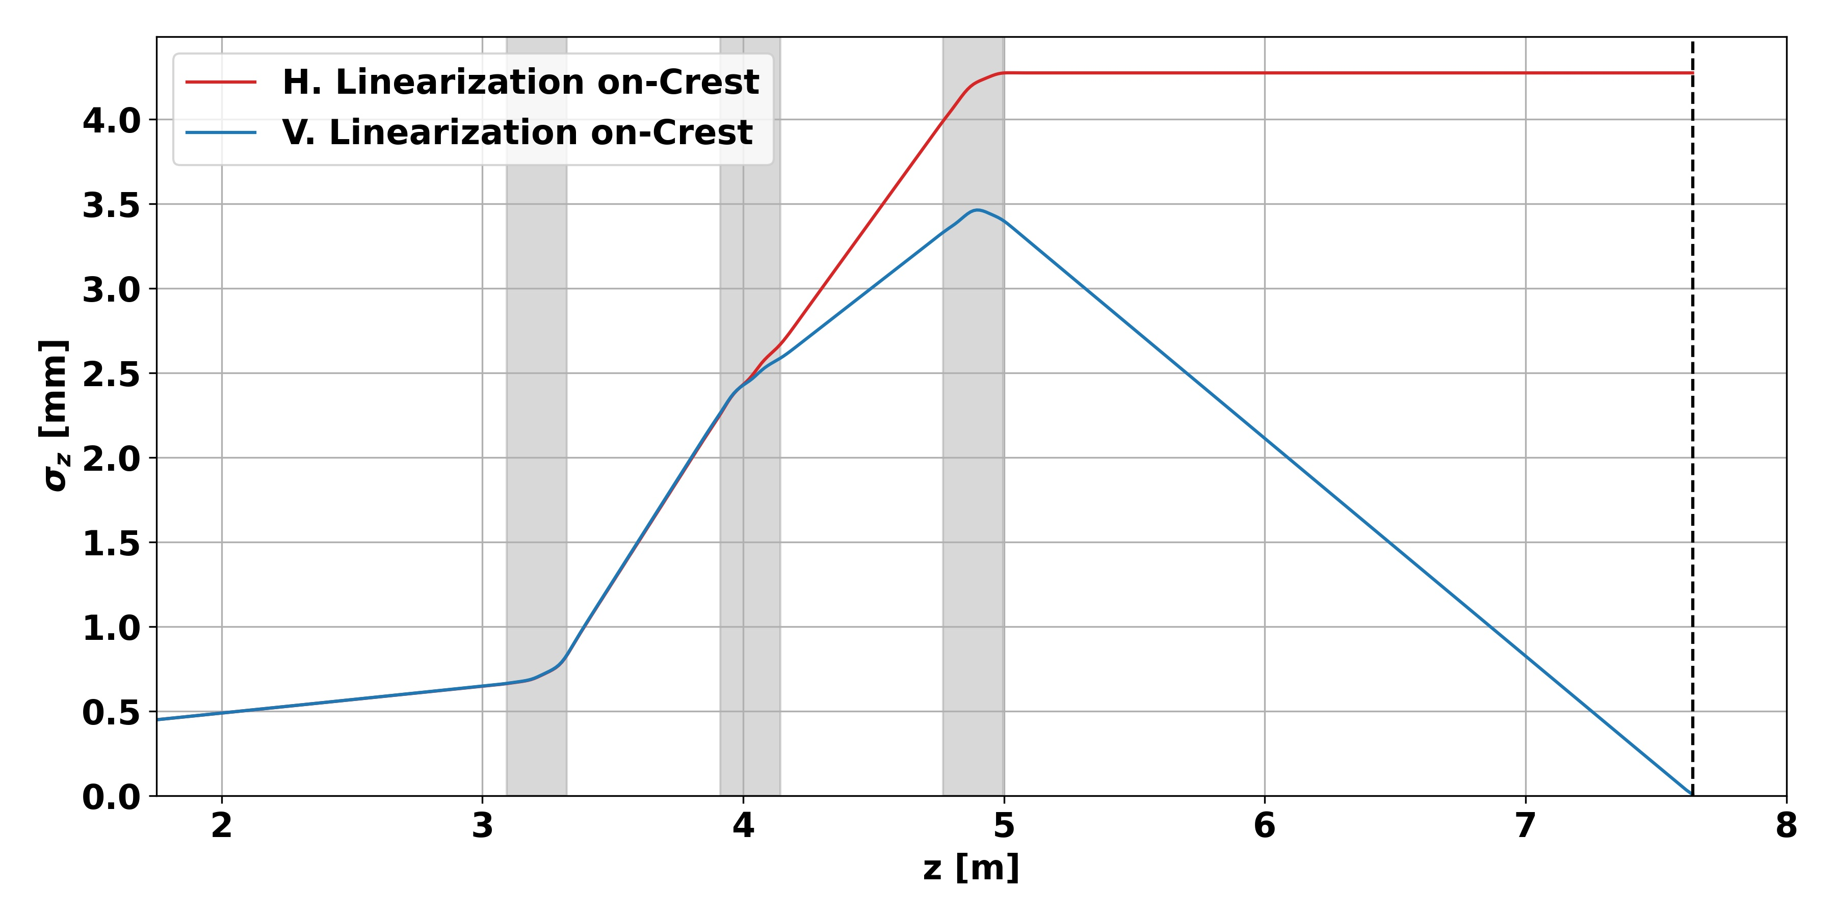
Longitudinal Phase-space Manipulation
Study of the different bunch compression methods in the SRF Photoinjector (with SC and with collimation):
Linearization is cool: Bunch length can be reduced to few 10s of fs / energy spreads under 0.01% at few MeV energies.
However, one needs to take care of beam stability too...

Slide 12
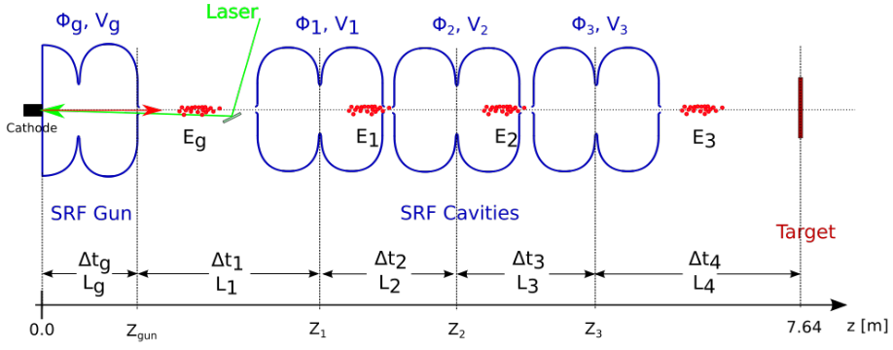
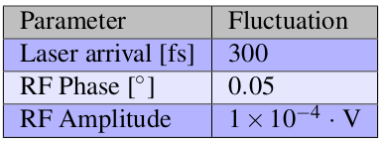
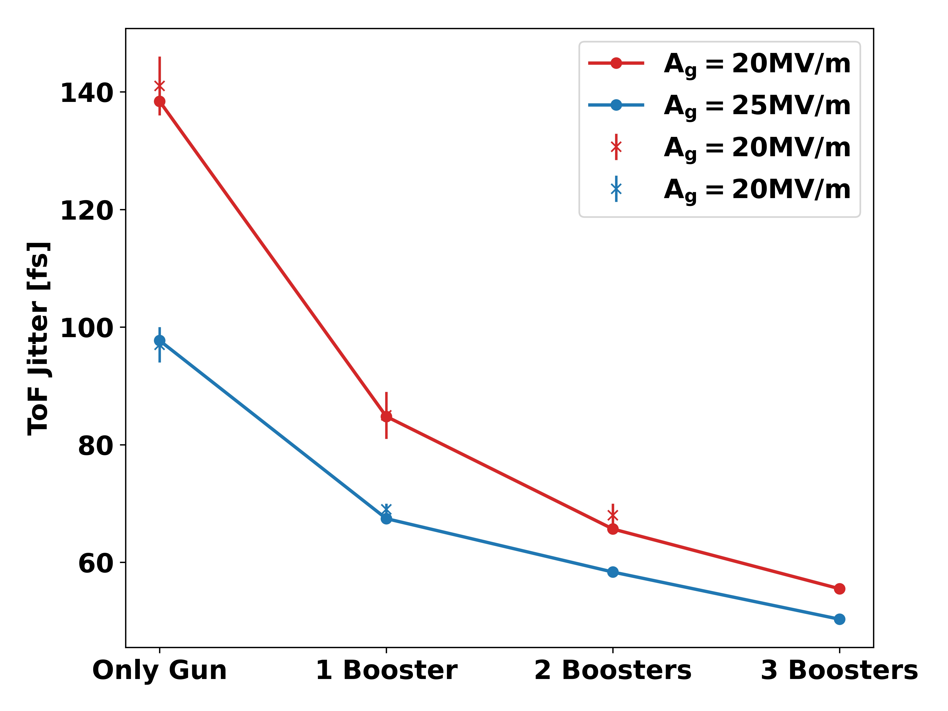
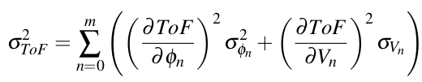
Time-of-flight Jitter Model
Fluctuations in cavity parameters (LLRF) result in energy and ToF fluctuations from bunch to bunch.
Simulations are time-consuming and only the ToF jitter
for a given working point can be calculated at a time.
Analytical model has been developed:

Slide 13
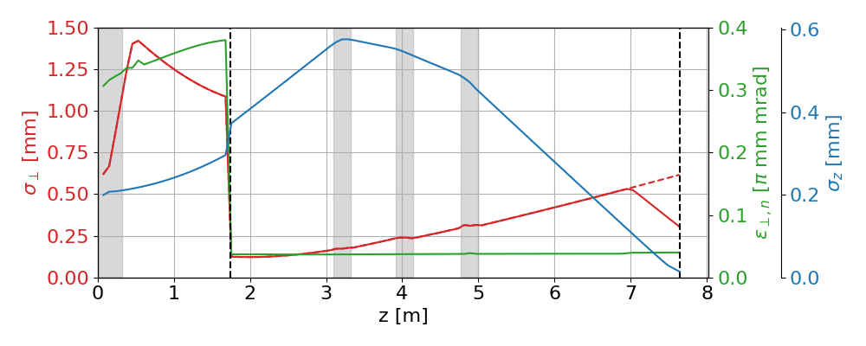

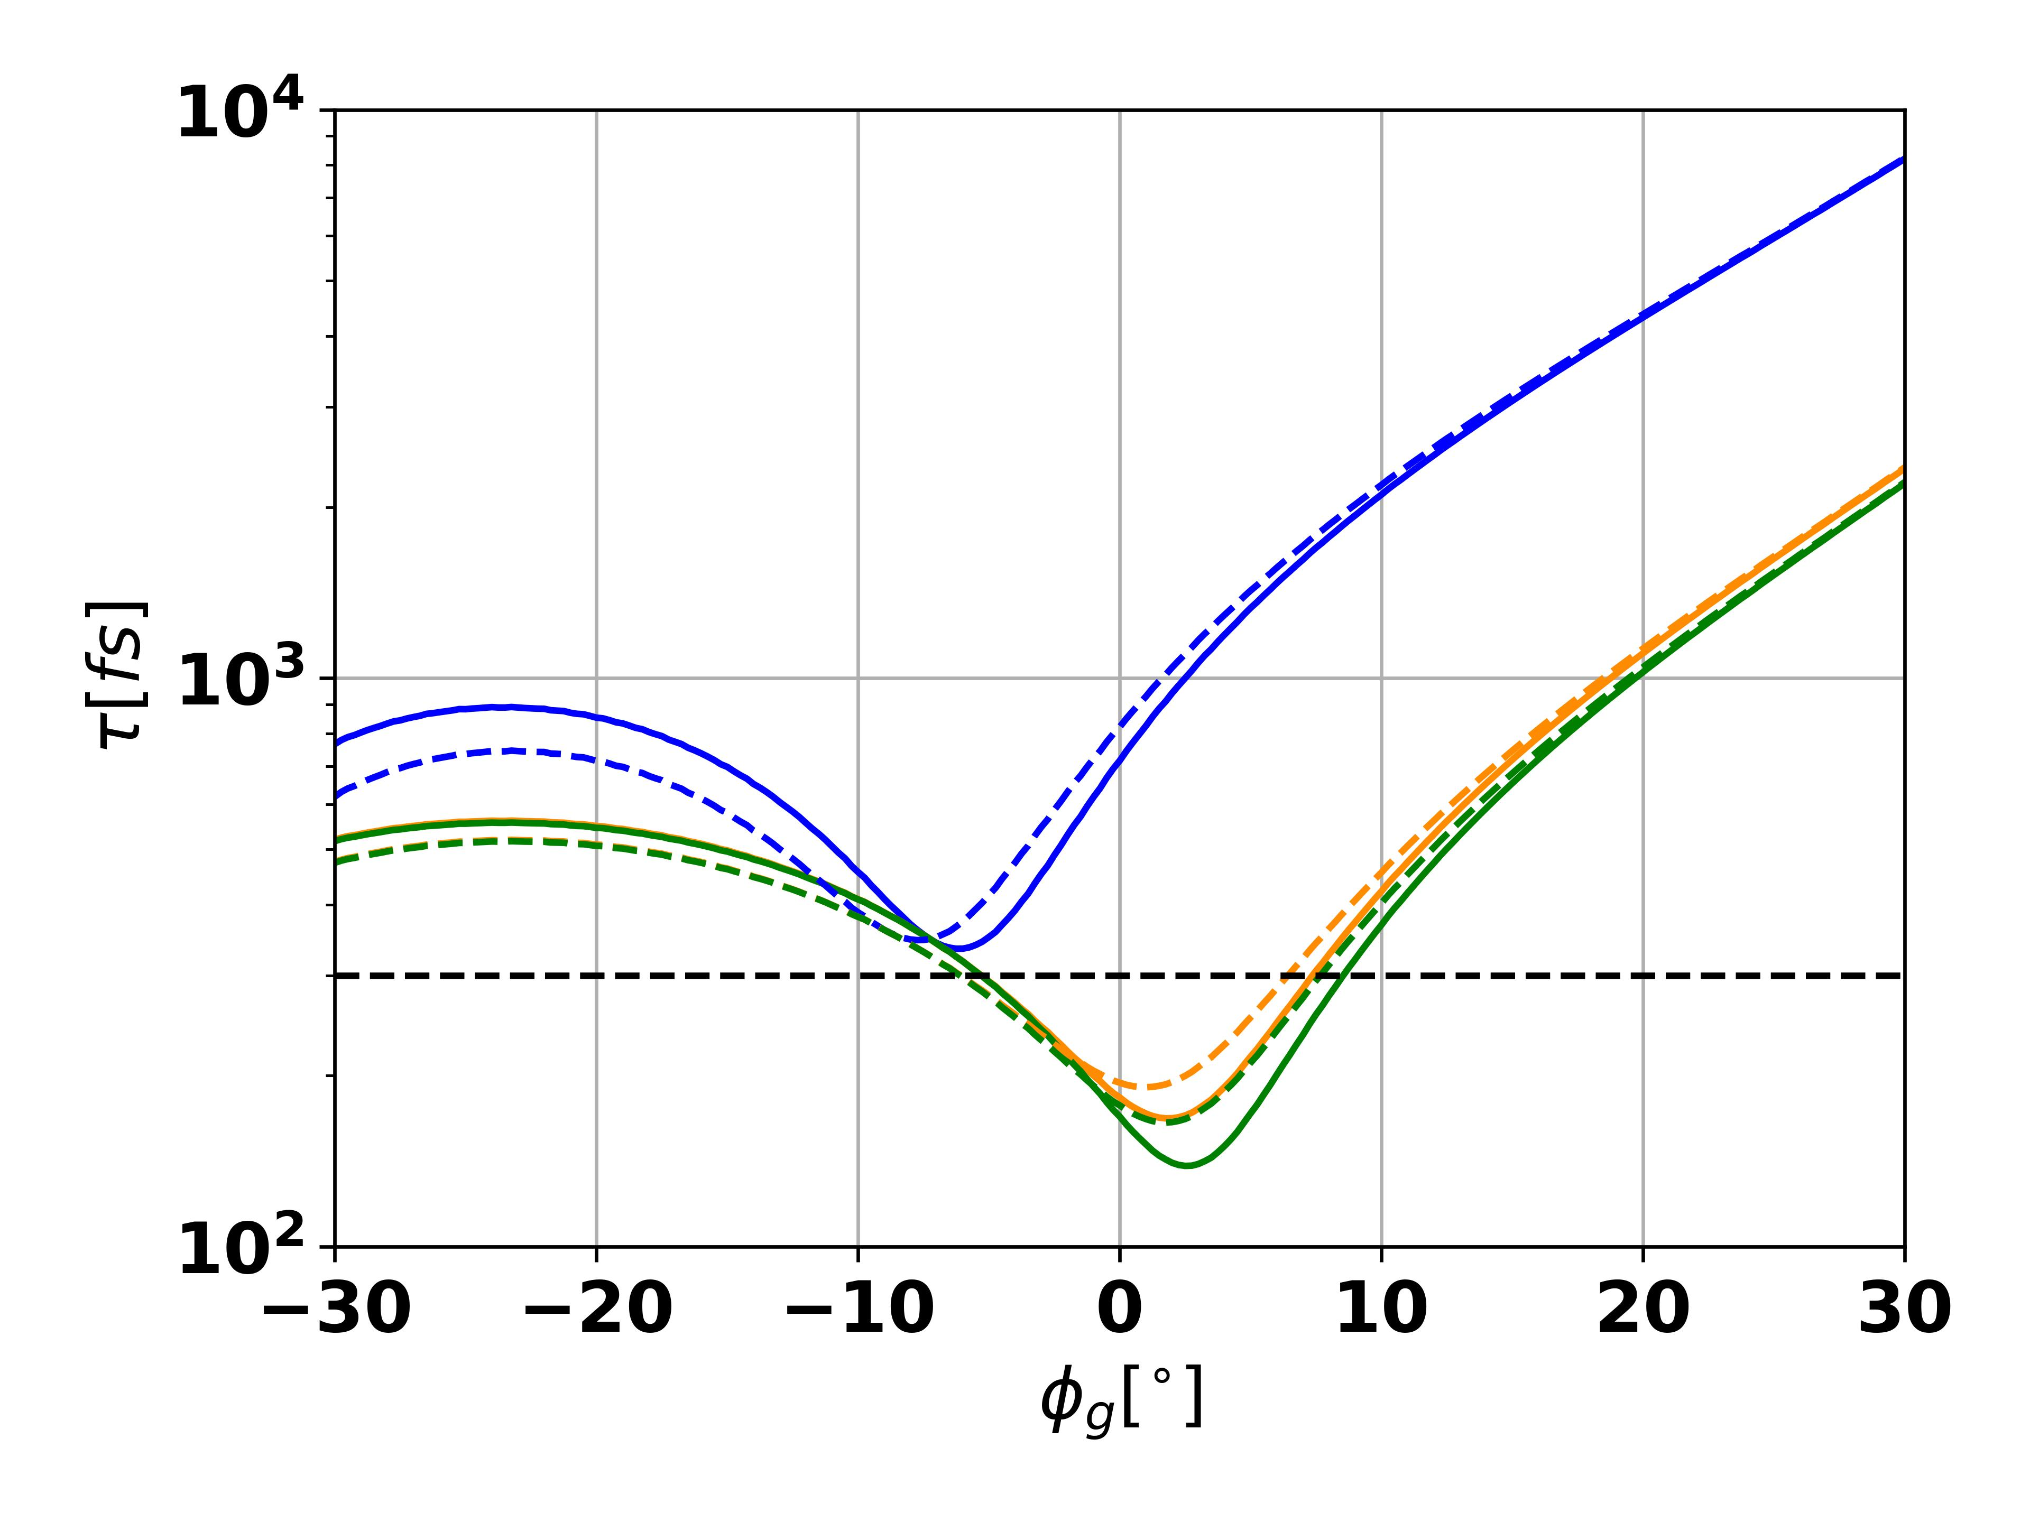
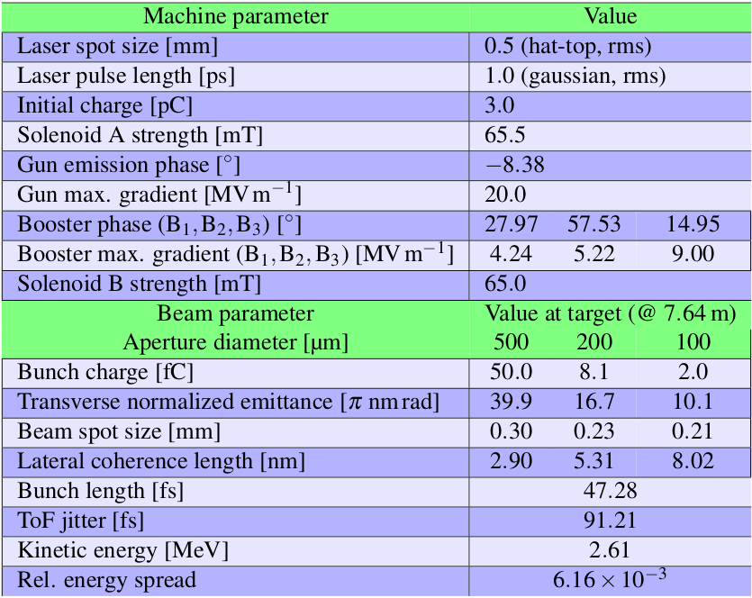
Time-resolved Experiments – Optimization
Using the booster cavities for compression and stability:
Time resolution in a pump-probe experiment:
0
0
Only using the gun for a temporary resolved exp.:
Time res. > 300fs
Time res. = 100fs

Slide 14
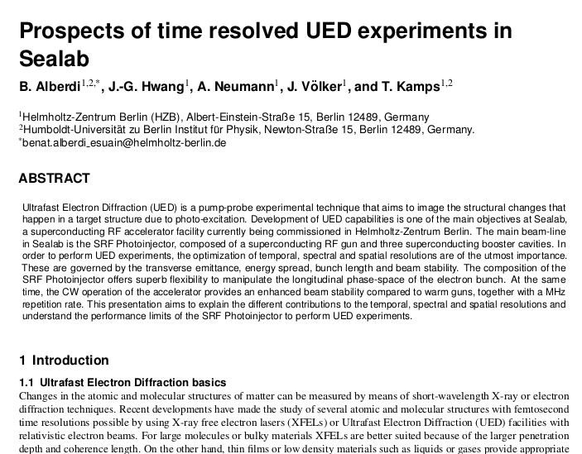
Time-resolved Experiments – Optimization
Using the booster cavities for compression and stability:
Time resolution in a pump-probe experiment:
0
0
Only using the gun for a temporary resolved exp.:
Time res. > 300fs
Time res. = 100fs

Slide 15
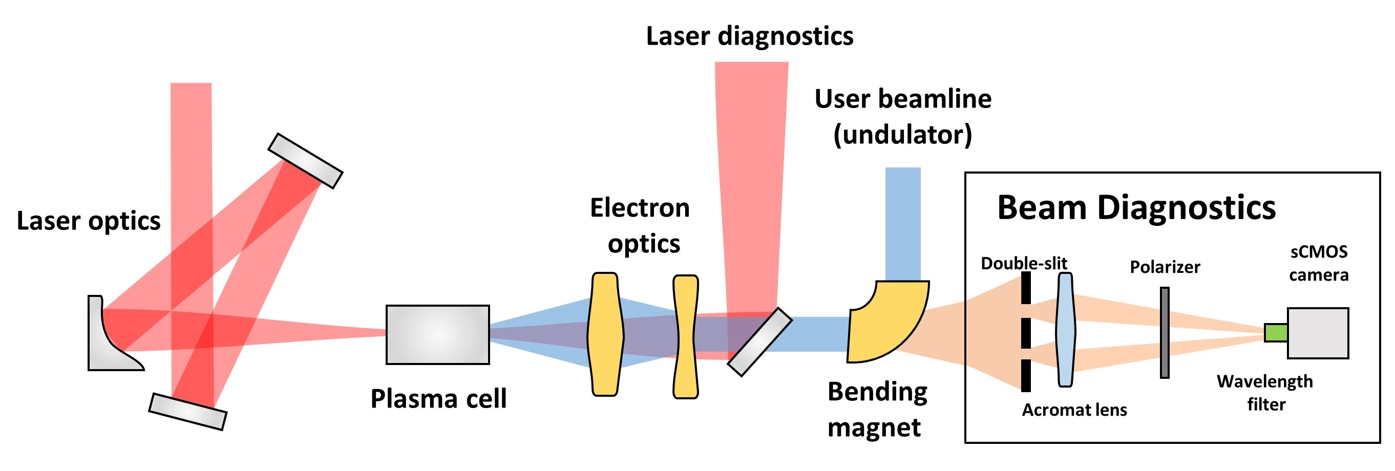
Spot Size Diagnotics – Athena-e
Hwang, Ji-Gwang, et al. "Monitoring the size of low-intensity beams at plasma-wakefield accelerators using high-resolution interferometry." Communications Physics 4.1 (2021): 1-8.
My part in this project involved:
  The simulation of the the emission spectrum for SR and CSR
  The simulation of corresponding interference patterns after the double slit
  The retrieval of visibility and spot size from the interference pattern for different conditions.

Slide 16
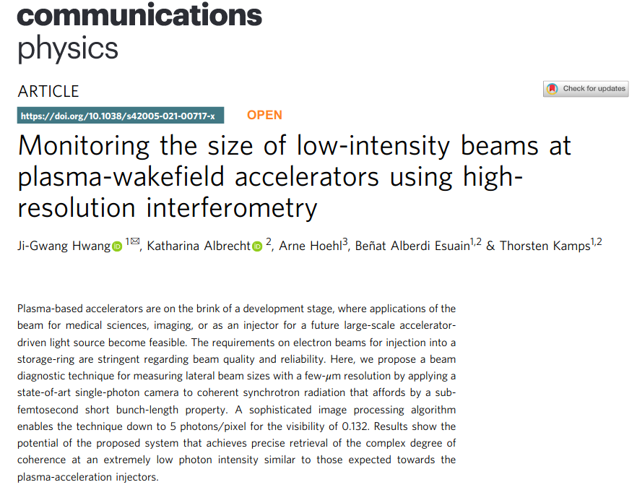
Spot Size Diagnotics – Athena-e
Hwang, Ji-Gwang, et al. "Monitoring the size of low-intensity beams at plasma-wakefield accelerators using high-resolution interferometry." Communications Physics 4.1 (2021): 1-8.
My part in this project involved:
  The simulation of the the emission spectrum for SR and CSR
  The simulation of corresponding interference patterns after the double slit
  The retrieval of visibility and spot size from the interference pattern for different conditions.

Slide 17
Outlook of Progress Report
Task in progress
  Target sample production and testing for static diffraction experiment.
  Arrival time monitor cavity design.
  Machine learning model for the SRF Photoinjector.
  Study and implement emittance minimization alternatives: The Spatial Light Modulator

Slide 18
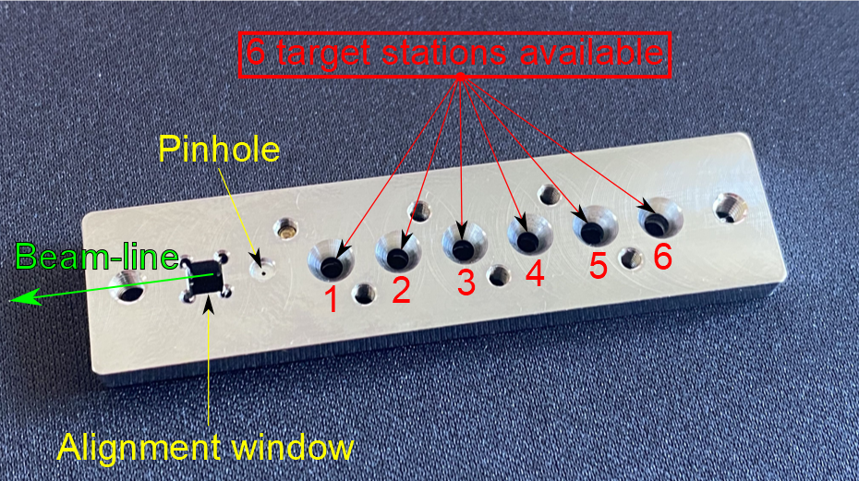
Target Samples for Static Diffraction Experiment
The target holder for the static diffraction experiment consists of:
1x empty TEM grid for emittance measurement
1x Silicon Nitride membrane for transmision experiment
1x Silicon mono-crystal for lateral coherence characterization
1x metallic poly-crystal for back-up beam characterization
1x sandwich of mono-crystal and poly-crystals
1x Phase-transition material, exhibits phase-transition close to room temperature.
Main duties in this project:
Coordinate the production or purchase of the samples with our collaborators from FHI and HU.
Assemble the target holder with the samples and test the system using TEM (HU) and particulate counter (HZB).
Document the production and testing processes in a suitable way.

Slide 19
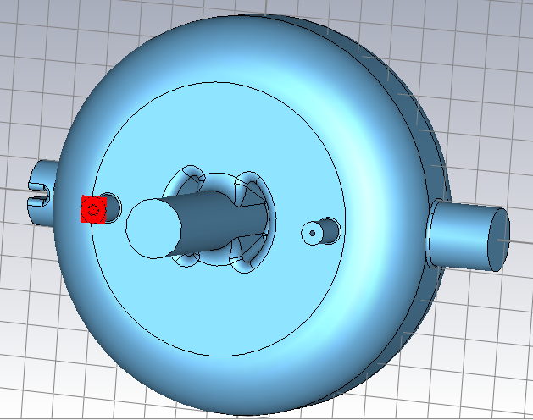
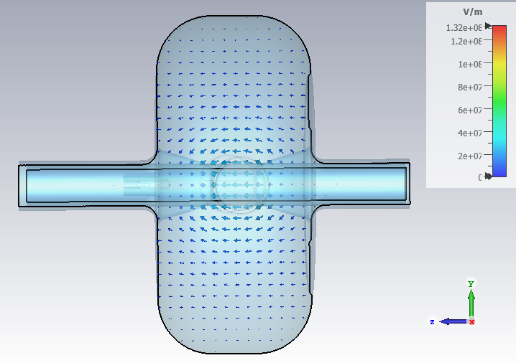
Arrival-time Diagnostics System
In order to measure the time-resolution of a pump-probe experiment an arrival-time diagnostics system is needed.
First idea: Use the TCAV already installed in the beam-line as a passive 'listening' cavity.
Resolution of such diagnostics system given by cavity characteristics and electronics.
  Maximize the output signal amplitude by maximizing R/Q and minimizing Qext.
  Choose an appropriate resonant frequency for the TM010 mode.
Simulations have been performed in CST. They show that the TCAV has a TM010 mode at 797MHz.
The R/Q value for the UED energy range is very good: R/Q = 265.31 Ω
However, the TCAV was not designed to bring power out. The coupling factor is too low.
The ports cannot be tuned to change the coupling factor.

Slide 20
Arrival-time Diagnostics System

Slide 21
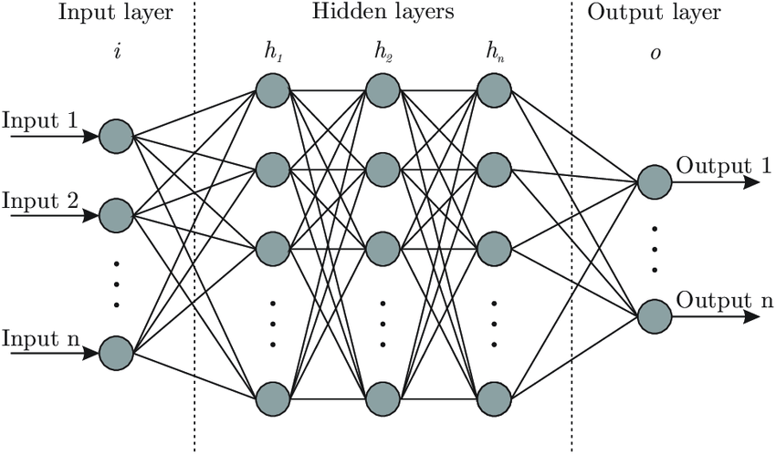
Machine Learning with the SRF Photoinjector

Slide 22
Machine Learning with the SRF Photoinjector

Slide 23
Time-of-flight jitter model - Compensation

Slide 24
Miscellaneous

