Slide 1
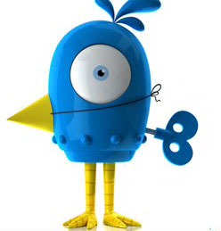
Twitter Bots Detection
Alvaro Albero Gran, Devyani Raghuwanshi, Kevin Study, Shritama Sengupta

Slide 2
What is a Twitter Bot?
Twitter bots are automated accounts that interact with users, without any human input.
Twitter bots are able to:
Post Original Content, including links to websites and images.
Provide an automated response to questions posted by users.
Re-tweet content posted by a user.
Follow Twitter users.

Slide 3
What is a Twitter Bot?
Twitters bots can be used for legitimate reasons.
For Example:
Respond to questions posted by users.
Post and Re-tweet news alerts from news organizations.

Slide 4
The Problem
However, Twitter bots that are used to perform malicious acts are a big problem in social media, especially Twitter.
For Example:
Posting links to malicious websites.
Re-tweeting false information such as news stories.
Artificially making topics trend on Twitter.
Providing fake followers.

Slide 5
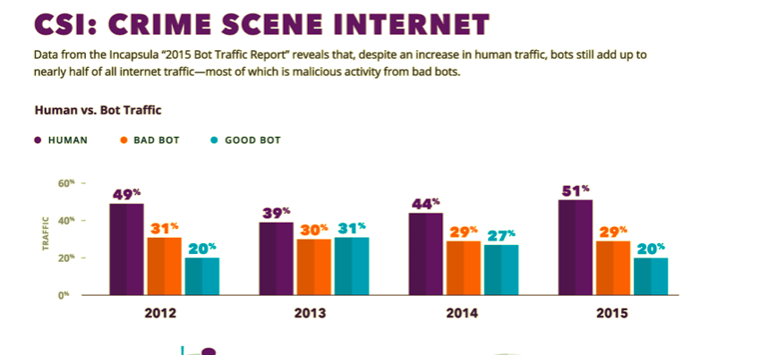
Good Bot vs. Bad Bots
This graphic is from Imperva’s 2015 Bot Traffic Report. This graphic shows that the bad outweigh the good.
https://www.imperva.com/blog/how-bots-impact-global-economy/?utm_campaign=Incapsula-moved

Slide 6
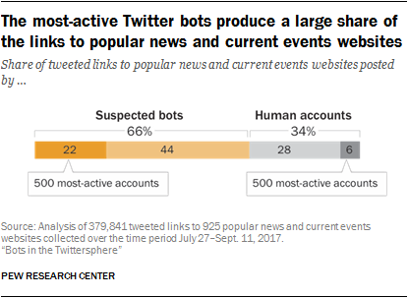
The Effect Bots Can Have
Pew Research produced a report about Twitter bots. They found that bots produce a large share of links to news sites. This demonstrates that users are constantly interacting with bots.
https://www.pewinternet.org/2018/04/09/bots-in-the-twittersphere/

Slide 7
How Do We Solve This Problem
Our group created an application that can identify bots on Twitter.
Enter Twitter User ID
The information is downloaded into a database
The data is analyzed.
The algorithm identifies possible Twitter bots based on characteristic of known bots.

Slide 8
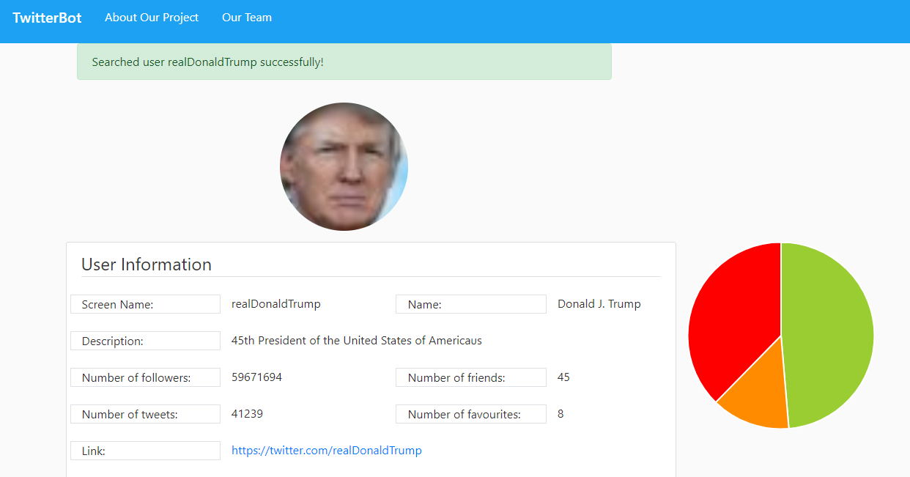
How Do We Solve This Problem
After the analysis, the application provides an outline of the type of followers a user has.
Real users
Suspicious users
Bot users

Slide 9
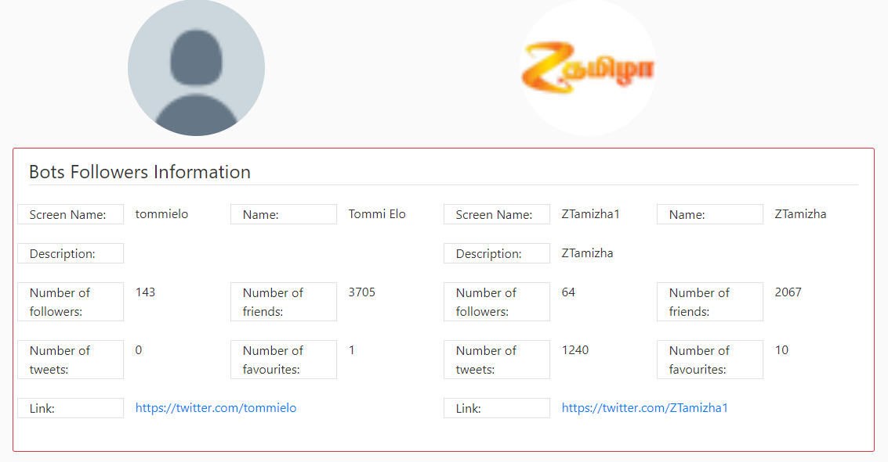
How Do We Solve This Problem
Two examples with the main characteristics and a link to their twitter profile of the users in the different categories are also provided

Slide 10
Conclusion
Detecting Twitter bots is difficult because the behaviors vary and many different parameters must be combined.
The application is able to analyze the user’s followers and categorize them.
False positive may appear, with a deeper study of bots behavior and a machine learning algorithm this number will decline.

