Slide 1
How to Write a Social Science Research Paper
Albert Chiu
ECON/POLISCI 151 Section, Week 9

Slide 2
One Paper = One Point
Barry Weingast’s “Caltech Rules for Writing Papers”
One question, clearly stated
Be able to summarize contribution in first paragraph/sentence of abstract
E.g., “This paper uses evidence from a natural experiment in Brazil to show how oil windfalls shore-up ruling regimes.”

Slide 3
Elements of a Research Paper
Gary King’s “Publication, Publication”
Style section
“Rigorously structured and organized into sections and subsections”
Research paper, not an essay
Structure will depend on your goals/message
Today’s outline is just a starting point/template, not a definitive rule
Be clear and forthcoming about weaknesses

Slide 4
Structure
Intro
[Background]
[Literature review/related work]
[Theory]
Data/methods
Results
Discussion
[Extensions]
Conclusion
References

Slide 5
Introduction
Research question & its importance
Existing research/answers, why your study is needed
Errors, unsettled debate, new dimension
Your contribution
Road map
“This paper proceeds as follows. Section 1 introduces…”

Slide 6
Data
What data you use, where’d you get it
Which variables you are interested in (and how they pertain to the Q)
Descriptive stats
Summary
Trends over time
Possible concerns
e.g. non-representativeness, measurement error

Slide 7
Methods
What methods you use
OLS, RF, k-means, etc.
If applicable: model, e.g., Y = α + β_{income}Income +…
Identification assumptions
[(Casual inference) identification strategy]
[“Control” for confounders: selection on observables]
[If applicable: What source of exogeneity are you exploiting? e.g., regression discontinuity + why the discontinuity is valid]

Slide 8
Results
Estimates
[Goodness of fit, model evaluation]
Interpretation
Significance
Causality?
Problems, how it could be done better
[Robustness checks]
How supportive for your theory? Alternative interpretations?
How should we update our understanding?

Slide 9
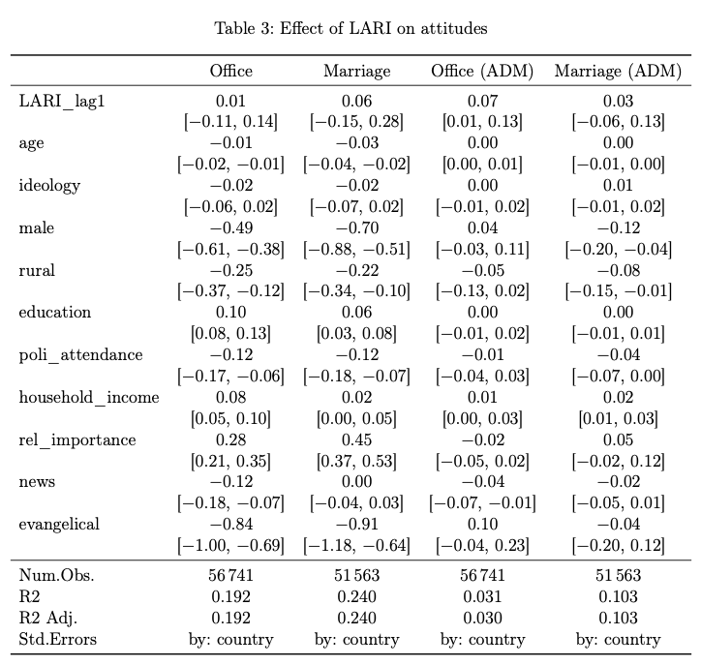
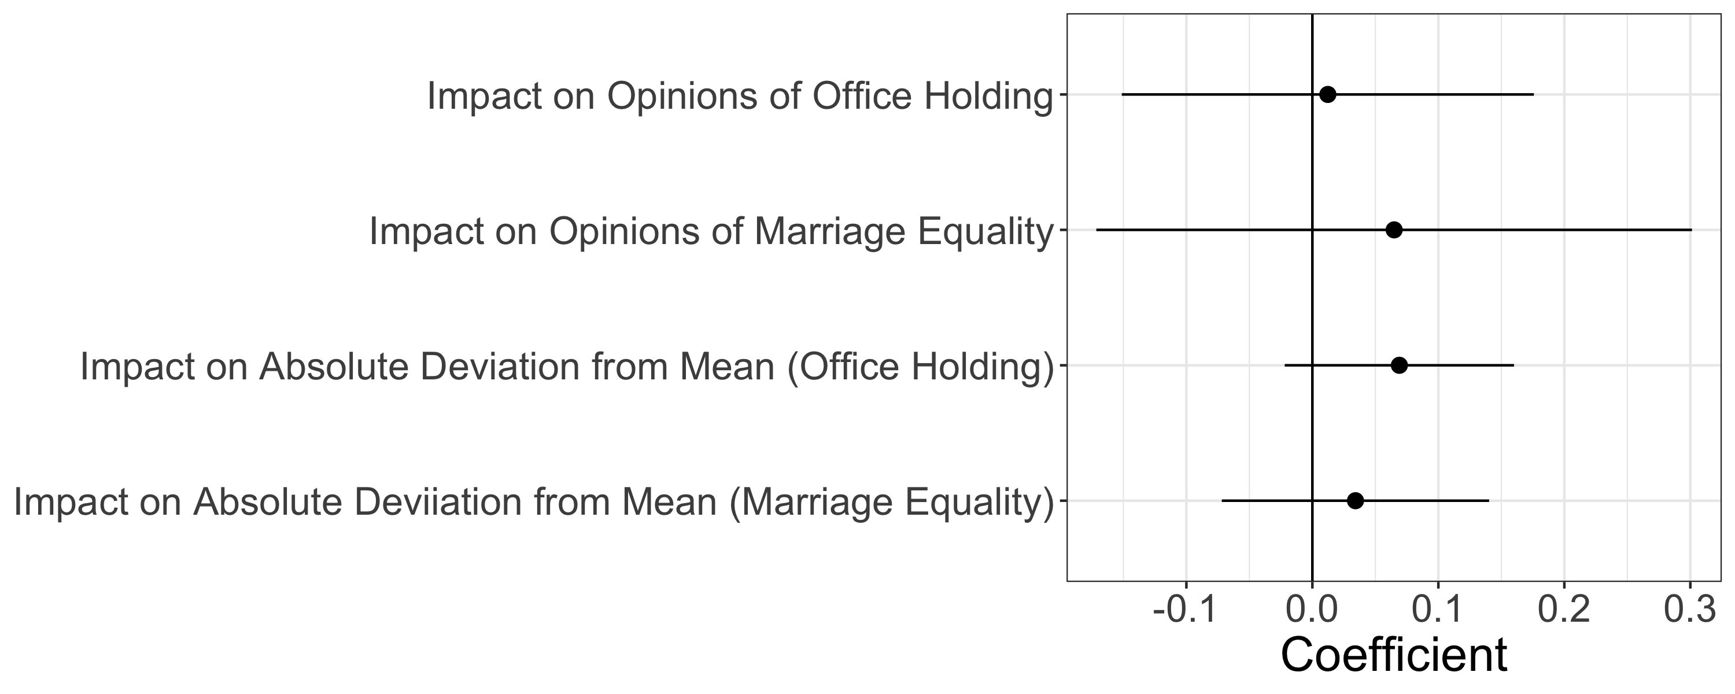
Presenting Results
Dot-and-whisker plots
(vs. regression table)

Slide 10
Conclusion
Summarize
Limitations
Future work

Slide 11
*My Writing Order
Abstract
Check that your paper is sufficiently focused (one paper, one question)
Figures
Results + discussion
Data, methods, literature
Conclusion
Introduction
At this point, you will know what it is you are introducing
Cut, revise, revise, revise…

Slide 12
Style
[Strunk and White’s Elements of Style]
Clear and concise
Tempting & easy to write a lot. Harder to be concise.
“write not merely so that the reader can understand but so that he cannot possibly mis-understand” (McCloskey, Writing of Economics)
You won’t be there to explain to the reader

Slide 13
Language
Academic writing is terse and straightforward
Your goal for the reader to understand your results
Goal is not to impress them with your vocab. This isn’t the SATs. Save your 12-syllable words for the LSAT.
Avoid “flabby” writing
Active > passive
Direct > flowery/circuitous
Try putting a paragraph into the Writer’s Diet test
Helen Sword on “Zombie Nouns:” avoid unnecessary -ity, -tion, -ism

Slide 14
Soft “Rubric”
Main text should be 10-15 pages
May vary slightly depending on figures, but no longer than 20
Include citations (in text citations + references section at end)
Style of writing matters
Correctness & extensiveness of analysis matter
Must include:
Clear research question, properly introduced
Data & methods
Results & interpretation/discussion

Slide 15
Some papers I like
Theory heavy: Blaydes and Chaney, “The Feudal Revolution and Europe’s Rise”
Formal (game theory): Weingast, “The Political Foundations of Democracy and the Rule of the Law”
Empiric (probably the closest to what you will be writing):
Fouka, “How Do Immigrants Respond to Discrimination? The Case of Germans in the US During World War I”
Dell, “The Persistent Effects of Peru's Mining Mita”
Jha, “Trade, Institutions, and Ethnic Tolerance: Evidence from South Asia”

