Slide 1
Formio
Need a form?
Radek Beran 27.3.2014

Slide 2
Motivation
I hate solving of repetitive problems where it is not necessary
I want to solve them in a simple way
I want to have an easy to use tool that i can use anywhere…

Slide 3
Formio
Form definition & binding framework
Easy-to-use configurable handy tool
Validation of form data (using bean validation)
Support for file uploads, configurable max. request/file size
Immutable, composable form definitions
One simple entry point to API
Easy integration to existing frameworks
For environments with or without HttpServletRequest
Simply unit testable forms

Slide 4
Simple form example
private static final FormMapping<Person> personForm =
Forms.automatic(Person.class, "person").build(/* Opt. config */);
…
FormData<Person> formData = new FormData<Person>(person, null);
FormMapping<Person> filledForm = personForm.fill(formData);
// push filledForm to template …
…
FormData<Person> formData = personForm.bind(
new HttpServletRequestParams(request));
if (formData.isValid()) {
// save person - formData.getData() …
} else {
// …
}

Slide 5
Formio API
Forms – entry point
FormMapping, BasicFormMappingBuilder
FormField, FieldProps for field definition
ParamsProvider
ValidationResult
ConstraintViolationMessage
Config
Formatters, Formatter
CollectionBuilders, CollectionBuilder,
BeanExtractor
Binder, Instantiator, ArgumentNameResolver
BeanValidator
PropertyMethodRegex
UploadedFile

Slide 6
Data binding
Setter and construction method binding
Immutable objects supported (Instantiator abstraction)
Default or non-default constructors
Static factory methods
Collections and arrays
Complex nested objects and lists of complex objects
And arbitrary combination recursively
Primitives (and their wrapper classes) supported everywhere
String, Enums, BigDecimal, BigInteger, Date supported by default formatters

Slide 7
Data for templates
Just push the filled form to the template
Use its properties
validationResult
success
fieldMessages
globalMessages
fields – Map<String, FormField>
name – unique name/path of mapping
labelKey – key for caption of nested complex object carried by mapping
filledObject
required
nested – map with nested mappings
list – list of nested mappings for complex objects if this is MappingType.LIST mapping

Slide 8
Data for templates (2)
Properties of FormField
name – unique name/path of form field
labelKey – key for localization of label (name without brackets)
filledObject, filledObjects (for group of checkboxes, multiselect)
required

Slide 9
Form definition
private static final FormMapping<RegDate> regDateMapping =
Forms.basic(RegDate.class, "regDate").fields("month", "year")
.build();
private static final FormMapping<Registration> registrationForm =
Forms.basic(Registration.class, "registration")
// whitelist of properties to bind
.fields("attendanceReasons", "cv", "interests", "email")
.nested(Forms.basic(Address.class, "contactAddress",
Forms.factoryMethod(Address.class, "getInstance"))
.fields("street", "city", "zipCode").build())
.nested(Forms.basic(Collegue.class, "collegues",
null, MappingType.LIST)
.fields("name", "email")
.nested(regDateMapping)
.build())
.build();

Slide 10
Form definition (2)
Or equivalent automatic one
private static final FormMapping<Registration> registrationForm =
Forms.automatic(Registration.class, "registration")
.nested(Forms.automatic(Address.class, "contactAddress",
Forms.factoryMethod(Address.class, "getInstance")).build())
.build();
Automatic mapping
Introspects readable (and settable – via setters/instantiators) properties (incl. nested objects, list of nested objects)
@Ignored on getters can be used
Custom field definitions have precedence
Custom field definition
new FieldProps(propertyName, pattern, formatter)

Slide 11
Validation
Using bean validation API (JSR-303)
ValidationResult
ConstraintViolationMessage(s) for global and field constraints
Fields (properties) and also mappings (whole complex objects) are validated
Binding and validation errors
Custom message bundle can be configured
Default are properties for class of form data
Fallback to ValidationMessages.properties with default messages
Message bundle need not to be used
Error messages carry possible translation and also unresolved key with arguments

Slide 12
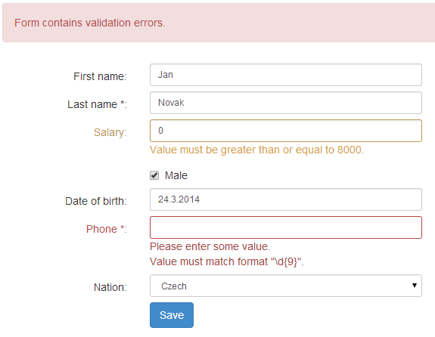
Other validation features
Conditional validation
Using bean validation groups
Custom validators can be written
NotEmpty
RodneCislo
Email
CustomMultiFieldValidator, …
Error, warning, info severity supported and recognized from payload of annotations
Required flag automatically filled from Size, NotNull and derived constaints in default validator implementation
For FormFields
For mappings of complex objects

Slide 13
Configuration
Config object (Created using Forms.config()…build())
Immutable
Default configuration available
Custom configuration can be supplied
Automatically propagated to nested mappings

Slide 14
File uploads
Using Apache FileUpload API
Max. request size, size of one uploaded file, threshold for storing data in memory can be set via Formio API
Global/field ConstraintViolationMessages created when limits are exceeded
Automatic binding to UploadedFile, collections/arrays of UploadedFile(s)
UploadedFileWrapper as a complex object for indexed lists of uploaded files (nested list mappings)

Slide 15
What about AJAX?
AJAX compatible
You can expose server methods/API for update of state called from client
On the server: Form definition can be filled with current data updated with sent data
Filled nested mapping (inc. its validation result) can be sent back to client
Cooperating AJAX framework can be used
Twinstone TDI, jQuery, …

Slide 16
Formio vs. Spring
Formio Pros:
Even easier to learn and use than Spring
Functional form processing, immutable/composable/reusable form definition
Immutable view/domain objects can be used (via constructors, static factory methods), arbitrarily nested – no need for custom Spring MVC WebArgumentResolver(s) or HttpMessageConverter(s)
Minimum of dependencies (bean validation, fileupload)
Message bundle for form data class with fallback to common ValidationMessages
Not bound to any particular UI architecture like MVC, but fully usable in Spring MVC or other frameworks
Automatic construction of form field names/paths, also for nested objects/lists
Cons:
Spring is widely used and offers usable solution in Spring MVC

Slide 17
Further development
Available in Maven central
Intensive coverage with unit tests
Getting started documentation
Static/dynamic definition of flags
Readonly, disabled, …
ArgumentProvider (from ArgumentSource),
Example TFS parts for form fields
Filter of suspicious user input for ParamsProvider

Slide 18
Q & A?
Demo: http://formio-demo.herokuapp.com/, https://github.com/beranradek/formio-demo

