Slide 1
DTSA 5510 Unsupervised Algorithms in Machine Learning
Final Project

Slide 2
Comparing Supervised and Unsupervised Methods to classify Product Descriptions
The Dataset
https://www.kaggle.com/datasets/saurabhshahane/ecommerce-text-classification
50425 Ecommerce product descriptions
labeled with one of 4 classes: "Electronics", "Household", "Books" and "Clothing & Accessories"

Slide 3
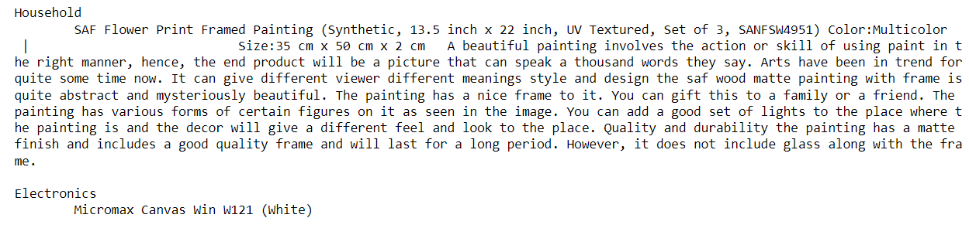
Sample Product Descriptions

Slide 4
Unsupervised – Model 1
removed English stop words and non-alphabetic characters, lowercased all text.
Extracted word embedding features using scikit learn TfidfVectorizer
Used the most frequently occurring 10000 terms in the corpus of all product descriptions, using ngrams of length 1 and 2
Then used non-negative matrix factorization to try to extract topic weights for 4 topics

Slide 5
Unsupervised – Model 2
Extracted 10,000 terms as TFIDF vectors like Model 1
This is a (very) sparse representation
Applied scikit-learn TruncatedSVD for dimensionality reduction
Experimented with a range of SVD components between 1 and 100
Applied KMeans as a clustering technique using the reduced SVD components as features

Slide 6
Supervised – Model 3
Used 10,000 TFIDF features (as in Model 1 and Model 2)
Used XGBoost to solve a supervised classification problem for the four product categories.
Used 80% of the samples for training and reserved 20% as test data

Slide 7
Supervised – Model 4
Data cleaning -- removed English stop words and non-alphabetic characters, lowercased all text.
Used GloVe word embeddings to encode each word of each document
Used an LSTM neural network trained on the sequences of words in each document.
This is again a 4 way supervised classification problem
Used 80% of the samples for training and reserved 20% as test data

Slide 8
Comparing Model Accuracy
Model 1 –TFIDF features, NMF for topic weightings
Accuracy 69%
Model 2 – TFIDF features, TuncatedSVD Dimension Reduction, KMeans clustering
Best Accuracy 86%
Model 3 – TFIDF features, Supervised Classification using XGBoost
Test Accuracy 95.8%
Model 4 – GloVe word embeddings, Supervised Classification using LSTM neural network
Test Accuracy 96.0%

Slide 9
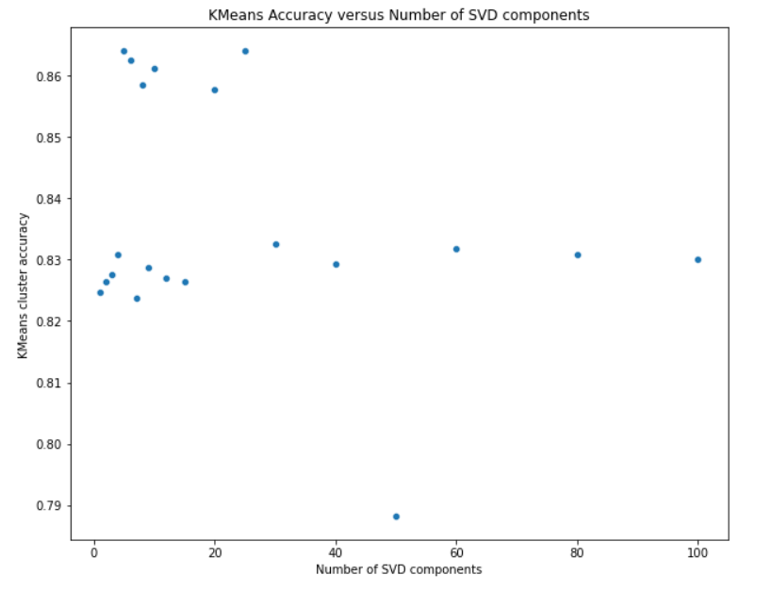
Other Observations

