Slide 1



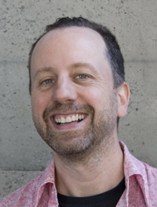
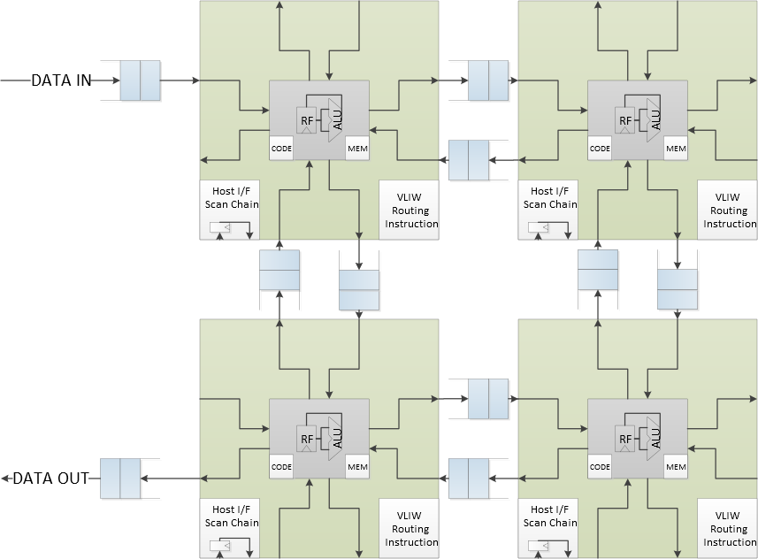
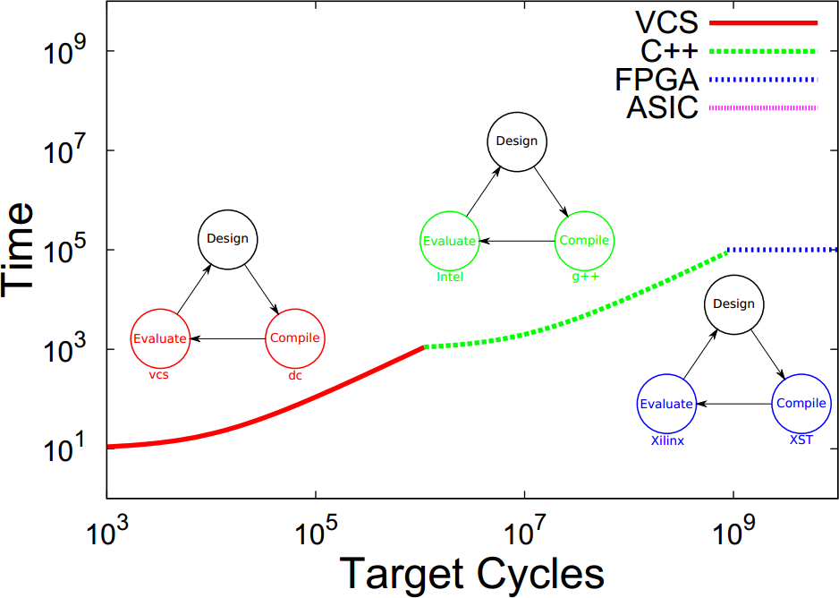
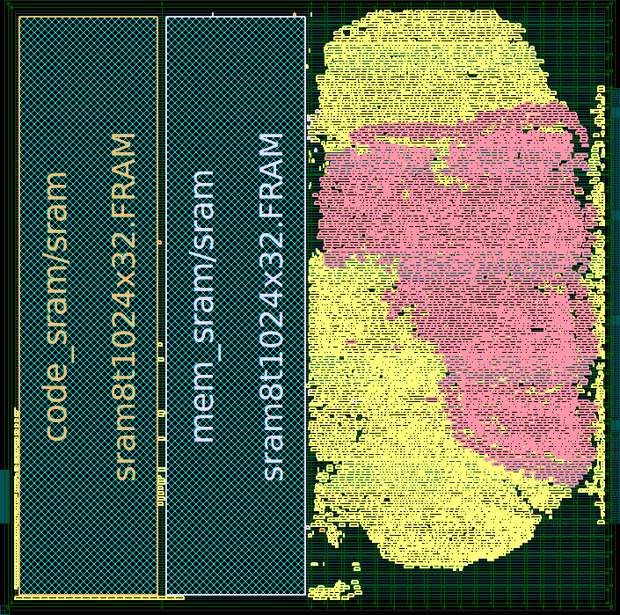
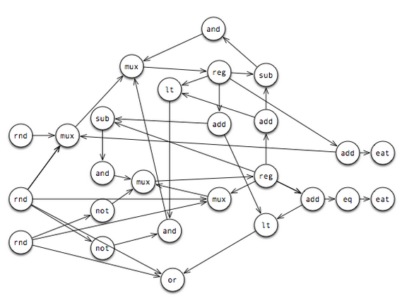
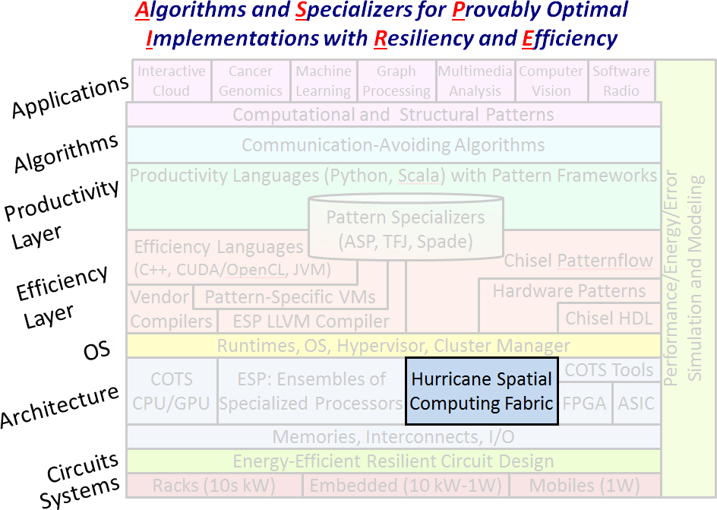
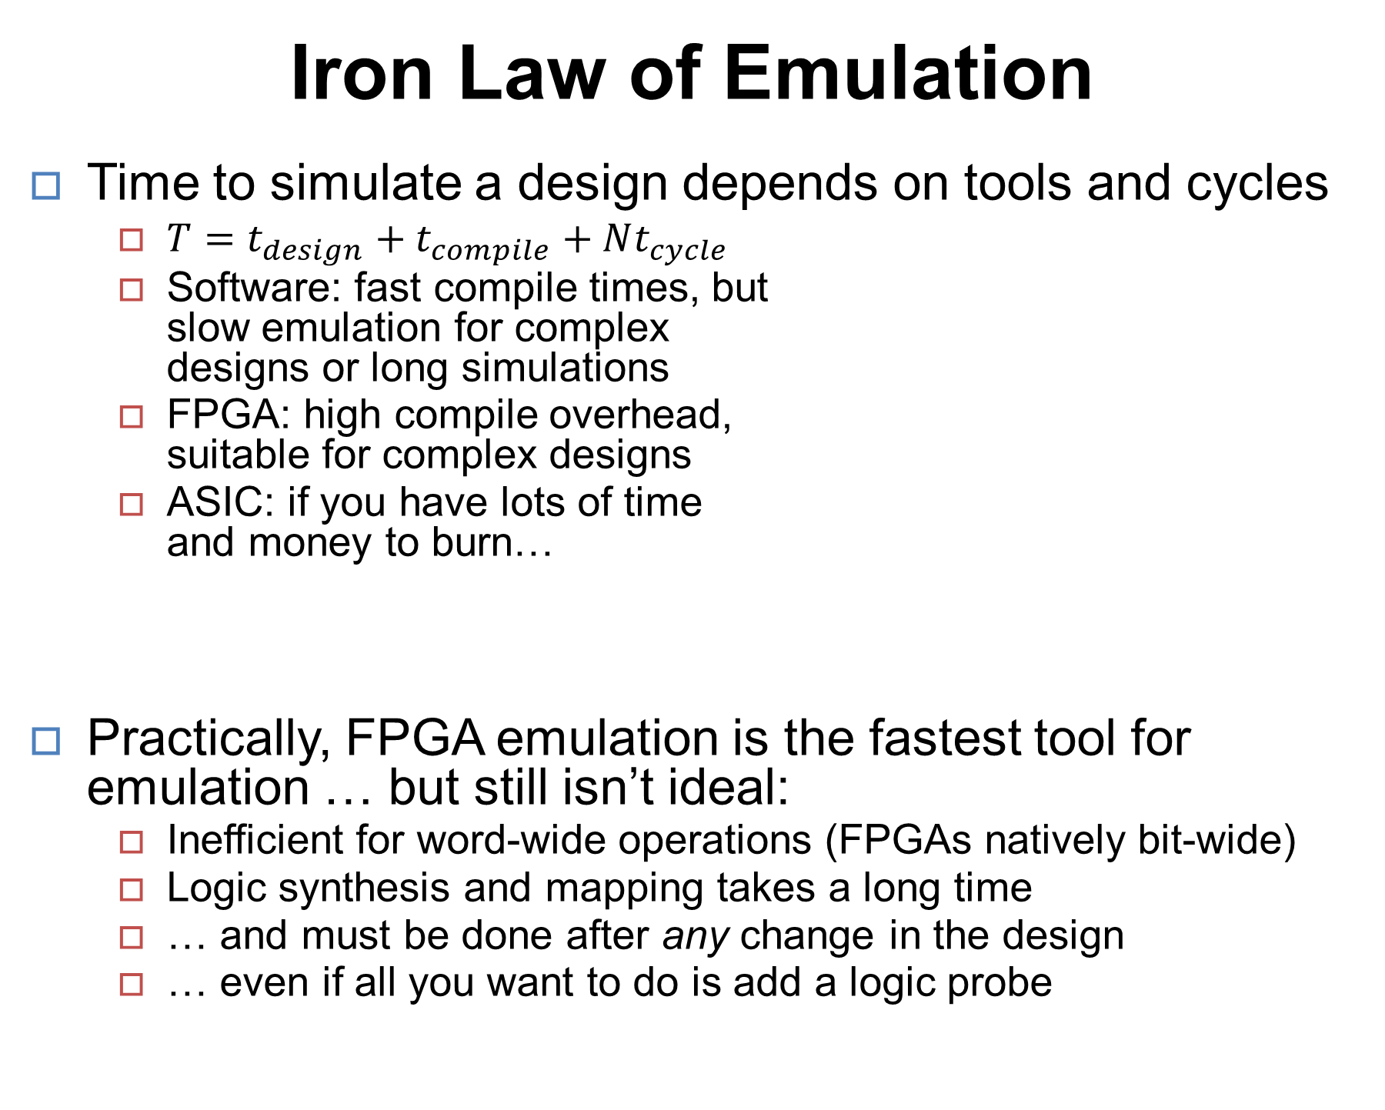
Dreamer
Palmer Dabbelt, Richard Lin, Albert Magyar,
Jonathan Bachrach
Fast reconfigurable logic for emulation
Background
Architecture
Parallel Dataflow Machine
The Design-Test-Execute Loop
Design – test – execute: current iterative method for hardware design
Generalizing from emulation, array can be used as a general parallel dataflow machine or systolic array
Can even be programmed in Chisel
… or parallel assembly, if you’re feeling adventurous
Edge ports can be connected to any ready-valid interface:
GPIO, DRAM, or host communications
Possible applications
General-purpose reconfigurable logic coprocessor
DSP filtering, or really anything dataflow-parallel
Iron Law of Emulation
Time to simulate a design depends on tools and cycles
$T=t_{design}+t_{compile}+Nt_{cycle}$
Software: fast compile times, but slow emulation for complex designs or long simulations
FPGA: high compile overhead, suitable for complex designs
ASIC: if you have lots of time and money to burn…
Practically, FPGA emulation is the fastest tool for emulation … but still isn’t ideal:
Inefficient for word-wide operations (FPGAs natively bit-wide)
Logic synthesis and mapping takes a long time
… and must be done after any change in the design
… even if all you want to do is add a logic probe
Preliminary Results
FPGA
(Zedboard with Xilinx Zynq)
See our pretty demos!
16 tiles in a 4 x 4 array
Clock: 40 MHz
ASIC
(TSMC 45nm process)
0.9 ns clock (1.1 GHz)
63,442 µm² per tile (1,576 tiles in 100mm², 4,728 tiles in 300mm²)
The Array
Massively parallel array of simple compute tiles
Cores connected in a nearest-neighbor network
Each connection is a 2-element buffer (reduce deadlocks)
Ready-valid interlocked ports (avoid explicit no-ops)
Additionally, all tiles’ host interfaces connected in a scan chain (for debugging and control)
Edge ports can be mapped to external data
Statically scheduled computation and communication
Simple hardware architecture, push complexity to tools
All inter-tile data movement explicit (one tile at a time)
The Tile
Simple compute cores
A mini computer – datapath, registers, memory, and code
Reduced ISA specialized for simulation, containing:
your standard arithmetic / bitwise-logical operations
emulation-specific instructions like mux
No branching – simple emulation loop
Dedicated host interface
Process host command packets in-place, then shift response to next tile in chain
Arbitrary peek/poke access into all state elements
Control tile execution
Specs:
1024 x 32 data memory
1024 x 32 code memory
32 x 32 register file
Overview
DREAMER: a new reconfigurable logic platform
New point in the space between programmability and efficiency
Instead of array of bits, use parallel array of simple processors
Each tile executes a portion of design’s hardware graph (right)
Supporting tools to map RTL to array
Compiles in seconds, not hours
Integrated debugging support
Probe state without recompiling
Overall, faster design iteration time
Future Work
FPGA area optimization
Pipelining for faster clock speeds and realistic SRAM data memory
Automatic instruction set generation and specialization
DSP optimization
Efficiently handling fine-grained (bit-width) operations
In the big picture:
Notes:
Please put in notes here to explain poster so that someone else could summarize what your poster is about

