Slide 1
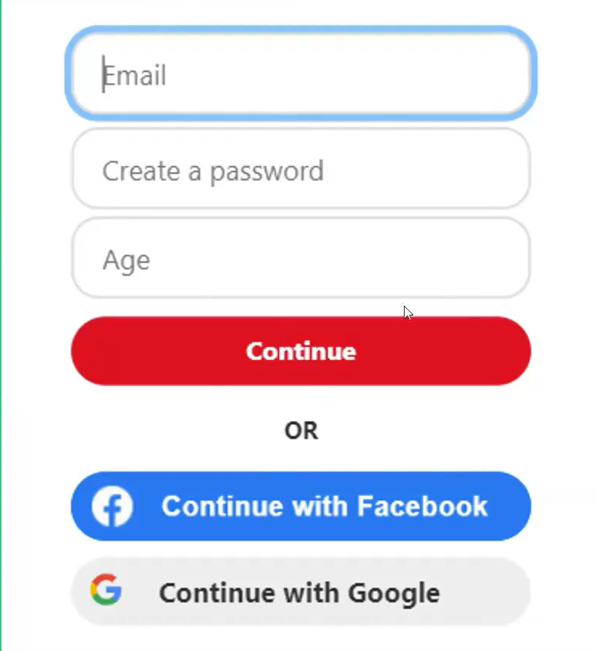
API:
API = Application Programming Interface
An API is a set of rules and definitions that allows different software applications to communicate with each other.
Think of it like a menu in a restaurant: it tells you what you can order (available functions) and how to order it (parameters, data format). You don't need to know how the kitchen prepares the food; you just use the menu.
API in Simple Words :
API is like a waiter
You request → waiter brings response
Why APIs Matter
Used in apps, websites, payments, maps, login
Here the website is using APIs of google and facebook

Slide 2
Examples of APIs
Google Maps API
Weather API
Payment API
What are REST APIs?
REST = Representational State Transfer
Most popular web API type
REST is an architectural style for designing networked applications. It's not a protocol (like HTTP) but a set of guidelines
RESTful APIs are designed to be stateless, client-server, cacheable, and use a uniform interface (HTTP methods).
Client-Server:Separation of concerns. The client (e.g., web browser, mobile app) and server (e.g., your Django API) evolve independently.
The Client (your web browser, a mobile app, or another server) is only responsible for the user interface and the user's experience.
The Server (the backend database and application logic) is only responsible for managing data, security, and processing.

Slide 3
Why it matters: Because they are completely separate, a frontend developer can completely redesign the mobile app without the backend developer having to touch the server code, as long as the server keeps sending the same data formats.
Stateless:Each request from client to server must contain all the information needed to understand the request. The server should not store any client context between requests. This is arguably the most important and most misunderstood rule of REST. Stateless means the server has amnesia between every single request. The server does not remember anything about the client's previous requests. You cannot send a request saying "Log me in," and then a second request saying, "Show me my profile.“
How it works instead: Every single request from the client must contain all the information the server needs to fulfill it. If you want to see your profile, your request must say, "Show me the profile for User 123, and here is my secure authentication token to prove I am allowed to see it."

Slide 4
Why it matters: It makes servers incredibly scalable. If a company has 100 servers, your first request might go to Server A, and your second request might go to Server B. Because the requests contain all the necessary context, Server B doesn't need to know what you said to Server A.
Cacheable: Responses can be explicitly or implicitly defined as cacheable to improve performance. Examples are:
If you request a list of the 50 US States, the server should attach a note to the response saying, "This data won't change anytime soon; cache it for a month." The next time the client needs that list, it uses its local copy instead of bothering the server.
Why it matters: It drastically reduces network traffic, lowers server load, and makes the application feel lightning-fast for the user.
Uniform Interface: The most critical constraint. It simplifies system architecture by having a common way to interact with resources. This involves:
Resource-based: Data is identified as resources (e.g., /products, /users/1).
Standard HTTP Methods: Use standard HTTP verbs to perform actions on resources:
GET: Retrieve (Read) a resource or collection of resources. (Idempotent & Safe)
POST: Create a new resource. (Not Idempotent & Not Safe)

Slide 5
PUT: Update/Replace an existing resource (entirely). (Idempotent)
PATCH: Partially update an existing resource. (Not Idempotent)
PATCH: Partially update an existing resource. (Not Idempotent)
Stateless Interactions: No session information is stored on the server.
Hypermedia as the Engine of Application State (HATEOAS): Resources should contain links to related resources, guiding the client on available actions. (Often not fully implemented in simpler APIs).
Code on Demand (Optional): Servers can temporarily extend or customize the functionality of a client by transferring executable code.
JSON (JavaScript Object Notation):
The most common data format for REST APIs due to its lightweight nature and ease of parsing for both humans and machines.
Looks like Python dictionaries and lists. Examples are:
["Apple“ , "Banana", "Cherry"] and , { "firstName“ : "John“ , "lastName“ : "Doe“ , "age“ : 28,"isEmployed“ : true}

Slide 6
REST API METHODS:
.
When we talk about REST API methods, we are talking about the verbs of the internet. If a URL (like /users/123) is the noun or the resource, the HTTP methods are the actions you take on those resources. To understand these in detail, we must look at two technical properties: Safety and Idempotency.
The Ground Rules: Safety & Idempotency:
Safe Methods:These are read-only. They do not change the state of the server. You can call them a million times, and the database remains untouched. Example is GET is a safe method.
Idempotent Methods:An operation is idempotent if performing it once has the same effect as performing it multiple times . Example is GET, PUT , DELETE.
The Primary REST Methods:
GET (Read) : The most common method. It retrieves a representation of a resource.
Safety: Safe. It only fetches data.
Idempotency: Idempotent. Requesting the same data repeatedly doesn't change the data
Example: GET /products/45 fetches the details of product #45.

Slide 7
POST (Create): Used to send data to the server to create a new resource. The server usually decides the ID for the new item.
Safety: Not Safe. It creates new records . It changes the database.
Idempotency: Not Idempotent. If you send the same POST request twice (like clicking "Submit Order" twice), you might end up with two identical orders in the system.
Example: POST /products with a body containing name and price creates a new product.
PUT (Update/Replace) : Used to update an existing resource by replacing it entirely. You send the complete new version of the resource.
Safety: Not Safe. It modifies data.
Idempotency: Idempotent. If you update a user's name to "Alex," doing it once or five times results in the name being "Alex.
Example: PUT /users/12 replaces everything about user #12 with the new data provided.
PATCH (Partial Update):
Unlike PUT, PATCH is used for partial modifications. You only send the specific fields you want to change.

Slide 8
Safety: Not Safe.
Idempotency: Usually Not Idempotent. While changing a "status" to "active" is idempotent, a PATCH request that says "increment age by 1" would change the result every time you run it.
Example: PATCH /users/12 sending only {"email": "new@email.com"}.
DELETE (Remove):
Deletes the specified resource.
Safety: Not Safe. It removes data.
Idempotency: Idempotent. The first time you delete a resource, it’s gone. Every time after that, the resource is still "gone." The state of the server doesn't change further.
Example: DELETE /posts/99 removes post #99

Slide 9
How to Consume an API :
Consuming an API (Application Programming Interface) simply means writing code that talks to another system over the internet to get or send data. Think of it like ordering food at a restaurant : you (the client) look at the menu (the API documentation), place an order with the waiter (send a request), and the kitchen brings you your food (the response).
To consume an API, you generally need to understand three core concepts:
The Endpoint (URL): The specific web address where the data lives
The Method: What you want to do. The most common is GET (fetch data), but there is also POST (send new data), PUT (update data), and DELETE.
The Format: Most modern APIs return data in JSON (JavaScript Object Notation), which looks a lot like a standard dictionary or object in code. While an API can technically return data in almost any format, JSON has become the undisputed industry standard.
(like xml,csv,etc.)

Slide 10
Let's look at how to consume a free, public API (we'll use JSONPlaceholder, a fake API designed for testing):
A Simple CLI (Using Python):
We will use Python for writing quick CLI tools. We'll use the built-in “requests” library to fetch data about a fake user and print it to the terminal.
Prerequisite:
We may need to install the “requests” library by running “pip install requests” in your terminal.
How it will work:
We run this file from your terminal (python script.py). It reaches out to the URL, waits for the server to reply, translates the JSON response into variables it can read, and prints them formatted to your screen.

Slide 11
Python code:
import requests
def fetch_user_data(n):
# 1. Define the Endpoint
url = f"https://jsonplaceholder.typicode.com/users/{n}"
print("Fetching user data...")
try:
# 2. Send a GET request to the API
response = requests.get(url)
# 3. Check if the request was successful (Status Code 200 means OK)
if response.status_code == 200:
# 4. Parse the JSON data into a Python dictionary
user = response.json()
# 5. Output the data to the CLI
print("\n--- User Profile ---")
print(f"Name: {user['name']}")
print(f"Username: {user['username']}")
print(f"Email: {user['email']}")

Slide 12
print(f"City: {user['address']['city']}")
print("--------------------\n")
else:
print(f"Failed to retrieve data. Status code: {response.status_code}")
except requests.exceptions.RequestException as e:
print(f"An error occurred: {e}")
# Run the function
If __name__ == "__main__":
fetch_user_data(any number from 1 to 10)
Let's break down the Python CLI code step by step:
Setting the Target Coordinates:
url = "https://jsonplaceholder.typicode.com/users/1"
This is the Endpoint. It is the exact location of the data we want to retrieve. In this specific case, we are pointing directly at the data model for "User 1" on a public testing server.

Slide 13
Common parts of an API URL :
When you see url = "https://jsonplaceholder.typicode.com/users/1", it is composed of three pre-defined parts:
Setting Up a Safety Net :
“try: # (API call happens here) except requests.exceptions.RequestException as e: print(f"An error occurred: {e}") “
When writing code that connects to the outside world, variables are unpredictable—the Wi-Fi might drop, a DNS server could fail, or the API might be offline. The try...except block is a structural safety mechanism. It tells Python: "Try to execute this block of code. If the connection fails, do not abruptly crash the entire program. Instead, catch the error, jump to the except block, and print a readable warning."
Protocol (https://): The standard rules for communication.
Base URL / Domain (jsonplaceholder.typicode.com): The "house" where the API lives.
Endpoint / Path (/users/1): The specific "room" inside that house where the specific data you want is stored.

Slide 14
Executing the Request :
“response = requests.get(url)”
This is the core action of the script. We use our requests tool to send a GET message to the URL. The variable response now holds the entire payload the server sent back. This includes the data you asked for, but also hidden metadata like headers, security certificates, and the status code.
Quality Control :
“if response.status_code == 200:”
Just like you wouldn't proceed with an installation without verifying the materials arrived intact, we need to check the delivery status before we read the data. Web servers use HTTP status codes to report what happened:
> 200 means "OK" (Success).
>404 means "Not Found" (You asked for a URL that doesn't exist).
>500 means "Internal Server Error" (The API's backend crashed).

Slide 15
Translating the Data :
“user = response.json()”
The server sends the data over the wire as a raw string of text formatted as JSON. Python cannot easily extract variables from a giant string. The .json() method translates that raw text and converts it into a native Python Dictionary. Now, Python sees structured, queryable key-value pairs.
Extracting the Output :
print(f"Name: {user['name']}")
print(f"City: {user['address']['city']}")
Because user is now a standard Python dictionary, we can pull out exactly what we need using its keys.
Notice the City extraction:
user['address']['city']. In the JSON payload, the "city" data is nested inside an "address" group. We chain the brackets to drill down into the structure and isolate that specific value.

Slide 16
The Engine Starter :
if __name__ == "__main__":
fetch_user_data()
This is a standard Python idiom used at the bottom of scripts. It tells Python: "Only run the fetch_user_data() function if I am executing this file directly from the command line." If you were to import this file into another one of your Python projects to reuse the code later, this line ensures the function doesn't fire off automatically until you explicitly call it.

Slide 17
Creating API using Flask
Flask = Python web framework
Python Code for creating API :
from flask import Flask, jsonify
# 1. Initialize the Flask application
app = Flask(__name__)
# 2. Mock Database (A list of dictionaries)
projects = [
{"id": 1, "name": "Foundation Site A", "status": "Completed"},
{"id": 2, "name": "Bridge Inspection", "status": "In Progress"}
]
# 3. Define the Route (The Endpoint)
@app.route('/api/projects', methods=['GET'])
def get_projects():
# 4. Return the data as JSON
return jsonify({"status": "success", "data": projects})
# 5. Run the server
if __name__ == '__main__':
app.run(debug=True)

Slide 18
app = Flask(__name__): This line creates the "Application Object." It tells Python that this specific file is a web server.
The "Database": In a real-world scenario, this data would come from a database like PostgreSQL or SQLite. Here, we use a Python list so the code remains self-contained.
The Decorator (@app.route): This is the most important part of Flask. It maps a specific URL path (/api/projects) and an HTTP Method (GET) to a Python function. When someone visits that URL, Flask automatically triggers the function below it.
jsonify(): This helper function turns your Python dictionary or list into a JSON string. It also sets the "Content-Type" header to application/json so the browser knows exactly how to read the data.

Slide 19
app.run(debug=True): This starts the local development server. The debug=True mode is very helpful—it automatically restarts the server every time you save a change to your code.
Why Flask?
Lightweight, Python-based .
Easy to scale from a "Hello World" to a complex system.
Flask offers a simple but powerful entry point for backend development.

Slide 20
Conclusion :
. The "Who Are You?" (Identity & Security)
Since public APIs often cost money to run, companies don't just let anyone use them indefinitely. They use these tools to manage access:
API Key: Think of this as a Username and Password combined into one long string. It’s a unique identifier that tells the server, "Hey, this is [Your Name] calling." If you leak this on GitHub, someone else can use your "credits."
Authentication (AuthN): The process of proving who you are. (e.g., "I am User #5521").
Authorization (AuthZ): The process of proving what you are allowed to do. (e.g., "User #5521 is allowed to read posts but not delete them").
Bearer Token (OAuth): A more secure, temporary "pass." Instead of sending your permanent API key every time, you exchange your credentials for a token that might expire in an hour. It’s like a hotel key card—it works for a while, then stops.
Understanding APIs is essential for modern software development.
REST APIs are widely used because they follow simple HTTP principles.
APIs power modern apps
Easy to build and use
In the code for consuming api if we write url address as
https://public-api-lists.github.io/public-api-lists/api/all.json
we can assess the json api of KOSS uploaded on git-hub
Thank you for your time

