Slide 1
Operating Systems
Wed 234, DTH 102
薛智文
cwhsueh@csie.ntu.edu.tw
http://www.csie.ntu.edu.tw/~cwhsueh/
2017 Spring

Slide 2
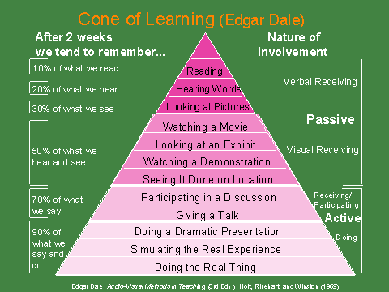

Slide 3
百分數 | 等第 | 定義
90-100(95) | A+ | All goals achieved beyond expectation 所有目標皆達成且超越期望
85-89(87) | A | All goals achieved 所有目標皆達成
80-84(82) | A- | All goals achieved, but need some polish 所有目標皆達成，但需一些精進
77-79(78) | B+ | Some goals well achieved 達成部分目標，且品質佳
73-76(75) | B | Some goals adequately achieved 達成部分目標，但品質普通
70-72(71) | B- | Some goals achieved with minor flaws 達成部分目標，但有些缺失
67-69(68) | C+ | Minimum goals achieved 達成最低目標
63-66(65) | C | Minimum goals achieved with minor flaws 達成最低目標，但有些缺失
60-62(61) | C- | Minimum goals achieved with major flaws 達成最低目標但有重大缺失
<59(含) | F | No goals achieved 所有目標皆未達成

Slide 4
Course Expectation
Understand the OS concepts
Participation
Ask and answer questions
Do not skip the class unless …
Team Work
Software Engineering
Turn in projects in time (minimum)

Slide 5
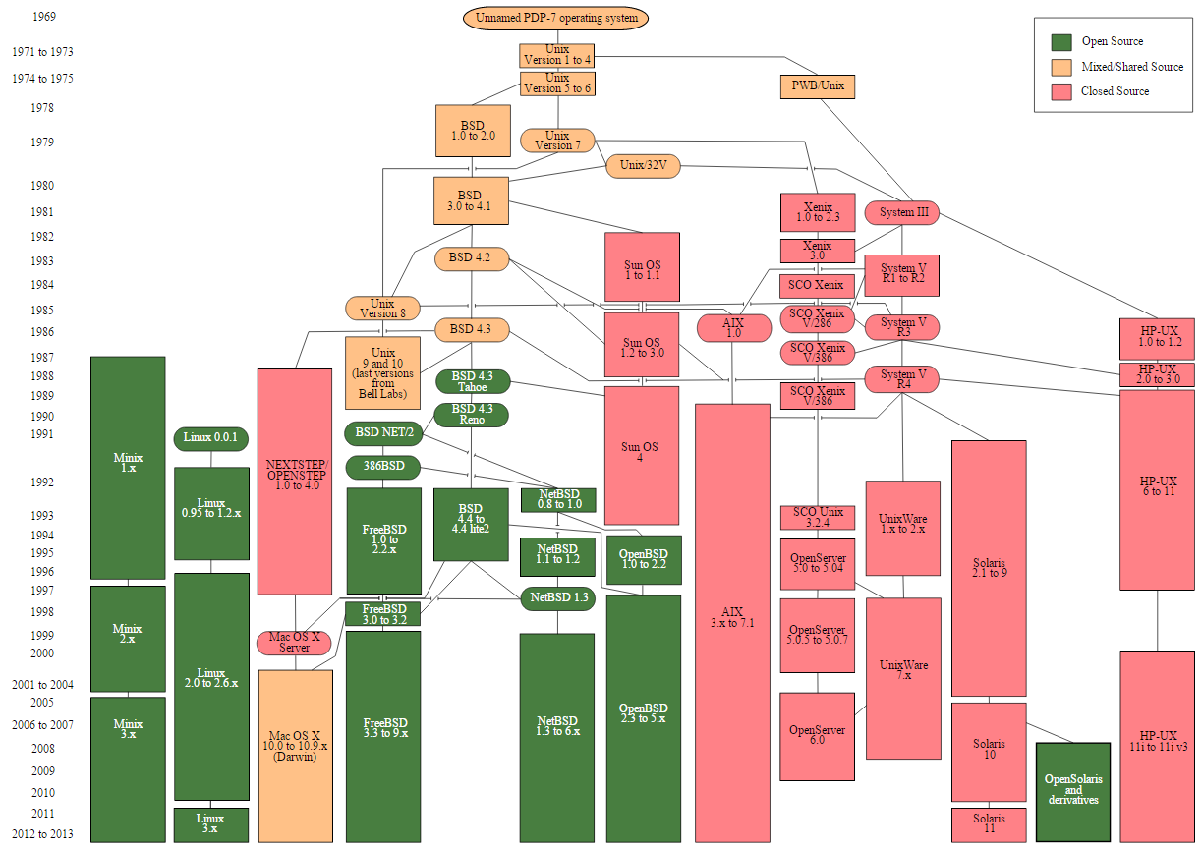

Slide 6
Chapter 1: Introduction

Slide 7
Objectives
To provide a grand tour of the major operating systems components
To provide coverage of basic computer system organization

Slide 8
Chapter 1: Introduction
What Operating Systems Do
Computer-System Organization
Computer-System Architecture
Operating-System Structure
Operating-System Operations
Process Management
Memory Management
Storage Management
Protection and Security
Kernel Data Structure
Computing Environments
Open-Source Operating Systems

Slide 9
Chapter 1: Introduction
What Operating Systems Do
Computer-System Organization
Computer-System Architecture
Operating-System Structure
Operating-System Operations
Process Management
Memory Management
Storage Management
Protection and Security
Kernel Data Structure
Computing Environments
Open-Source Operating Systems

Slide 10
What is an Operating System?
A (system) program that
manages the computer hardware (and software)
provides a basis for application programs and acts as an intermediary between a user of a computer and the computer hardware.
讓使用者妥善地使用軟硬體資源的系統程式

Slide 11
Operating System Goals
Mainframe OSes are designed primarily to optimize utilization of hardware.
PC OSes support complex games, business applications, and everything in between.
OSes for handheld systems are designed to provide an environment in which a user can easily interface with the computer to execute programs.
Convenient (GUI), efficient, both, or between.

Slide 12
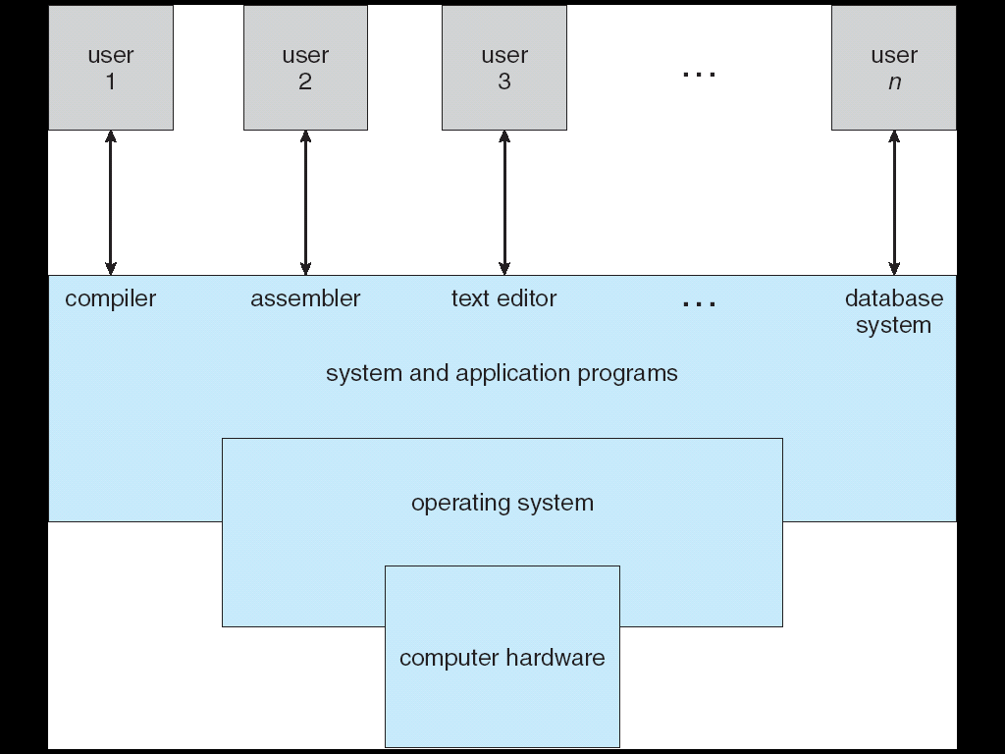
Computer System Structure and Components
Similar to
a Government!
Notes:
Computer system can be divided into four components
Hardware – provides basic computing resources
CPU, memory, I/O devices
Operating system
Controls and coordinates use of hardware among various applications and users
Application programs – define the ways in which the system resources are used to solve the computing problems of the users
Word processors, compilers, web browsers, database systems, video games
Users
People, machines, other computers

Slide 13
Operating System Definition (1/2)
User View
Server, Mainframe, Workstations, PC, Handhelds.
System View
OS is a resource allocator
Manages all resources
Decides between conflicting requests for efficient and fair resource use
OS is a control program
Controls execution of programs to prevent errors and improper use of the computer

Slide 14
Operating System Definition (2/2)
No universally accepted definition
“Everything a vendor ships when you order an operating system” is good approximation
But varies wildly
“The one program running at all times on the computer” is the kernel. Everything else is either a system program (ships with the operating system) or an application program

Slide 15
作業系統特徵遷移示意圖
Cloud OS?
1950 1960 1970 1980 1990 2000 2010
MULTICS
WeOS?
大型電腦
無軟體 編譯器 分時 多使用者 分散式系統
批次 多處理器
常駐監控常式 網路 容錯
UNIX
虛擬化
virtualization
虛擬機器
迷你電腦
無軟體 編譯器
分時 多使用者 多處理器
常駐監控常式 網路 容錯
叢集
UNIX
虛擬機器
個人電腦
無軟體 編譯器
交談式 多處理器
多使用者
網路
UNIX
虛擬機器
虛擬化
virtualization
手持式電腦
編譯器 無軟體
交談式
網路 多處理器
虛擬機器
虛擬化
virtualization

Slide 16
Chapter 1: Introduction
What Operating Systems Do
Computer-System Organization
Computer-System Architecture
Operating-System Structure
Operating-System Operations
Process Management
Memory Management
Storage Management
Protection and Security
Kernel Data Structure
Computing Environments
Open-Source Operating Systems

Slide 17
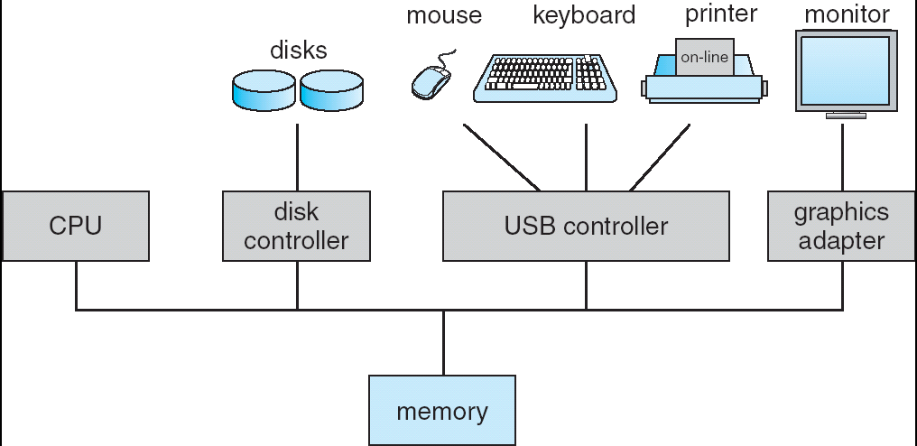
Computer System Organization

Slide 18
Computer-System Operation (1/2)
Computer Startup
bootstrap program is loaded at power-up or reboot
Typically stored in ROM or EPROM, generally known as firmware
Initializates all aspects of system
Loads operating system kernel and starts execution
One or more CPUs, device controllers connect through common bus providing access to shared memory
Concurrent execution of CPUs and devices competing for memory cycles

Slide 19
Computer-System Operation (2/2)
I/O devices and the CPU can execute concurrently.
Each device controller is in charge of a particular device type.
Each device controller has a local buffer.
CPU moves data from/to main memory to/from local buffers
I/O is from the device to local buffer of controller.
Device controller informs CPU that it has finished its operation by causing an interrupt.

Slide 20
How a Modern Computer System Works?
Thread of execution
CPU (*N)
Cache
instruction execution cycle
instructions
and data
memory
data movement
data
interrupt
I/O request
DMA
device
(*M)

Slide 21
Common Functions of Interrupts
Interrupt transfers control to the interrupt service routine generally, through the interrupt vector, which contains the addresses of all the service routines.
Interrupt architecture must save the address of the interrupted instruction.
Incoming interrupts are disabled while another interrupt is being processed to prevent a lost interrupt.
A trap is a software-generated interrupt caused either by an error or a user request.
An operating system is interrupt driven.

Slide 22
Interrupt Handling
The operating system preserves the state of the CPU by storing registers and the program counter.
Determines which type of interrupt has occurred:
polling
vectored interrupt system
Separate segments of code determine what action should be taken for each type of interrupt

Slide 23
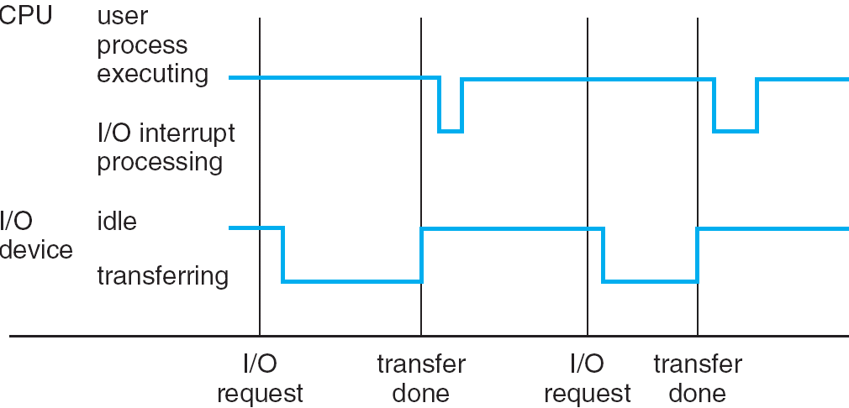
Interrupt Timeline

Slide 24
I/O Structure
After I/O starts, control returns to user program only upon I/O completion.
Wait instruction idles the CPU until the next interrupt
Wait loop (contention for memory access).
At most one I/O request is outstanding at a time, no simultaneous I/O processing.
After I/O starts, control returns to user program without waiting for I/O completion.
System call – request to the operating system to allow user to wait for I/O completion.
Device-status table contains entry for each I/O device indicating its type, address, and state.
OS indexes into I/O device table to determine device status and to modify table entry to include interrupt.

Slide 25
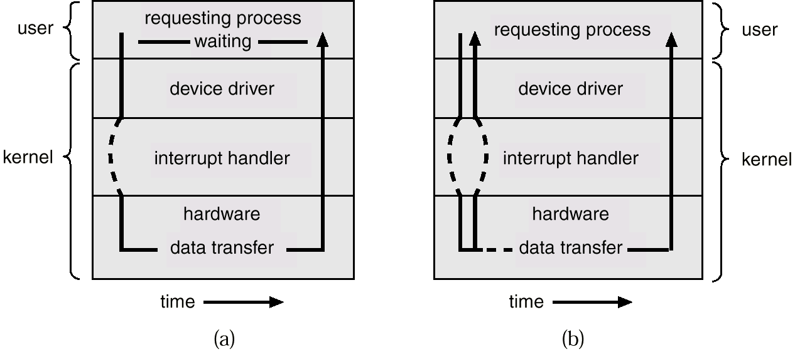
Two I/O Methods
Synchronous
Asynchronous

Slide 26
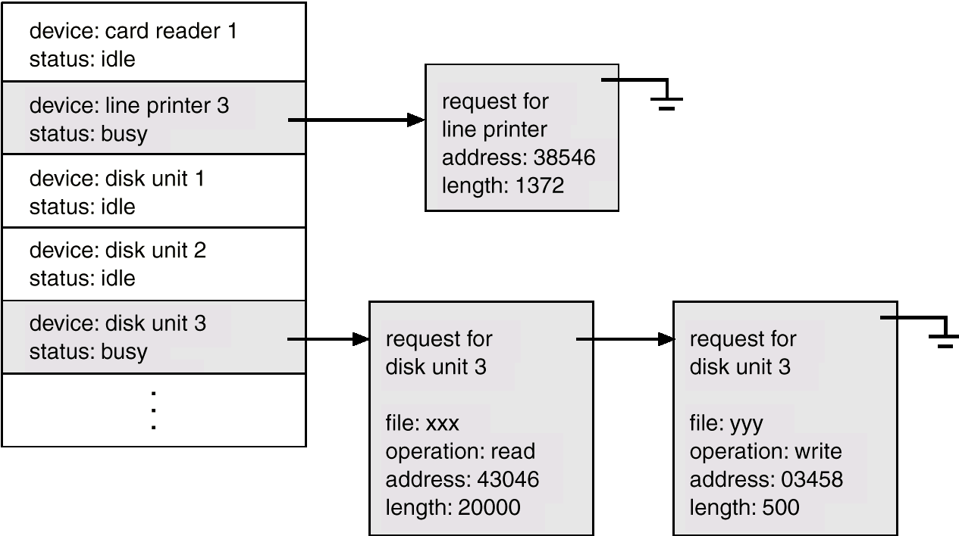
Device-Status Table

Slide 27
Direct Memory Access Structure
Used for high-speed I/O devices able to transmit information at close to memory speeds.
Device controller transfers blocks of data from buffer storage directly to main memory without CPU intervention.
Only one interrupt is generated per block, rather than the one interrupt per byte.

Slide 28
Storage Structure
Main memory – only large storage media that the CPU can access directly.
Secondary storage – extension of main memory that provides large nonvolatile storage capacity.
Magnetic disks – rigid metal or glass platters covered with magnetic recording material
Disk surface is logically divided into tracks, which are subdivided into sectors.
The disk controller determines the logical interaction between the device and the computer.

Slide 29
Storage Hierarchy
Storage systems organized in hierarchy.
Speed
Cost
Volatility
Caching – copying information into faster storage system; main memory can be viewed as a last cache for secondary storage.

Slide 30
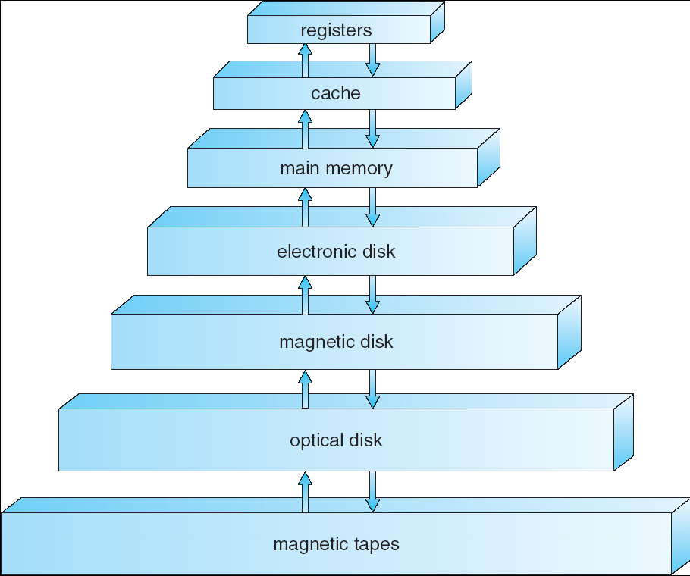
Storage-Device Hierarchy

Slide 31
Caching
Important principle, performed at many levels in a computer (in hardware, OS, software)
Information in use copied from slower to faster storage temporarily
Faster storage (cache) checked first to determine if information is there
If it is, information used directly from the cache (fast)
If not, data copied to cache and used there
Cache smaller than storage being cached
Cache management important design problem
Cache size and replacement policy

Slide 32
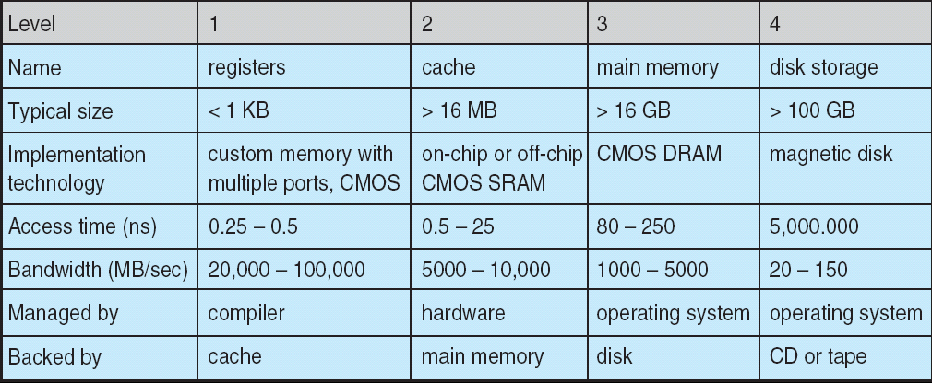
Performance of Various Levels of Storage
Movement between levels of storage hierarchy can be explicit or implicit

Slide 33
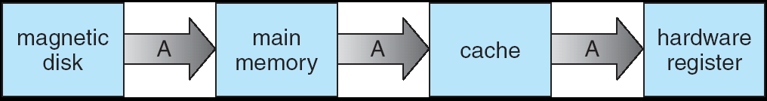
Migration of Integer A from Disk to Register
Multitasking environments must be careful to use most recent value, no matter where it is stored in the storage hierarchy Multiprocessor environment must provide cache coherency in hardware such that all CPUs have the most recent value in their cache
Distributed environment situation even more complex
Several copies of a datum can exist
Various solutions covered in Chapter 17

Slide 34
Chapter 1: Introduction
What Operating Systems Do
Computer-System Organization
Computer-System Architecture
Operating-System Structure
Operating-System Operations
Process Management
Memory Management
Storage Management
Protection and Security
Kernel Data Structure
Computing Environments
Open-Source Operating Systems

Slide 35
Computer-System Architecture
Single-processor systems
Multiprocessor systems
Increased throughput
Economy of scale
Increased reliability
Clustered systems

Slide 36
Multiprocessor systems
CPU₀
CPU₁
CPU₂
Graceful degradation
Fault tolerant
Asymmetric multiprocessing
vs. symmetric multiprocessing (SMP)
UMA vs. NUMA
Multicore
Blade server
registers
registers
registers
cache
cache
cache
memory
CPU core₀
CPU core₁
registers
registers
cache
cache
memory

Slide 37
Clustered systems
Linked via LAN
Provide high availability
Hot-standby more
Provide high-performance computing
Parallelization
Distributed lock manager (DLM)
computer
interconnected
computer
interconnected
computer
Storage Area Network

Slide 38
Chapter 1: Introduction
What Operating Systems Do
Computer-System Organization
Computer-System Architecture
Operating-System Structure
Operating-System Operations
Process Management
Memory Management
Storage Management
Protection and Security
Kernel Data Structure
Computing Environments
Open-Source Operating Systems

Slide 39
Operating System Structure
Multiprogramming needed for efficiency
Single user cannot keep CPU and I/O devices busy at all times
Multiprogramming organizes jobs (code and data) so CPU always has one to execute
A subset of total jobs in system is kept in memory
One job selected and run via job scheduling
When it has to wait (for I/O for example), OS switches to another job
Timesharing (multitasking) is logical extension in which CPU switches jobs so frequently that users can interact with each job while it is running, creating interactive computing
Response time should be < 1 second
Each user has at least one program executing in memory process
If several jobs ready to run at the same time  CPU scheduling
If processes don’t fit in memory, swapping moves them in and out to run
Virtual memory allows execution of processes not completely in memory

Slide 40
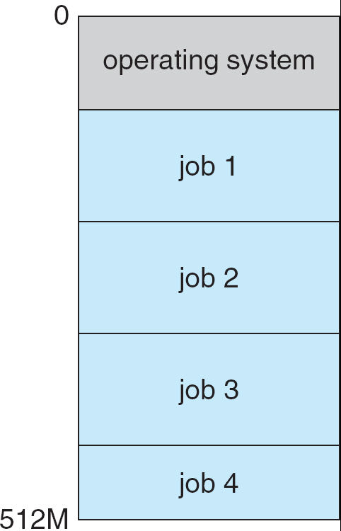
Memory Layout for Multiprogrammed System

Slide 41
Chapter 1: Introduction
What Operating Systems Do
Computer-System Organization
Computer-System Architecture
Operating-System Structure
Operating-System Operations
Process Management
Memory Management
Storage Management
Protection and Security
Kernel Data Structure
Computing Environments
Open-Source Operating Systems

Slide 42
Operating-System Operations
Interrupt driven by hardware
Software error or request creates exception or trap
Division by zero, request for operating system service
Other process problems include infinite loop, processes modifying each other or the OS
Dual-mode operation allows OS to protect itself and other system components
User mode and kernel mode
Mode bit provided by hardware
Provides ability to distinguish when system is running user code or kernel code
Some instructions designated as privileged, only executable in kernel mode
System call changes mode to kernel, return from call resets it to user

Slide 43
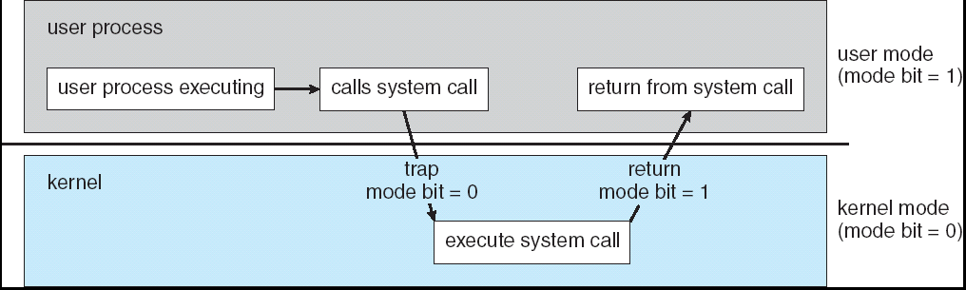
Transition from User to Kernel Mode
Timer to prevent infinite loop / process hogging resources
Set interrupt after specific period
Operating system decrements counter
When counter zero generates an interrupt
Set up before scheduling process to regain control or terminate program that exceeds allotted time

Slide 44
Chapter 1: Introduction
What Operating Systems Do
Computer-System Organization
Computer-System Architecture
Operating-System Structure
Operating-System Operations
Process Management
Memory Management
Storage Management
Protection and Security
Kernel Data Structure
Computing Environments
Open-Source Operating Systems

Slide 45
Process Management
A process is a program in execution. It is a unit of work within the system.
Program is a passive entity, process is an active entity.
Process needs resources to accomplish its task
CPU, memory, I/O, files
Initialization data
Process termination requires reclaim of any reusable resources
Single-threaded process has one program counter specifying location of next instruction to execute
Process executes instructions sequentially, one at a time, until completion
Multi-threaded process has one program counter per thread
Typically system has many processes, some user, some operating system running concurrently on one or more CPUs
Concurrency by multiplexing the CPUs among the processes / threads

Slide 46
Process Management Activities
The operating system is responsible for the following activities in connection with process management:
Creating and deleting both user and system processes
Suspending and resuming processes
Providing mechanisms for process synchronization
Providing mechanisms for process communication
Providing mechanisms for deadlock handling

Slide 47
Chapter 1: Introduction
What Operating Systems Do
Computer-System Organization
Computer-System Architecture
Operating-System Structure
Operating-System Operations
Process Management
Memory Management
Storage Management
Protection and Security
Kernel Data Structure
Computing Environments
Open-Source Operating Systems

Slide 48
Memory Management
All data in memory before and after processing
All instructions in memory in order to execute
Memory management determines what is in memory when
Optimizing CPU utilization and computer response to users
Memory management activities
Keeping track of which parts of memory are currently being used and by whom
Deciding which processes (or parts thereof) and data to move into and out of memory
Allocating and deallocating memory space as needed

Slide 49
Chapter 1: Introduction
What Operating Systems Do
Computer-System Organization
Computer-System Architecture
Operating-System Structure
Operating-System Operations
Process Management
Memory Management
Storage Management
Protection and Security
Kernel Data Structure
Computing Environments
Open-Source Operating Systems

Slide 50
Storage Management
OS provides uniform, logical view of information storage
Abstracts physical properties to logical storage unit - file
Each medium is controlled by device (i.e., disk drive, tape drive)
Varying properties include access speed, capacity, data-transfer rate, access method (sequential or random)
File-System management
Files usually organized into directories
Access control on most systems to determine who can access what
OS activities include
Creating and deleting files and directories
Primitives to manipulate files and dirs
Mapping files onto secondary storage
Backup files onto stable (non-volatile) storage media

Slide 51
Mass-Storage Management
Usually disks used to store data that does not fit in main memory or data that must be kept for a “long” period of time.
Proper management is of central importance
Entire speed of computer operation hinges on disk subsystem and its algorithms
OS activities
Free-space management
Storage allocation
Disk scheduling
Some storage need not be fast
Tertiary storage includes optical storage, magnetic tape
Still must be managed
Varies between WORM (write-once, read-many-times) and RW (read-write)

Slide 52
I/O Subsystem
One purpose of OS is to hide peculiarities of hardware devices from the user
I/O subsystem responsible for
Memory management of I/O including buffering (storing data temporarily while it is being transferred), caching (storing parts of data in faster storage for performance), spooling (the overlapping of output of one job with input of other jobs)
General device-driver interface
Drivers for specific hardware devices

Slide 53
Chapter 1: Introduction
What Operating Systems Do
Computer-System Organization
Computer-System Architecture
Operating-System Structure
Operating-System Operations
Process Management
Memory Management
Storage Management
Protection and Security
Kernel Data Structure
Computing Environments
Open-Source Operating Systems

Slide 54
Protection and Security
Protection – any mechanism for controlling access of processes or users to resources defined by the OS
Security – defense of the system against internal and external attacks
Huge range, including denial-of-service, worms, viruses, identity theft, theft of service
Systems generally first distinguish among users, to determine who can do what
User identities (user IDs, security IDs) include name and associated number, one per user
User ID then associated with all files, processes of that user to determine access control
Group identifier (group ID) allows set of users to be defined and controls managed, then also associated with each process, file
Privilege escalation allows user to change to effective ID with more rights

Slide 55
Chapter 1: Introduction
What Operating Systems Do
Computer-System Organization
Computer-System Architecture
Operating-System Structure
Operating-System Operations
Process Management
Memory Management
Storage Management
Protection and Security
Kernel Data Structure
Computing Environments
Open-Source Operating Systems

Slide 56
Kernel Data Structure
Lists, Stacks, and Queues
Trees
Hash Functions and Maps
Bitmaps
<linux/list.h>

Slide 57
Chapter 1: Introduction
What Operating Systems Do
Computer-System Organization
Computer-System Architecture
Operating-System Structure
Operating-System Operations
Process Management
Memory Management
Storage Management
Protection and Security
Kernel Data Structure
Computing Environments
Open-Source Operating Systems

Slide 58
Computing Environments (1/2)
Traditional computer
Blurring over time
Office environment
PCs connected to a network, terminals attached to mainframe or minicomputers providing batch and timesharing
Now portals allowing networked and remote systems access to same resources
Home networks
Used to be single system, then modems
Now firewalled, networked

Slide 59
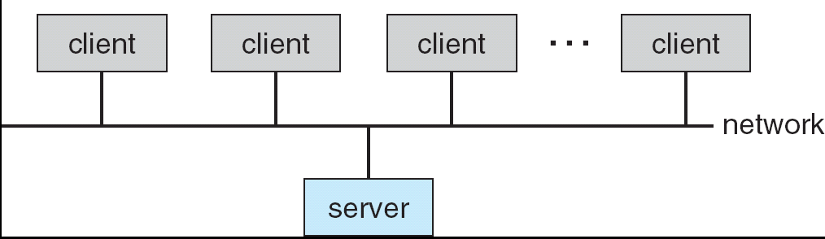
Computing Environments (2/2)
Client-Server Computing
Dumb terminals supplanted by smart PCs
Many systems now servers, responding to requests generated by clients
Compute-server provides an interface to client to request services (i.e. database)
File-server provides interface for clients to store and retrieve files

Slide 60
Peer-to-Peer Computing
Another model of distributed system
P2P does not distinguish clients and servers
Instead all nodes are considered peers
May each act as client, server or both
Node must join P2P network
Registers its service with central lookup service on network, or
Broadcast request for service and respond to requests for service via discovery protocol
Examples include Napster and Gnutella

Slide 61
Web-Based Computing
Web has become ubiquitous
PCs most prevalent devices
More devices becoming networked to allow web access
New category of devices to manage web traffic among similar servers: load balancers
Use of operating systems like Windows 95, client-side, have evolved into Linux and Windows XP, which can be clients and servers

Slide 62
Chapter 1: Introduction
What Operating Systems Do
Computer-System Organization
Computer-System Architecture
Operating-System Structure
Operating-System Operations
Process Management
Memory Management
Storage Management
Protection and Security
Distributed Systems
Special-Purpose Systems
Computing Environments
Open-Source Operating Systems

Slide 63
Open-Source Operating Systems
Closed-source OS
Reverse engineering
Copyright, copyleft
Digital Rights Management (DRM)
Free Software Foundation (FSF)
GNU General Public License (GPL)
Linux 2.6.x, 3.x, BSD UNIX, Solaris
Utility, open-source projects

Slide 64
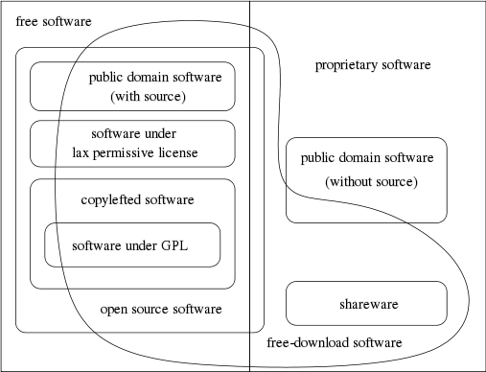
Categories of free and nonfree software

Slide 65
Chapter 1: Introduction
What Operating Systems Do
Computer-System Organization
Computer-System Architecture
Operating-System Structure
Operating-System Operations
Process Management
Memory Management
Storage Management
Protection and Security
Distributed Systems
Special-Purpose Systems
Computing Environments
Open-Source Operating Systems

Slide 66
Distributed Systems
LAN
local-area network
WAN
wide-area network
MAN
metropolitan-area network
SAN
small-area network
NOS
Network operating system
DOS
Distributed operating system

Slide 67
Chapter 1: Introduction
What Operating Systems Do
Computer-System Organization
Computer-System Architecture
Operating-System Structure
Operating-System Operations
Process Management
Memory Management
Storage Management
Protection and Security
Distributed Systems
Special-Purpose Systems
Computing Environments
Open-Source Operating Systems

Slide 68
Special-Purpose Systems
Real-Time Embedded Systems
Embedded systems almost always run real-time operating systems?
Multimedia Systems
Handheld Systems

Slide 69
End of Chapter 1

