Slide 1
Chapter 4: Threads

Slide 2
Objectives
To introduce the notion of a thread — a fundamental unit of CPU utilization that forms the basis of multithreaded computer systems
To discuss the APIs for the Pthreads, Win32, and Java thread libraries
To explore several strategies that provide implicit threading
To examine issues related to multithreaded programming
To cover operating system support for threads in Windows and Linux

Slide 3
Chapter 4: Threads
Overview
Multicore Programming
Multithreading Models
Thread Libraries
Implicit Threading
Threading Issues
Operating System Examples

Slide 4
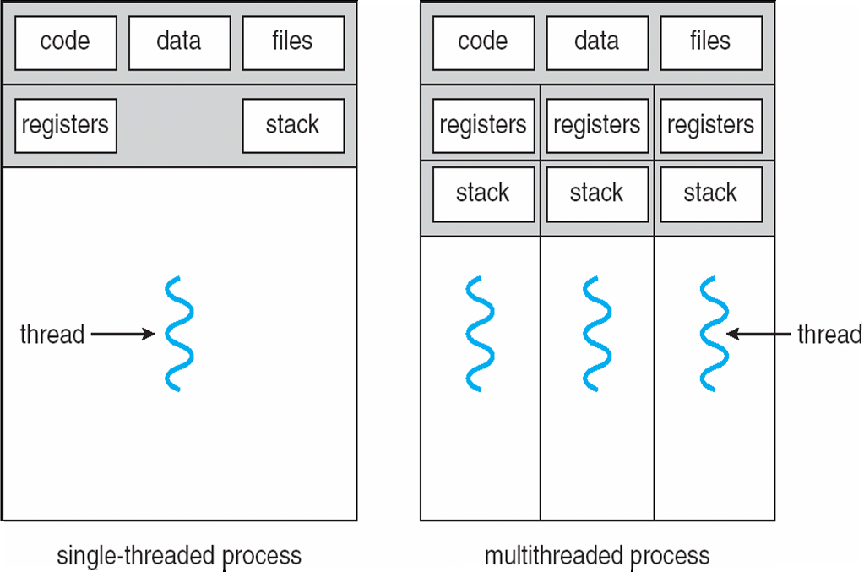
Single and Multithreaded Processes

Slide 5
Benefits
Responsiveness
Resource Sharing
Economy
Scalability

Slide 6
Multicore Programming
Multicore systems putting pressure on programmers, challenges include
Dividing activities
Balance
Data splitting
Data dependency
Testing and debugging

Slide 7
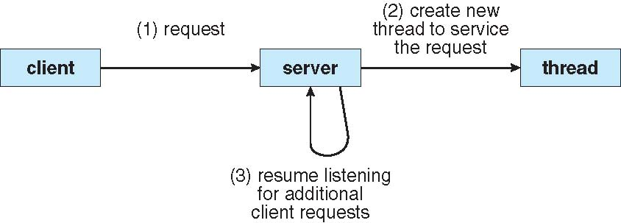
Multithreaded Server Architecture

Slide 8
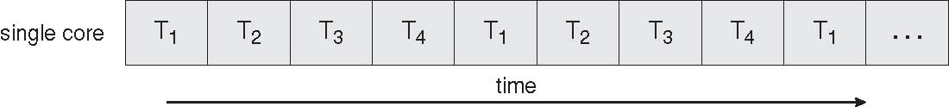
Concurrent Execution on a Single-core System

Slide 9
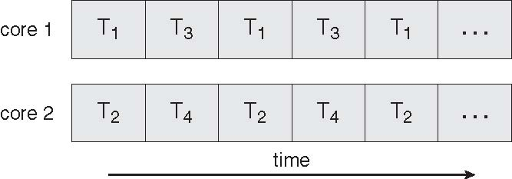
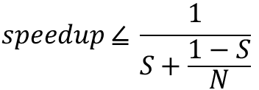
Parallel Execution on a Multicore System
AMDAHL’s Law
$$speedup ⦤ \frac{1}{S+\frac{1−S}{N}}$$

Slide 10
Programming Challenges
Identifying tasks
Balance
Data splitting
Data dependency
Testing and debugging

Slide 11
Types of Parallelism
Data parallelism
Task parallelism

Slide 12
User Threads
Thread management done by user-level threads library
Three primary thread libraries:
POSIX Pthreads
Win32 threads
Java threads

Slide 13
Kernel Threads
Supported by the Kernel
Examples
Windows XP/2000
Solaris
Linux
Tru64 UNIX
Mac OS X

Slide 14
Multithreading Models
Many-to-One
One-to-One
Many-to-Many

Slide 15
Many-to-One
Many user-level threads mapped to single kernel thread
Examples:
Solaris Green Threads
GNU Portable Threads
Linux, …

Slide 16
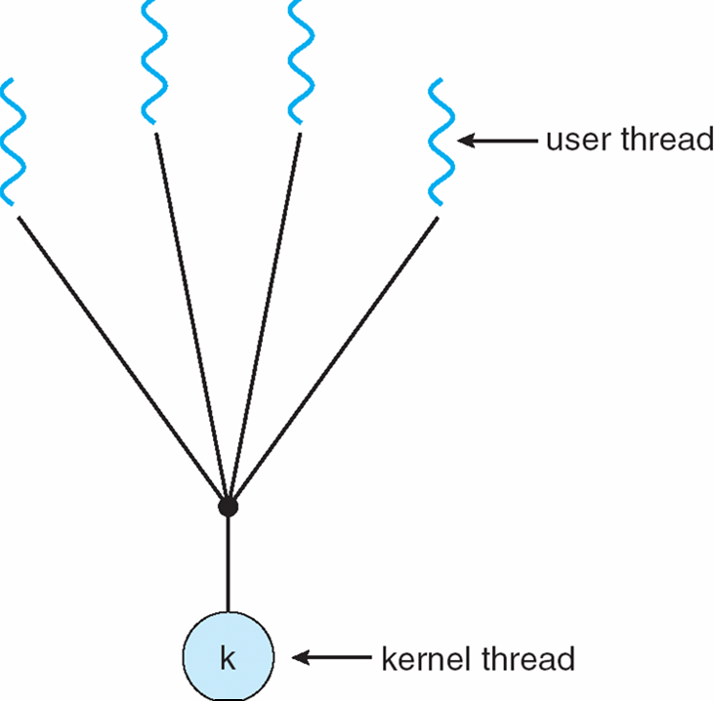
Many-to-One Model

Slide 17
One-to-One
Each user-level thread maps to kernel thread
Examples
Windows NT/XP/2000
Linux
Solaris 9 and later

Slide 18
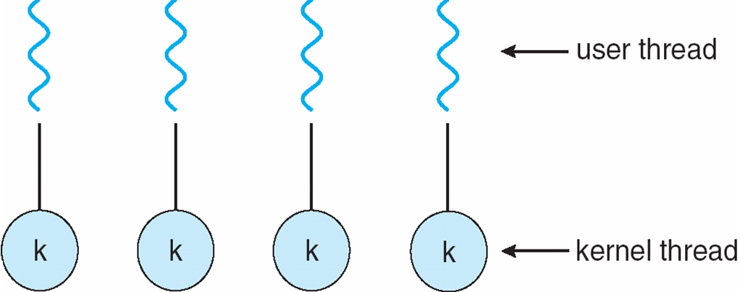
One-to-one Model

Slide 19
Many-to-Many Model
Allows many user level threads to be mapped to many kernel threads
Allows the operating system to create a sufficient number of kernel threads
Solaris prior to version 9
Windows NT/2000 with the ThreadFiber package

Slide 20
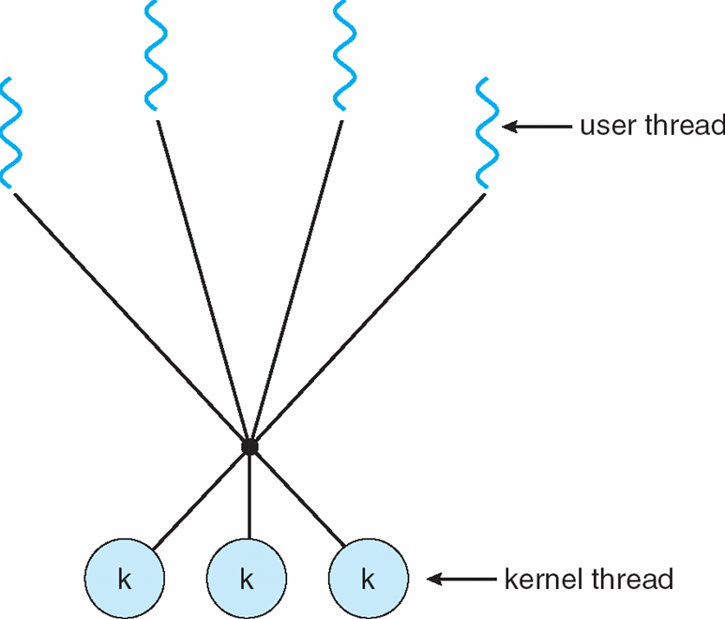
Many-to-Many Model

Slide 21
Two-level Model
Similar to M:M, except that it allows a user thread to be bound to kernel thread
Examples
IRIX
HP-UX
Tru64 UNIX
Solaris 8 and earlier

Slide 22
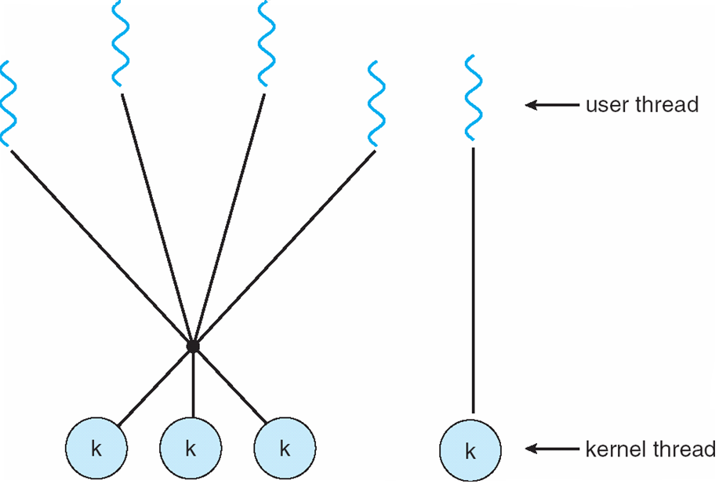
Two-level Model

Slide 23
Thread Libraries
Thread library provides programmer with API for creating and managing threads
Two primary ways of implementing
Library entirely in user space
Kernel-level library supported by the OS

Slide 24
Pthreads
May be provided either as user-level or kernel-level
A POSIX standard (IEEE 1003.1c) API for thread creation and synchronization
API specifies behavior of the thread library, implementation is up to development of the library
Common in UNIX operating systems (Solaris, Linux, Mac OS X)

Slide 25
Java Threads
Java threads are managed by the JVM
Typically implemented using the threads model provided by underlying OS
Java threads may be created by:
Extending Thread class
Implementing the Runnable interface

Slide 26
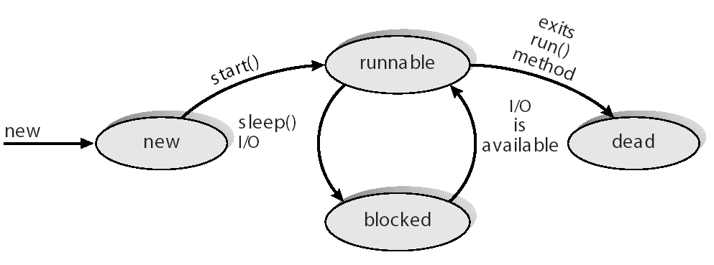
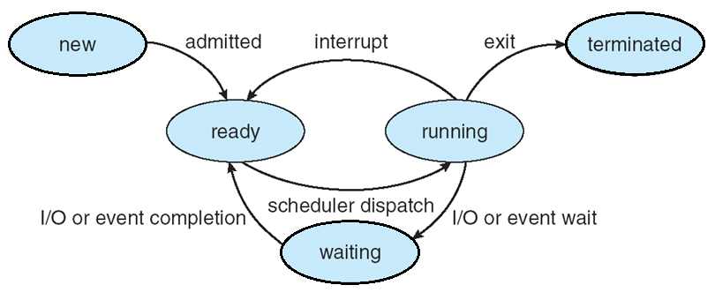
Java Thread States
zombie

Slide 27
Implicit Threading
Transfer the creation and management of threading from developer to compilers and run-time library
Thread Pools
OpenMP
#pragma omp parallel {…}
Grand Central Dispatch (GCD), Apple
^{…}
Threading Building Blocks (TBB), Intel

Slide 28
Thread Pools
Create a number of threads in a pool where they await work
Advantages:
Usually slightly faster to service a request with an existing thread than create a new thread
Allows the number of threads in the application(s) to be bound to the size of the pool
Easier to use different strategies for running the task
Delay or periodically

Slide 29
Threading Issues
Semantics of fork() and exec() system calls
Signal handling
Thread cancellation of target thread
Asynchronous or deferred
Thread-local storage
Scheduler activations

Slide 30
Semantics of fork() and exec()
Does fork() duplicate only the calling thread or all threads?
Notes:
fork() is originally for process.

Slide 31
Signal Handling
Signals are used in UNIX systems to notify a process that a particular event has occurred
A signal handler is used to process signals
Signal is generated by particular event
Signal is delivered to a process
Signal is handled
Options:
Deliver the signal to the thread to which the signal applies
Deliver the signal to every thread in the process
Deliver the signal to certain threads in the process
Assign a specific threa to receive all signals for the process

Slide 32
Thread Cancellation
Terminating a thread before it has finished
Two general approaches:
Asynchronous cancellation terminates the target thread immediately
Deferred cancellation allows the target thread to periodically check if it should be cancelled

Slide 33
Thread–Local Storage
Allows each thread to have its own copy of data
Useful when you do not have control over the thread creation process (i.e., when using a thread pool, but need own transaction ID).
A static data vs. a local variable

Slide 34
Scheduler Activations
Both M:M and Two-level models require communication to maintain the appropriate number of kernel threads allocated to the application
light weight processor (LWP) or virtual processor
Scheduler activations provide upcalls - a communication mechanism from the kernel to the thread library
This communication allows an application to maintain the correct number kernel threads

Slide 35
Operating System Examples
Windows XP Threads
M:M
Linux Thread
Notes:
34

Slide 36
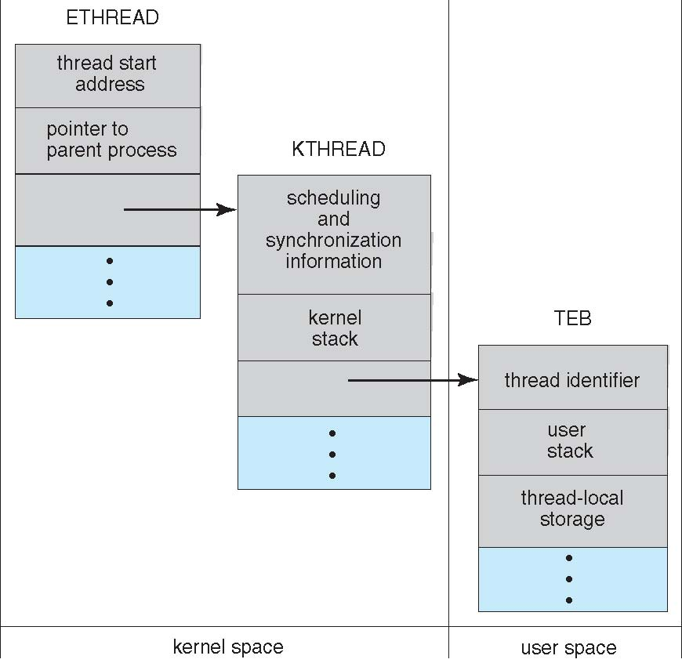
Windows XP Threads
Notes:
ETHREAD = executive thread Block
KTHREAD = kernel thread Block
TEB = Thread Environment Block

Slide 37
Windows XP Threads
Implements the one-to-one mapping, kernel-level
Each thread contains
A thread id
Register set
Separate user and kernel stacks
Private data storage area
The register set, stacks, and private storage area are known as the context of the threads
The primary data structures of a thread include:
ETHREAD (executive thread block)
KTHREAD (kernel thread block)
TEB (thread environment block)

Slide 38
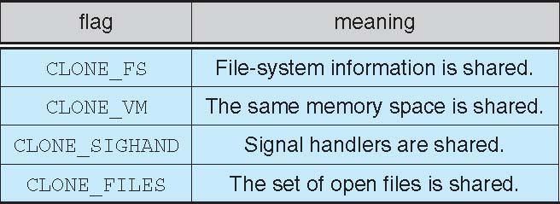
Linux Threads

Slide 39
Linux Threads
Linux refers to them as tasks rather than threads
Thread creation is done through clone() system call
clone() allows a child task to share the address space of the parent task (process)

Slide 40
End of Chapter 4

