Slide 1
Chapter 5: Process Scheduling
Notes:
Project 3

Slide 2
Objectives
To introduce CPU scheduling, which is the basis for multiprogrammed operating systems
To describe various CPU-scheduling algorithms
To discuss evaluation criteria for selecting a CPU-scheduling algorithm for a particular system

Slide 3
Chapter 5: Process Scheduling
Basic Concepts
Scheduling Criteria
Scheduling Algorithms
Thread Scheduling
Multiple-Processor Scheduling
Real-Time CPU Scheduling
Operating Systems Examples
Algorithm Evaluation

Slide 4
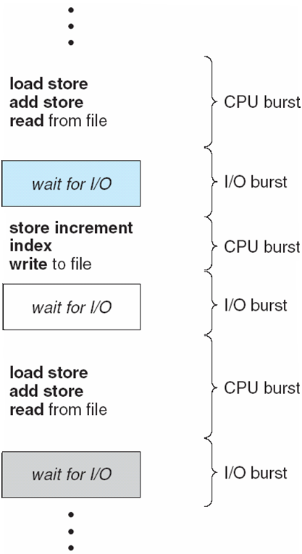
Basic Concepts
Maximum CPU utilization obtained with multiprogramming
CPU–I/O Burst Cycle – Process execution consists of a cycle of CPU execution and I/O wait
CPU burst distribution

Slide 5
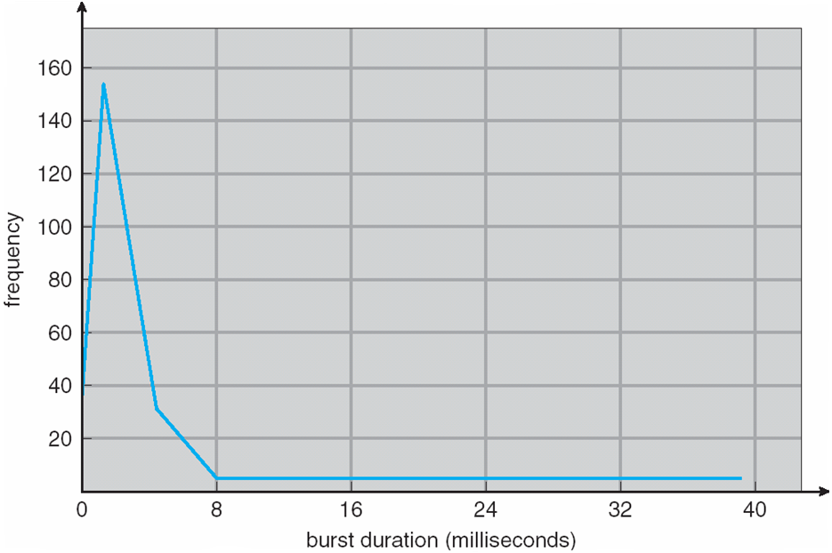
Histogram of CPU-burst Times

Slide 6
CPU Scheduler
Selects from among the processes in memory that are ready to execute, and allocates the CPU to one of them
CPU scheduling decisions may take place when a process:
1. Switches from running to waiting state
2. Switches from running to ready state
3. Switches from waiting to ready
4. Terminates
Scheduling under 1 and 4 is nonpreemptive
All other scheduling is preemptive

Slide 7
Dispatcher
Dispatcher module gives control of the CPU to the process selected by the short-term scheduler; this involves:
switching context
switching to user mode
jumping to the proper location in the user program to restart that program
Dispatch latency – time it takes for the dispatcher to stop one process and start another running

Slide 8
Scheduling Criteria
CPU utilization – keep the CPU as busy as possible
Throughput – # of processes that complete their execution per time unit
Turnaround time – amount of time to execute a particular process
Waiting time – amount of time a process has been waiting in the ready queue
Response time – amount of time it takes from when a request was submitted until the first response is produced, not output (for time-sharing environment)

Slide 9
Scheduling Algorithm Optimization Criteria
Max CPU utilization
Max throughput
Min turnaround time
Min waiting time
Min response time

Slide 10
First-Come, First-Served (FCFS) Scheduling
Process Burst Time
P₁ 24
P₂ 3
P₃ 3
Suppose that the processes arrive in the order: P₁ , P₂ , P₃ The Gantt Chart for the schedule is:
Waiting time for P₁ = 0; P₂ = 24; P₃ = 27
Average waiting time: (0 + 24 + 27)/3 = 17
P₁
P₂
P₃
0
24
27
30

Slide 11
FCFS Scheduling (Cont.)
Suppose that the processes arrive in the order
P₂ , P₃ , P₁
The Gantt chart for the schedule is:
Waiting time for P₁ = 6; P₂ = 0; P₃ = 3
Average waiting time: (6 + 0 + 3)/3 = 3
Much better than previous case
Convoy effect short process behind long process
P₂
P₃
P₁
0
3
6
30

Slide 12
Shortest-Job-First (SJF) Scheduling
Associate with each process the length of its next CPU burst. Use these lengths to schedule the process with the shortest time
Two schemes:
nonpreemptive – once CPU given to the process it cannot be preempted until completes its CPU burst
preemptive – if a new process arrives with CPU burst length less than remaining time of current executing process, preempt.
This scheme is know as the Shortest-Remaining-Time-First (SRTF)
SJF is optimal – gives minimum average waiting time for a given set of processes

Slide 13
Example of Non-Preemptive SJF
Process Arrival Time Burst Time
P₁ 0.0 7
P₂ 2.0 4
P₃ 4.0 1
P₄ 5.0 4
SJF (non-preemptive)
Average waiting time = (0 + 6 + 3 + 7)/4 = 4
P₁
P₃
P₂
P₄
0
3
7
8
12
16

Slide 14
Example of Preemptive SJF
Process Arrival Time Burst Time
P₁ 0.0 7
P₂ 2.0 4
P₃ 4.0 1
P₄ 5.0 4
SJF (preemptive)
Average waiting time = (9 + 1 + 0 + 2)/4 = 3
P₁
P₂
P₃
P₂
P₄
P₁
0
2
4
5
7
11
16

Slide 15
Determining Length of Next CPU Burst
Can only estimate the length
Can be done by using the length of previous CPU bursts, using exponential averaging

Slide 16
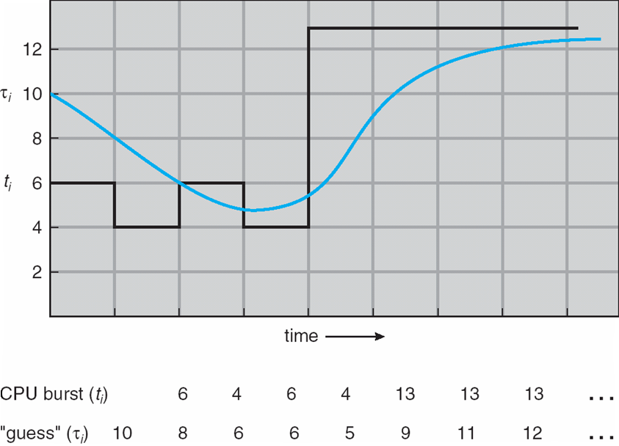
Prediction of the Length of the Next CPU Burst

Slide 17
Examples of Exponential Averaging
α =0
τ_{n+1} = τ_{n}
Recent history does not count
α =1
τ_{n+1} = α t_{n}
Only the actual last CPU burst counts
If we expand the formula, we get:
τ_{n+1} = α t_{n}+(1 - α)α t_{n-1} + …
+(1 - α )^{j} α t_{n-j} + …
+(1 - α )^{n +1} τ₀
Since both α and (1 - α) are less than or equal to 1, each successive term has less weight than its predecessor

Slide 18
Priority Scheduling
A priority number (integer) is associated with each process
The CPU is allocated to the process with the highest priority (smallest integer ≡ highest priority)
Preemptive
nonpreemptive
SJF is a priority scheduling where priority is the predicted next CPU burst time
Problem ≡ Starvation – low priority processes may never execute
Solution ≡ Aging – as time progresses increase the priority of the process

Slide 19
Round Robin (RR)
Each process gets a small unit of CPU time (time quantum), usually 10-100 milliseconds. After this time has elapsed, the process is preempted and added to the end of the ready queue.
If there are n processes in the ready queue and the time quantum is t, then each process gets 1/n of the CPU time in chunks of at most t time units at once. No process waits more than (n-1)t time units.
Performance
t large ⇒ FIFO
t small ⇒ t must be large with respect to context switch, otherwise overhead is too high

Slide 20
Example of RR with Time Quantum = 20
Process Burst Time
P₁ 53
P₂ 17
P₃ 68
P₄ 24
The Gantt chart is:
Typically, higher average turnaround than SJF, but better response
P₁
P₂
P₃
P₄
P₁
P₃
P₄
P₁
P₃
P₃
0
20
37
57
77
97
117
121
134
154
162

Slide 21
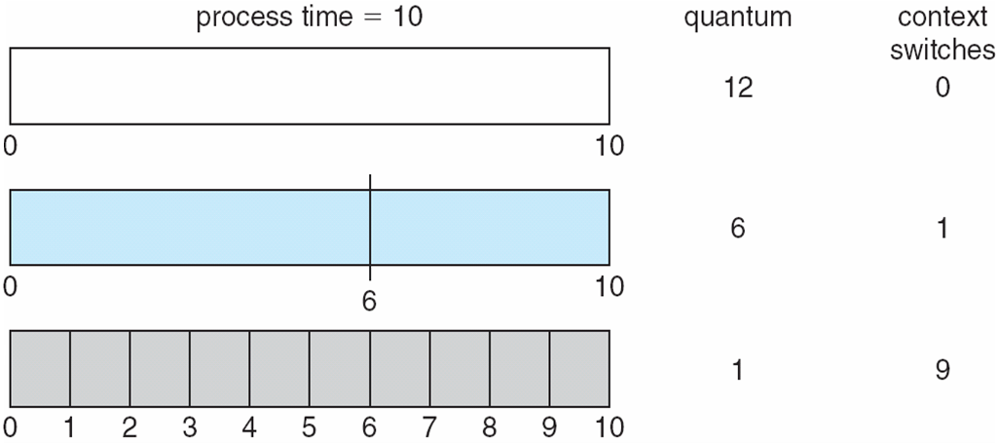
Time Quantum and Context Switch Time

Slide 22
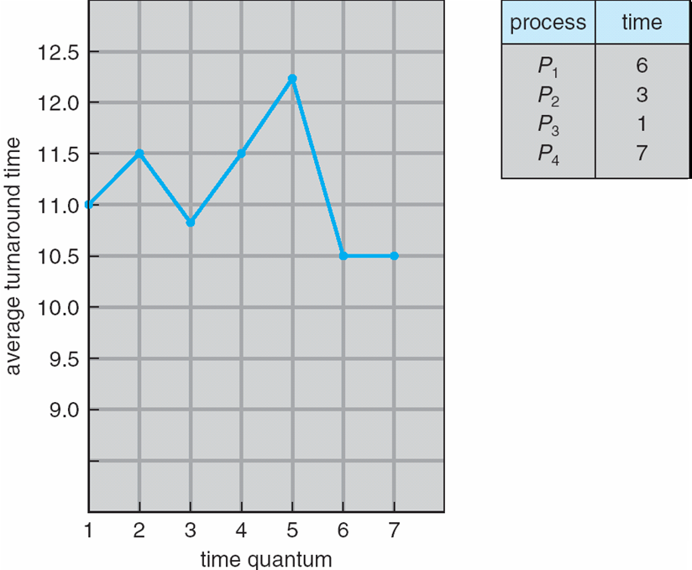
Turnaround Time Varies With The Time Quantum
Notes:
What is the ideal pattern?

Slide 23
Multilevel Queue
Ready queue is partitioned into separate queues: foreground (interactive) background (batch)
Each queue has its own scheduling algorithm
foreground – RR
background – FCFS
Scheduling must be done between the queues
Fixed priority scheduling; (i.e., serve all from foreground then from background). Possibility of starvation.
Time slice – each queue gets a certain amount of CPU time which it can schedule amongst its processes; i.e., 80% to foreground in RR
20% to background in FCFS

Slide 24
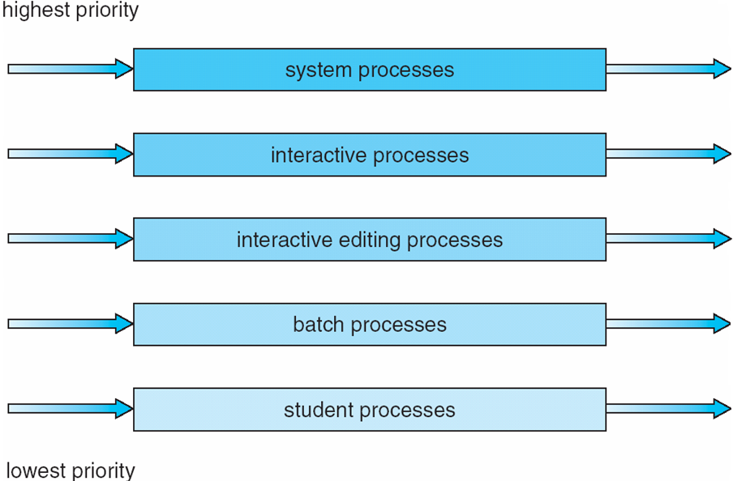
Multilevel Queue Scheduling

Slide 25
Multilevel Feedback Queue
A process can move between the various queues; aging can be implemented this way
Multilevel-feedback-queue scheduler defined by the following parameters:
number of queues
scheduling algorithms for each queue
method used to determine when to upgrade a process
method used to determine when to demote a process
method used to determine which queue a process will enter when that process needs service

Slide 26
Example of Multilevel Feedback Queue
Three queues:
Q₀ – RR with time quantum 8 milliseconds
Q₁ – RR time quantum 16 milliseconds
Q₂ – FCFS
Scheduling
A new job enters queue Q₀ which is served FCFS. When it gains CPU, job receives 8 milliseconds. If it does not finish in 8 milliseconds, job is moved to queue Q₁.
At Q₁ job is again served FCFS and receives 16 additional milliseconds. If it still does not complete, it is preempted and moved to queue Q₂.

Slide 27
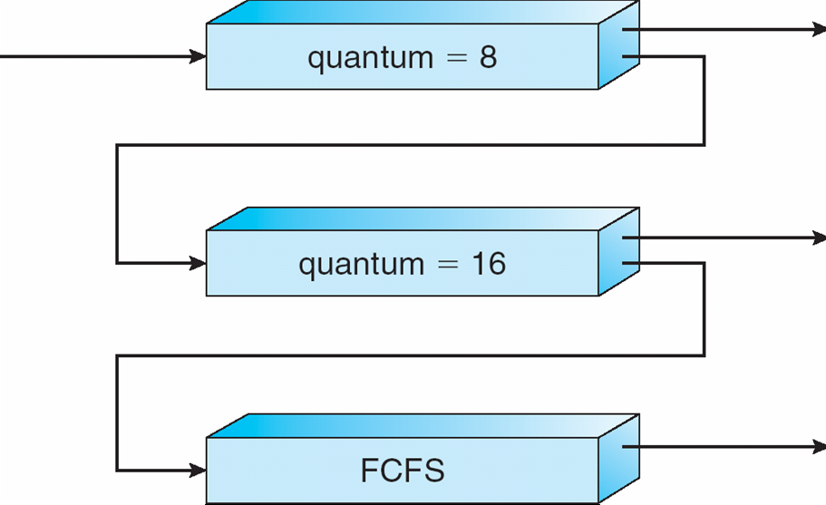
Multilevel Feedback Queues

Slide 28
Thread Scheduling
Distinction between user-level and kernel-level threads
Many-to-one and many-to-many models, thread library schedules user-level threads to run on LWP
Known as process-contention scope (PCS) since scheduling competition is within the process
Kernel thread scheduled onto available CPU is system-contention scope (SCS) – competition among all threads in system

Slide 29
Pthread Scheduling
API allows specifying either PCS or SCS during thread creation
PTHREAD SCOPE PROCESS schedules threads using PCS scheduling
PTHREAD SCOPE SYSTEM schedules threads using SCS scheduling.

Slide 30
Pthread Scheduling API (1/2)
#include <pthread.h>
#include <stdio.h>
#define NUM THREADS 5
int main(int argc, char *argv[])
{
int i;
pthread_t tid[NUM THREADS];
pthread_attr_t attr;
/* get the default attributes */
pthread_attr_init(&attr);
/* set the scheduling algorithm to PROCESS or SYSTEM */
pthread_attr_setscope(&attr, PTHREAD_SCOPE_SYSTEM);
/* set the scheduling policy - FIFO, RT, or OTHER */
pthread_attr_setschedpolicy(&attr, SCHED_OTHER);
/* create the threads */
for (i = 0; i < NUM_THREADS; i++)
pthread_create(&tid[i],&attr,runner,NULL);

Slide 31
Pthread Scheduling API (2/2)
/* now join on each thread */
for (i = 0; i < NUM_THREADS; i++)
pthread_join(tid[i], NULL);
}
/* Each thread will begin control in this function */
void *runner(void *param)
{
printf("I am a thread\n");
pthread_exit(0);
}

Slide 32
Multiple-Processor Scheduling
CPU scheduling more complex when multiple CPUs are available
Homogeneous processors within a multiprocessor
Asymmetric multiprocessing – only one processor accesses the system data structures, alleviating the need for data sharing
Symmetric multiprocessing (SMP) – each processor is self-scheduling, all processes in common ready queue, or each has its own private queue of ready processes
Processor affinity – process has affinity for processor on which it is currently running
soft affinity
hard affinity

Slide 33
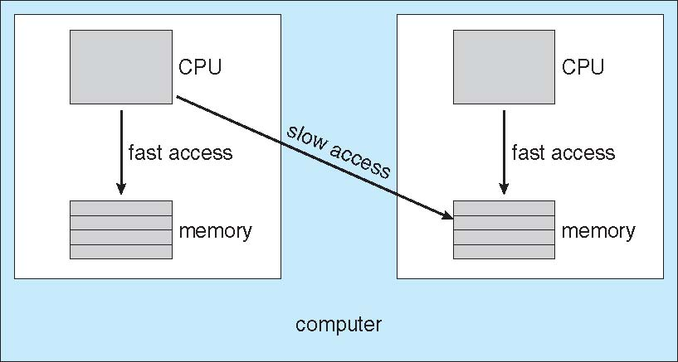
NUMA and CPU Scheduling

Slide 34
Multicore Processors
Recent trend to place multiple processor cores on same physical chip
Faster and consume less power
Multiple threads per core also growing
Takes advantage of memory stall to make progress on another thread while memory retrieve happens

Slide 35
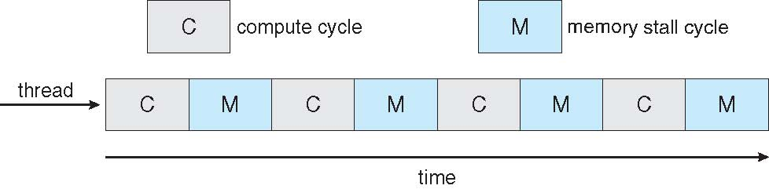
Multithreaded Multicore System

Slide 36
Real-Time Scheduling
Hard real-time systems – required to complete a critical task within a guaranteed amount of time
Soft real-time computing – requires that critical processes receive priority over less fortunate ones
Firm real-time computing – the timing constraints can be changed on-line

Slide 37
Real-Time Systems
.
Value
Deadline
Soft RTS
Hard RTS
FirmRTS
Time
-Value

Slide 38
Real-Time Task Model
Periodic Task Model
parameters are known a priori
request time ready time
deadline
start
finish
preempt
resume
period
worst-case execution time
Predictability vs. Schedulability
high predictability and schedulability
easy-to-check schedulability condition
Admission Control, rate

Slide 39
Scheduling Approaches
Time-Driven Scheduling Approach
widely used
inflexible, efficient
large space needed
e.g. cyclic executive
Priority-Driven Scheduling Approach
dynamic-priority
e.g. earliest deadline first
fixed-priority
e.g. rate monotonic

Slide 40
Periodic Real-Time Schedulers
Earliest Deadline First : optimal dynamic-priority scheduler
job with earlier deadline gets higher priority
schedulability condition
ρ (Τ) = ≤ 1
Rate Monotonic : optimal fixed-priority scheduler
job with smaller period gets higher priority
schedulability condition
ρ (Τ) ≤ n (2^{1/n}- 1)
n→∞, ㏑2 ≅ 0.69

Slide 41
Proportional Share Scheduling
Share among all tasks
Admission-control policy

Slide 42
Operating System Examples
Solaris scheduling
Windows XP scheduling
Linux scheduling

Slide 43
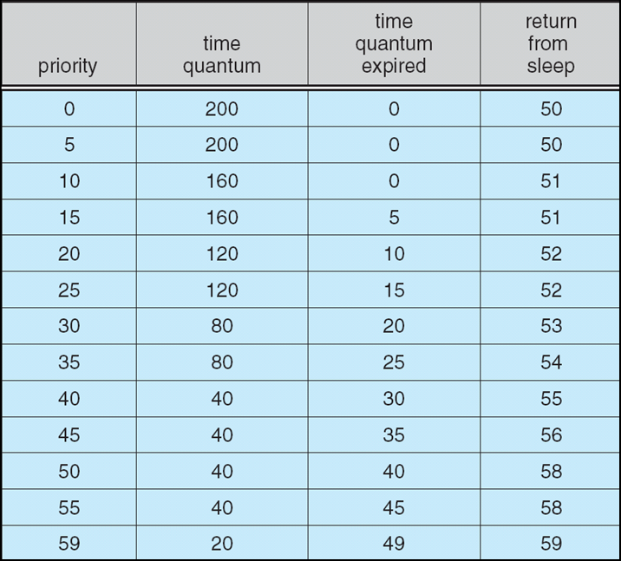
Solaris Dispatch Table

Slide 44
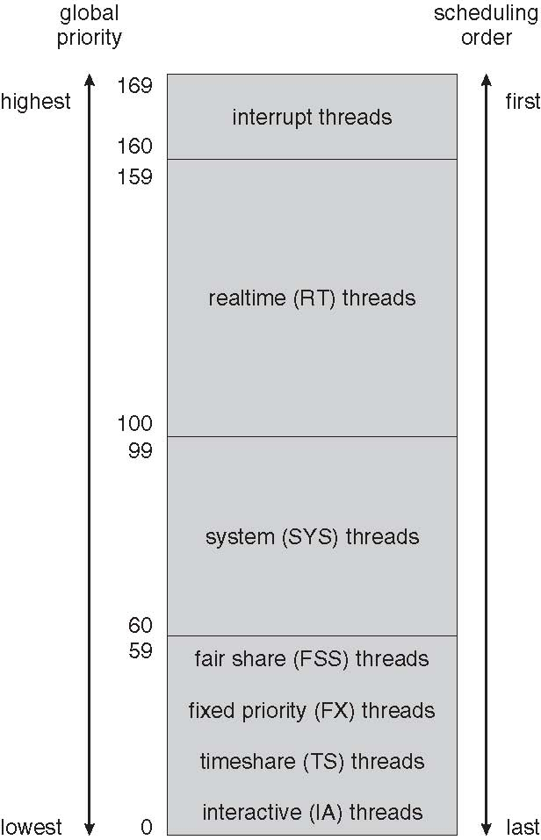
Solaris Scheduling

Slide 45
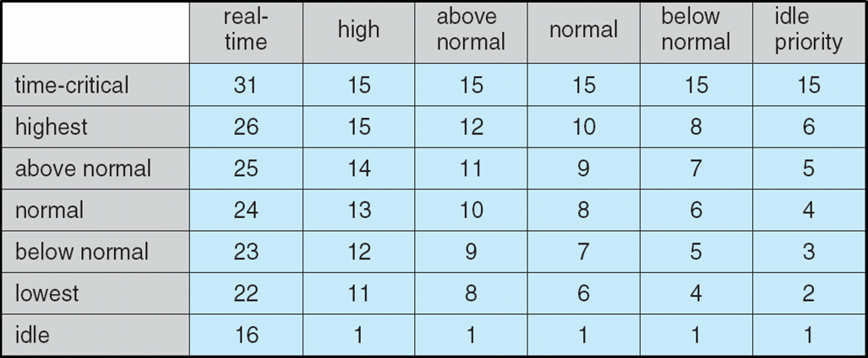
Windows XP Priorities

Slide 46
Linux 2.5 Scheduling
Constant order O(1) scheduling time, 2 queues
Two priority ranges : time-sharing and real-time
Time-sharing
Prioritized credit-based – process with most credits is scheduled next
Credit subtracted when timer interrupt occurs
When credit = 0, another process chosen
When all processes have credit = 0, recrediting occurs
Based on factors including priority and history
Real-time
Soft real-time
Posix.1b compliant – two classes, FCFS and RR
Highest priority process always runs first

Slide 47
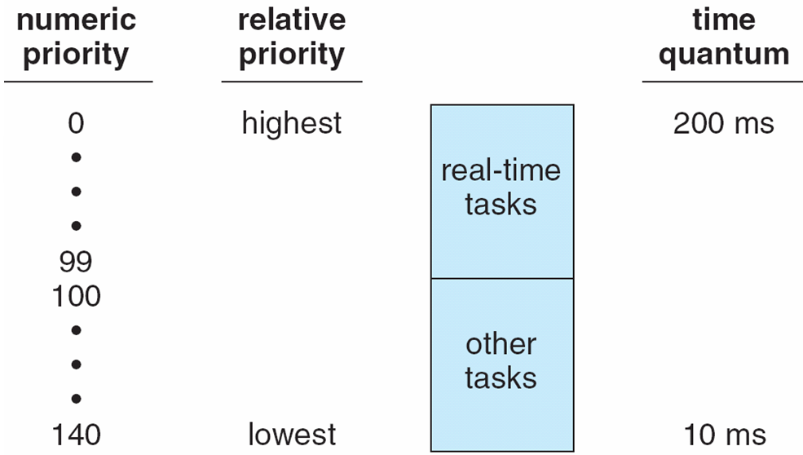
Priorities and Time-slice length

Slide 48
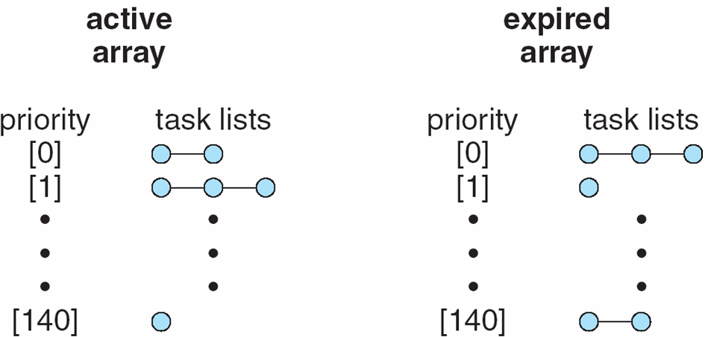
List of Tasks Indexed According to Priorities

Slide 49
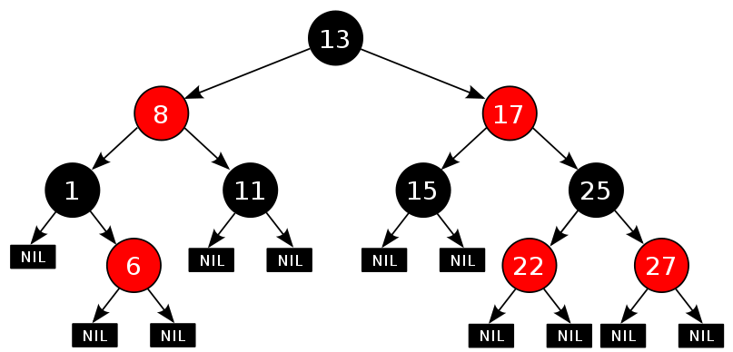
Linux 2.6 Scheduling
Completely Fair Scheduling, red-black tree of vruntime, O(lgN)
Cache the rb-leftmost
Notes:
Brain Fuck Scheduling

Slide 50
Algorithm Evaluation
Deterministic modeling – takes a particular predetermined workload and defines the performance of each algorithm for that workload
Queuing models
Simulation
Emulation
Implementation

Slide 51
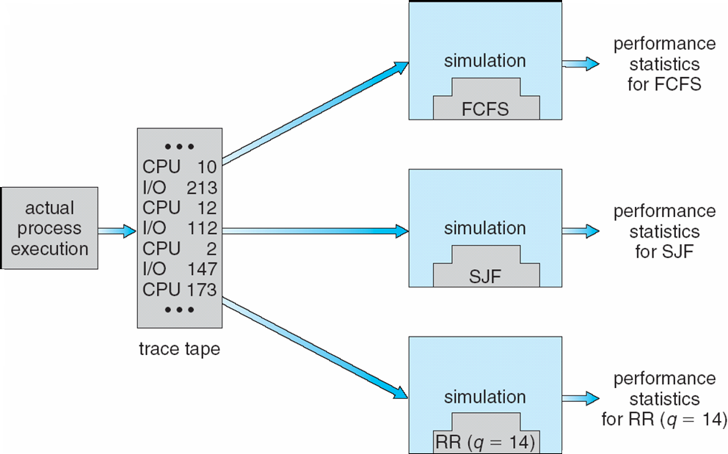
Evaluation of CPU schedulers by Simulation

Slide 52
End of Chapter 5

