Slide 1

MIPS
Pipeline version
2017 Spring, Computer Architecture
Final Project Proposal
NTUEE Group 4
B03901010 周子萱
B03901017 董子維
B03901111 汪家銘

Slide 2
Outline
Baseline
MIPS
Cache
Hazard & forwarding
Extension
Branch prediction
L2 cache
Assembly
Multiplication & Division

Slide 3
Baseline
Base

Slide 4
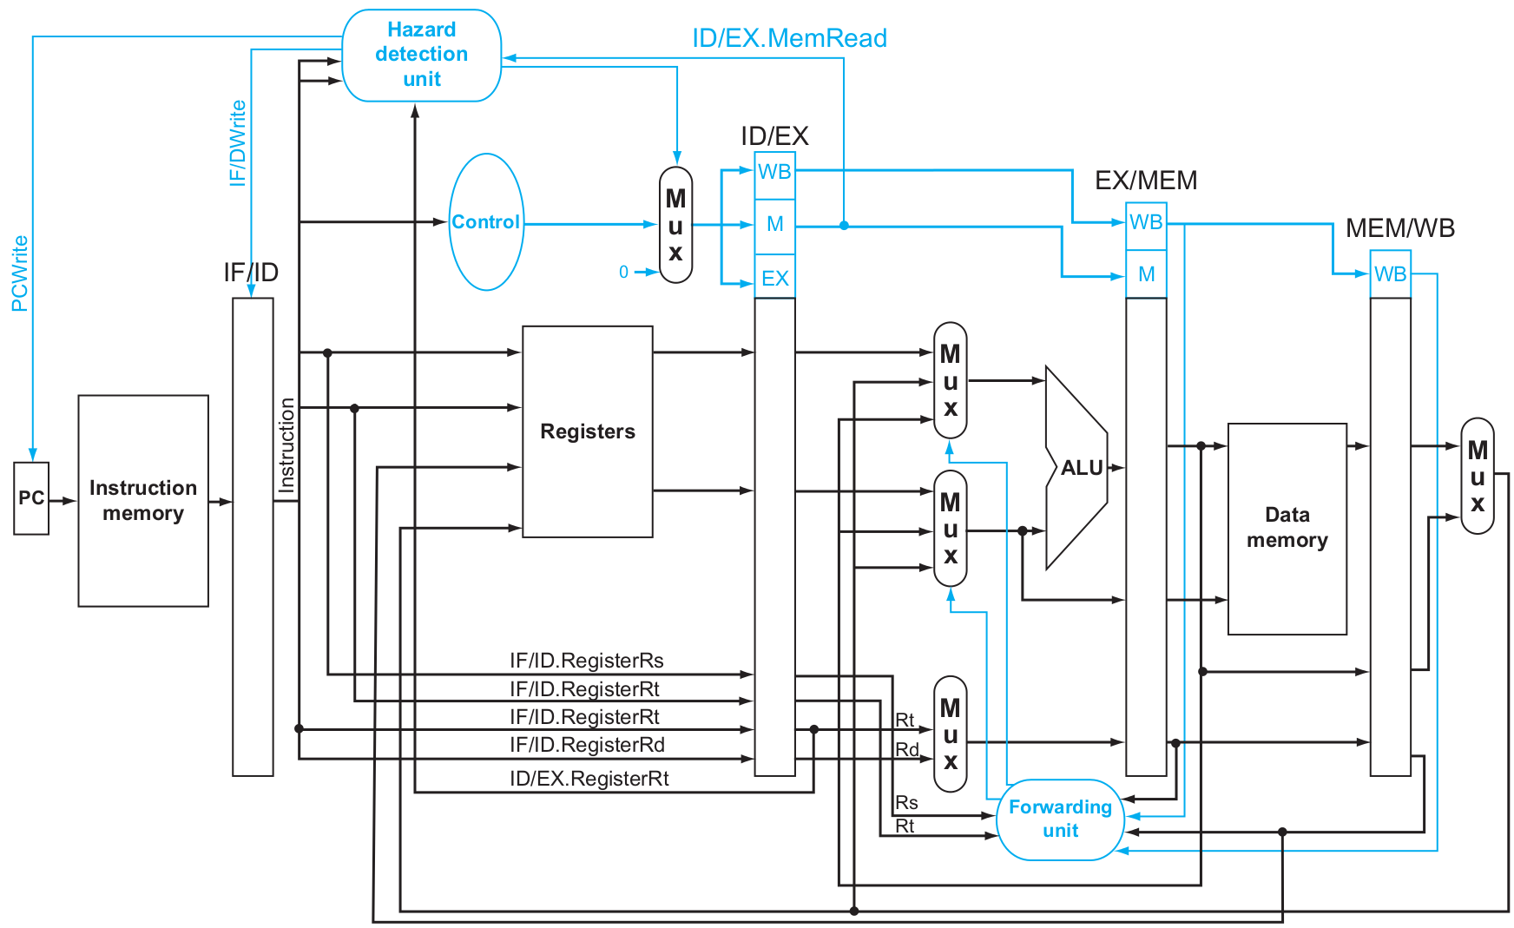
MIPS
Pipeline version
Rewire
Sequential part included
Hazard & Forwarding
Instruction set expending
I-type, jalr
Shift type (shamt)
Alu expend
Notes:
Rewire:
命名不同，register feed submodule，注意時序
Hazard & Forwarding:
避免NOP(bubble)產生，需要多次設計→better coding style = smaller & faster
Instruction set expending
Jalr: jump and link register，存放PC_next在指定register

Slide 5

MIPS
Problems
Time
Time + Liver
Time + Liver + Eyes + Back + …..

Slide 6
Cache
Instruction
MIPS
I Cache
I-cache, D-cache
Write back
Same as HW5
Port reconnection
D Cache
Data
Notes:
Baseline: I-cache, D-cache same as HW5 direct mapped(?) write back done(?)

Slide 7
Extension
Exten

Slide 8
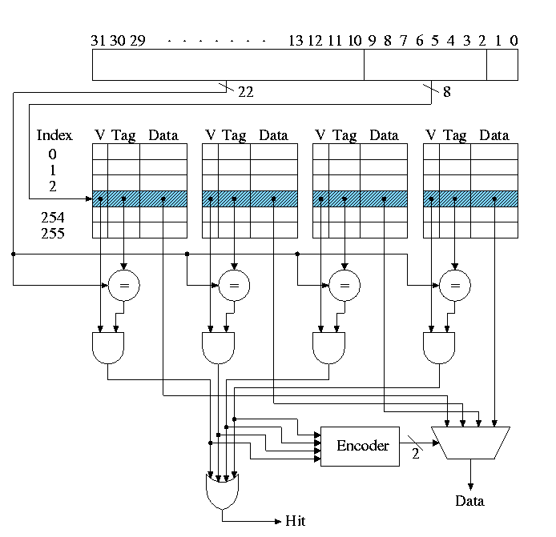
L2 cache
Chip
256 words
Memory interface
Low collision vs. Extra tag
n way associative
LRU + write back
future work
Customize for Inst vs. Data
Instruction
MIPS
I Cache
I Cache
D Cache
I Cache
Data
L1 Cache
L2 Cache
Notes:
64 blocks 4 words ??? (words的決定是不是和memory interface有關???) n way(?) (比較好嗎???) LRU(如果要做n way???) write back future work

Slide 9
Branch Prediction
Early stage branch prediction
At EX stage
2-bits predictor
Easy implement
Suit for multiple situation
Notes:
先期應用：
在Baseline MIPS的基礎上，將Branch Prediction的位置前移到EX階段。
後期目標：
將Branch Prediction Controler獨立出來，應用2-Bit Predictor。

Slide 10
Assembly
Self-design assembly compiler
Branch location assignment
Two stage compile
Finish location assignment at second stage
Notes:
使用c++自己寫轉換程式(前半已經ok)
修改DSP中的parser，首先將作業2中的文件讀入取token，對應課本前面的table轉換成數字，再轉換成十六進制的inst.
(尚未完成)主要難點有兩點。第一點是spim中的syscall要刪掉。第二點是位置的確定，例如“bge $s2, $s3, Devide”中，Devide就要改成絕對位置或相對位置，這個要另外設定parse。

Slide 11
Multiplication & Division
Textbook version: multi-cycles
Extra optimization
Wallace tree
Booth’s encoding
Blah blah blah
If still have time……

