Slide 1


Building the End-to-End AI Ecosystem
From Infrastructure to Intelligent Agents — Connecting Global AI Technology with Local Partners
COMPANY PROFILE
1

Slide 2



WHO WE ARE
“Eco” means Ecosystem
EcoTech helps AI technology companies expand into overseas markets. We connect software and hardware, and partner with local players on the ground — together building an AI ecosystem that truly takes root.
One Ecosystem,
Four Layers Deep
Data Center · Server · LLM · Agent — EcoTech delivers a complete portfolio from the ground up.
Overseas Expansion
Software + Hardware
Local Partners
We help AI technology companies enter and grow in new markets.
We connect the full technology stack, not just one layer of it.
We work with on-the-ground partners to make deployment real.
2

Slide 3




OUR APPROACH
An End-to-End AI Ecosystem, Layer by Layer
To build a real AI ecosystem, EcoTech provides a complete product portfolio — from the foundational infrastructure to the intelligent applications running on top of it.
1
AI Data Center
Power system & Cooling system
2
Servers
AI & traditional server hardware
3
Large Language Models
Open & closed-source model access
4
Agents
Intelligent products that get work done
3
→ Layers 1–4 explored in detail on the following pages

Slide 4



LAYER 1 · FOUNDATION
AI Data Center
That modular, ever-growing power demand means: heavier electrical load to manage, more heat to remove, and greater risk if the grid drops. That is exactly the gap our four product lines close.
Why power density changes everything
Traditional DC
< 1 MW, single block
AI Data Center
+3 MW
+3 MW
+3 MW
+ ...
UPS + Battery
Precision Air Conditioning (PAC)
Generator Sets
3 MW is the traditional UPS/breaker building block. AI facilities scale by adding more of it as GPU rack demand grows — 3, 6, 9 MW and beyond, not one fixed size.
Reliable backup power for heavier, more critical loads
Removes the extra heat that high-density racks generate
Continuity when the grid fails — the stakes are higher now
We sell the power and cooling backbone that scales with the facility, block by block.
4

Slide 5

LAYER 2 · COMPUTE
Servers
With power and cooling in place, the next layer is the hardware that actually runs AI workloads.
AI Server
Traditional Server
Server brands in the market
GPU + NPU + CPU
CPU only
Leading server brands available in today’s market.
Dell
We sell both — matched to what each workload actually needs.
HP
A global chip & memory shortage
Supermicro
NVIDIA leads GPUs; Huawei leads AI accelerators (Ascend NPUs); Samsung leads memory — all in constrained supply. We sell the servers built around them, so this scarcity still shapes what we can deliver.
Gigabyte
Huakun
5

Slide 6


LAYER 3 · INTELLIGENCE
Large Language Models
Hardware needs a brain. This is where AI compute becomes AI capability.
Closed-Source
Open-Source
The key insight
Because closed-source models are bound to a single cloud, they can’t be privately deployed. So when a client needs on-premise or private deployment, what we actually sell is open-source model deployment and integration — not the model itself.
Claude · Gemini · OpenAI · Doubao
Qwen · DeepSeek · GLM · Kimi
Each is tied to one cloud: AWS–Claude, GCP–Gemini, Azure–OpenAI. Great for API use, but not available for private deployment.
Not locked to one cloud — can be self-hosted for free on infrastructure the client controls. Note: several open-source families (e.g. Qwen, DeepSeek) also ship a closed-source hosted version of the same model.
Three ways to buy tokens for closed-source models
Open-source is free to self-host — these channels are for paid, closed-source access.
1
Direct from the model provider
2
Via OpenRouter
3
Via a cloud provider
6

Slide 7








LAYER 4 · APPLICATION
Agents
The model becomes useful once it can act. An agent turns one instruction into a finished workflow.
Our five agent scenarios
Example: User says, “I want to buy clothes”
Open Shopping App
Reads purchase history, search history & OOTD
MyVoice.AI
Yusys Technologies
AI Transcend
Auto-recommends and prepares the order
AI contact center
Vibe coding agent
Customer engagement agent
Human confirms payment
TalkCloud
RivereTech
Online class platform
Credit card, risk control & agent platform
7

Slide 8
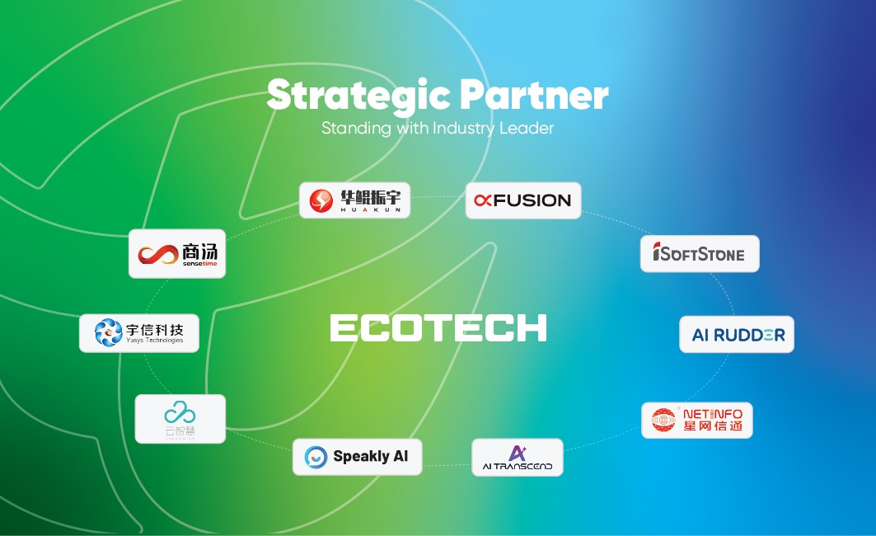
OUR PARTNERS
Working Across the Full Stack
EcoTech partners with leading names at every layer we sell — from data center hardware to applications.
8

Slide 9

OUR VISION
Beyond Reselling — Toward Our Own Agent Platform
The four-layer portfolio is not the destination — it is how we get there.
→
→
→
→
Sell Data Center
Sell Servers
Sell LLM Token
Sell Agents
Our Own
Agent Platform
Every product we sell today builds the experience, relationships, and knowledge that get us there — one step at a time.
9

Slide 10
Thank You
EcoTech — Connecting AI Infrastructure to Local Ecosystems
10

