Slide 1


SurveyAPK 5.0
VS.

Slide 2
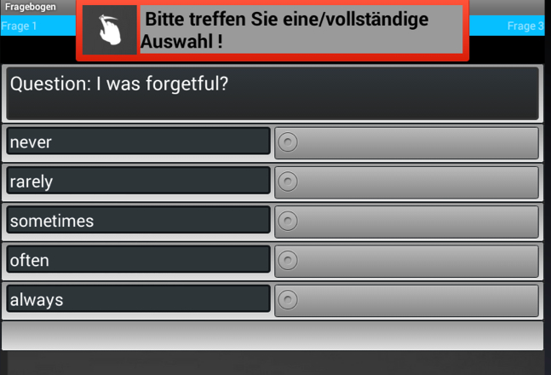
Input Control

Slide 3
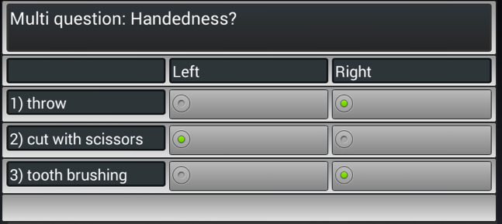
Multi questions

Slide 4
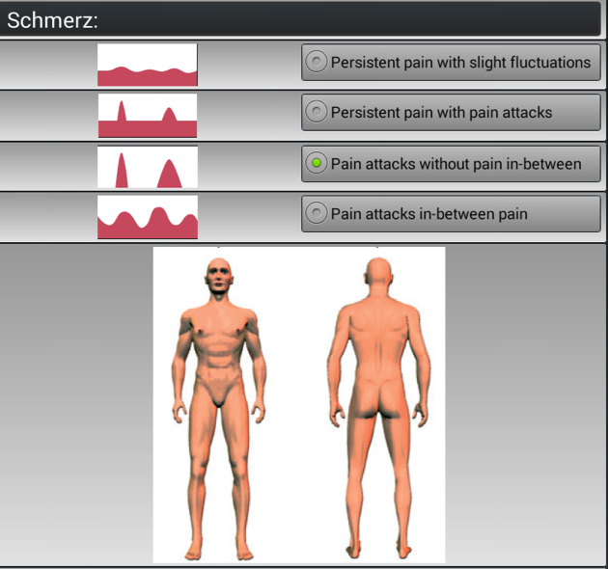
Images

Slide 5
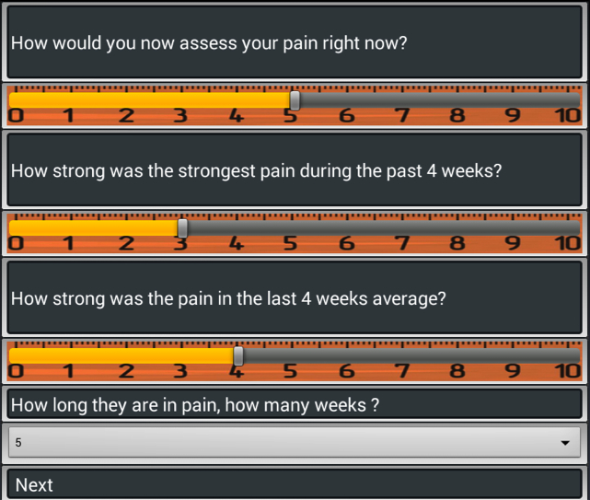
Slider

Slide 6
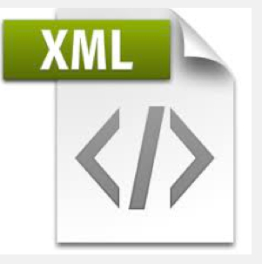
Protocols:
English
handiness
BDI
Deutsch
STAI-X
Händigkeit
BDI
STAI-X
Routine

Slide 7
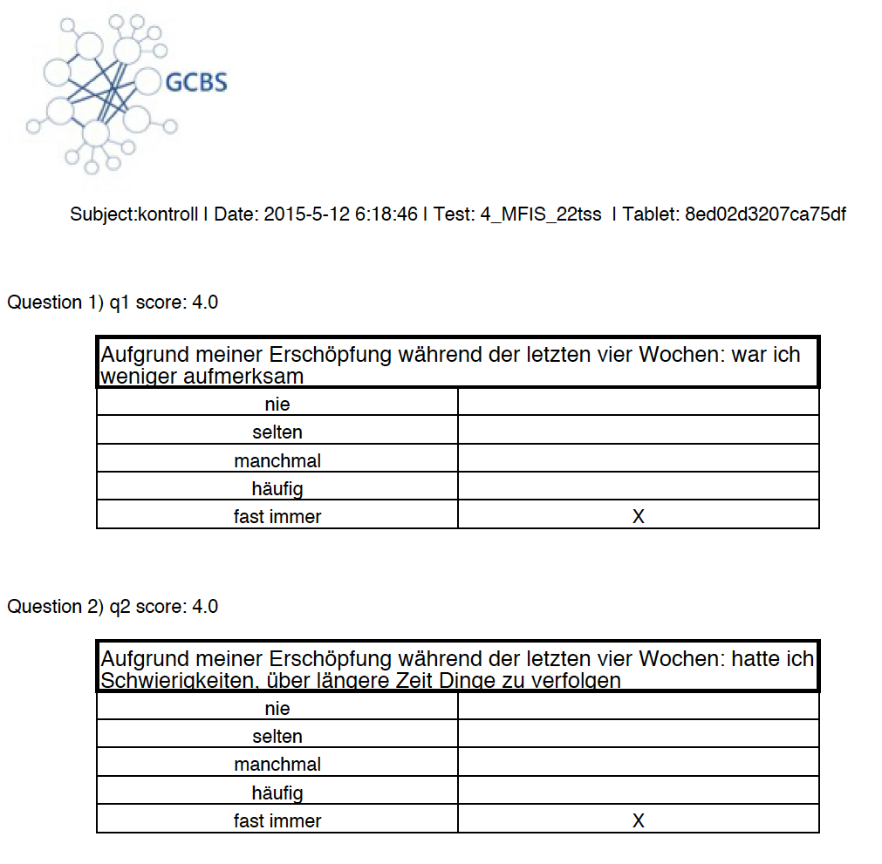
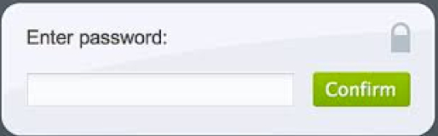



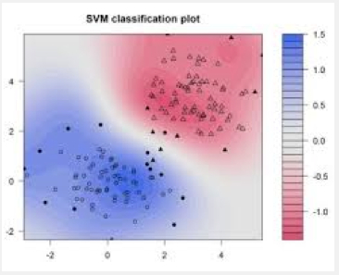


Slide 8

Signature

Slide 9
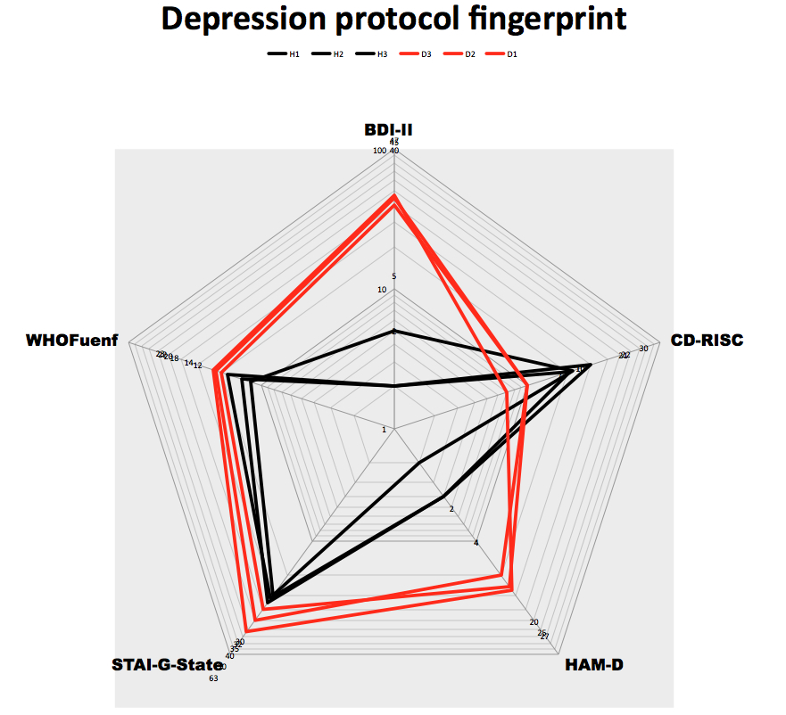
Instant results: Clustering and Datamining

Slide 10


