Slide 1
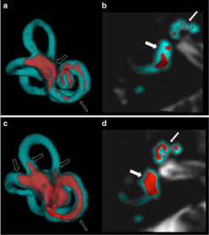
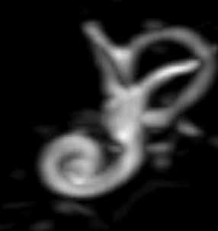
Progress Presentation
Fingerprinting Endolymphatic Hydrops using fMRI Information
5. Feb . 2016
Albert Berman and Fatemeh Nejat
Department of Neuroradiology
LMU

Slide 2






Initial Plan

Slide 3
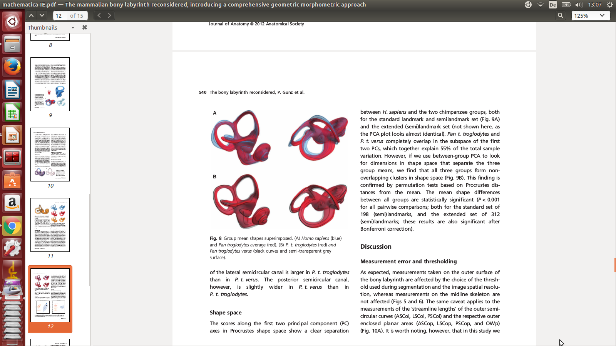
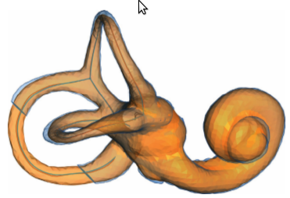
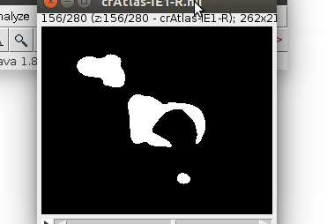
Automatic measurment of the labyrinth using Image registration and a deformable inner ear Atlas
Gary E Christensen
Leipzig Academic Radiology
2003
Goal: Deforming an atlas into a subject’s data in order to create a new individualized atlas

Slide 4
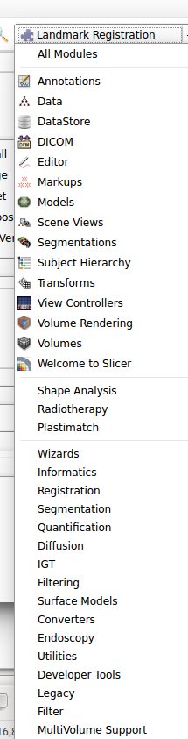

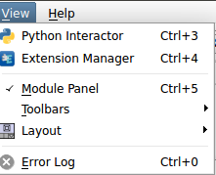

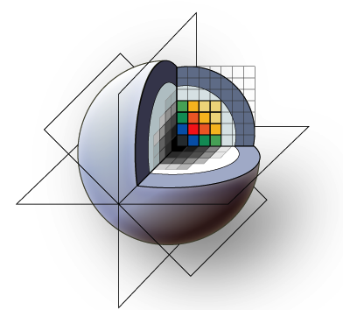
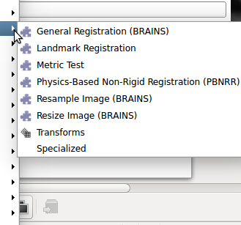

Slide 5






Model
FMRI
Size: 192 183 187
Contrast
Enhanced
Region
Atlas
Size:262 213 280
262.213.280

Slide 6
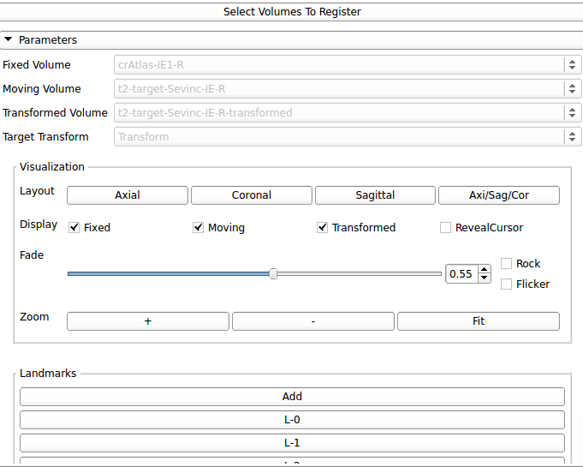
Landmark based
deforming a brain atlas into a subject’s brain in order to create a new individualized brain atlas

Slide 7
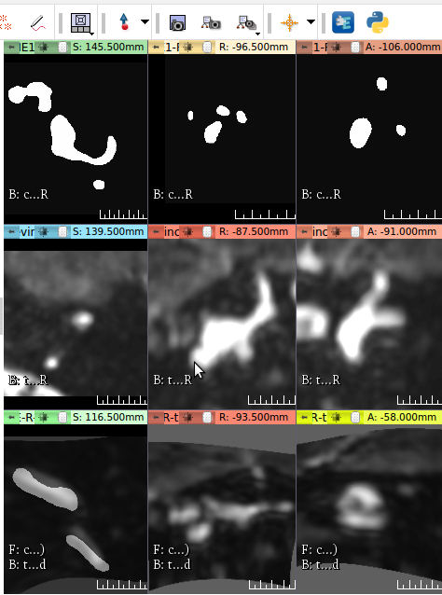

Landmark based
Landmark based

Slide 8
Bspline and Deformable
Evaluation of Plastimatch B-Spline Registration, Gregory Sharp. Drexel University, PA
Plastimatch is an open source software for image computation.
B-spline method for deformable image registration.
Landmark penalty function for B-spline registration.
Plastimatch is available as an Extension (plug-in) for 3D Slicer.

Slide 9
Demo

Slide 10









Pipeline

Slide 11
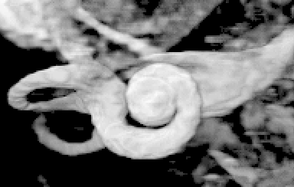
Thank you for your time :)

