Slide 1
Development
Runtime
Clojure
Bytecode
Machine Code
Groovy
…
Java
Programming Language Source Files
Machine independent Bytecode
Machine dependent executable code
Interpreted by the JIT (Just in Time Compiler)
Compiled into Bytecode

Slide 2
Stack
Free memory available
Memory available to a process
Heap
Data
Text

Slide 3
main()
The first method invoked
The current stack
printf()
The last method invoked and currently active method

Slide 4
main()
The first method invoked
a()
b()
The current stack
c()
The last method invoked and currently active method

Slide 5
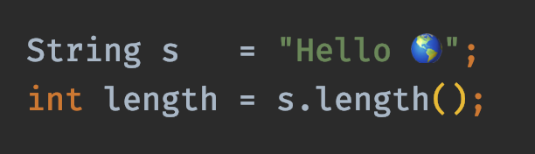
reference type
primitive type
variables
values

Slide 6
stack
heap
mno
Point[x=1,y=2]
pqr
Point[x=3,y=4]
stu
Point[x=5,y=6]

Slide 7
stack
heap
a
7

Slide 8
stack
heap
a
3

Slide 9
stack
heap
a
7
s
xyx
xyz
"my object type"

Slide 10
stack
heap
a
7
s
xyx
xyz
"my object type"
s1
xyx
s2
xyx
s3
xyx

Slide 11
stack
heap
a
xyz
b
xyx
xyz
Point[x=7,y=3]
c
xyx

Slide 12
stack
heap
s
null

Slide 13
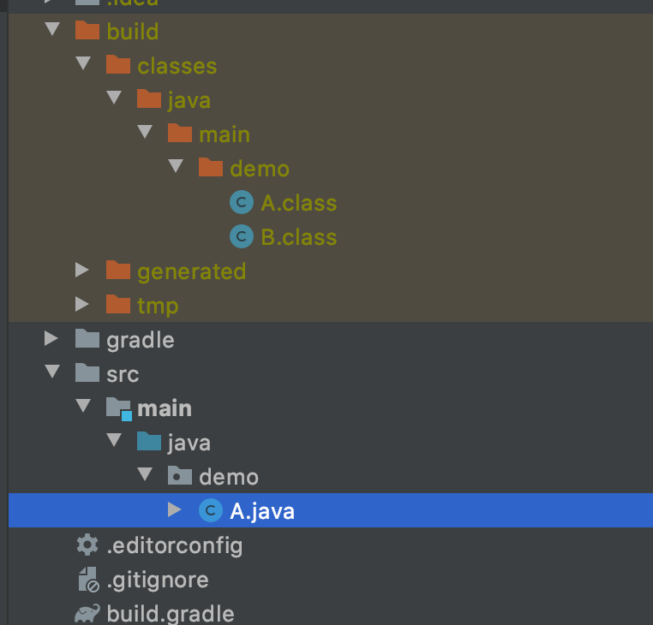
One Java source file produces two class files

Slide 14
new
empty & closed
full & closed
open()
close()
close()
open()
empty & open
full & open
putItem()

Slide 15

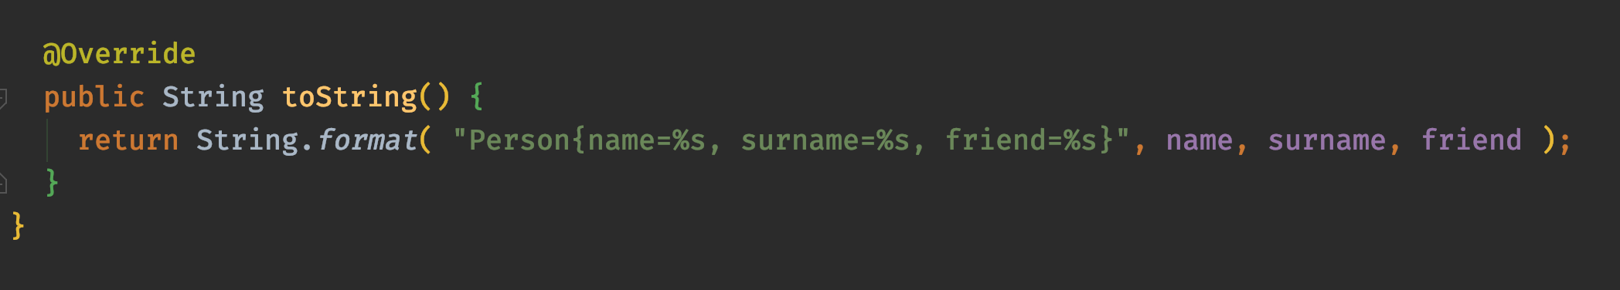
albert
john

Slide 16
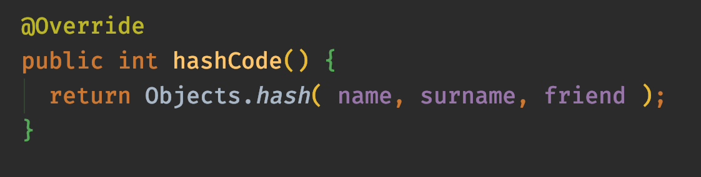
albert
john

Slide 17
Object
Person
(extends Object)
Upcasting
Downcasting
Very Important Person
(extends Person)

Slide 18
Object
is a
is a
Person
(extends Object)
Box
(extends Object)
has
is a
String
int
LightBox
(extends Box)

Slide 19

push
pop
peek
Stack Data Structure

Slide 20
Take plates from the top of the stack
We can only see the plate at the top. We don't know if the other plates are clean or not.
Add plates to the top of the stack

Slide 21
A
pink()
extends
yellow()
B
(extends A)
overrides
X
overrides
yellow()
cyan()
overrides
extends
C
(extends B implements X)
implements
pink()
cyan()

Slide 22
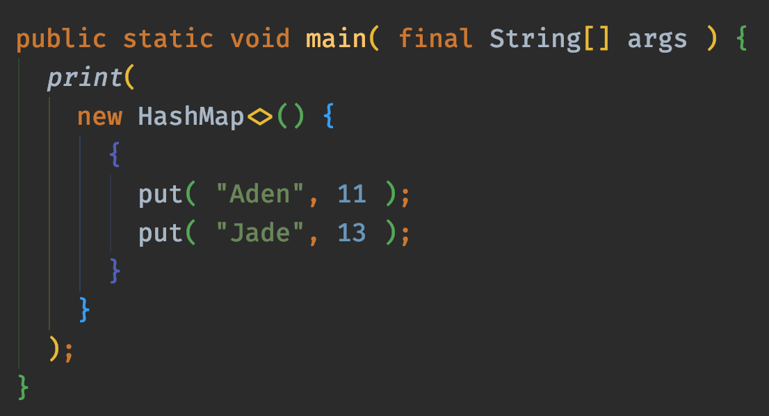
Creates an inner anonymous class

Slide 23
Creates an initialisation block within the inner anonymous class

Slide 24

Source Code
Bytecode
Java Compiler

Slide 25
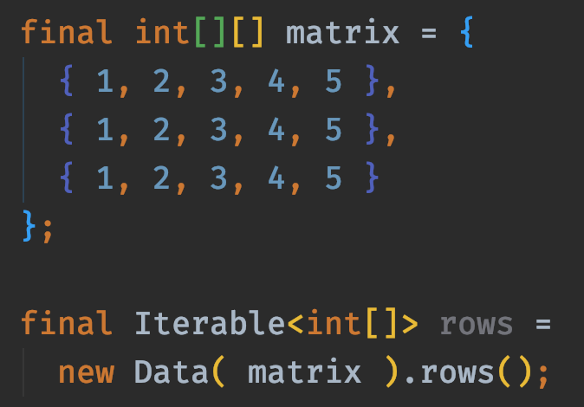
heap
int[][]
Data
Rows

Slide 26
indices
0
1
2
3
4
final int[] numbers =
new int[] { 1, 2, 3, 4, 5 };
1
2
3
4
5
elements
number[1]

Slide 27
indices
0
1
2
1
2
3
final int[][] a = {
{ 1, 2, 3 },
{ 4, 5, 6 },
{ 7, 8, 9 }
};
0
4
5
6
1
7
8
9
2
a[2]

Slide 28
indices
0
1
2
1
2
3
final int[][] a = {
{ 1, 2, 3 },
{ 4, 5, 6 },
{ 7, 8, 9 }
};
0
4
5
6
1
7
8
9
2
a[2][0]

Slide 29
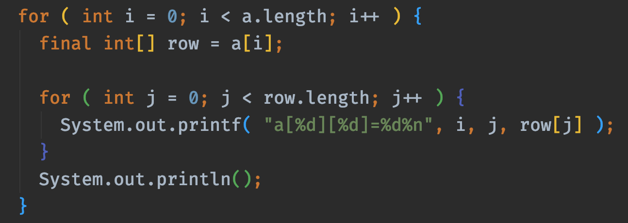
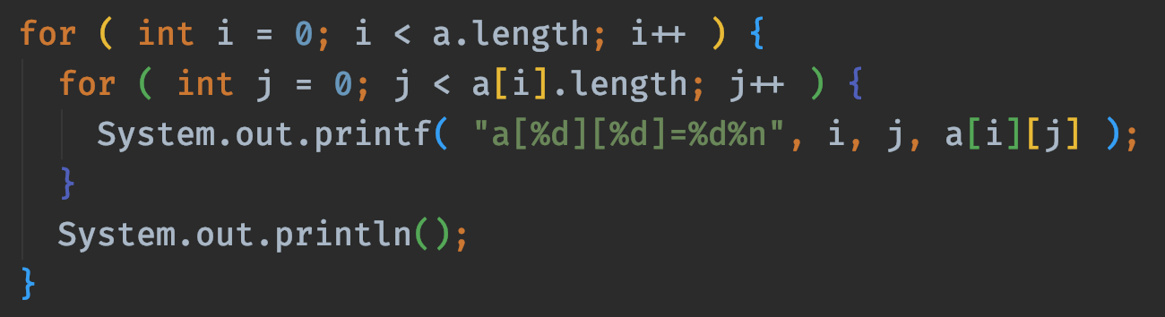

Slide 30
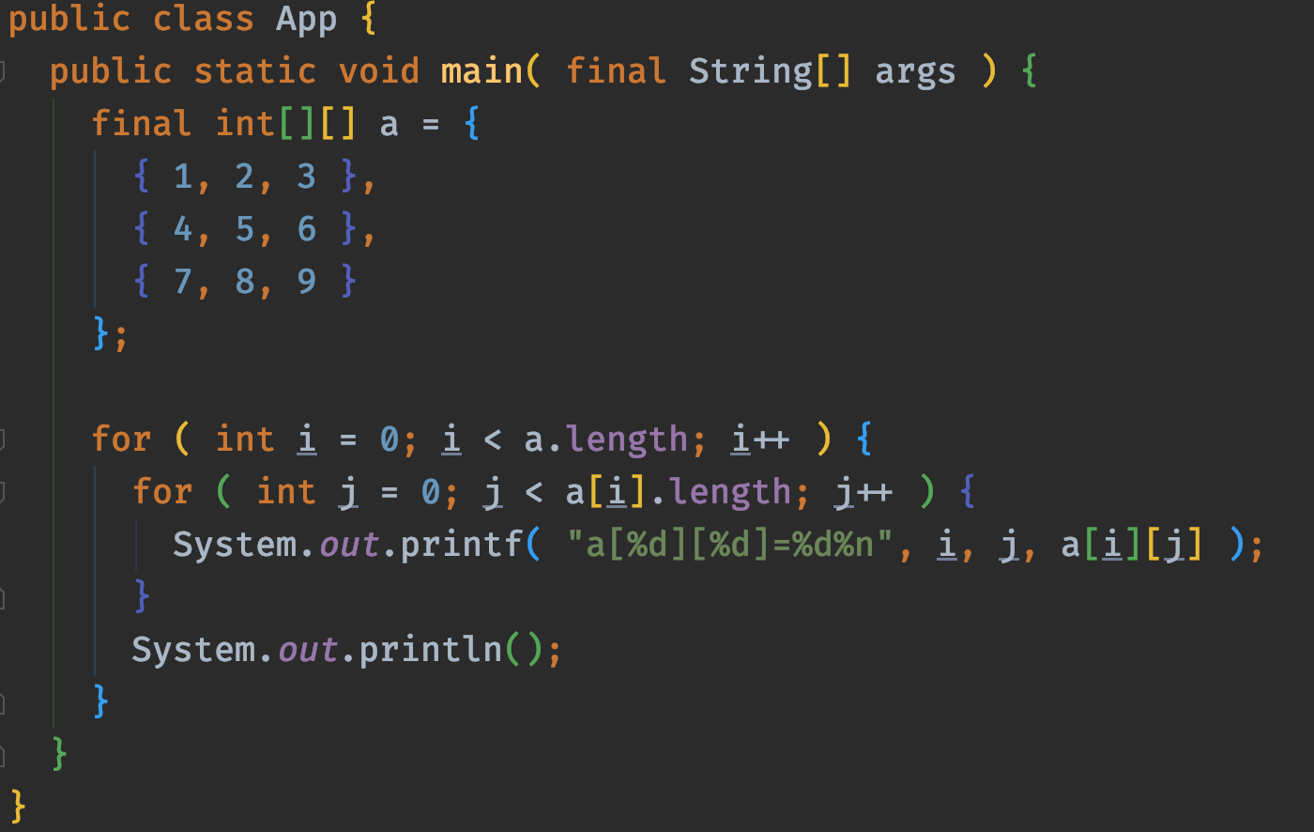
The length of array a is 3

Slide 31
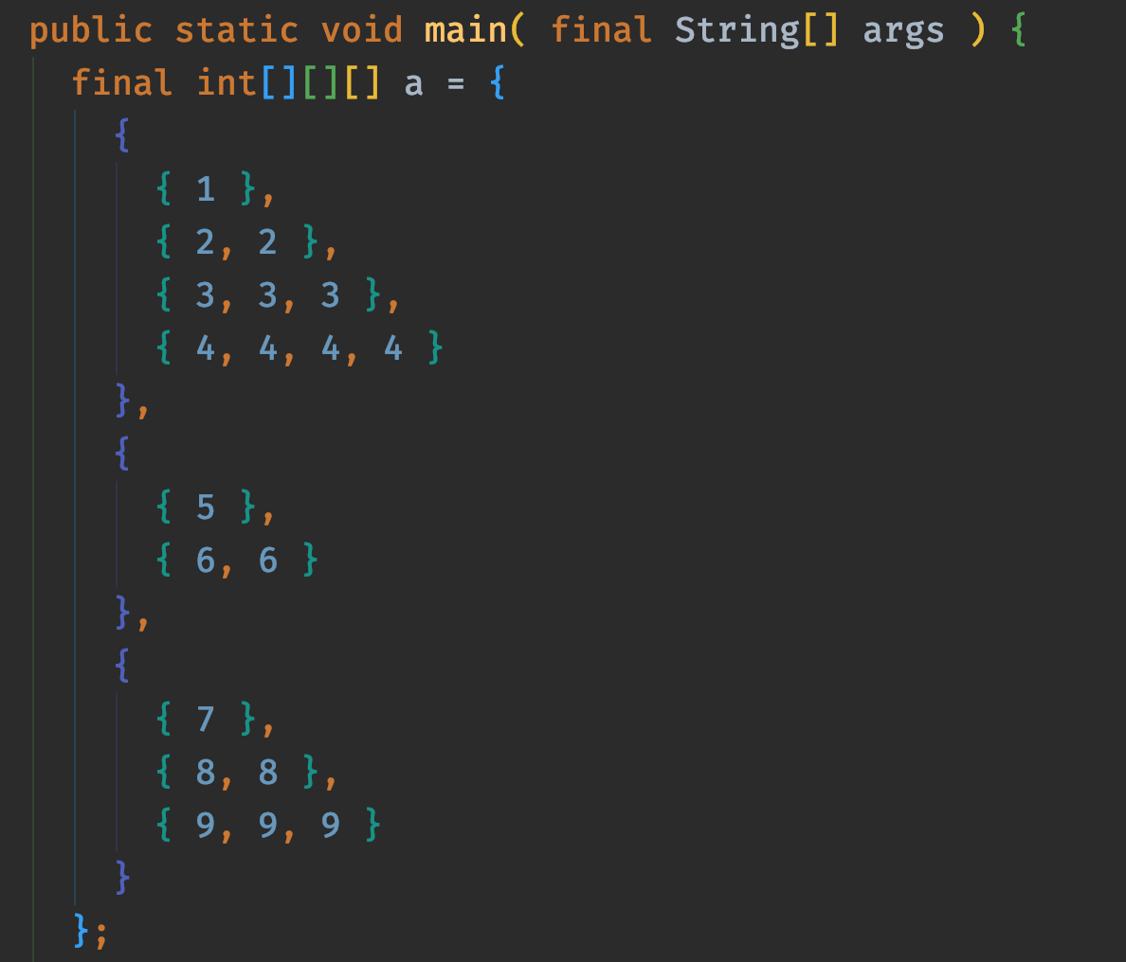
1st dimension
2nd dimension
3rd dimension

Slide 32
The first index, a[i], determines which of these three elements we access
a[0]
a[1]
a[2]

Slide 33
a[1]
The third (and final) index, a[1][1][k], determines which value of these two elements we access
a[1][1]
a[1][1][1]
a[1][1][0]

Slide 34
code
final int[] numbers = { 1, 2, 3, 4, 5 };
stack
heap
The array values
numbers
xyz
xyz
1
2
3
4
5
0
1
2
3
4
The array indices

Slide 35
code
final String[] names = { "Jade", "Aden" };
stack
heap
mno
Jade
names
xyz
pqr
Aden
xyz
mno
pqr
0
1

Slide 36
Object
These three classes extends the Object class by default
Shape
Rectangle
Circle
Triangle
Square

Slide 37
Raw Type
put(Object)
Generics (of type String)
put(String)

Slide 38
The method type parameter changed from T to Object during type erasure
Call to put(Object) method
put(Object)
Box
Invokes the method of the subtype (polymorphism)
put(Object)
put(String)
StringBox
The method generated by type erasure

Slide 39
The method type parameter changed from T to Object during type erasure
Call to clear() method
clear()
put(Object)
Box
Invokes the method of the subtype (polymorphism)
put(Object)
put(String)
StringBox
The method generated by type erasure

Slide 40
Buckets
HashSet elements
HashSet
A list of buckets
Each bucket points to another list
Empty bucket

Slide 41

Buckets
HashSet elements
$$f(element)$$
Determine the bucket where this element goes
Add it to the (head or tail) of the bucket

Slide 42
Buckets
HashSet elements
The element's equals() method is used to determine whether the element exists in this bucker or not.
$$f(element)$$
The element's hashCode() method is used to determine which bucket to used

Slide 43
key
value
Map Entry

Slide 44
Buckets
Hashtable entries
Hashtable
Each map entry containing both the key and value
A list of buckets
Each bucket points to another list
Empty bucket

Slide 45

Buckets
Hashtable entries
$$f(entry^{′}s key)$$
Determine the bucket where this entry goes
Add it to the (head or tail) of the bucket

Slide 46
Buckets
Hashtable entries
The entry's key equals() method is used to determine whether the entry exists in this bucker or not.
$$f(entry^{′}s key)$$
The entry's key hashCode() method is used to determine which bucket to used

Slide 47
Apple
2
Orange
1

Slide 48
Apple
2
Take an apple and an orange from the bag
Apple
1
Orange
1

Slide 49
peek
enqueue
dequeue
back
front
Queue Data Structure

Slide 50

Back of the queue
Front of the queue
People will join the queue at this end (enqueue)
Queue of people waiting in line for the ATM
Once ready, thee next in line will move forward, leaves the queue (dequeue) and uses the ATM

Slide 51
Source
A number of intermediate operations
Terminal Operation

Slide 52
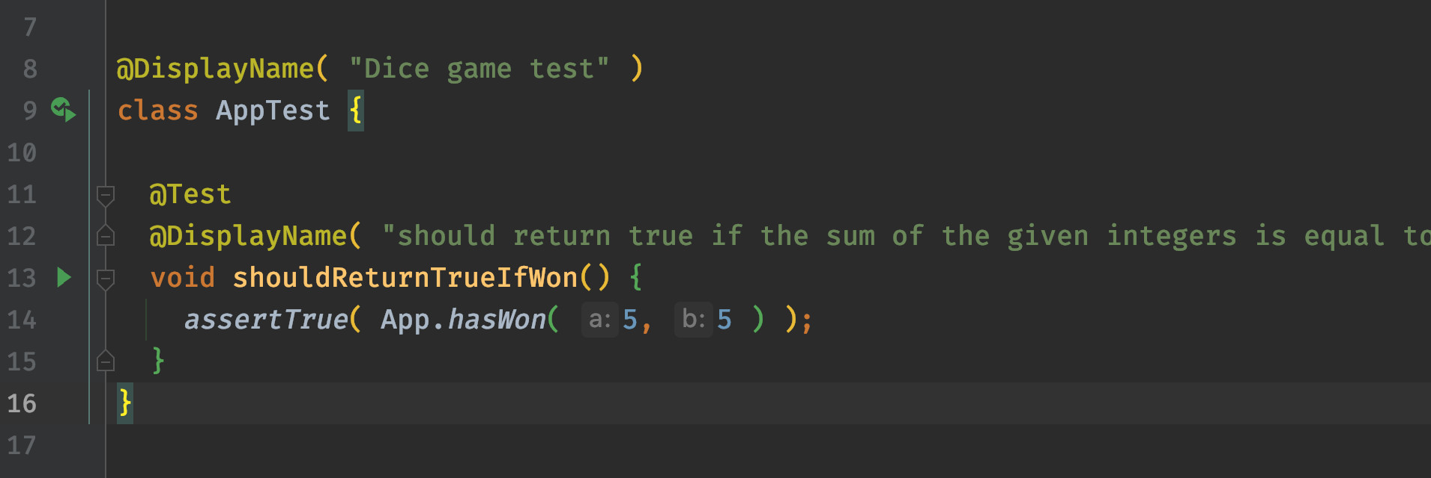
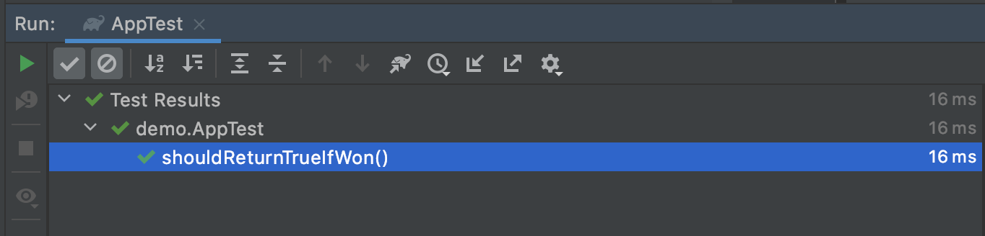

Slide 53
Test Double
Dummy
Stub
Spy
Mock
Fake

