Slide 1




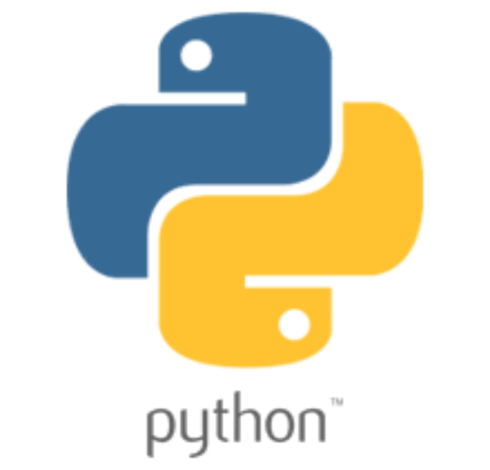


Operating System
Docker Container
Runtime Environment
Application
Dependencies
Configuration

Slide 2
Docker File
Docker Container
Docker Container
docker build …
docker run …

Slide 3
Docker Command
Builds on the previous layer
Layer
FROM adoptopenjdk/openjdk14:jre-14.0.1_7-alpine
WORKDIR /opt/app
+
=
Intermediate images
ADD ./build/libs/*.jar ./application.jar
+
=
CMD ["java", "-jar", "application.jar"]
+
=
Final image

