Slide 1




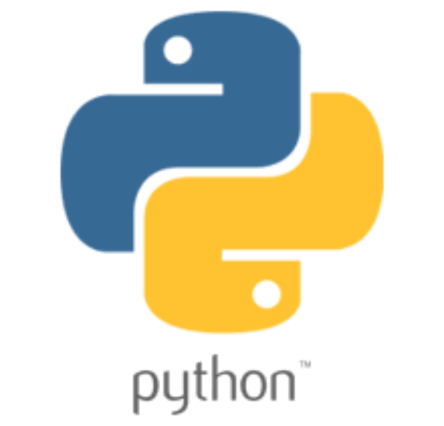


Operating System
Docker Container
Runtime Environment
Application
Dependencies
Configuration

Slide 2
Docker File
Docker Image
Docker Container
docker build …
docker run …

Slide 3
Docker Command
Builds on the previous layer
Layer
FROM adoptopenjdk:8u252-b09-jre-hotspot-bionic
WORKDIR /opt/app
+
=
Intermediate images
ADD ./build/libs/*.jar ./application.jar
+
=
ENTRYPOINT ["java", "-jar", "application.jar"]
+
=
Final image

Slide 4
The existing intermediate images are reused
The application.jar file contains our code together with the dependencies
Version 1
Version 2
Version 3
Version 4

Slide 5
The existing intermediate images are reused
The application dependencies
The layer contains our code together without the dependencies
The application code
Version 1
Version 2
Version 3
Version 4

