Slide 1
Bayes Factors
Ben Meuleman
Peers Meeting
Swiss Center for Affective Sciences
October 12, 2017, Geneva

Slide 2
Contents
1. Frequentism and p-values
2. Information criteria
3. Bayes factors
4. BayesFactor package in R

Slide 3
1. Frequentism and p-values

Slide 4
Frequentism and p-values
Running data analyses and conducting inference requires an underlying philosophy regarding probability. Many researchers are not aware that there are, in fact, two competing such views: frequentist probability and Bayesian probability.
Classical inference using null hypothesis testing and p-values come from the frequentist probability view, and were heavily developed by people such as Fischer, Pearson, and Neyman. This view dominates statistics in science to this day.
Frequentism assumes that an event’s probability is equal to its relative frequency in the limit of being repeated infinitely. This view is naturally compatible with the scientific practice of "experiments" and "trials". It supposes that probability is an objective truth that can be established by repetition.
Frequentism rejects (mostly) the idea of subjective probability…

Slide 5
P-values
P-values arise in the framework of null hypothesis testing associated with frequentist probability views. They allow binary decision making on the "relevance" of an observed effect in data.
Given a model and a hypothesis to be nullified (H₀), the p-value quantifies how unlikely a given effect (or larger) would be, assuming that H₀ was true.
In classical hypothesis testing, the burden is entirely on rejecting the null hypothesis. Typically, we reject H₀ when the p-value exceeds a fixed threshold (e.g., 5%). If it does not exceed the threshold, we state that there was insufficient evidence for rejecting H₀. The null hypothesis is never accepted.
The conventional significance level of 5% has been adopted to reduce Type I error rates (=false positive results).

Slide 6
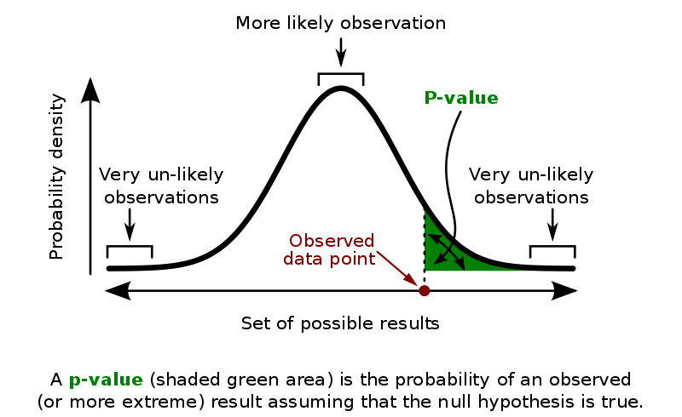
P-values
https://en.wikipedia.org/wiki/P-value

Slide 7

P-values
What predicts the degree of belief in Santa Claus (-4 to 4) in a sample of 300 school children?
Coefficients:
Estimate Std. Error t value Pr(>|t|)
(Intercept) 5.487031 0.312914 17.535 < 2e-16 ***
Age -0.769430 0.029532 -26.054 < 2e-16 ***
Gendergirl 0.022870 0.145955 0.157 0.876
Siblings 0.002239 0.073478 0.030 0.976
Rank 0.069784 0.130941 0.533 0.594
Easter_bunny 0.152862 0.030902 4.947 1.27e-06 ***
---
Signif. codes: 0 ‘***’ 0.001 ‘**’ 0.01 ‘*’ 0.05 ‘.’ 0.1 ‘ ’ 1
Residual standard error: 1.253 on 294 degrees of freedom
Multiple R-squared: 0.7667, Adjusted R-squared: 0.7627
F-statistic: 193.2 on 5 and 294 DF, p-value: < 2.2e-16

Slide 8
Evils of the p-value
Criticism has increased against the use of p-values to decide whether empirical evidence is meaningful:
P-values reflect both effect size and sample size, meaning that p = 0.00001 in principle says nothing about how large an effect actually is, without knowledge of the sample size
Researchers stretch the objective significance level by introducing marginal significance and trend effects
P-values are misunderstood to reflect the probability of hypotheses
Arbitrary switching between one- and two-sided testing for symmetrically distributed test statistics (t-values, z-values)
Lack of multiple testing corrections leads to an inflation of Type I error
Publication bias toward significant results leads to a suppression of non-significant data
General critical consensus seems to be that p-values are ambiguous and vulnerable to misunderstandings and abuses…
Mulder & Wagenmakers, 2016

Slide 9


Solutions?
"For fields where the threshold for defining statistical significance for new discoveries is P < 0.05, we propose a change to P < 0.005. This simple step would immediately improve the reproducibility of scientific research in many fields."
Benjamin et al., 2017
"Perhaps you’re already among the lucky participants in the human race who don’t know what a P value is. Trust me, you don’t want to. P stands for pernicious, and P values are at the root of all (well, most) scientific evil."
Siegfried, 2015

Slide 10
2. Information criteria

Slide 11
Information criteria
Researchers would like to quantify effect size and at the same time take binary decisions on variable relevance. P-values are flawed for a variety of reasons. An alternative that inches closer to Bayesian inference is information criteria.
You may have heard previously of the Akaike Information Criterion (AIC) and the Bayesian Information Criterion (BIC).
These statistics measure the fit of a model to observed data, penalized by the number of parameters that it includes. The penalization can act as a threshold, such that a parameter will only be "added" to a model if its informativeness exceeds that threshold. The BIC penalty is more strict than AIC.
AIC and BIC approximate so-called Occam factors, named after Occam's Razor. This principle states that one should always prefer the theory/model that best explains the observations/data with the least amount of assumptions/parameters.

Slide 12
Interpreting AIC/BIC
AIC/BIC are somewhat analogous to adjusted R², which penalizes regular R² by the number of parameters in the model.
AIC/BIC values have no absolute interpretation, strictly speaking. Their meaning is entirely relative to one model versus another. By convention, smaller AIC/BIC is better, with differences > 2 considered "meaningful".
However, they can have a somewhat absolute interpretation when the absolute worst model (e.g., usually the intercept-only model) set to be the reference level.
For AIC, the following relative likelihood interpretation can be applied:
exp( (AIC_{min} – AIC_{i})/2 )
= the probability that model i will minimize information loss over model min
https://en.wikipedia.org/wiki/Akaike_information_criterion

Slide 13
Why is it useful?
When conducting an exploratory model selection or when determining parameter relevance in the absence of explicit hypotheses (e.g., random effects in multilevel models), AIC/BIC are a more sensible choice than p-values to guide selection.
Due to their penalization, they tend to be more conservative than p-value selection, but can still be used for binary decision making on relevance.
AIC/BIC can be applied for non-nested model comparisons, e.g.:
Y = A + B
vs
Y = C + D
This is not possible with conventional F-tests, which require nesting

Slide 14
In R
Calculating AIC/BIC is one of the easiest things to do in R with the functions:
AIC()
BIC()
…on whatever model that was just fitted (lm, glm, lmer, fa, etc.). AIC/BIC are extremely general are available for almost all parametric models.
The function step(), which performs stepwise model selection, by default uses AIC minimization to arrive at the best subset of predictors.
You could compare models in a Type III ANOVA fashion for experimental designs, and decide on relevance using the AIC_{red} − AIC_{full} > 2 criterion.

Slide 15
In R
Santa Claus data model comparisons:
baseline <- AIC(lm(Santa_Claus~1,data=santa))
baseline
> 1421.391
AIC(lm(Santa_Claus~Age,data=santa)) - baseline
> -410.5424
AIC(lm(Santa_Claus~Age+Easter_bunny,data=santa)) - baseline
> -432.1385
AIC(lm(Santa_Claus~Age+Gender+Easter_bunny,data=santa)) - baseline
> -430.1482
AIC(lm(Santa_Claus~Age+Gender+Siblings+Easter_bunny,data=santa)) - baseline
> -428.2998
AIC(lm(Santa_Claus~Age+Gender+Siblings+Rank+Easter_bunny, data=santa)) - baseline
> -426.5895

Slide 16
In R
Relative likelihood example:
baseline <- AIC(lm(Santa_Claus~1,data=santa))
age <- AIC(lm(Santa_Claus~1+Age,data=santa))
exp((Age - baseline)/2)
> 7.109701e-90
So a model containing only an intercept is ≈ 0.000 times as probable as the age model to minimize the information loss. This indicates enormous evidence in favour of including age as a predictor.

Slide 17
Penalization
Penalization arises naturally in Bayesian probability. Consider the following series of replications:
Study 1
P = 0.894
Study 2
P = 0.456
Study 3
P = 0.104
Study 4
P = 0.819
Study 5
P = 0.788
Study 6
P = 0.329
Study 7
P = 0.217
Study 8
P = 0.635
Study 9
P = 0.647
Study 10
P < 0.0001

Slide 18
Penalization
Despite Study 10 yielding a highly significant p-value, most researchers would be inclined to consider this a false positive, considering the previous evidence.
In other words, we penalize the significance of the 10th study by a threshold set by the previous 9 studies. This is analogous to the AIC/BIC philosophy.
In still other words, we had a prior belief about the strength (and possibly direction) of the effect. Prior beliefs are one of the defining characteristics of Bayesian probability, and act as an automatic restriction on the evidence supplied by (new incoming) data.
When our prior belief about an effect is strong, (contradictory) evidence from data must be strong/numerous to change it. When our prior belief about an effect is weak, evidence from data will influence our estimates easily.

Slide 19
3. Bayes factors

Slide 20
Bayes factors
Bayes factors are highly similar to AIC/BIC in the manner that they quantify "evidence" for or against two competing models. Formally, the Bayes factor is the following ratio:
K = =
Which corresponds roughly to the relative likelihood of both models given a prior distribution for the model's parameters.
In practice, the quantities Pr(M₁|D) and Pr(M₁|D) may involve an integral over the model's parameters and hyperparameters, the latter representing prior beliefs about the likelihood of the parameters. Software does not require the user to specify these explicitly so I will not go into detail here…
Pr(D|M₁) Pr(M₁|D) × Pr(M₂)
Pr(D|M₂) Pr(M₂|D) × Pr(M₁)

Slide 21
Bayes factors
Rules of thumb exist for interpreting the value of K (Jeffreys, 1935):
< 10⁰ Negative (supports M2)
10⁰ to 10^{1/2} Barely worth mentioning
10^{1/2} to 10¹ Substanial
10¹ to 10^{3/2} Strong
10^{3/2} to 10² Very strong
> 10² Decisive (supports M1)
Note that these rules make no real distinction between null hypothesis and alternative hypothesis, just competing models. This is one of the advertised advantages of Bayes factors (Raftery, 1986; Burnham & Anderson, 2004; Mulder & Wagenmakers, 2016).

Slide 22
4. BayesFactor package in R

Slide 23
BayesFactor
In R, the BayesFactor package makes it easy to calculate Bayes factors for various models, including the t-test, factorial between ANOVA, and multiple regression models. An excellent vignette for learning how to use the package is available here: http://bayesfactorpcl.r-forge.r-project.org/
Separate functions are called depending on the analysis you run:
The reason for separate functions is that Bayesian parametrization is sometimes very different depending on the underlying model!
Function Description
ttestBF Bayes factors for one- and two- sample designs
anovaBF Bayes factors comparing many ANOVA models
regressionBF Bayes factors comparing many linear regression models
generalTestBF Bayes factors for all restrictions on a full model
lmBF Bayes factors for specific linear models
proportionBF Bayes factors for tests of single proportions
contingencyTableBF Bayes factors for contingency tables

Slide 24
Type III breakdown example
To get a Type III style ANOVA breakdown for a regression analysis, we use the regressionBF() function, specifying the option "top" at the whichModels argument.
Because the regression function does not allow mixing of categorical and continuous variables, I first create the model matrix manually:
library(BayesFactor)
santa2 <- data.frame(Santa_Claus=santa$Santa_Claus, model.matrix(lm(Santa_Claus~.- Child,data=santa))[,-1])
Next we run the function:
bf <- regressionBF(Santa_Claus~., data=santa2,
whichModels = "top")

Slide 25
Type III breakdown example
Bayes factor top-down analysis
--------------
When effect is omitted from Age + Gendergirl + Siblings +
Rank + SES + Easter_bunny , BF is...
[1] Omit Easter_bunny : 0.0001132238 ±0%
[2] Omit SES : 9.492228 ±0%
[3] Omit Rank : 11.215 ±0%
[4] Omit Siblings : 13.43429 ±0%
[5] Omit Gendergirl : 13.16837 ±0%
[6] Omit Age : 2.038867e-74 ±0.01%
Against denominator:
Santa_Claus ~ Age + Gendergirl + Siblings + Rank + SES + Easter_bunny
---
Bayes factor type: BFlinearModel, JZS

Slide 26
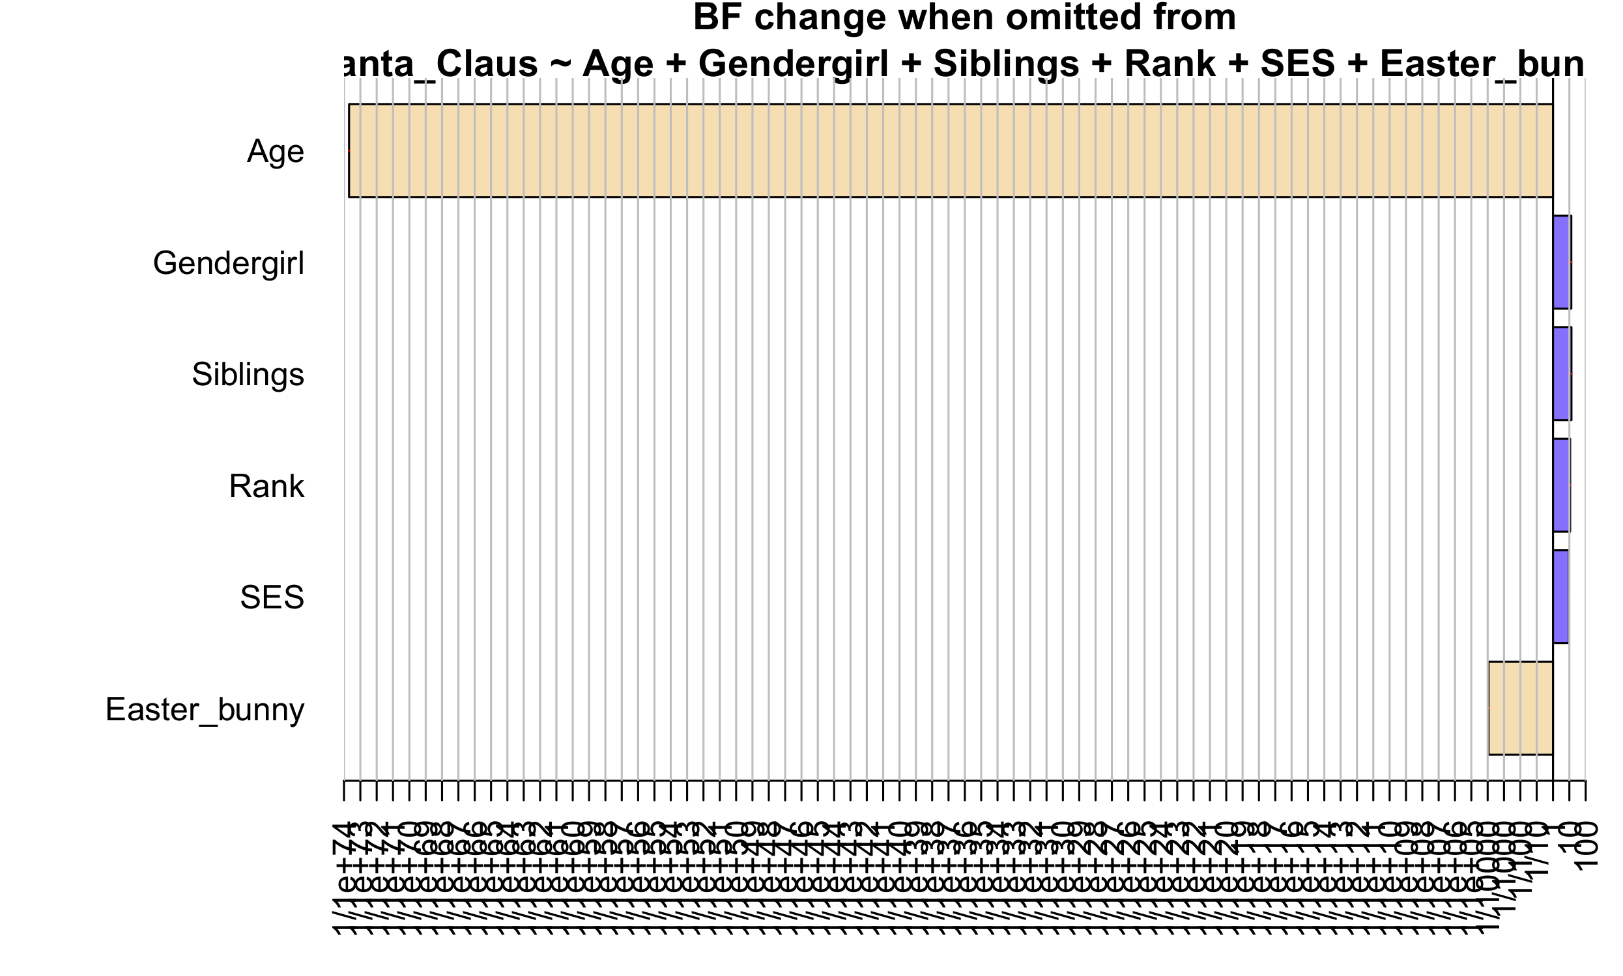
Type III breakdown example
plot(bf)

Slide 27
Type III breakdown example
Enormous reduction in evidence when "age" was omitted from the full model. A model with age was preferred by a factor that is almost infinite.
Omitting SES, gender, siblings, and sibling rank increased the evidence for the resulting reduced model (blue bars).
This style of breakdown is conventionally outputted in standard regression as a so-called Type III ANOVA, which tests the presence of each predictor against its absence in a full model. This is the typical multiple regression approach, testing predictors while adjusting for others.
Another approach would be to test each predictor in isolation, as in a correlational approach. In BayesFactor this can be done by specifying whichModels="bottom". The usual cautions apply when interpreting pairwise vs adjusted measures of effect (e.g., confounding).

Slide 28
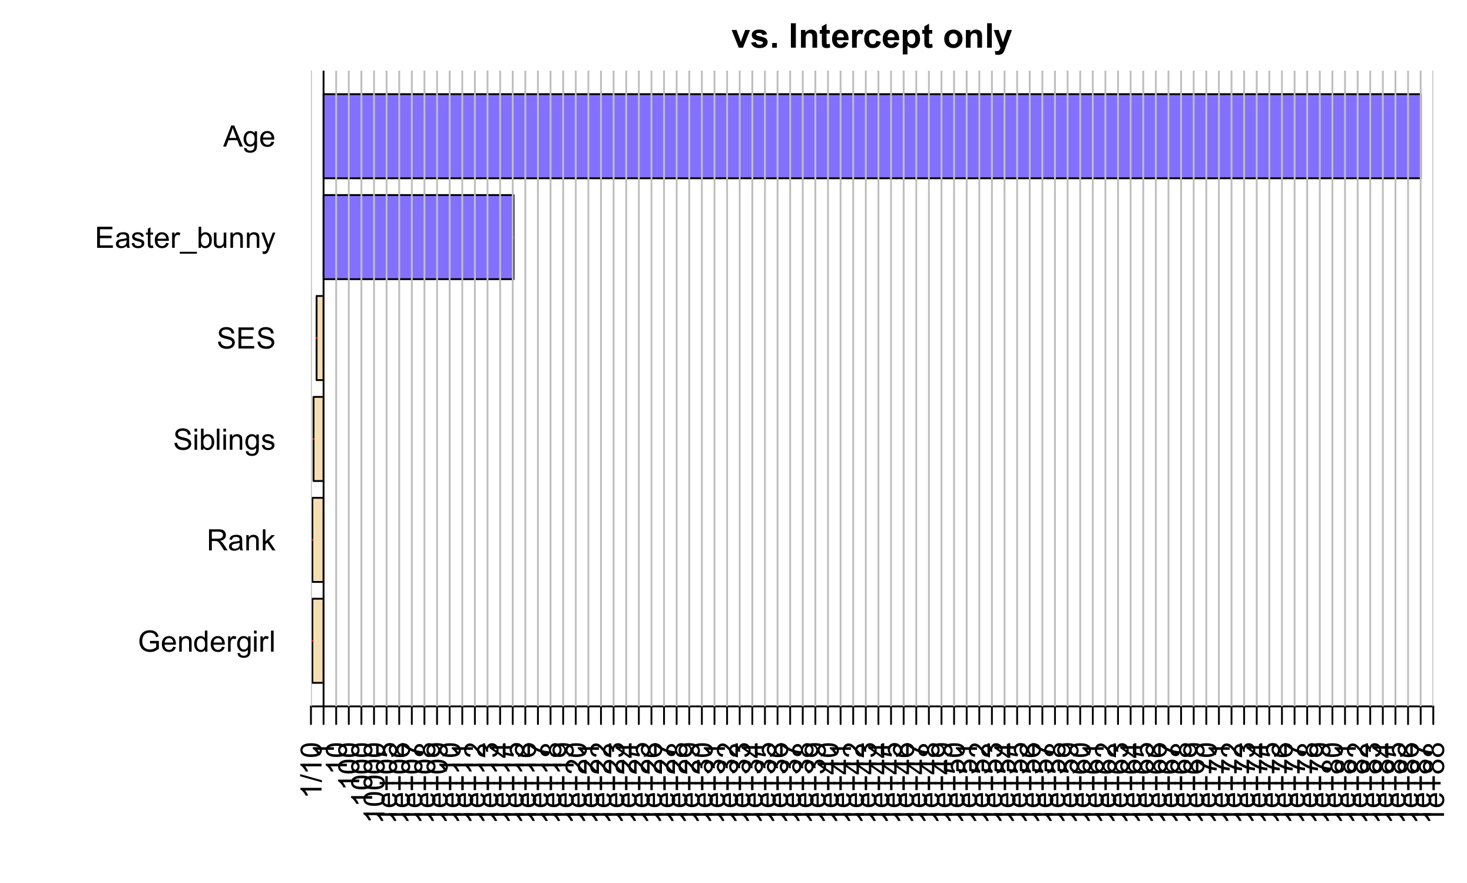
Pairwise breakdown example

Slide 29
Best subset selection
When nothing is specified at whichModels, the regressionBF function will exhaustively fit every possible model by default. This allows the user to return the best subset of predictors (=that maximizes the Bayes factor):
bf <- regressionBF(Santa_Claus~., data=santa2)
head(bf)
> Bayes factor analysis
> --------------
> [1] Age + Easter_bunny : 4.708472e+90 ±0%
> [2] Age + SES + Easter_bunny : 3.220689e+89 ±0%
> [3] Age + Rank + Easter_bunny : 2.92409e+89 ±0%
> [4] Age + Siblings + Easter_bunny : 2.554117e+89 ±0%
> [5] Age + Gendergirl + Easter_bunny : 2.386019e+89 ±0%
> [6] Age + Rank + SES + Easter_bunny : 2.446284e+88 ±0%
>
> Against denominator:
> Intercept only
> ---
> Bayes factor type: BFlinearModel, JZS

Slide 30
More analyses…
The vignette contains more examples of how to compare specific models to each other, how to interpret the results, and how to plot the effects.
Functions exist not only for t-test, ANOVA, and regression, but also for a binomial proportion test, and for a chi-square analysis of a frequency table.
Information pages for individual BF functions contain more information about which Bayesian priors are being used for each analysis, and which method of estimation. These choices are often not trivial!
When using BayesFactor, always read up on the documentation…

Slide 31
Repeated designs
BayesFactor supports conventional models for between data. For within data, the situation is a bit more complicated. anovaBF() allows the specification of random factors for a factorial design, e.g.,
bf <- anovaBF(RT ~ shape*color + ID,data=puzzles,whichRandom="ID")
For balanced designs with repeated measures in subjects, and specifying a random factor for subjects, this is equivalent to univariate repeated measures ANOVA that assumes sphericity for the within-subjects correlation.
Complicated random effects structures are not supported, nor is GG-corrected repeated measures analysis. Doing this requires some tricks…

Slide 32
RM-MANOVA
A paired t-test is nothing more than a one-sample t-test on the difference scores of the paired data. Repeated measures MANOVA generalizes this principle by allowing an arbitrary number of repeated samples, applying a difference transformation, and conducting a multivariate test on the intercept of the resulting regression model.
Long story short, BayesFactor can accommodate the paired t-test by applying the one-sample t-test Bayes factor analysis to data that has already been differenced by the user:
bf = ttestBF(x = diffScores)
bf
## Bayes factor analysis
## --------------
## [1] Alt., r=0.707 : 17.3 ±0%
##
## Against denominator:
## Null, mu = 0
## ---
## Bayes factor type: BFoneSample, JZS

Slide 33
RM-MANOVA
The preceding principle could be applied to any 2 × 2 × 2 ×… , repeated design. No solution yet available for designs with factors containing more than 2 levels.
In these cases, AIC/BIC could be used as an approximation of a Bayes factor analysis, although calculating these criteria for multivariate regression models also complicated…

Slide 34
Conclusions
Frequentist approaches (including p-values and null hypothesis testing) have historically been popular (among other reasons) due to being simple to calculate, sometimes even by pen and paper.
Rapid advances in computational power have made Bayesian alternatives—which often require the calculation of complex integrals—increasingly attractive. A paradigm shift is expected in science with more Bayesian analyses being reported and Bayesian probability being taught in statistics courses.
The authors that proposed lowering the alpha treshold for p-values (Benjamin et al., 2017) actually recommended a general shift toward Bayes factors! They only proposed α = 0.005 when p-values must be used or for "new" analyses. Not when they can be avoided or when replicating previous results.

Slide 35
Conclusions
Bayes factors have many attractive properties…:
They can be used for non-nested model comparisons
They are unbiased by sample size
They can quantify evidence for and against null/alternative hypotheses
They naturally penalize overparametrized models
Their value can be interpreted as the relative degree of evidence of one model versus another, given the observed data

Slide 36
Thank you for your attention!

