Slide 1
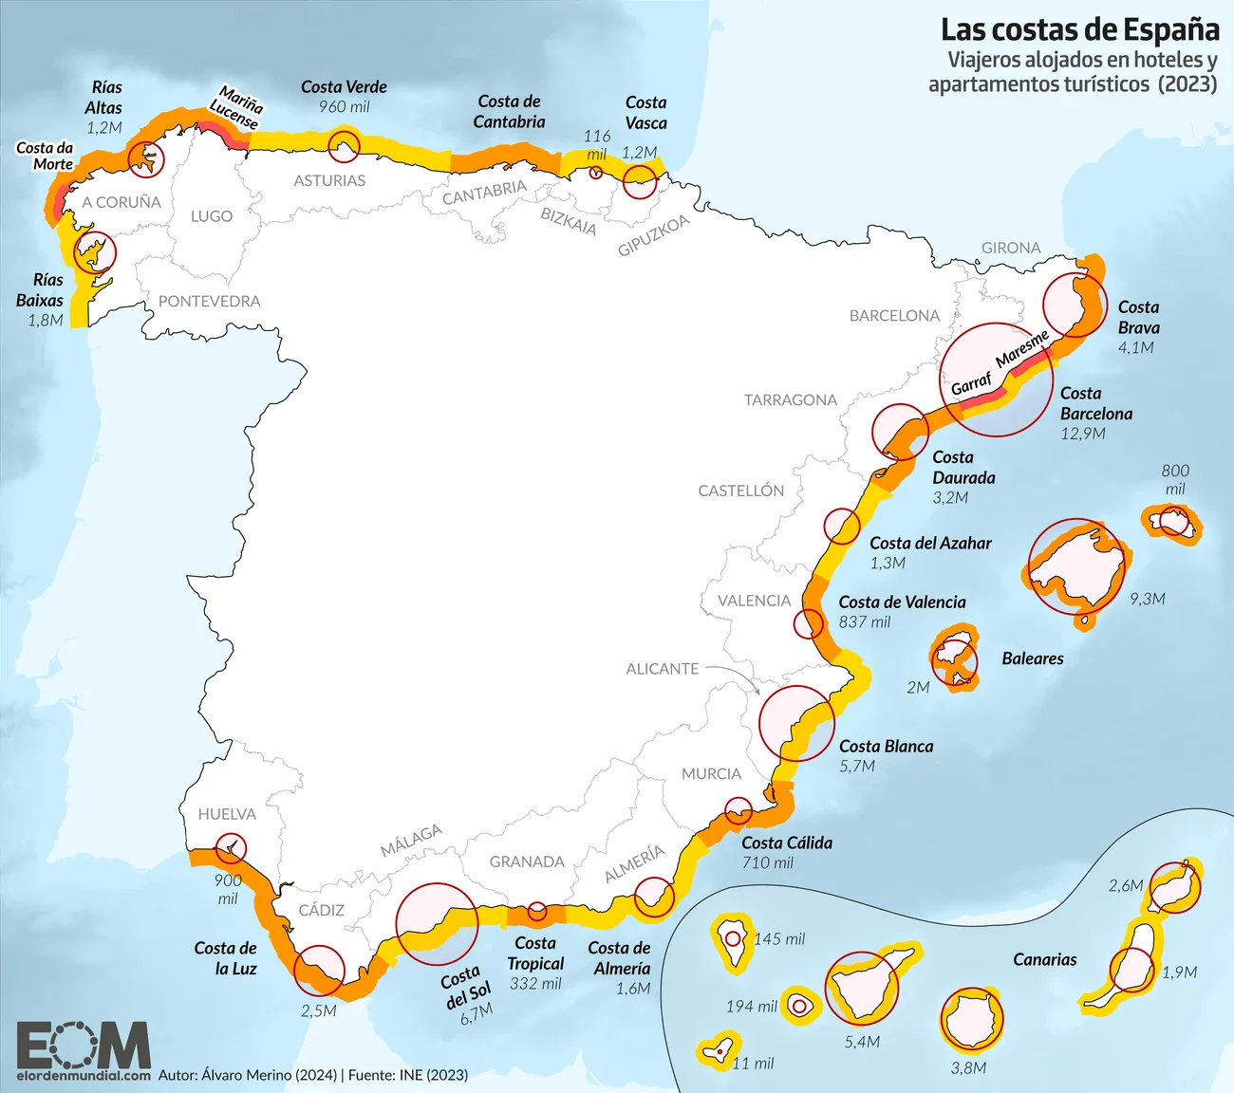
Distance DTW
CLUSTER 1
CLUSTER 2
CLUSTER 3

Slide 2
Distance Cosine
CLUSTER 1
CLUSTER 2
CLUSTER 3

