Slide 1


Fitness User Segmentation and Churn Analysis
Understanding user groups and retention patterns effectively
Notes:
AI-generated content may be incorrect. ---

Slide 2
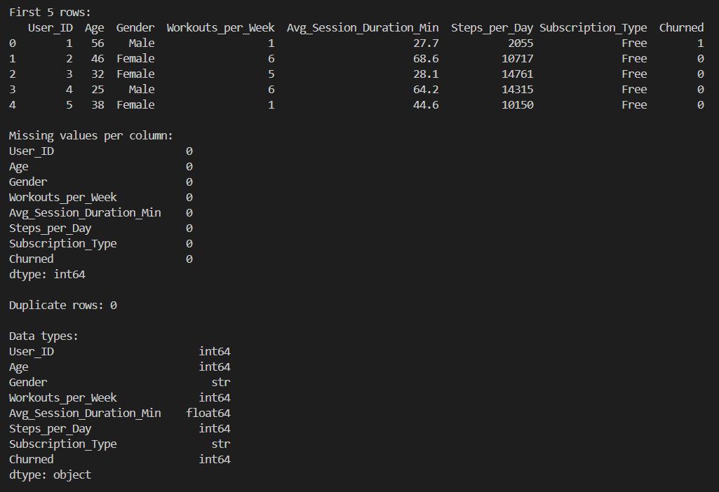
Data Cleaning Process Overview
Missing Values Check
No missing values were found in any of the eight columns, preserving all records for analysis.
Duplicate Records Detection
Duplicate detection confirmed unique user records, preventing bias from repeated entries.
Data Type Validation
Age and activity metrics were validated as integers; session duration confirmed as float; categories verified as strings.
Categorical Encoding
Gender and subscription types were encoded numerically for machine learning compatibility.
Notes:
This slide documents the data cleaning and preparation process applied to the fitness user dataset prior to any modeling or analysis. The dataset consisted of 200 individual user records and 8 columns: User_ID, Age, Gender, Workouts_per_Week, Avg_Session_Duration_Min, Steps_per_Day, Subscription_Type, and Churned. A systematic data quality check was conducted to ensure the dataset was suitable for clustering analysis. First, all eight columns were examined for missing values using summary statistics and null-value checks. No missing values were detected, which eliminated the need for imputation or row removal and preserved the full sample size for downstream analysis. Second, duplicate detection was performed across all columns to identify any repeated user records. This check confirmed that there were no duplicate rows, ensuring that each record represented a unique user and that no bias would be introduced by repeated observations. Third, data types were validated to confirm consistency with analytical requirements. Age, Workouts_per_Week, and Steps_per_Day were verified as integer variables, reflecting count-based or discrete measures. Avg_Session_Duration_Min was confirmed as a floating-point variable to capture fractional session durations accurately. Gender and Subscription_Type were validated as categorical string variables prior to encoding. Finally, categorical encoding was applied to prepare the data for machine learning algorithms. Gender was mapped to numerical values with Male encoded as 0 and Female encoded as 1. Subscription_Type was ordinally encoded as Free = 0, Basic = 1, and Premium = 2, reflecting increasing levels of commitment and service access. These steps ensured the dataset was clean, consistent, and numerically compatible with distance-based clustering methods, while retaining all original records for maximum analytical reliability.

Slide 3
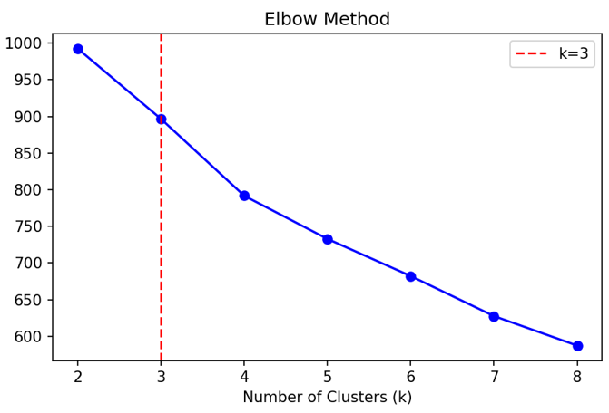
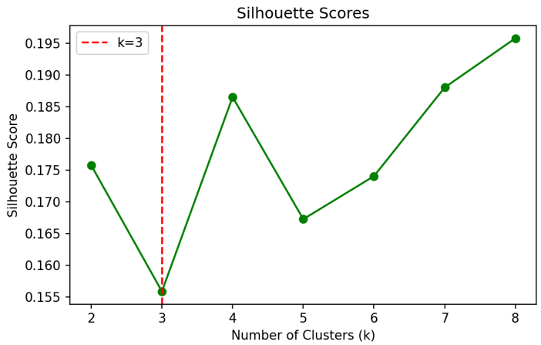
Clustering Methodology and Model Selection
Feature Selection Criteria
Selected features capture user behavior; identifiers and outcome variables like User_ID and Churned are excluded to prevent bias.
Feature Normalization
StandardScaler was used to normalize features to ensure equal influence during clustering regardless of numeric scale.
Optimal Cluster Number
Optimal k was determined by analyzing inertia drops with elbow method combined with silhouette score for cluster quality.
KMeans Model Training
KMeans was trained with random state and multiple initializations to ensure reproducibility and stable cluster solutions.
Notes:
This slide explains the methodology used to segment users into meaningful behavioral clusters. Feature selection was driven by the goal of capturing user behavior rather than identifiers or outcomes. The selected features were Age, Workouts_per_Week, Avg_Session_Duration_Min, Steps_per_Day, Gender_Enc, and Sub_Enc. User_ID was explicitly excluded because it serves only as a unique identifier and contains no behavioral information. Churned was also excluded because it is an outcome variable; including it would leak future information into the clustering process and distort natural behavioral groupings. Prior to clustering, all selected features were normalized using StandardScaler. This step was critical because the features exist on different numeric scales, such as steps per day being much larger in magnitude than workouts per week. Standardization ensured that no single feature dominated the distance calculations used by KMeans. To determine the optimal number of clusters, values of k from 2 to 8 were evaluated using both the elbow method, based on inertia, and the silhouette score, which measures cluster separation quality. Rather than manually selecting k, the optimal number of clusters was computed automatically by identifying the largest drop in inertia between consecutive k values. This approach balances objectivity with interpretability. The analysis identified k = 4 as the optimal choice. The final KMeans model was trained using random_state = 42 to ensure reproducibility and n_init = 10 to improve solution stability by averaging multiple centroid initializations. This methodology produced stable, interpretable clusters grounded in normalized behavioral data.

Slide 4
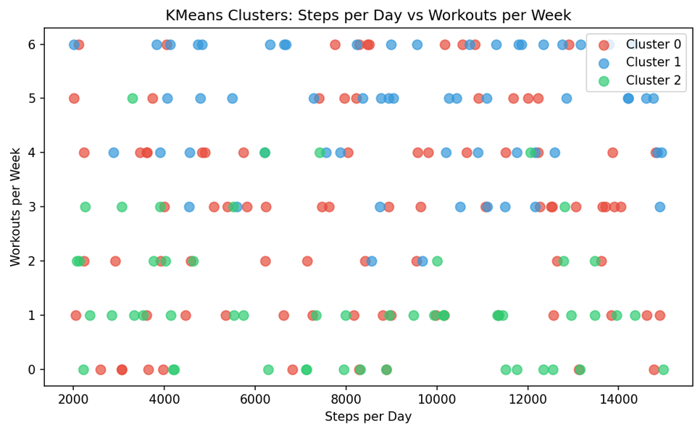
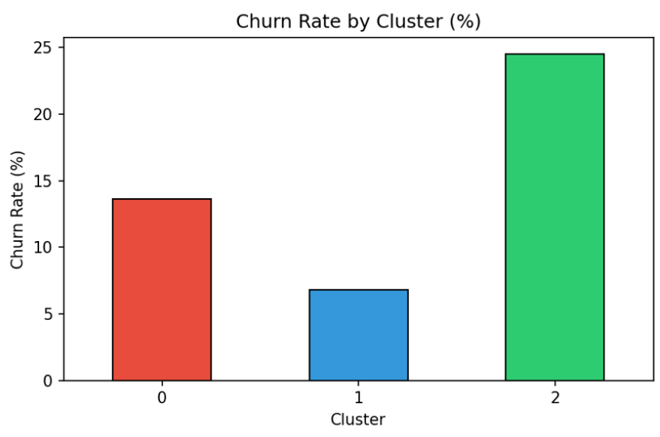
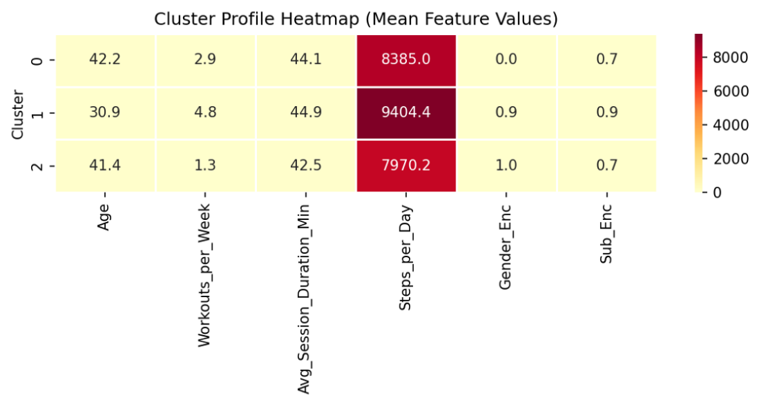
Cluster Profiles and Business Insights
Cluster 0 Profile
Moderate-age users with average workouts and mid-range steps show moderate churn risk and reasonable engagement.
Highly Engaged Cluster 1
Younger users with highest workouts and steps have the lowest churn, forming the most valuable segment.
At-Risk Cluster 2
Older users with low workouts and steps show highest churn, needing targeted re-engagement strategies.
Mixed Engagement Cluster 3
Mixed ages with moderate activity but lower subscription tiers indicate engagement without full monetization.
Notes:
This slide summarizes the key findings derived from the clustering analysis and translates them into actionable insights. The model identified four distinct clusters among the 200 users. Cluster 0 consists primarily of moderate-age users with average workout frequency and mid-range daily step counts. This group shows a moderate risk of churn, suggesting they are reasonably engaged but not strongly committed. Cluster 1 represents younger users with the highest number of workouts per week and the greatest steps per day. This segment demonstrates the lowest churn rate and can be considered the most engaged and valuable user group, likely benefiting from advanced features or loyalty incentives. Cluster 2 includes older users with the fewest workouts per week and the lowest daily step counts. This cluster exhibits the highest churn rate and represents the most at-risk segment in the user base. Their low activity levels suggest disengagement, potential motivational barriers, or unmet needs. Cluster 3 is a mixed-age group characterized by moderate-to-high activity levels but a tendency toward lower subscription tiers, indicating engagement without full monetization. The most important insight across all clusters is that low physical activity is the strongest indicator of churn risk, outweighing age or subscription type alone. As a result, Cluster 2 should be the top priority for intervention. Targeted re-engagement strategies such as personalized workout reminders, low-effort fitness challenges, onboarding refreshers, or tailored subscription upgrade offers could help reduce dropout rates in this group. These insights provide a clear, data-driven foundation for retention-focused decision-making.

