Slide 1
Analysis on
Beijing Multi-Site Air Quality
1

Slide 2
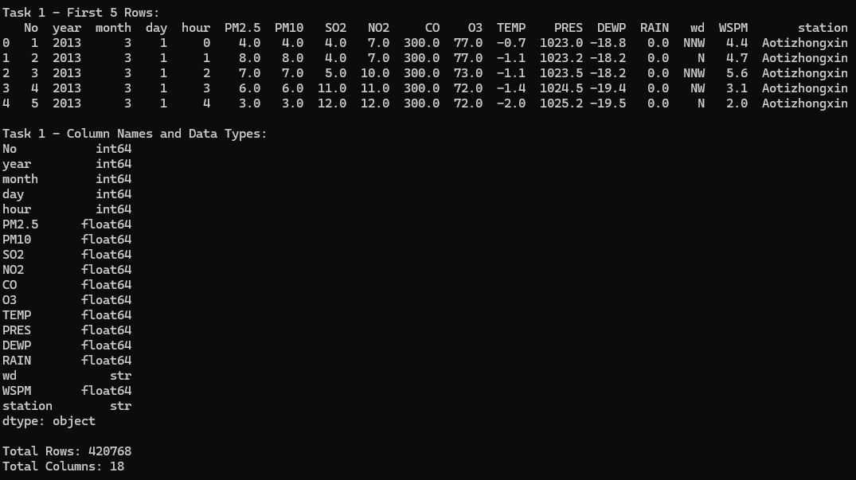
Task 1 Load and Inspect the Dataset
Answers
Output
Downloaded a zip file as source data from Beijing Multi-Site Air Quality.
The zip file contains a jpg file, zip file and a excel sheet.
Upon checking, only zip file is related to air quality and other 2 files are not relevant hence ignored.
Loaded 12 CSV files and merged into one table
420,768 rows and 18 columns total
Pollutants (PM2.5, PM10, SO2, NO2, CO, O3) — float
Time columns (year, month, day, hour) — integer
Station and wind direction — string
Code
csv_files = glob.glob("PRSA_Data*.csv")
data = pd.concat(
(pd.read_csv(f) for f in csv_files),
ignore_index=True
)
print(data.head())
print(data.dtypes)
rows, columns = data.shape
print(f"Total Rows: {rows}")
print(f"Total Columns: {columns}")
2

Slide 3
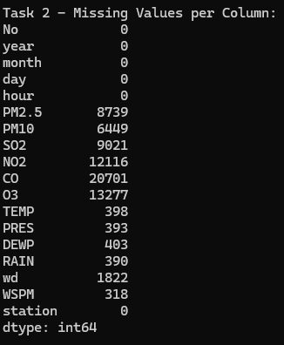
Task 2 Data Cleaning
Answers
Output
Missing values found in PM2.5, PM10, SO2, NO2, CO, O3
Replaced numeric missing values with column mean — fillna()
Removed remaining rows with missing values — dropna()
Code
print(data.isnull().sum())
data.fillna(
data.select_dtypes(include="number").mean(),
inplace=True
)
data.dropna(inplace=True)
3

Slide 4
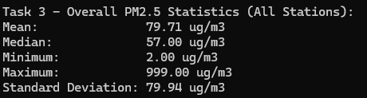
Task 3 Basic Statistical Analysis
Answers
Output
Shows statistics for all stations
Mean 79.71 ug/m3
Median 57.00 ug/m3
Minimum 2.00 ug/m3
Maximum 999.00 ug/m3
Std Dev 79.94 ug/m3
Code
print(f"Mean: {data['PM2.5'].mean():.2f} ug/m3")
print(f"Median: {data['PM2.5'].median():.2f} ug/m3")
print(f"Min: {data['PM2.5'].min():.2f} ug/m3")
print(f"Max: {data['PM2.5'].max():.2f} ug/m3")
print(f"Std Dev: {data['PM2.5'].std():.2f} ug/m3")
4

Slide 5
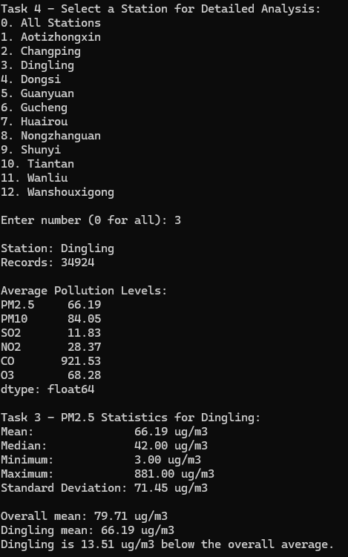
Task 4 Data Filtering
Answers
Output
Station selected for this example: Dingling
Summary table shows average PM2.5, PM10, SO2, NO2, CO, O3 for Dingling station
Code
avg_all = data.groupby("station")[
["PM2.5","PM10","SO2","NO2","CO","O3"]
].mean().round(2)
print(avg_all)
stations = sorted(data["station"].unique())
for i, name in enumerate(stations, 1):
print(f"{i}. {name}")
choice = input("Enter number (0 for all): ")
if choice == "0":
selected = data
else:
stn = stations[int(choice)-1]
selected = data[data["station"]==stn]
5

Slide 6
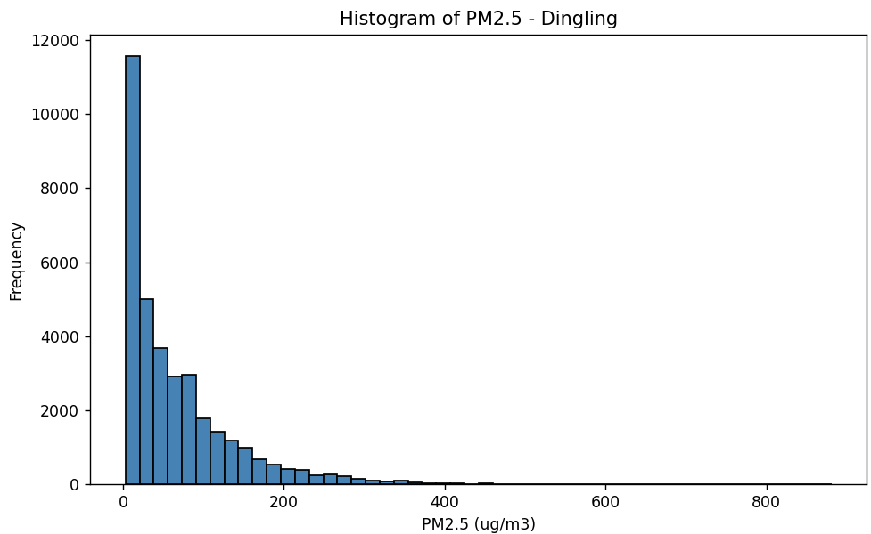
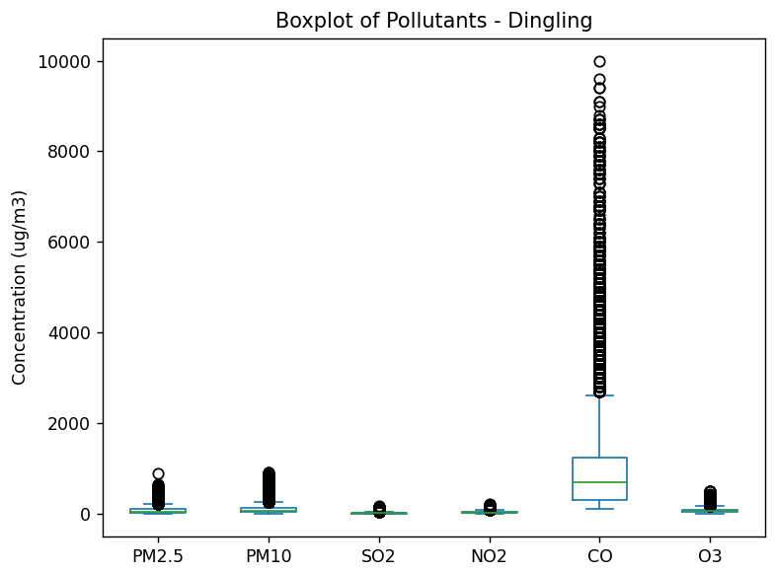
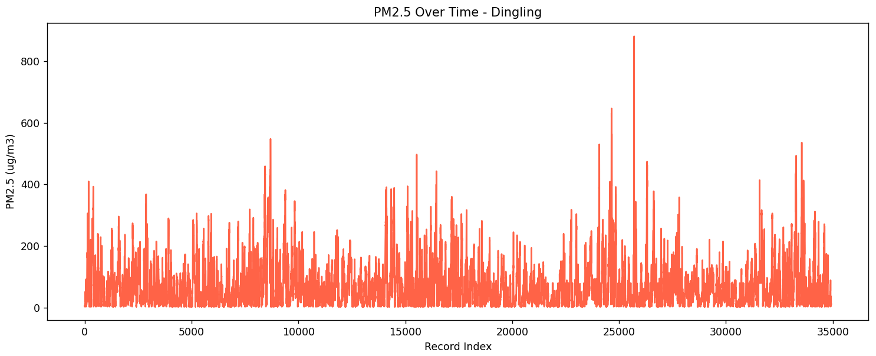
Task 5 Data Visualization
Answers
Output
Based on selected station: Dingling
Histogram — PM2.5 is right-skewed, most readings are low with a long right tail
Line plot — PM2.5 spikes occasionally which shows signs of seasonal triggers
Boxplot —CO has by far the most outliers reaching nearly 10,000 ug/m3 — other pollutants are relatively contained by comparison
Code
selected["PM2.5"].plot(kind="hist", bins=50)
plt.title(f"Histogram of PM2.5 - {label}")
plt.savefig("histogram_pm25.png")
selected["PM2.5"].reset_index(drop=True).plot()
plt.title(f"PM2.5 Over Time - {label}")
plt.savefig("lineplot_pm25.png")
selected[["PM2.5","PM10","SO2","NO2","CO","O3"]]\
.plot(kind="box")
plt.title(f"Boxplot - {label}")
plt.savefig("boxplot_pollutants.png")
6

Slide 7
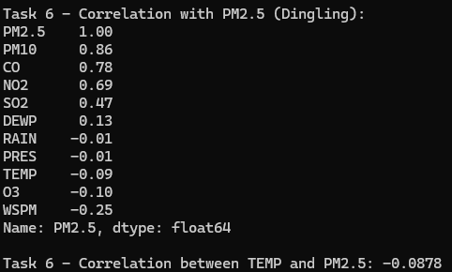
Task 6 Correlation Analysis
Answers
Output
Based on selected station: Dingling
Most correlated: PM10 (r=0.86) — same pollution sources as PM2.5
CO (r=0.78) and NO2 (r=0.69) also strongly correlated
Temperature (r=-0.09) — cold weather means more coal heating, raises PM2.5
High correlation does not mean causation — variables may share the same source
Code
cols = [
"PM2.5","PM10","SO2","NO2","CO","O3",
"TEMP","PRES","DEWP","RAIN","WSPM"
]
corr = selected[cols].corr()
print(
corr["PM2.5"]
.sort_values(ascending=False)
.round(2)
)
temp_corr = selected["TEMP"].corr(selected["PM2.5"])
print(f"TEMP vs PM2.5: {temp_corr:.4f}")
7

Slide 8
Summary
Task 1 — 420,768 records, 18 columns, 12 stations merged into one table
Task 2 — Missing values filled with column mean, remaining nulls dropped
Task 3 — Mean PM2.5 ~75 ug/m3, above WHO safe level of 15 ug/m3
Task 4 — Summary table for all stations, user selects one for detailed view
Task 5 — Histogram right-skewed, line plot shows winter spikes, CO has most outliers
Task 6 — PM10 (r=0.87) most correlated, temperature at -0.21 confirms winter effect
Video link: https://www.loom.com/share/c46640b23962478ebca18a5cb9eac265
8

